Slide 1
Preliminary results
GGF UPDT user tool survey
Focus on Grid
Susanne M. Balle
(Hewlett Packard)
GGF UPDT RG co-chair
Version 0.1
Copyright @ Global Grid Forum (2003). All Rights Reserved

Slide 2
Thanks to:
Sergiu Sanielevici (Pittsburgh Supercomputing Center)
Jie Song (Nanyang Technology University (NTU))
Pierre Lagier (Fujitsu)
Users who completed the survey

Slide 3
Our goal
Understand how users develop programs
  For large scale systems
  For the Grid
  Other
Get more information about the tools they use and if they are adequate
Understand the challenges encountered when developing apps for large scale systems and the Grid

Slide 4
Where did we distribute the survey?
Mailing list
  GGF UPDT RG
  Globus
  MPICH G2
  GGF Apps WG
  GGF APM RG
  …
Pittsburgh Supercomputing Center
Colleagues
Etc.

Slide 5
High level description of the survey
User profile: type of apps, research area, etc.
Platforms: system architectures, etc.
Design cycle: tools used, etc.
Program development cycle:
  languages, parallel programming paradigms, etc.
Debugging cycle: tools used, etc.
Performance Tuning cycle: tools used, etc.
Maintenance and administration: tools used, etc.
Other

Slide 6
Summary of results
Survey responses gathered from February 2003 until August 2003.
Sample size of 46 respondents
20 respondents completed the GGF survey
  10 completed the “test” survey
  10 completed the on-line final survey
26 respondents completed a similar survey conducted by Dr. Song from NTU

Slide 7
Summary of results
GGF survey’s data:
  The respondents only answered the questions they wanted to answer
  The data only take the 26 NTU respondents into consideration if their responses do not bias the results

Slide 8
Summary of results
GGF survey only (/20)
Writing apps for the 1000+ processors?
  45% Yes | 30% No

Slide 9
Platforms: Conclusion
Heterogeneous systems Yes 7 No 4 (/20)
  Believe that some respondents thought this question meant if their apps run on different systems/OS/etc.
  SPACI (Southern Partnership for Advanced Computational Infrastructure)
    3 HP Alphaserver SC (16 procs), 2 Origin 2000, IBM SP2 (16 procs), IBM SP3 (8 procs), Meiko CS2 (128 procs), 6 Beowulf clusters

Slide 10
Design cycle: Conclusion (1/4)
Some respondents were confused about what “Design cycle” means
Apps design/implementation:
  Starting from scratch 17 (/42)
  Modifying existing code 13 (/42)
Tools used:
  Matlab 3, UML 1, HTML 1
  Taking advantage of a number of building blocks e.g. energy evaluation procedures, local minimization procedures, etc.
Adequate 6 (/20)

Slide 11
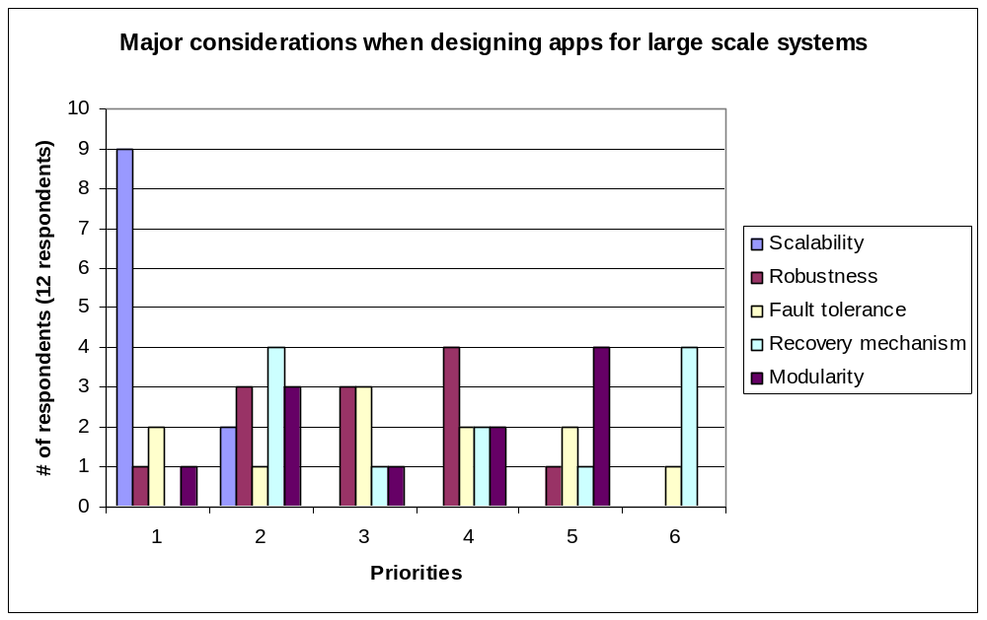
Design Cycle: Conclusion (2/4)

Slide 12
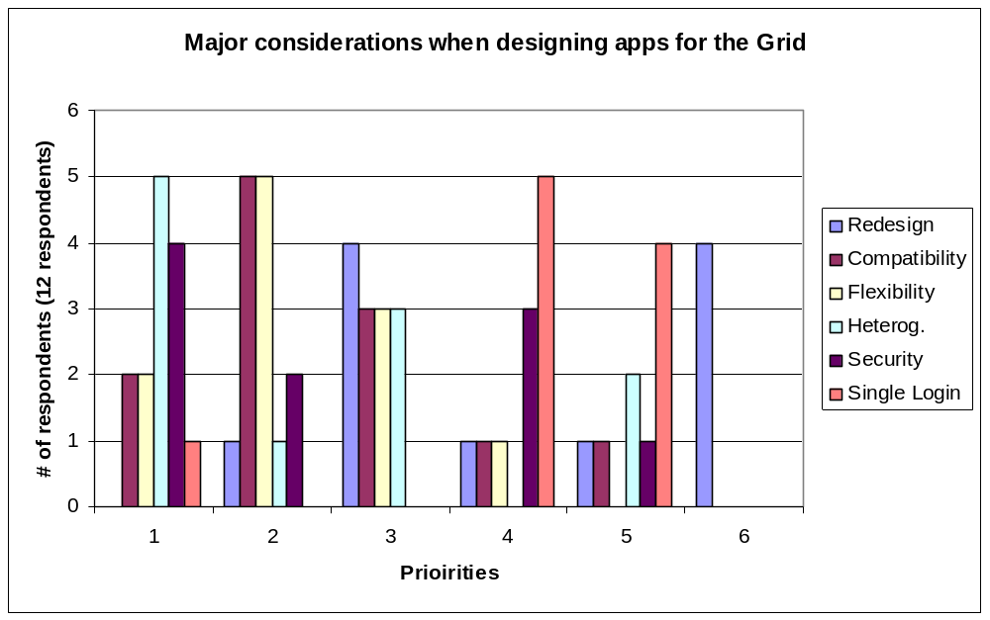
Design Cycle: Conclusion (3/4)

Slide 13
Design cycle: Conclusion (4/4)
Other (GRID):
  Software licensing 1, interoperability 2, resource management 1, performance 1, non-standard 1, non-uniform 1

Slide 14
Software development environment: Conclusion
Respondents are using the common programming paradigms (see Grid Primer, Lee & al) to program for the Grid
35% (/20) are looking into Grid enabling their apps
  Already start 15% | within 6 months 10%
  Within 12 months 10% | other timeframe 10%
20% (/20) uses MPICH G2
25% (/20) uses Globus

Slide 15
Debug cycle: Conclusion
Additional problems created by the Grid
  Remote debugging
  Arithmetic
  Irreproducibility
  Dynamic issues
Debugging by attaching to the local processes
Debug the same way as we debug multi-process programs

Slide 16
Tuning cycle: Conclusion
Additional problems created by the Grid
  Variable latency
  Bandwidth
  CPU speed
  Everything!
Tune each machine separately

Slide 17
Maintenance and administration: Conclusion
Tools: (/20)
  Unix scripts 1
  CVS 4 adequate
  RCS 2 adequate
  PBS 1
In many cases the person working on the code keeps the files

Slide 18
Conclusions
From one of the respondents: “It is indeed curious that scientists who presumably have been drilled in the methodology of rigorous”scientific inquiry for their particular discipline […] are often very casual when reporting on the performance of the computers they employ in their research.” R. Hockney, “The art of Computer Benchmarking”
www.kvasar.com/GGF/GGF_UPDT.html

Slide 19
Summarized survey data
Summarized
survey data

Slide 20
High level description of the survey (1/3)
User profile
  Type of apps, research area, person’s role in the project, project size
Platforms
  System architectures, OS’s, production versus development, heterogeneous versus homogeneous
Design cycle
  Tools used, adequate or inadequate, scratch versus modifying existing apps, ranking of specific criteria for respectively large scale apps and the Grid

Slide 21
High level description of the survey (2/3)
Program development cycle
  IDE, editors, languages, parallel programming paradigms, plans for the Grid, software packages
Debugging cycle
  Tools used, adequate or inadequate, typical debugging cycle, common problems, new problems cause by the Grid

Slide 22
High level description of the survey (3/3)
Performance Tuning cycle
  Tools used, adequate or inadequate, performance tuning cycle, tuning for the Grid, new problems cause by the Grid
Maintenance and administration
  Tools used, adequate or inadequate
Other

Slide 23
User profile
Apps for 1000+ processors?
  GGF survey 9 Yes 6 No (/20)
  NTU survey 3 Yes 12 No (/26)
Owner of the app.
  Yes: 5 No: 6 (/46)

Slide 24
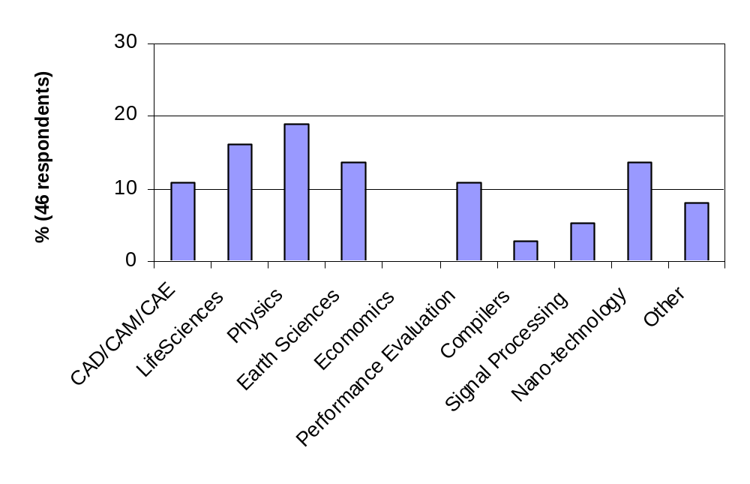
User’s research/work areas

Slide 25
User’s research/work areas
Others:
  General Scientific computing
  Optic
  Multimedia

Slide 26
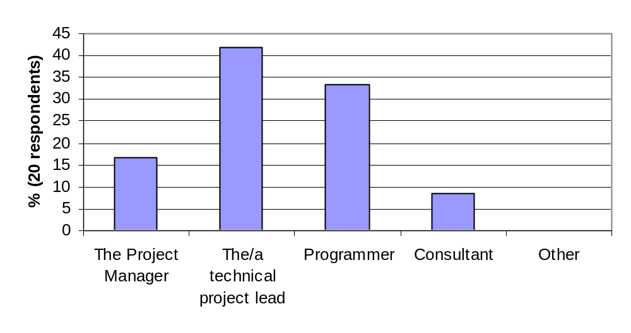
More user profile info

Slide 27
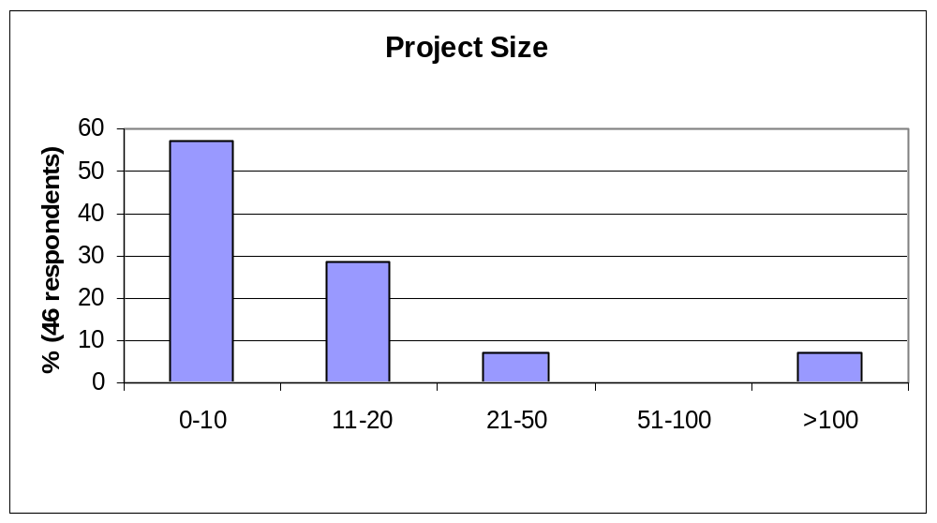
More user profile info

Slide 28
Platforms
Development versus production system
  62.5% uses the same system for development and production
  Varies with the project

Slide 29
Platforms
Users use any machine they can get access to
  HP AlphaServer SC (Lemieux @ PSC) (>3)
    Production run 512, 100-600, …
  HP Itanium (1), IBM SP (2), Fujitsu VX (1), SGI Origin (2), Itanium Cluster (2), Power4 Cluster (1), IBM p690 (1), 32-processor Linux Cluster (3), 256-processor Pentium cluster (1), 384-processor Windows 2000 cluster (1)

Slide 30
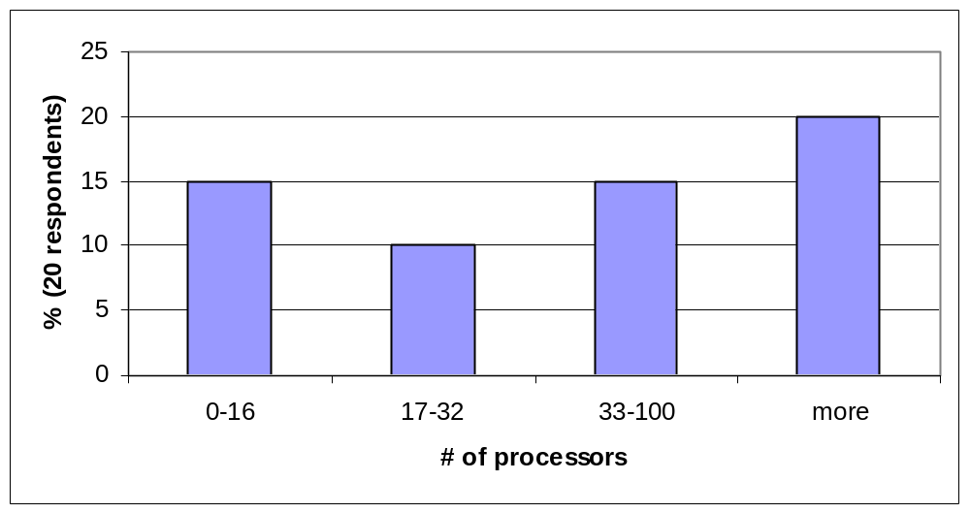
Production runs

Slide 31
Production runs
Lemieux (HP AlphaServer SC @ PSC) (3)
  Production runs
    4-600 processors
    512 processors
246-processor Pentium cluster (1)
  Production runs 4-64 processors
384-processor Windows 200 cluster (1)
  Production runs 20-100 processors
1392-processor UNIX system (1)
  Additional details not available
  Typical runs 1-256 processors

Slide 32
Platforms
UNIX version (11/20)
AIX (4.3.3), Tru64, HPUX, Solaris, IRIX (6.5)
Linux version (9/20)
  (2.4.19, 2.4.20) (1)
  Red Hat 6.0 (1), 7.2 (1)
Windows (5/20)

Slide 33
Platforms
Development system characteristics:
  IA32 Linux box (develop and test)

Slide 34
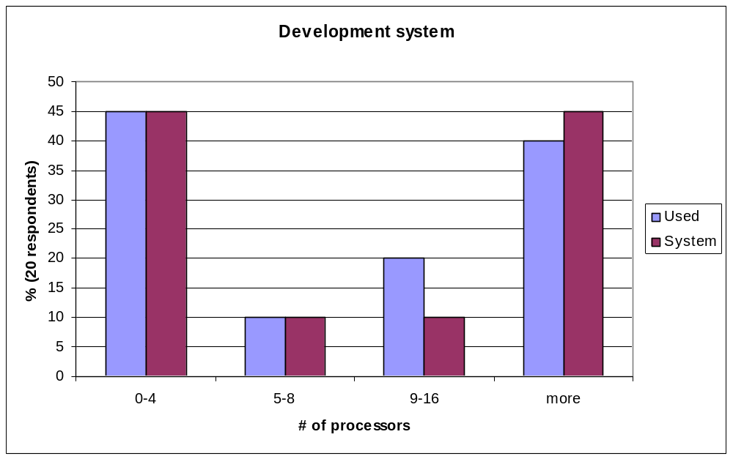
Platforms

Slide 35
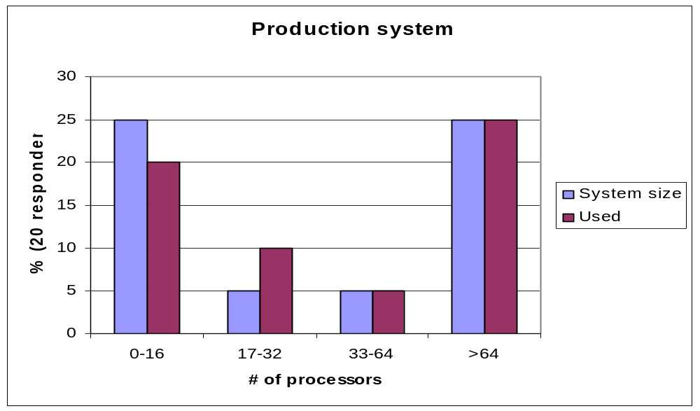
Platforms

Slide 36
Platforms: Heterogeneous sys.
Heterogeneous systems Yes 7 No 4 (/20)
  Believe that some respondents thought this question meant if they apps run on different systems
SPACI (Southern Partnership for Advanced Computational Infrastructure)
  SPACI computational and storage capacity:
    3 HP Alphaserver SC (16 procs), 2 Origin 2000, IBM SP2 (16 procs), IBM SP3 (8 procs), Meiko CS2 (128 procs), 6 Beowulf clusters

Slide 37
Design cycle
Tools
  Visual Studio (1), Matlab (3), UML (1), Dev. Studio (1), HTML
  Taking advantages of a number of “building blocks”
Adequate (6)
Scratch (17/42)
Modifying existing code (13/42)

Slide 38
Design Cycle

Slide 39
Design Cycle

Slide 40
Design cycle
Other (GRID):
  Software licensing (1), interoperability (2), resource management (1), performance (1), non-standard (1), non-uniform (1)

Slide 41
Software development environment
IDE
  Jbuilder (3/42)
  Other (5/42)
    Visual studio (2), JDE (sun) (1), Linux IDE (1), Websphere (1)

Slide 42
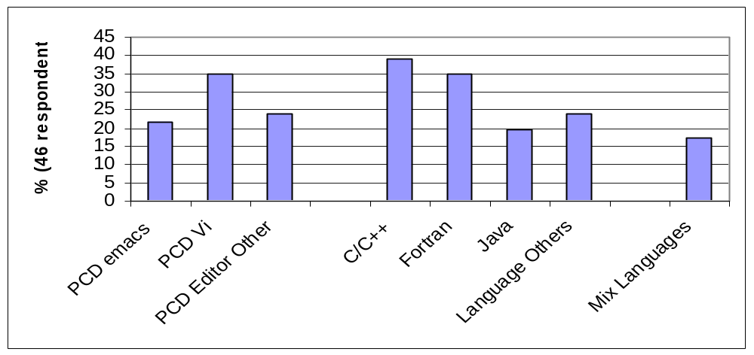
Software development environment

Slide 43
Software development environment
Other (editor)
  Nedit, VidualSlic, kEdit, CMS, Xedit, gedit, joe, VC, ultraedit
Other (languages)
  Perl, Matlab, Cobol, assembler, Python, tcl/tkl, HPF
Mixed languages
  C Fortran (4), Java C++ (3)

Slide 44
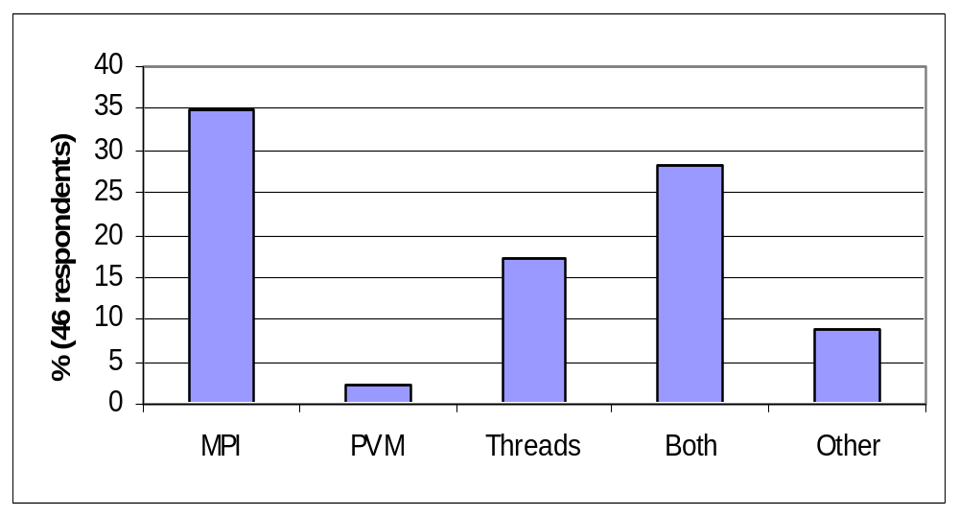
Software development environment

Slide 45
Software development environment
Other (parallel languages)
  HPF, Shmem

Slide 46
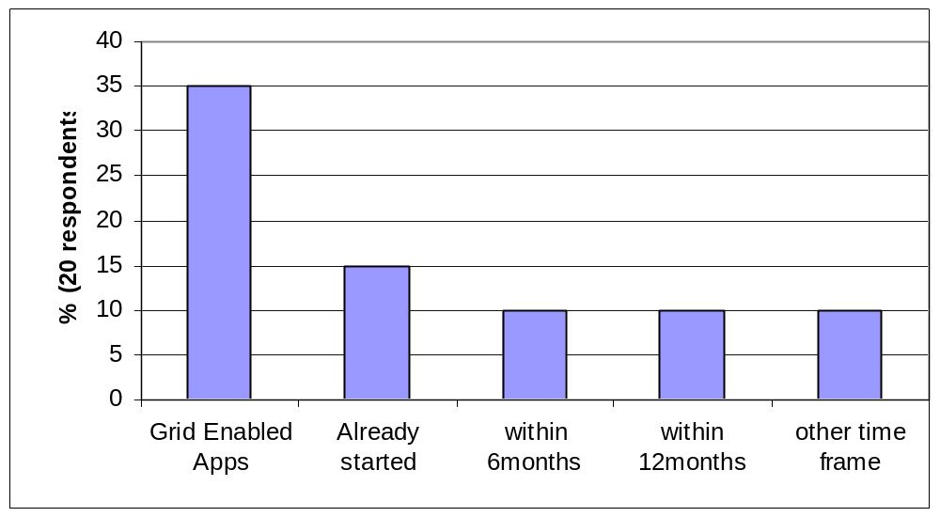
Software development environment

Slide 47
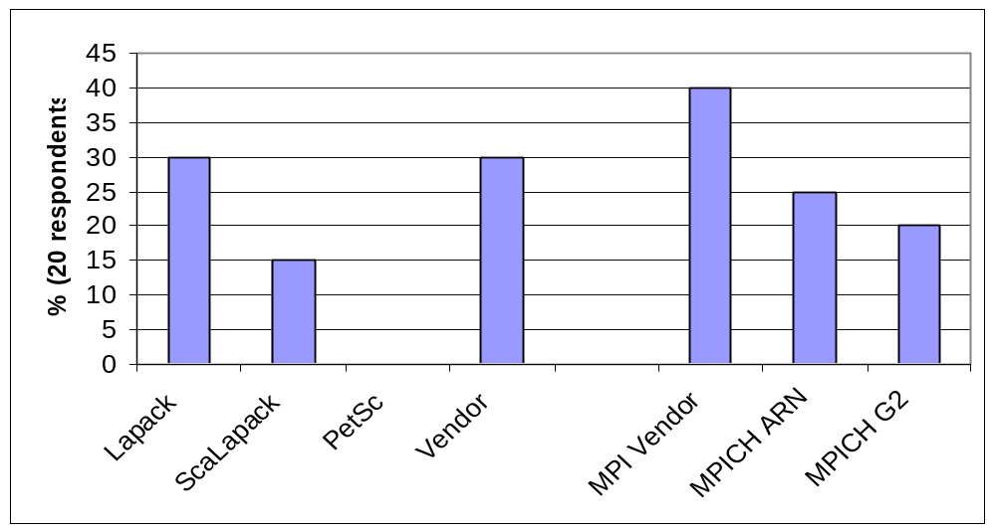
Software development environment

Slide 48
Software development environment
Other (Math Libraries)
  WSMP, SuperLu, ARPACK/PARPACK, METIS/ParMETIS, FFTW
Other (MPI)
  Customized MPI (1), pyMPI (1)
Globus: GT2 (3), GT3 (2)
Comments:
  OpenMP, 2D/3D graphical programming library or tool, Charm++/Converse

Slide 49
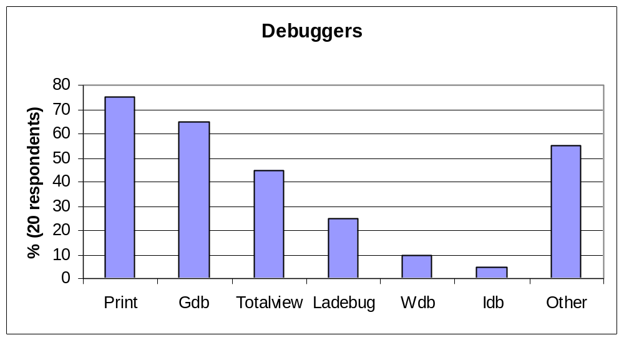
Debugging cycle

Slide 50
Debugging cycle
Other:
  Visual threads, Visual MPI, Visual Studio, DDD (1 proc), pdb
Memory debugger
  Third degree 50%
  Other 50% (valgrind, memcheck)

Slide 51
Debugging cycle
50% adequate (10 out of 20 respondents)
20% inadequate (4 out of 20 respondents)
  “Good memory debugging tools tend to be expensive”
  “Totalview too expensive”
Debugging cycle:
  While (1)
    { stare at code; edit code; build code; look at output;}

Slide 52
Debugging cycle
Best tools:
  flexible and simple
  MPI aware tools (such as Totalview and Vampir)
Data collected:
  Variables/callstacks
Wishlist
  Gprof with PAPI sampling

Slide 53
Debugging cycle
Debugging by comparing results for the parallel program with a serial program
Some types of problems we know that the algorithm should scale. If it doesn’t it is a bug in the algorithm or in the hardware

Slide 54
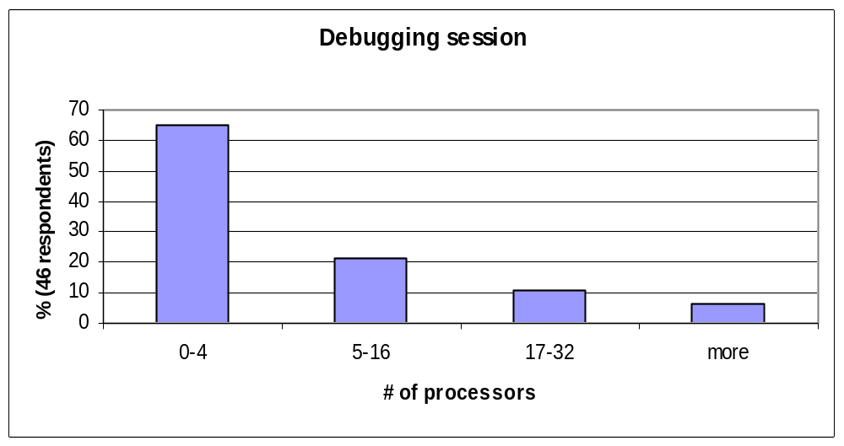
Debugging cycle

Slide 55
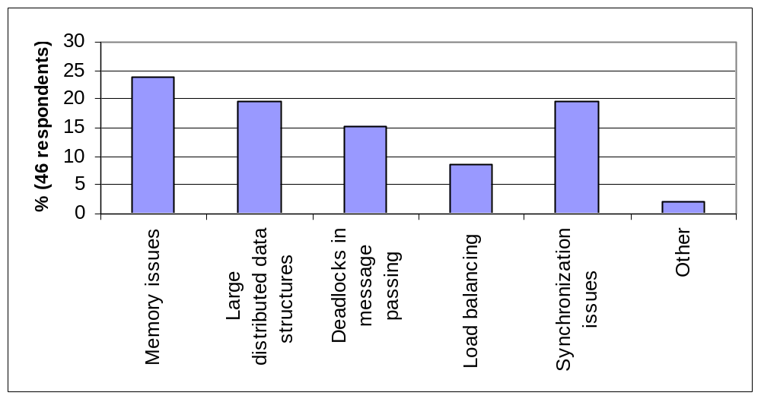
Debugging cycle

Slide 56
Debugging cycle (Grid)
Additional problems created by the Grid
  Remote debugging
  Arithmetic
  Irreproducibility
  Dynamic issues
Debugging by attaching to the local processes
Debug the same way as we debug multi-process programs

Slide 57
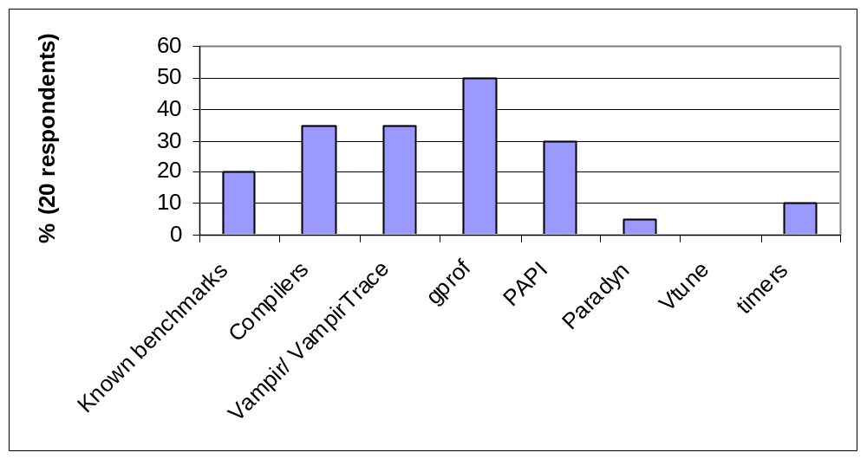
Performance tuning cycle

Slide 58
Performance tuning cycle
Other: Visual Thread, Visual MPI, gperf, Xemsys toolkit, perfmon, WBTK, Hpm, DCPI, Atom, MPI tracers, XemSys Tuner, XemSys Analyzer, Intel’s optimization report, Speedshop (SGI), memprof, Paragraph
Adequate 50% Inadequate 10%

Slide 59
Performance tuning cycle
Inadequate
  Vampir: “too expensive for large systems and too little development going on”
  Gprof: “Only wall clock, no PAPI information available, hard to interpret the output”
  “Very poor idea of what is limiting the processor”
Adequate
  “The Intel IA64 compiler will tell you how many cycles and what percentage of resources each loop in the code was taking”

Slide 60
Performance tuning cycle
Data collected: Hardware counters (4), CPU and wallclock (3), message queues (1), function overhead (1), message granularity (1), recv Wait time (1), Wall Clock timings for subroutines and critical sections (1), runtime (1)

Slide 61
Performance tuning cycle
Grid
Additional problems created by the Grid
  Variable latency
  Bandwidth
  CPU speed
  Everything!
Tune each machine separately

Slide 62
Performance tuning cycle
Wishlist:
  Processor simulator which would show where time is spend (1),
  Automatic performance tuning a la “ATLAS” (1),
  Automatic performance monitoring a la “PAPI” (1), gprof + PAPI hooks (1)

Slide 63
Performance tuning cycle
Example of tuning session: (adequate)
  Performance specifications/benchmarks to set expectation
  Compilers with code annotations to see how the compiler analyzes the code
  Pixie to get operation counts
  DCPI for low-impact profiling to discover where the time is spent
  Atom tools for post-compile instrumentation to time the code

Slide 64
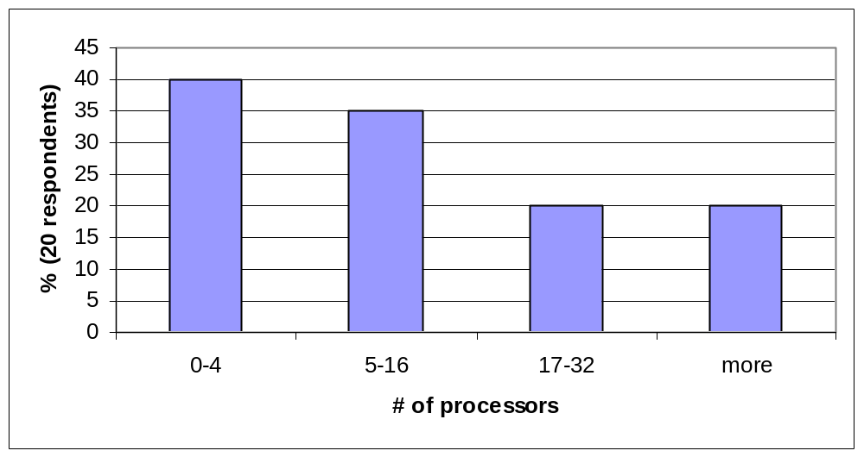
Performance tuning cycle

Slide 65
Maintenance and administration
Tools:
  Unix scripts (1)
  CVS (4) adequate
  RCS (2) adequate
  PBS (1)
In many cases the person working on the code keeps the files

