Slide 1
GHPN-RG and its Most Recent
NetServices Adventure
Franco Travostino, Co-Chair
travos@nortelnetworks.com

Slide 2
Chairs:
Jon Crowcroft, University of Cambridge, UK
Jon.Crowcroft@cl.cam.ac.uk
Franco Travostino, Nortel Networks, Boston USA
travos@nortelnetworks.com
Secretaries:
Volker Sander
Forschungszentrum Jülich, Germany
v.sander@fz-juelich.de
Nagi Rao, ORNL, USA
raons@ornl.gov

Slide 3
GHPN-RG ?
To bridge gaps between Networking and Grid advanced communities
  E.g., Grid requirements not yet understood by ‘Net-heads’
  E.g., Net rules/concepts not yet exploited by ‘Grid-heads’
while countering any premature ossification around Grid/Net dominant scenarios
  E.g., Advocacy of Grids using non-traditional mixes of end-systems and net infrastructures
Outcomes: Informational or BCP Drafts, new RGs/WGs, liaisons with other Groups

Slide 4
Got Drafts?
draft-ggf-ghpn-netissues-2
  Pain points in attaching Grids to the network
draft-ggf-ghpn-opticalnets-1
  Convergence of optical nets and Grids
draft-ggf-ghpn-netservices-0
  The forming ensemble of Grid Network Services
All available at: http://forge.gridforum.org/docman2/ViewCategory.php?group_id=53&category_id=364

Slide 5
netservices’ Goals
To scope out all the services that are required to elevate the network to Grid-managed resource
  Dynamic provisioning
  Dynamic topology discovery
  Monitoring, AAA, etc.
A breadth-first exercise !
  Name the necessary and sufficient abstractions
  Establish guidelines for new abstractions
  Use cases
  Labeling portTypes is a way out

Slide 6


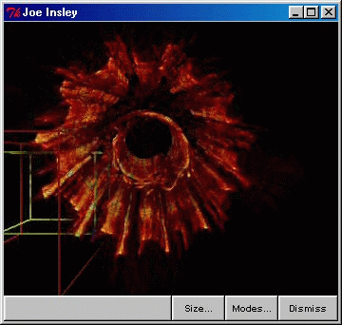
Global Resource Management Flow
Indexes
Broker/Metascheduler
Application
Storage RM
Computing RM
Network Services
Visual RM
“Make things as simple as possible,
but no simpler“ …
Derived from © ANL

Slide 7






This style ain’t scalable nor practical
Broker/Metascheduler
???
Storage
Servers
Storage

Slide 8
The centrality of a Path abstraction
Broker/Metascheduler
E2E Path
P2
P1
R&E Net
Centrally Managed Net
Servers
Storage

Slide 9

Other than abstracting,
NetServices enact feedback loops
Applications
{
demand
OGSA
WS+WSRF
Negotiate
Alert,
Adapt
System
Policy
Network(s)
Detect
supply
events

Slide 10
/* XXX */
Data Replication
Service
Transfer of
Analog
Data
Sharing of Raw
Instrumentation
Data
Authentication/
Authorization
Service
(Network?)
Resource
Discovery Service
Job Scheduling
Service
Replica
Optimization
Service
Grid
Push/Pull
Notifications
Network Fault
Notification
Service
Network Advance
Reservation
Service
Network Information
Service
Network Cost Estimation
Service
Connectivity
Service
Network
Topology
Service
Network
Performance
Service
Check GHPN Sessions on Fri
Network Resource
Management
Service
Network Monitoring
Service
Network
Fault Detection
Service
Path
Grid general-purpose service
Grid network service

Slide 11
Wouldn’t it be nice if …
We had access to a worked out example of WS-A within a network context …
We had access to a hierarchy for network services …
  Approach and outcome of NM-WG are useful !!
  Though they’re not quite the same thing
    Specification ≠ Network Performance Characteristic
Sounds as we will have to build these !!

Slide 12
Email über alles
Drafts in the making, new Drafts, comments, ideas, why and why-nots, technical news …
… anything we do, you hear about here:
ghpn-wg@gridforum.org
Home page: http://forge.gridforum.org/projects/ghpn-rg/

