Slide 1
Scheduler Interfaces in the ASKALON Grid Environment
Marek Wieczorek, GGF16 Athens, February 14th

Slide 2
Agenda
Scheduling in the ASKALON environment
Scheduler interfaces
Interesting scenarios
Summary

Slide 3
ASKALON Grid Environment
ASKALON
AGWL
(Workflow Representation)
User
Interface
Resource
Management
Scheduler
Performance
Predictor
Enactment
Engine
Monitoring
Service
Grid Environment (Globus Toolkit)

Slide 4
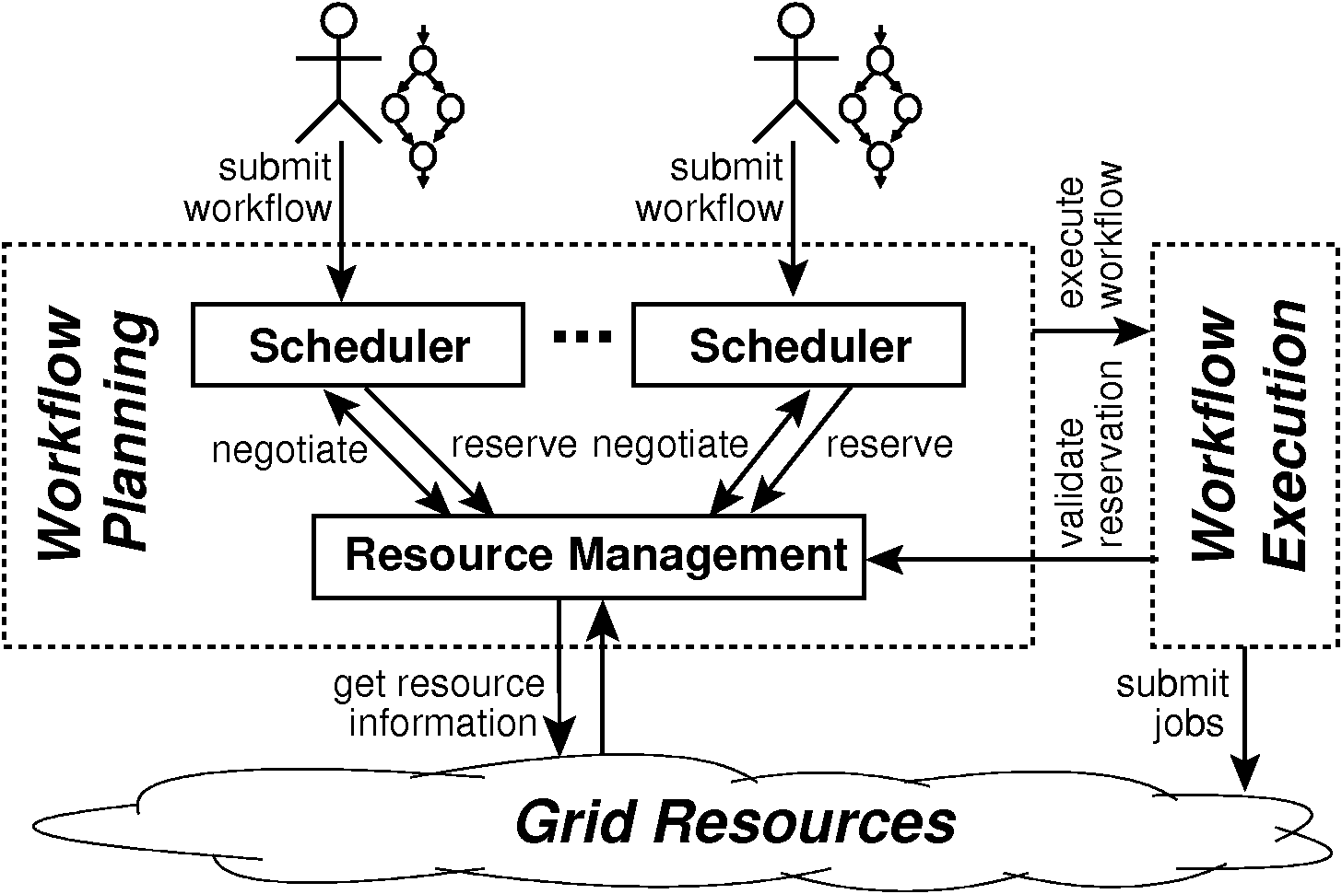
Scheduling Model
Scientific workflow scheduler
Separate instance for each workflow submission
Interacts with other ASKALON services
Dynamic scheduling (rescheduling enabled)

Slide 5
Scheduler Input
Workflow specification created by the user
A workflow composed of activity types and dependencies between them
ASKALON workflow description language (AGWL)
workflow specification
receive: AGWL file (XML)
protocol: GT4 WS interface
User Interface
(TEUTA)
Scheduler

Slide 6
Interface to the Resource Management (GridARM)
Resource brokerage based on resource constraints (e.g., CPU count, memory)
Logical resources considered, i.e. software components (executables Grid/Web services)
Advance reservation support
Billing/pricing
resource query
receive: resource list
protocol: GT4 WS interface
service query
receive: service description
protocol: GT4 WS interface
Resource
Management
Scheduler
reservation request
receive: reservation offers
protocol: GT4 WS interface
reservation confirmation
receive: reservation ticket
protocol: GT4 WS interface

Slide 7
Interface to the Enactment Engine
Enactment Engine – advanced Job Manager
Communication protocol based on the internal workflow representation
Current implementation based on the Java API
workflow submission
send: full workflow graph
protocol: GT4 WS interface
Enactment
Engine
Scheduler
rescheduling request
receive: executed workflow
send: rescheduled workflow
protocol: GT4 WS interface

Slide 8
Interface to the Performance Predictor
Auxiliary service
Important for proper scheduling and for advance reservations
Model: workflow-oriented activity predictions
prediction request
send: activity type, resource,
input parameters
receive: prediction
protocol: Java API/GT4 WS
Performance
Predictor
Scheduler

Slide 9
Interface to the Monitoring Service
Not implemented yet
Monitoring of resources and activities
Control over many aspects of execution (including scheduling)
Possible execution problems reported
May trigger workflow rescheduling
scheduling event
send: scheduling/
rescheduling
protocol: GT4 WS interface
Monitoring
Service
Scheduler
event notification
receive: event
protocol: GT4 WS interface

Slide 10
Workflow Processing Lifecycle
Scheduler
Resource
Management
Performance
Predictor
Enactment
Engine
Monitoring
Service
AGWL workflow
specification
resource/service
query
prediction request
negotiation/
reservation
scheduled workflow
rescheduling request
event notification
rescheduled workflow

Slide 11
Scheduling under Uncertainty
Full-graph scheduling
ASKALON workflow model (loops, conditional branches, etc.) allow different possible executions
Runtime assumption made by the scheduler
Assumption fulfilment controlled by the enactment engine
Enactment
Engine
Scheduler
+assumptions=
original
workflow
+assumption
violation=
predicted DAG
rescheduling
rescheduled workflow

Slide 12
Advance Reservation
Negotiations between the scheduler and the Reservation Management
  The scheduler acts on behalf of the user,
  Resource Management optimizes the profit of the Grid (resource usage, fair-sharing)
Two-stage negotiation protocol:
  reservation request,
  reservation confirmation

Slide 13
Event-driven Dynamic Scheduling
Different sources of events
Scheduling and rescheduling performed in a dynamic way.
Two types of reasons for rescheduling:
  execution model (assumption violation)
  unexpected behiavor (execution problems)
Enactment Engine
assumption violation,
execution problem
Scheduler
SLA violation
performance
breakdown
Resource
Management
Monitoring
Service

Slide 14
Other Service Properties
Static property values (economic cost, QoS, etc.)
Resource usage conditions stored into an SLA
SLA violation triggers rescheduling

Slide 15
Summary
Importance of the scheduler in the ASKALON environment.
Multitude of the scheduler interfaces
Resource negotiation and event-driven scheduling

Slide 16
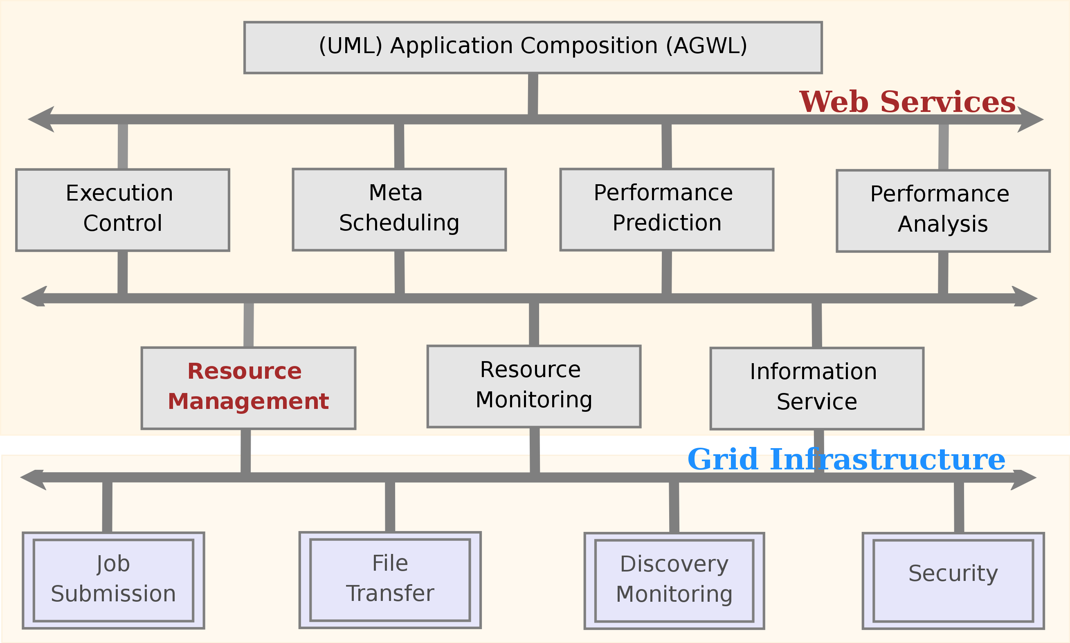
ASKALON
http://dps.uibk.ac.at/projects/askalon/

