Slide 1



Querying Distributed Data
Using Grid Messaging
Peter Z. Kunszt
Peter.Kunszt@cern.ch

Slide 2
Overview
Defining the problem and its background
Token-based query processing
Example

Slide 3
Problem specification
How to query data stored in relational databases having identical or similar schema structure?
How can distributed joins be performed, i.e. queries like
SELECT a.x, b.y WHERE a.x + b.y > c.z
where a,b,c are all potentially located in many different physical database instances.

Slide 4
Example in Astrophysics
  SDSS.u – 2MASS.J > 0.1 &&
  GALEX.K – SDSS.g < 0.2
To be able to perform such queries is one of the major scientific motivations for the Astrophysics Grid projects like the Virtual Observatory
Exploration of new data dimensions
– proper N+M-dimensional data
Extraction of new subcatalogs for scientific projects
Starting-point for new data mining tools

Slide 5
Examples for Monitoring
Aggregate functions
  AVG(CPULoad)
  MAX(MemoryUse)
Information mining on time-based monitoring ‘objects’: get measurements where CPU load was high
  (site1.EventX + site2.EventX)/2 > 0.9
Production of processed monitoring data

Slide 6
Background, Assumptions
The token-based join mechanism presented here is based on work carried out in the scope of the SDSS Project at Johns Hopkins University, Baltimore.
Applicable to databases with the following properties:
  There exists at least one data element upon which a common index can be built (dynamically if necessary) : At least one column in each table represents the same entity or is logically linkable to such an index.
  There exists an abstraction layer at each node of the distributed system : There is a common schema and a well-defined mechanism by which local schema objects are exposed.

Slide 7
The Common Index
Distributed queries run over data that at least have the same semantic properties.
  Astronomy: tables represent properties of stars, galaxies, nebulae…
  Monitoring: tables represent properties of computers, data stores, networks…
Most of the distributed data have at least one common data element that is ‘indexable’ in a semantically well-defined way.
  Astronomy: object location in the sky (ra,dec)
  Monitoring: timestamps t, job identifiers, etc..
This requirement is ~o.k.

Slide 8
The Abstraction Layer
OGSA will be the instrument to build such a layer. The work in DAIS-WG is also aimed at defining the abstraction layer necessary for our mechanism to work properly. WSDA also gives an equivalent mechanism.
  All data processing and data presenting layers can be looked upon as Grid services with well-defined semantics
  All Grid services describe themselves through their Service Data elements
  All Grid services are registered and can be queried in well-defined ways.
This is a safe bet

Slide 9
Token-Based Join Algorithm

Slide 10
Query Preparation
Based on the index, additional clauses are added to the query to horizontally partition the data:
AND (index > val1 AND index <= val2)
where val1 and val2 denote an index interval. The index intervals are dynamically adjustable,
based on statistics of the data
distribution in these bins.
QUERY?
query
query
query
query
query
query
query
query
query
query
query
query

Slide 11
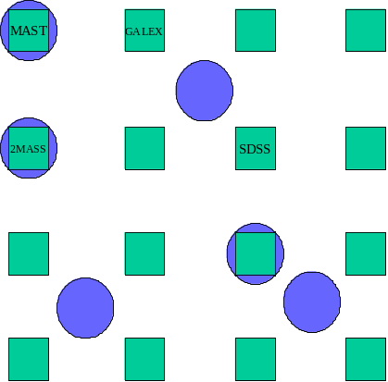
Query Preparation
QUERY?
Decompose the query volume into a manageble size
Collect information about which archive node has data content relevant for this query.
Estimate data volume at each node
query
query
query
query
query
query
query
query
query
query
query
query

Slide 12
Query Execution
query
Collect data elements at ‘lightest’ node for a subquery.
Send tokens to next node.
Collect data elements at next-lightest node and dynamically cross-correlate the objects with the tokens from the previous node.
Assign likelihoods to each object match.
Kill tokens with no match, send to next node.

Slide 13
Synchronized Parallel Querying
Assemble result of query using all token information from all archives for objects with sufficient likelihood match.
Each query bit can be processed through a queue, fed into the system in a controlled way – depending on priority, available resources etc.
query
query
query

Slide 14
Matching Objects
The semantics of a ‘match’ differs from schema to schema
Astronomy: location match can be given a probability: objects in different archives are ‘matched’ based on their location and the measurement error of the location.
Monitoring events: may be matched by their timestamp when they occurred – with a certain precision of how often such events occur.
Hidden semantic requirement: Need some granularity – i.e. ‘matchable’ entities.

Slide 15
An Example
SELECT s.u – m.H, s.g – g.K
FROM SDSS as s, 2MASS as m, GALEX as g
WHERE
s.u > 22 AND
g.K – m.J > 1.5 AND
s.r – m.K < 1

Slide 16
An Example
Determine relevant grid nodes and construct query
token template.
Query entry node requests a status from the Grid nodes that hold the data to determine the ‘players’ of the query.
The query token template is constructed
The token template is sent to each archive for evaluation to get a weight estimate.

Slide 17
Query Token Content
ID
Item
Archive Dependency
Type
1
SDSS.u
atomic
2
SDSS.g
atomic
3
SDSS.r
atomic
4
2MASS.H
atomic
5
2MASS.J
atomic
6
2MASS.K
atomic
7
GALEX.K
atomic
8
SDSS position and error
informational
9
2MASS position and error
informational
10
GALEX position and error
informational
11
Match likelihood
informational
12
[1] – [4]
mix
derived result
13
[2] – [7]
mix
derived result
14
[1] > 22
SDSS
derived constraint
15
[7] – [5] > 1.5
mix
derived constraint
16
[3] – [6] < 1
mix
derived constraint
17
[10] && [11] && [12]
mix
query constraint

Slide 18
Example cont.
Determine queried area.
This query is an all-sky query for all the archives
The archives themselves often have only partial sky coverage; for example SDSS covers only the northern galactic cap.
Framework for the Virtual Observatory provides the metadata necessary to evaluate this operation.

Slide 19
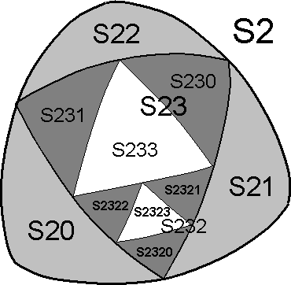
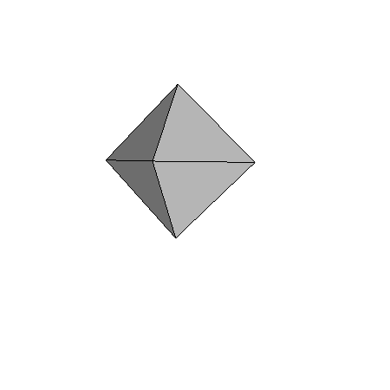
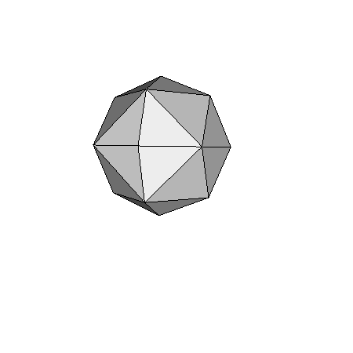
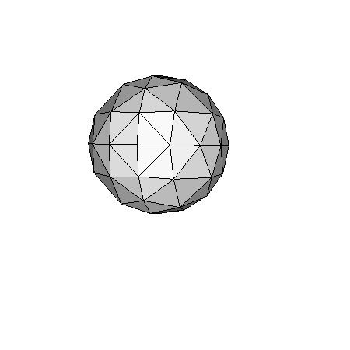

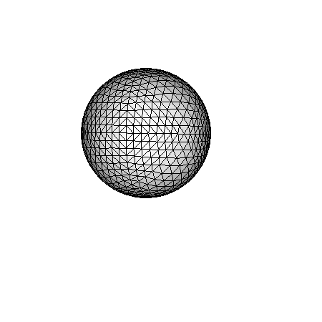
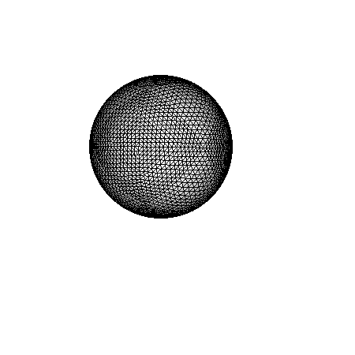
Hierarchical Triangular Mesh
Hierarchical subdivision of spherical triangles
represented as a quadtree
20 levels correspond to a resolution of 1”

Slide 20
Example cont.
Get HTM triangle list.
Obtain the relevant HTM nodes for the query by intersecting the query area with the HTM index.
Order nodes
Determine index depth by looking at the resolution of the archives involved.
Send token messages to Grid nodes.
submit a query for all of the parameters involved from the archives involved.
If the query has constraints on parameters that can be evaluated within a single archive, then these constraints are also processed.

Slide 21
Example cont.
Negotiate node weights.
Query only for a subset of involved HTM triangles sent and executed at each node but returning only the result count. (Index interval)
Collect the weights of each node – the larger the count, the heavier.
At planning, each site has an allocated weight and the link to the next heaviest site. The token keeps this information.
Say the numbers look like SDSS: 7,000; 2MASS: 25,000; GALEX: 55,000. The query will start executing at the SDSS archive, passing its tokens to 2MASS that then continues to GALEX.

Slide 22
Example cont.
Enter HTM loop.
The token message is sent to the lightest grid node and the query is executed again, now filling the token with results – the query was most probably still cached from the previous count operation.
Identify next lightest node.
Send token to next grid node.
Compute cross-identification HTM nodes for the incoming tokens and look up the objects matching them.
Process as many tokens as possible.
Kill unmatched entries.
Token items that cannot be matched cannot be further processed and are discarded.
Send to next node.

Slide 23
Necessary Functionality
Query Initiator and Planner
  Assemble token
  Generate Query Plan
Query controller
  Handle failures, timeouts, empty lists, QoS
  Process aggregation nodes
Query result buffer
  Hold result for the client to retrieve

Slide 24
Conclusion and Outlook
Exploiting Grid Service messaging a simplistic distributed query framework can be built using existing technology
Very dynamic, can address a large range of data mining queries
Future work will investigate
  Adaptability to other schemas
  Detailed technical requirements
  Detailed set of queries that perform well and others for which this mechanism is not suitable
  Performance of such a mechanism through EDG Spitfire.

Slide 25
Related Information
SDSS:
http://www.sdss.org/ http://www.sdss.jhu.edu/
OGSA:
http://www.globus.org/ogsa
WSDA:
http://cern.ch/grid-data-management/publications.html
DAIS-WG
http://www.cs.man.ac.uk/grid-db/

