Slide 1

Network Measurements
Working Group
A Brief History
Richard Hughes-Jones

Slide 2

Introduction: Charter
The performance of most grid applications is dependent on the performance of the networks forming the grid. The Network Measurements Working Group (NMWG) identifies network metrics (aka characteristics) useful to grid applications and middleware, and develops standard mechanisms to describe and publish these characteristics to the Grid.
The NMWG focuses on characteristics of interest to grid applications and works in collaboration with other standards groups such as the IETF IPPM WG and the Internet2 End-to-end initiative. The NMWG will determine which of the network characteristics are relevant to Grid applications, and pursue standardization of the attributes required to describe these characteristics.
The first product of the NMWG will be a document categorizing the characteristics in use by network monitoring tools. This document will establish a dictionary that can be used by tools to publish their results.
The second product will be a document recommending the XMLSchema to be used to publish the detailed attributes for these characteristics.
In plain English: NM-WG will describe Grid relevant network characteristics, and how this can be made available to middleware, network operators etc. NM-WG will not look at how measurements should be made.
From Mark’s Talk in Tokyo

Slide 3
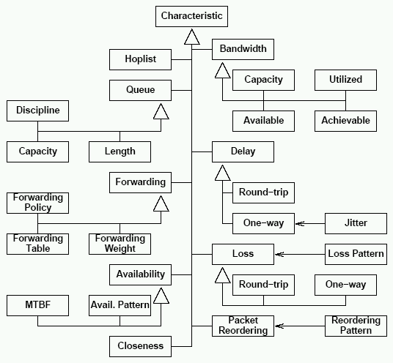
Characteristic Hierarchy Doc
“A Hierarchy of Network Performance Characteristics for
Grid Applications and Services”
Document defines terms & relations:
  Network characteristics
  Measurement methodologies
  Observation
Nodes & Paths
  Defines the meanings
  Discusses the use & relations
For each Characteristic
  Defines the meaning
  Stated the attributes that SHOULD be included
  Discusses the issues to consider when making an observation
GGF Proposed Recommendation GFD-R.023
www.gridforum.org/documents/GWD-R/GFD-R.023.pdf

Slide 4
History: Previous Work
“A Hierarchy of Network Performance Characteristics for Grid Applications and Services” published June 2004 (Recommendation, GFD.23, http://www.ggf.org/documents/GFD.23.pdf)
Used to create schemata for describing network monitoring data.
Using a standard classification maximises data portability: your TCP achievable bandwidth is the same as someone else’s, even if the measurements were made differently (e.g. with different tools)
path.bandwidth.Achievable
Metadata:
Description
parameters: eg TCP
+
hierarchy

Slide 5
Schemata: History
NM-WG then focused on standardizing schemas for exchanging network measurements
Extended concept to
  Requesting historical network measurements
  Requesting measurements to be made on demand
  Traps and Event Notification
NM-WG has Two sets of schemata:
  v.1::Monolithic, straight mapping of “characteristics” doc
  v.2::Framework:
    Base schema - common components, types, topology
    Add separate sub-schema for each characteristic and/or tool
    Framework has extensibility to just about anything ☺
    Schema language: Relax-NG compact syntax

Slide 6
Contact Details
Chairs:
  Eric Boyd (Internet2), eboyd@internet2.edu
  Richard Hughes-Jones (University of Manchester),
  R.Hughes-Jones@manchester.ac.uk
  Mark Leese (Daresbury Laboratory), m.j.leese@dl.ac.uk
Website under re-construction: http://nmwg.internet2.edu
Mailing list: nm-wg@ogf.org
  To subscribe, https://forge.gridforum.org/sf/projects/nm-wg
  then Subscribe and fill in the web form

Slide 7
Full Copyright Notice
Copyright (C) Open Grid Forum (2006,2007). All Rights Reserved.
This document and translations of it may be copied and furnished to others, and derivative works that comment on or otherwise explain it or assist in its implementation may be prepared, copied, published and distributed, in whole or in part, without restriction of any kind, provided that the above copyright notice and this paragraph are included on all such copies and derivative works.
The limited permissions granted above are perpetual and will not be revoked by the OGF or its successors or assignees.
Notes:
OGF Full Copyright Notice if necessary

