Slide 1

Network Measurements
Working Group
Summary of the Version 2 Schemata
Richard Hughes-Jones
Martin Swany, swany@cis.udel.edu
Jason Zurawski, zurawski@eecis.udel.edu
Dan Gunter, dkgunter@lbl.gov
Have put a lot of work into this!
NM-WG GGF18 Washington

Slide 2

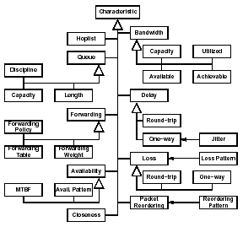
The Characteristic Hierarchy Doc
“A Hierarchy of Network Performance Characteristics for
Grid Applications and Services”
Document defines terms & relations:
  Network characteristics
  Measurement methodologies
  Observation
Nodes & Paths
  Defines the meanings
  Discusses the use & relations
For each Characteristic
  Defines the meaning
  Stated the attributes that SHOULD be included
  Discusses the issues to consider when making an observation
GGF Proposed Recommendation GFD-R.023
www.gridforum.org/documents/GWD-R/GFD-R.023.pdf

Slide 3
Schemata: History
NM-WG then focused on standardizing schemas for exchanging network measurements
Extended concept to
  Requesting historical network measurements
  Requesting measurements to be made on demand
NM-WG has Two sets of schemata:
  v.1::Monolithic, straight mapping of “characteristics” doc
  v.2::Framework:
    Base schema - common components, types, topology
    Add separate sub-schema for each characteristic and/or tool
    Framework has extensibility to just about anything ☺
    Schema language: Relax-NG compact syntax

Slide 4
Version2 Schemata: Overview
Enable separation of data & metadata:
  Metadata – relatively constant information
    Eg src and dst of tests, test parameters etc.
  Data – rapidly changing measurement results:
    actual values + associated timestamps
  Identifiers explicitly link Data with Metadata
Metadata can be stored, searched, transmitted independently of the changing data
This gives:
  Efficiency
  Re-usability
    eg V1 had only Request & Response
    V2 will allow to subscribe to event notifications and report those events

Slide 5
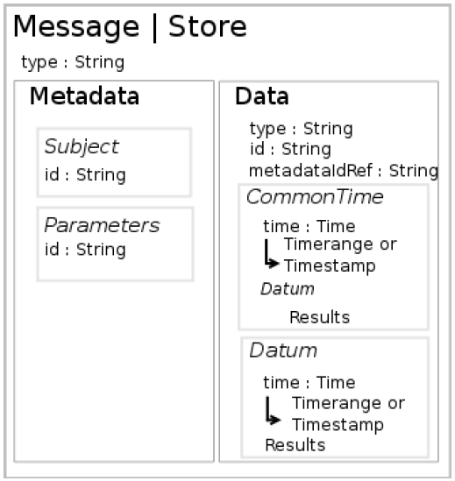
Version 2 Schemata: Recap [1]
All schema instances are either:
  a store: stationary entity for storing
  measurement data
  a message: transient request or response
  that is to be exchanged
Message | Store consist of either or both of:
  Data:
    Datum: an item of factual information derived
    from measurement or research. In our case,
    is associated with a particular point in time.
    Time
  Metadata:
    Subject: the measured/tested entity
    Event Type: the type of measurement, value or event which occurred
    (already you can see that this extends beyond the request-response model)
    Parameters: how, or under what conditions, did this event occur?
Notes:
The amount of metadata returned isn’t really specified and may vary from case to case or
Maybe at a directive in the header. The response must have a data section with a valid
Id. That id could refer to the verbatim metadata from the query. It might also be inlined
If the query was a range or a request for a new measurement.

Slide 6
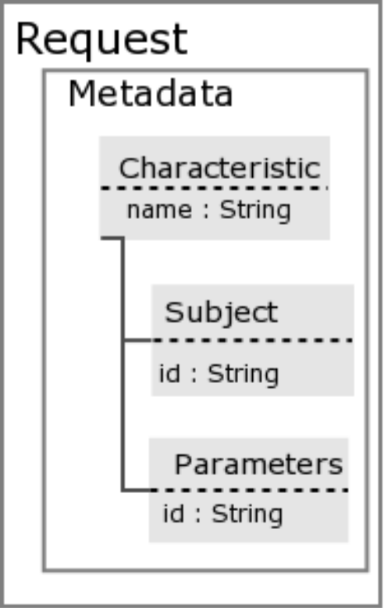
Version 2 Schemata: Recap [2]
Request:
  Just has a metadata section - containers for:
    characteristic – namespace required
    (e.g. http://www.ggf.org/nmwg/iperf)
    subject (e.g. host pair)
    parameters appropriate either for making a test or filtering historic data
    (e.g. TTL, TCP buffer size …)
    Time/date (of required observation)
  Time is a range
  Other parameters are specified or implied *
Notes:
The amount of metadata returned isn’t really specified and may vary from case to case or
Maybe at a directive in the header. The response must have a data section with a valid
Id. That id could refer to the verbatim metadata from the query. It might also be inlined
If the query was a range or a request for a new measurement.

Slide 7
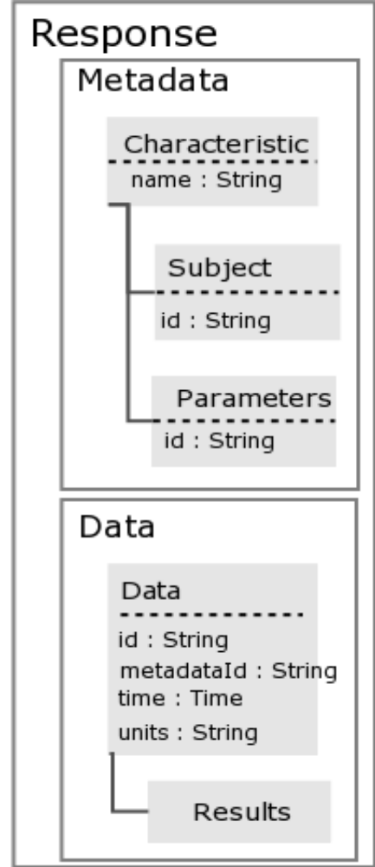
Version2 Schemata: Recap [3]
Response:
  metadata: <same as Request>
    These are the “conditions” / parameters / tool used for the test.
    Parameters could be
      The same parameters and values as in the Request
      Same parameters but values modified
      Additional Parameter-value tuples
  data:
    <Content depends on the characteristic>
    Anything in xml eg bin64 encoded (but don’t expect to be sending binary)
    Could include a reference to other sources of data
Notes:
The amount of metadata returned isn’t really specified and may vary from case to case or
Maybe at a directive in the header. The response must have a data section with a valid
Id. That id could refer to the verbatim metadata from the query. It might also be inlined
If the query was a range or a request for a new measurement.

Slide 8
Version2 Schemata: Namespace
The Network characteristic does not have an explicit field namespace – each framework extension schema has its own namespace.
The specific structures of the Data and Metadata elements are dependent on the measurement they record, event they represent etc.
Because of this, we can change the namespace without upsetting anything, encoding the event type in the namespace of the elements.
Why would we want to do this?
  Some software components could pass-through Data and Metadata elements without understanding their specific structure, leaving validation to software which understands those elements (because it recognises the namespace)
  This also allows an implementation to decide whether it supports a specific varieties of element. In the example, does the receiving system support the http://ggf.org/ns/nmwg/characteristic/delay/roundTrip variety of “parameters” or “packetType”?
  Individuals or organisations can create their own independent extensions to the schemas without central co-ordination or vetting by simply placing their schema in a unique namespace, e.g. http://yourorg.org/ns/measurements/yourmetric
Notes:
The amount of metadata returned isn’t really specified and may vary from case to case or
Maybe at a directive in the header. The response must have a data section with a valid
Id. That id could refer to the verbatim metadata from the query. It might also be inlined
If the query was a range or a request for a new measurement.

Slide 9
V2 Schemata: 8 Easy Examples !!
Request
  Base request example
    traceroute request example
  Base request schema
    Traceroute request schema
Response example
  Base response example
    traceroute example
  Base response schema
    traceroute schema
Color-coded: base ; traceroute
With thanks to
Dan Gunter

Slide 10
1. Base Request Example
<nmwg:request xmlns:nmwg="http://www.ggf.org/nmwg/">
<metadata id="M001">
<subject id="S001">
</subject>
<parameters>
</parameters>
</metadata>
</nmwg:request>
Details go here
Details go here

Slide 11
2. Traceroute Request Example
Base Namespace
<nmwg:request xmlns:nmwg="http://www.ggf.org/nmwg/"
xmlns:tr= “ http://www.ggf.org/nmwg/characteristics/traceroute/ ">
<tr:metadata id="M001">
<tr:subject id="S001">
<nmwg:hostPairQuery>
<src type="ipv4"> 131.243.243.21 </src>
<dst type="hostnameWildcard"> *.udel.edu </dst>
</nmwg:hostPairQuery>
</tr:subject>
<tr:parameters id="P001">
<maxttl> 32 </maxttl>
<nqueries> 3 </nqueries>
<waittime> 5 </waittime>
</tr:parameters>
</tr:metadata>
</nmwg:request>
Namespace specifies
traceroute Characteristic
elements will have :tr
details

Slide 12
3. Base Request Schema
default namespace = http://www.ggf.org/nmwg/
Request =
element metadata { Metadata }*
Metadata =
attribute id { xsd:string }
Subject =
attribute id { xsd:string }
Parameters =
attribute id { xsd:string }
HostPairQuery =
element hostPairQuery {
element src { EndpointPattern },
element dst { EndpointPattern } }
EndpointPattern =
  attribute type { token },
  element address { string },
  element port { xsd:int }?
Extend these three elements

Slide 13
4. Traceroute Request Schema
namespace tr = http://www.ggf.org/nmwg/characteristics/traceroute
namespace nmwg = http://www.ggf.org/nmwg/
import “nmwg-base-schema.rnc”
Request =
element tr:metadata { Metadata }*
TrMetadata = nmwg:Metadata &
element tr:subject { TrSubject }
element tr:parameters { TrParameters }
TrSubject = nmwg:Subject &
( nmwg:HostPair | nmwg:HostPairQuery )
TrParameters = nmwg:Parameters &
( element maxttl { xsd:int }? &
element nqueries { xsd:int }? &
element waittime { xsd:int }? )
Extended for traceroute

Slide 14
5. Base Response Example
<nmwg:response xmlns:nmwg="http://www.ggf.org/nmwg/">
<metadata id="M001">
</metadata>
<data>
<timestamp>2005-03-13T00:00:00</timestamp>
<results>
</results>
</nmwg:response>
Metadata Details go here
Added timestamp
Results Details go here

Slide 15
6. Traceroute Response Example [1]
<nmwg:response xmlns:nmwg="http://www.ggf.org/nmwg/"
xmlns:tr= "http://www.ggf.org/nmwg/characteristics/traceroute/ ">
<tr:metadata id="M001">
<tr:subject id="S001">
<nmwg:hostPairQuery>
<src type="ipv4"> 131.243.243.21 </src>
<dst type="hostname"> huey.udel.edu </dst>
</nmwg:hostPairQuery>
</tr:subject>
<tr:parameters id="trp2">
<tr:maxttl> 30 </tr:maxttl>
<tr:nqueries> 3 </tr:nqueries>
<tr:dontFragment> 0 </tr:dontFragment>
<tr:mode> UDP </tr:mode>
</tr:parameters>
</tr:metadata>
Metadata
wildcard becomes
actual hostname
modified
added

Slide 16
6. Traceroute Response Example [2]
<tr:data>
<nmwg:time> 2005-03-13T00:00:00 </time>
<results>
<tr:probe num='1'>
<query num='1'>
<hopValue> ir100gw-r2 </hopValue>
<value> 0.233 </value>
</query>
query num='2' …
<query num=‘3'>
<hopValue> ir100gw-r2 </hopValue>
<value> 0.218 </value>
</query>
</tr:probe>
<tr:probe num=‘2'>
etc. …
</results>
<tr:data>
</nmwg:response>
Results
probe = setting of the ttl
query = observation at a given ttl

Slide 17
7. Base Response Schema
default namespace = http://www.ggf.org/nmwg/
Response =
( element metadata { Metadata } | element data { Data } )*
Metadata =
attribute id { xsd:string }
Subject =
attribute id { xsd:string }
Parameters =
attribute id { xsd:string }
Data =
attribute id { Identifier },
attribute metadataId { Identifier },
element time { Time }?,
element units { token }?,
Extend these three elements
Data Details go here

Slide 18
8. Traceroute Response Schema [1]
namespace tr = http://www.ggf.org/nmwg/characteristics/traceroute
namespace nmwg = http://www.ggf.org/nmwg/
import “nmwg-base-schema.rnc”
Response =
element tr: (metadata { Metadata } | element tr:data { TrData } )*
TrMetadata = nmwg:Metadata &
element tr:subject { TrSubject }
element tr:parameters { TrParameters }
TrSubject = nmwg:Subject &
( nmwg:HostPair | nmwg:HostPairQuery )
TrParameters = nmwg:Parameters &
( element maxttl { xsd:int }? &
element nqueries { xsd:int }? &
element waittime { xsd:int }? &
element dontFragment {xsd:bool}? &
element mode { token }? )

Slide 19
8. Traceroute Response Schema [2]
TrData = nmwg:Data &
element tr:probe {
attribute num { xsd:int },
element query {
attribute num { xsd:int },
element hopValue { nmwg:Endpoint },
element rtt { xsd:float }
}
}+
traceroute details

Slide 21
Full Copyright Notice
Copyright (C) Open Grid Forum (applicable years). All Rights Reserved.
This document and translations of it may be copied and furnished to others, and derivative works that comment on or otherwise explain it or assist in its implementation may be prepared, copied, published and distributed, in whole or in part, without restriction of any kind, provided that the above copyright notice and this paragraph are included on all such copies and derivative works.
The limited permissions granted above are perpetual and will not be revoked by the OGF or its successors or assignees.
Notes:
OGF Full Copyright Notice if necessary

