Slide 1
A Hierarchy of
Network Measurements for
Grid Applications and Services
Les Cottrell, Richard Hughes-Jones, Thilo Kielmann,
Bruce Lowekamp, Martin Swany, Brian Tierney
From
NMWG GGF7 Tokyo March 2003

Slide 2
Purpose of the “Characteristics” Document
Ultimate Goal: Facilitate Portability of Measurements
  Many APIs
  Many different tools
  More measurement systems
  More infrastructure being deployed and shared
Middleware must be able to:
  Determine what the network performance information is measuring.
  Access this information in a general manner
Document provides:
  Clear definitions of the terms used
  Hierarchical classification of the Characteristics
  Applicable to current and future Methodologies
  Input to constructing and annotating Schemas

Slide 3
Terminology
Network Characteristic
  Intrinsic property of a portion of the network that is related to its performance and reliability (A characteristic need not be a single number)
Measurement Methodology
  Means and method of measuring one or more characteristics
    There are often many techniques for the same characteristic
    Methodologies can be raw and derived – distinction for clarification only
Observation
  An instance of the information obtained by applying a measurement methodology.
    Singleton – the smallest individual observation
    Sample – a number of singletons
    Statistical – derived from a sample by computing a statistic
Note on IETF IPPM RFC2330
  Compatible where possible, but “metrics” means many different things.
Guiding principles:
  Clear meanings
  Follow standards where defined
  Use and clarify common terminology

Slide 4
Representing a Measurement
A measurement is represented by two elements:
  Characteristic
    What is being measured. Bandwidth, Latency, etc.
  Network Entity
    The part of the network described by the measurement
    Path, Hop, Host, etc.
Characteristic
describes
Network
Entity
measures
Measurement
Methodology
is result of
Observation
Singleton
Sample
Statistical

Slide 5
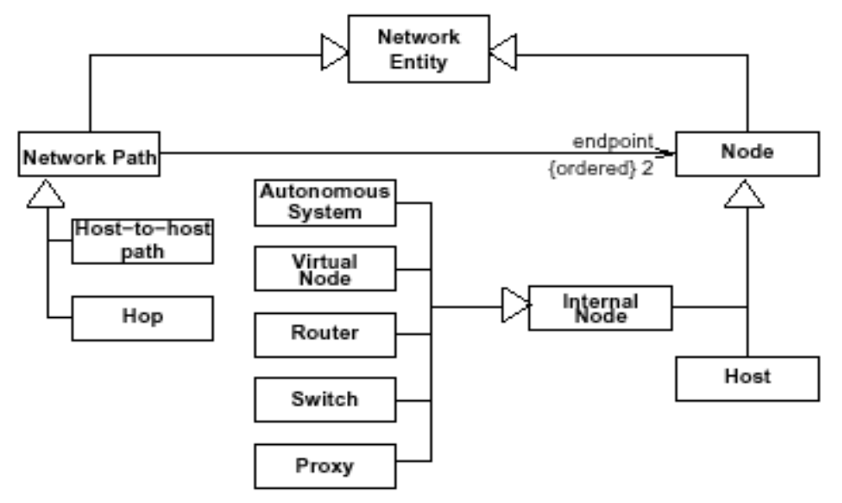
Network Entities
Note the Network Mark-up Language Working Group
Paths
  Set of links the data follows to get from source to destination
Nodes
  Hosts and internal nodes

Slide 6
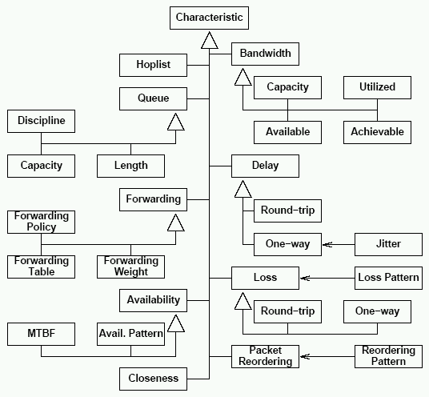
Overview of the Characteristics

Slide 7
Delay
Delay
One-way Delay
Roundtrip Delay
Jitter
  Variation in one-way delay
Measurement technique can affect results
  ICMP, TCP, UDP
Round-trip
One-way
Jitter

Slide 8
Bandwidth
Capacity:
  The maximum amount of data per time unit that a link or path
  can carry
    Link layer 2 maximum
Utilization:
  The aggregate traffic currently on that link or path. Eg SNMP
Available Bandwidth:
  The maximum amount of data per time unit that a link or path
  can provide given the current utilization.
    Maximum IP-layer throughput a link or path can provide
    Many different methodologies
Achievable Bandwidth (Input from GGF6):
  The maximum amount of data per time unit that a link or path can provide to an application, given the current utilization, the protocol and operating system used, and the end-host performance capability.
    The aim of this characteristic is to indicate what throughput a real user application would expect as opposed to what the network engineer could obtain.
Can apply to Path or Hop
Important to specify which Network layer
Bandwidth
Capacity
Utilisation
Available
Achievable

Slide 9
Hoplist & Forwarding
Hoplist:
  Allows a Path to be sub-divided into hops that form the path.
    Each member is a hop
    Can be at Layer-2 e.g. switch-switch or Layer-3 e.g. router-router
Forwarding:
  Describes how internal nodes forward traffic node-to-node.
    Can be at Layer-2 or Layer-3
Policy:
  Additional features of how the internal node forwards traffic
    Forwarding algorithm
    Queuing discipline
Table:
  Mechanism in an internal node to determine where to forward the traffic.
    Routing table
    NAT table
Weight:
  Information used as input to the Forwarding Policy
    OSPF – cost metric of each link (Path)
    BGP – vector of Autonomous Systems to be traversed
Hoplist
Forwarding
Policy
Table
Weight

