Slide 1
UNCLASSIFIED
ENTERPRISE SOFTWARE SERVICES (ESS)
mike.fetterman@disa.mil Mike Fetterman
griffithb@mont.disa.mil DISA SSO Montgomery
pennerl@mont.disa.mil 24 May 2005

Slide 2
OVERVIEW
BACKGROUND
SOFTWARE SERVICES
COMMUNITIES OF INTEREST
INFORMATION MARKETPLACES
DISA ENTERPRISE SOFTWARE SERVICES (ESS) EFFICIENCIES
DEFENSE SOFTWARE ENGINEERING MANAGEMENT SYSTEM (DSEMS)
MODERNIZATION
DEVELOPMENT
ENHANCEMENTS
SUMMARIES
A LOOK AHEAD

Slide 3
BACKGROUND
PROCESS STARTED IN MONTGOMERY IN OCTOBER 1999
JOINT SYSTEMS SUPPORT OFFICE/SYSTEMS MANAGEMENT CENTER (SSO/SMC) MONTGOMERY PROJECT
CUSTOMER BASE HAS TRIPLED
DIVERSIFIED

Slide 4


SOFTWARE SERVICES
INFORMATION DISSEMINATION MANAGEMENT (IDM) SERVICES
  DEFENSE ASSET DISTRIBUTION SERVICE
  PHYSICAL MEDIA
SECURITY SERVICES
  PATCH REPOSITORY
  GOLD DISK
  SOFTWARE UPDATE SERVICES (SUS)/ANTI-VIRUS (AV)

Slide 5
SOFTWARE SERVICES
APPLICATION SERVICES
  SUPPORT TO MULTIPLE COMMUNITIES OF INTEREST
  INCORPORATE A PROGRAM’S SPECIFIC BUSINESS RULES INTO ESS PROCESS
USER SERVICES
  DATA DISCOVERY
  USER NOTIFICATIONS
  OPTION TO USE DOD SUS SERVER FOR UNATTENDED UPDATES RATHER THAN COMMERCIAL INTERNET SITE

Slide 6
INFORMATION DISSEMINATION SERVICES
DEFENSE ASSET DISTRIBUTION SERVICE (DADS)
  SERVICES, SOFTWARE, DOCUMENTATION AVAILABLE FROM TAILORED CONTENT ENCLAVES ON BOTH NIPRNET AND SIPRNET
  CUSTOMIZED ASSURED SHARING
  INFORMATION POSTED ONCE, AVAILABLE DURING ANY STAGE OF DEVELOPMENT OR PRODUCTION
  SMART PULL TECHNOLOGY
  PHYSICAL DISTRIBUTION AS BACK-UP

Slide 7
SECURITY SERVICES
DOD PATCH REPOSITORY
  BOTH NIPRNET AND SIPRNET ENVIRONMENTS
  SUN, HP, MICROSOFT AVAILABLE TODAY
GOLD DISK
  REGISTER ONLINE TO RECEIVE MONTHLY MEDIA
  DOWNLOAD FROM PATCH REPOSITORY
DOD SOFTWARE UPDATE SERVICES (SUS)/ANTI-VIRUS (AV)
  BOTH NIPRNET AND SIPRNET ENVIRONMENTS
  CONTROLLED-PULL OF CRITICAL MICROSOFT OS PATCHES
  OPTIONAL SUBSCRIPTION SERVICE

Slide 8
APPLICATION SERVICES
DIVERSE APPLICATIONS POSTED FOR USE BY MULTIPLE COMMUNITIES OF INTEREST
  OPERATING SYSTEM PATCHES
  ANTI-VIRUS APPLICATIONS
  FUNCTIONAL APPLICATIONS
  COMMERCIAL PRODUCT SUITES
FLEXIBLE DEVELOPMENT TO SUPPORT PROGRAM’S UNIQUE BUSINESS RULES

Slide 9
USER SERVICES
DATA DISCOVERY
  VIA SUBSCRIPTION SERVICE
  AUTOMATIC UPDATES OF CRITICAL PC PATCHES
USER NOTIFICATIONS AS AN ITEM PROGRESSES THROUGHOUT ITS LIFE CYCLE

Slide 10
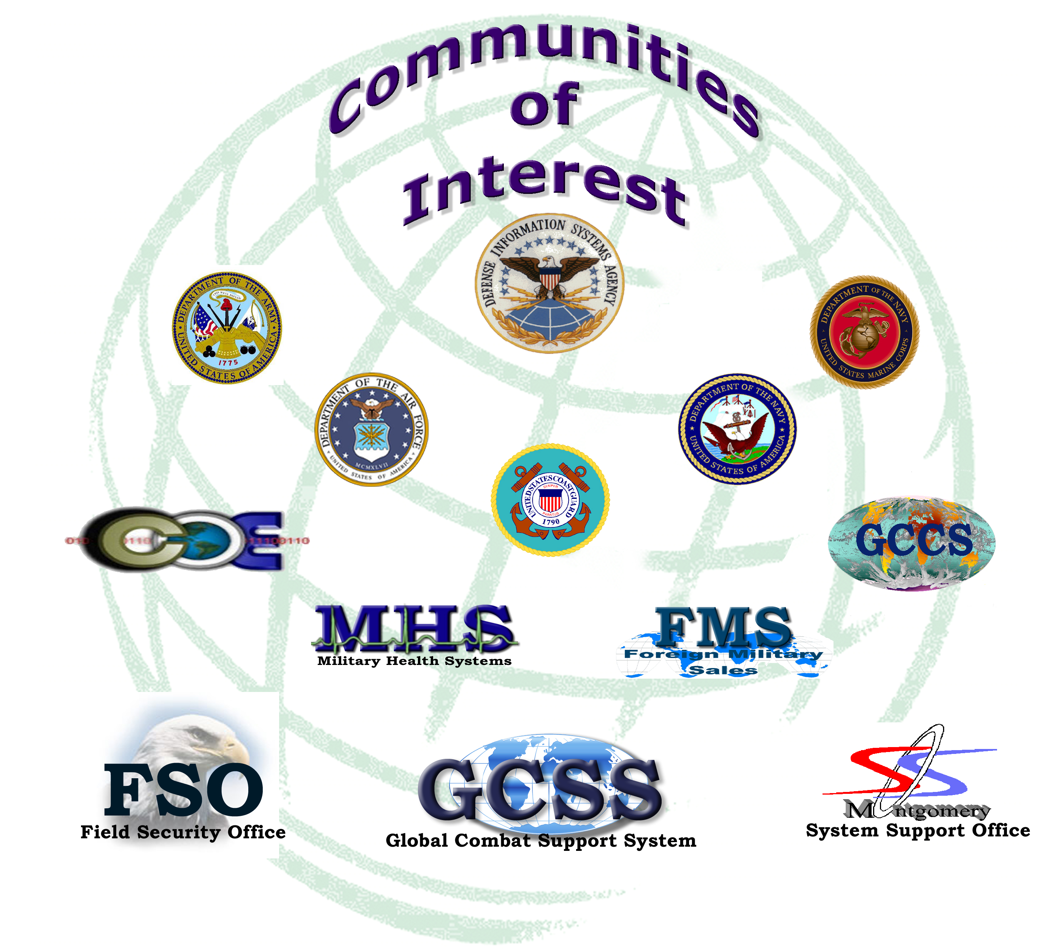

Slide 11
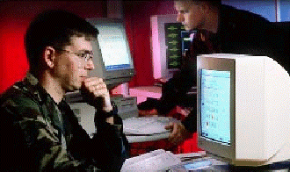
SUPPORT TO WARFIGHTERS
ENTERPRISE SOFTWARE SERVICES
Sun
HP
Microsoft
Unisys
MVS
Global Command & Control System (GCCS)
Common Operating Environment (COE)
Global Combat Support System (GCSS)
Foreign Military Sales (FMS)
SSO Mont Software Releases
SSO Mech Software Releases
Composite Health Care System (CHCS-II)
Field Security Operations (FSO)
Army GCCS
Army COE
Defense Logistics Agency
Defense Intelligence Agency
CUSTOMERS:
Mission First…People Always

Slide 12











INFORMATION MARKETPLACES
ENTERPRISE REPOSITORY
Software
Developers
Document Repository
Engineers
Pre Delivery Metadata
Consolidated Life-Cycle Metadata
Test Labs
Secured
Software
Repository
Testers
E-Delivery Staging
Physical
Delivery
Electronic Distribution
Federal
Express
Field Users
Physical Storage
Repro

Slide 13
DISA ESS EFFICIENCIES
COST OF DISA SOFTWARE SERVICES PROCESSING IS ONE FOURTH THE COST OF EQUIVALENT COMMERCIAL OPERATION (MICROSOFT) BASED ON 2002 GCCS-J STUDY
DISA SOFTWARE SERVICES TRACKS IN EXCESS OF 105,000 CONFIGURATION ITEMS
DATA POSTED PRIOR TO DELIVERY
  REGISTRATION METADATA
  TEST REQUIREMENTS AND RELEASE DETERMINATION

Slide 14
DISA ESS EFFICIENCIES
CONFIGURATION ITEMS PRE-POSITIONED FOR IMMEDIATE PULL AVAILABILITY
ASSETS AVAILABLE TO DISPARATE TEST SITES IN 30 MINUTES
OVER 70,000 ITEMS AVAILABLE FOR DOWNLOAD

Slide 15
WHAT IS DSEMS
DSEMS IS THE DEFENSE SOFTWARE ENGINEERING MANAGEMENT SYSTEM
  APPLICATION SUITE CONSISTS OF SEVERAL ORACLE DATABASES, AN ORACLE FORMS CLIENT, TWO REGISTRATION WEB SITES, AND EIGHT DADS SITES – ALL CONSISTING OF 2,600+ WEB PAGES

Slide 16
WHAT IS DSEMS
EXISTING CAPABILITIES
  SUPPORT TO DEVELOPERS
  SUPPORT TO END USERS
  SUPPORT TO TESTERS
  SUPPORT TO ENGINEERS
  SUPPORT TO CONFIGURATION MANAGERS
MODERNIZATION
PROJECTS IN DEVELOPMENT
FUTURE ENHANCEMENTS

Slide 17
WHAT IS DSEMS
DSEMS ARCHITECTURE INCLUDES:
  DATA SERVER
  SOFTWARE AND DOCUMENTATION REPOSITORIES
  TWO APPLICATION SERVERS (MONTGOMERY AND NCR)
  PRIMARY AND BACKUP NIPR AND SIPR WEB SERVERS
  NIPR AND SIPR DADS SERVERS
  SEVERAL DEVELOPMENT PLATFORMS

Slide 18
EXISTING CAPABILITIES
SUPPORT TO DEVELOPERS
  PRE-REGISTRATION AND SCHEDULING OF DISA DELIVERIES (BOTH EXTENSIVE COE-BASED AND ABBREVIATED REGISTRATION REQUIREMENTS)
  REGISTRATION OF NON-DISA DELIVERIES FOR SEGMENT CATALOG SERVICE
  PORT AND SOCKET REGISTRATION
  DEVELOPER DOCUMENTATION WITH DOWNLOAD CAPABILITY

Slide 19
EXISTING CAPABILITIES
SUPPORT TO END USERS
  RELEASED DOCUMENTATION WITH DOWNLOAD CAPABILITY
  FIELDED AND FUTURE RELEASE BUILD LISTS WITH CUSTOMIZED RESULT FORMATS
  AUTOMATED REQUEST FOR COPIES OF PHYSICAL MEDIA
  SUBMISSION OF PROBLEM REPORTS
  CUSTOMIZED DADS DOWNLOAD SITES

Slide 20
EXISTING CAPABILITIES
SUPPORT TO TESTERS
  RECORD MULTIPLE TYPES OF TESTING RESULTS BY MULTIPLE ORGANIZATIONS FOR MULTIPLE KERNELS, OS’s, AND RELEASES
  LINKS TO RELATED DOCUMENTATION AND WAIVERS
  AUTOMATIC EMAIL NOTIFICATIONS
  LINKS TO RELATED PROBLEM REPORTS
  TASK MANAGEMENT (OPEN TASKS ASSIGNED TO EACH TESTER)

Slide 21
EXISTING CAPABILITIES
SUPPORT TO ENGINEERS
  ITEM DETAIL RECORDS
    SUPPORTS “ANTICIPATED” RECORDS FOR PLANNING
    SUPPORTS TRACKING DEPENDENCIES, SUPERSEDED ITEMS
    TRACK TESTING AND ENGINEERING STATUS
    AUTOMATED EMAIL NOTIFICATIONS
    ASSIGN ITEMS TO MULTIPLE RELEASES FOR OS’s FOR MULTIPLE PROGRAMS, ALL AVAILABLE “AT A GLANCE”

Slide 22
EXISTING CAPABILITIES
SUPPORT TO ENGINEERS
  RELEASE MANAGEMENT TRACKS A BUILD FROM PLANNING THROUGH FIELDING
    LINKS TO INDIVIDUAL DETAIL RECORDS AND RELATED DOCUMENTATION
  REQUIREMENTS TRACKING
    WEB, CLIENT, OR IMPORTED DATA
    ASSIGNMENT, ANALYSIS AND RESOLUTION HISTORIES
  AUTOMATED EMAIL NOTIFICATIONS

Slide 23
EXISTING CAPABILITIES
SUPPORT TO CONFIGURATION MANAGERS
  CENTRALIZED TRACKING OF CONFIGURATION ITEMS
  BUILD MULTIPLE ITERATIONS OF RELEASES
  INITIATE AND TRACK DADS ACTIONS
  RETRIEVE DATA FOR CUSTOMER METRICS
  REQUEST PROCESSING AND SHIPMENT HISTORY
  AUTOMATED RELEASE DISTRIBUTION LISTS
  USER AND POC MANAGEMENT

Slide 24
MODERNIZATION
WEB PORTAL
WEB FORUM
CUSTOMER POST/PULL DOCUMENTATION WEB SITE

Slide 25
DEVELOPMENT
WEB-ENABLING ORACLE FORMS
  ELIMINATE NEED FOR CLIENT ON WORKSTATIONS
  ELIMINATE APPLICATION SERVERS RESULTING IN REDUCED HARDWARE AND SYSTEM ADMINISTRATOR COSTS
  RESULT IS A TRULY NET-CENTRIC LIFE-CYCLE SOLUTION

Slide 26
DEVELOPMENT
ORACLE FINE GRAIN ACCESS CONTROL (FGAC)
  IMPROVED SECURITY (MOVES FROM APPLICATION LEVEL TO INDIVIDUAL TABLE LEVEL)
  PHASE I (DATABASE STRUCTURE) RECENTLY IMPLEMENTED
  PHASE II (IMPLEMENTING ACCESS CONTROL) SCHEDULED FOR JUL 05

Slide 27
DEVELOPMENT
REDESIGN AND MODERNIZE CHANGE MANAGEMENT MODULE
  REQUIREMENTS BEING DETERMINED BY GCCS
  IMPLEMENTATION TBD BASED ON REQUIREMENTS
INCREASE BUILD LIST FUNCTIONS
  PROVIDE ABILITY TO TRACK CHANGES AND FREEZE ITERATIONS OF RELEASE BUILDS
  ANTICIPATE IMPLEMENTATION JUL 05

Slide 28
FUTURE ENHANCEMENTS
FURTHER MODERNIZE WEB FORMS
  PRESENT DATA IN A MORE SOPHISTICATED AND LOGICAL MANNER
MOVE ALL PROGRAMS TO NEW DADS
  AUTOMATED INTERFACE WITH DSEMS WILL ALLOW ENGINEERS TO TRIGGER DADS ACTIONS
DEVELOP LICENSE TRACKING MODULE
  AS NEEDED BY SUPPORTED PROGRAMS

Slide 29
FUTURE ENHANCEMENTS
AVAILABLE TO HOST A TEST TRACKING PRODUCT (e.g. Test Director)
  INTEGRATE WITH DSEMS DATA FOR CENTRALLY MANAGED NET-CENTRIC SOLUTION
  INSURE STANDARDIZATION WITHIN TEST ORGANIZATIONS
  SHARING OF TEST PLANS, SCRIPTS, AND DATA SAVES TIME AND RESOURCES

Slide 30
DSEMS SUMMARY
STANDARD, REPEATABLE PROCESS FOR TRACKING, STORING AND DISTRIBUTING SERVICES, SOFTWARE AND DOCUMENTATION
  QUALITY ASSURANCE
  RELEASE BUILDS/MANAGEMENT
  REQUIREMENTS TRACKING
  ELECTRONIC REPOSITORIES
  STATE-OF-THE-ART DATA SECURITY

Slide 31
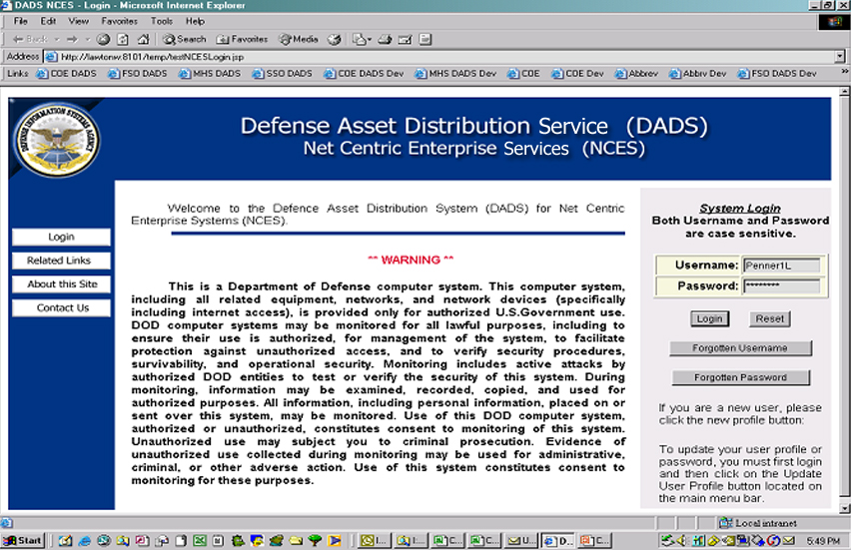
DADS

Slide 32
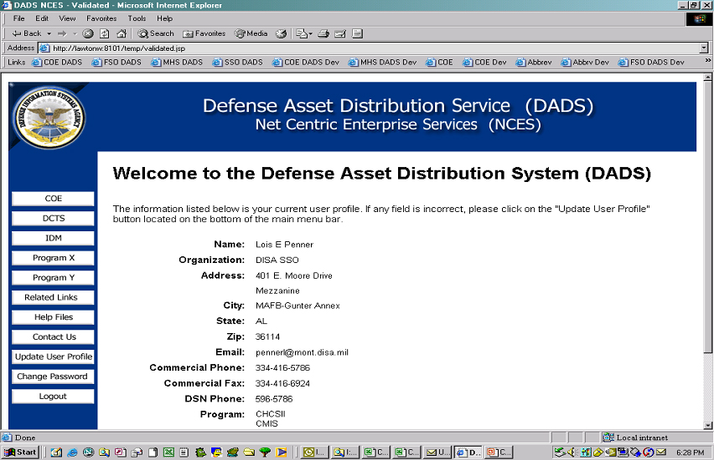
DADS

Slide 33
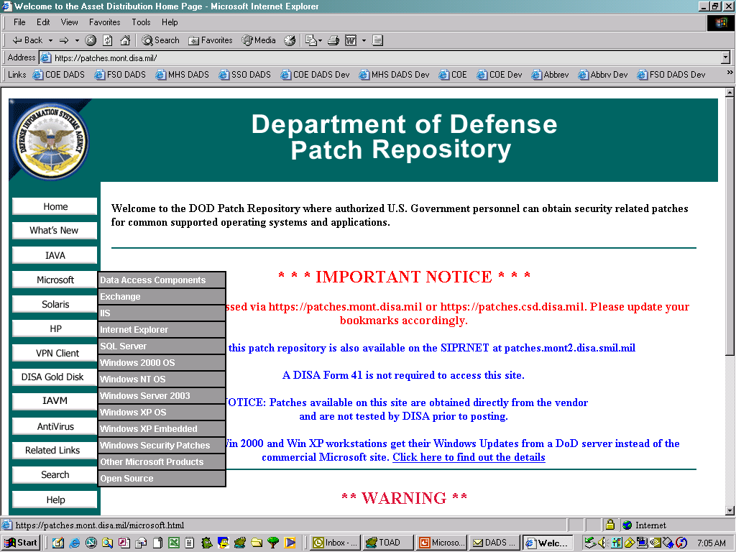
DADS

Slide 34
SOFTWARE SERVICES
SUMMARY
IDM SERVICES
SECURITY SERVICES
APPLICATION SERVICES
USER SERVICES
RELEASE MANAGEMENT SERVICE
WEB DEVELOPMENT
INTEGRATION SERVICES
HOST, MANAGE, MAINTAIN ADDITIONAL SUPPORT SOFTWARE

Slide 35
A LOOK AHEAD
EDGE TECHNOLOGY AVAILABLE TODAY
EAGER TO PARTNER WITH NCES TO PROVIDE EDGE SERVICES

