Slide 1
OBIEnv: An Environment for
Typical Computing
in Bioinformatics
Kenji Satou
JAIST

Slide 2
Typical Computing in Bioinformatics
Job
Software
DB
Task 1-250
Task 1
Task 2
Task 251-500
Software
DB
.
.
.
Task 501-750
Software
DB
Task 999
Task 1000
Task 751-1000
Software
DB
great many and similar tasks
independent to each other ...

Slide 3
for Ease of Such Computing ...
Where the appropriate computing environment ?
Are the databases and softwares sufficiently new ?
Who update them ? Isn't it tough work ?
Can we overcome the heterogeneity of platforms ?

Slide 4
Aim of OBIEnv
automatic
database
update
transparent execution with approximate load balancing
scalable
architecture
essential uniformity
of software
easy & least
configuration
Distributed Computing
Environment for Bioinformatics

Slide 5
We don't care about ...
Needs for Monitoring on Rapidly Changing Information
(e.g. Load Average, Memory Consumption, ...)
Needs for User's Permanent Files on Remote Machines
Needs for User Name on Remote Machines
(i.e. Representative Name is Sufficient)
Any Platform except Unix (Linux, Solaris, IRIX, etc.)
Avoiding Resource Occupation by Extraordinary Long Job

Slide 6
We focus on ...
Automatic Job Dividing and Machine Selection
Information Update for Slowly Changing Things
(e.g. Existence of DB & SW, Mem & HD Capacity, ...)
Automatic Update of Database and Software
Simple Configuration and Appropriate Defaults

Slide 7
PostgreSQL
OBIEnv Overview
P2P
Server
Environment
Information
Server
Divided Jobs
Node
Search
Set of
Nodes
Node
Node
Globus
Tool Kit
Results
Reporting
Environmental
Information
Globus
Tool Kit
Job Dispatcher
(obidispatch)
Temporal Work Area
for Job Execution
Local
Authentification
Job (List
of Tasks)
Environment
Scanner
(obiregist)
List of OBIEnv
Users
DB
SW
HW
OBIEnv User
Unauthorized
Local Users
transferred and updated
by obiupdate command

Slide 8
Configuration File (~obienv/.obienv.conf)
example
P2PSERVER p2p.obigrid.org,#port,...
USERLIST hiko s_tsuji ken
DBPATH /obienv
DBLIST trembl unigene pdb
WORKPATH /tmp
LOGPATH /var/tmp
SITE jaist-kenlab
NETPATH switch1.vjai01
...

Slide 9
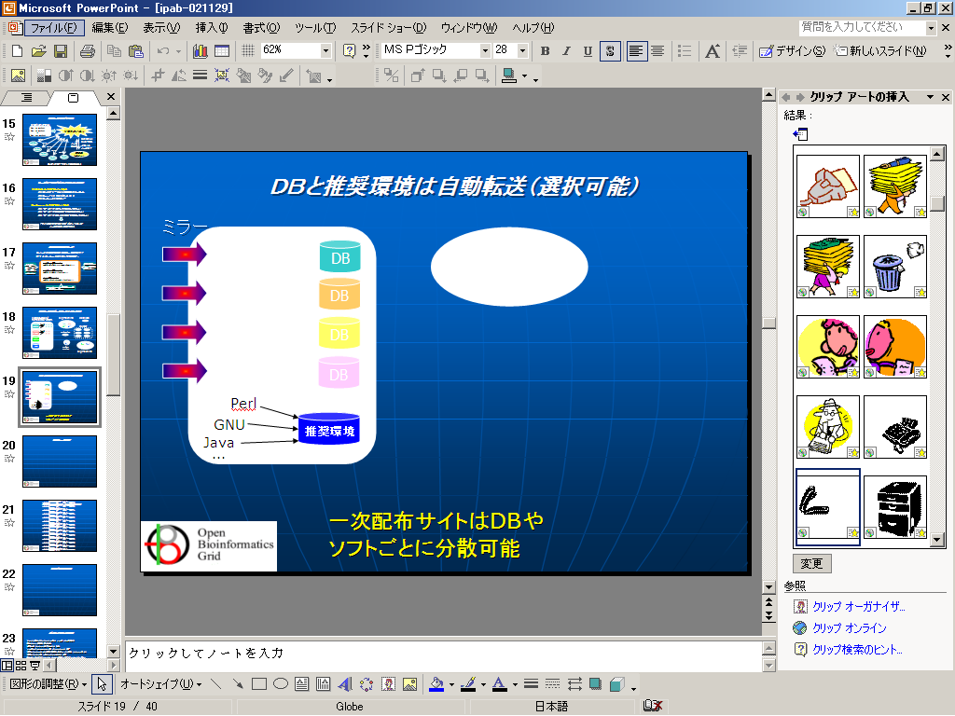
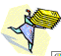
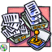
Database Transfer (obiupdate)
mirror
indexing
rsync
SSE
DB
DB
DB
DB
DB
DB
SSE
DB
SSE
DB
DB
DB
DB
Perl
GNU
SSE
SSE
BLAST
...
DB
DB
SSE: Standard Software Environment
multiple primary servers are allowed

Slide 10
Standard Software Environment
for Overcoming Platform Heterogeneity
Fundamental Unix Commands (GNU etc.)
Programming Languages (Perl, Java, etc.)
Bioinformatics Applications (BLAST, etc.)
Prepared and Transferred
Like a Database

Slide 11
Job Execution
Job (Task List)
Job Dispatcher
(obidispatch)
blast Q1 genbank
blast Q2 genbank
：
blast Q10 genbank
Q1,Q2
Nodes with
genbank and BLAST?
genbank
Q3,Q4
Set of Nodes
Q5,Q6
genbank
Q7,Q8
Q9,Q10
Environment
Information
Server
genbank
genbank
genbank
tasks are independent to each other

Slide 12
Task File
Syntax
Example of Constraints
-- DB = 'trembl'
(constraint on DB equipment)
-- CLOCK > 1000MHz
-- DISK > 500GB
-- MEMORY > 1000MB
(constraints on HW resources)
-- HOST like 'crobi'
(constraint on hostname)
-- SW_NOTE ~ 'Red'
-- SW_VERSION > '2.4.11'
(constraints on OS name and ver.)
Constraint(s)
Task (shell commands)
Task
Task
...
task can include some variables for:
1) I/O between local and remote
2) easy generation of similar tasks

Slide 13
Auxiliary Commands in SSE
obiget for entry retrieval
obiget unigene
obiget unigene/2002:11:20
env DBVERSION=unigene/2002:11:20 obiget
obiget -s unigene/2002:11:20
obiget -t flat unigene/2002:11:20
obiget -t fasta unigene/2002:11:20
obiget -i At.24121 unigene/2002:11:20
obiget -i 'At.24121 At.24126 At.24133' unigene/2002:11:20
obiget -t fasta -i 'At.24121 At.24126 At.24133' unigene/2002:11:20
obiget -s -c "id like 'Aga.%'" unigene/2002:11:20
powered by SQLite

Slide 14
Auxiliary Commands in SSE (continued)
obiblast (blast wrapper)
obiblast -dbver unigene ... (blastall options except -d)
obiblast -dbver unigene/2002:11:20 ...
env DBVERSION=unigene/2002:11:20 obiblast ...
obiblast -s -dbver unigene/2002:11:20 ...
obiblast -t blastdb -s -dbver unigene/2002:11:20 ...
it makes easy to specify a list of
appropriate file names in DB

Slide 15
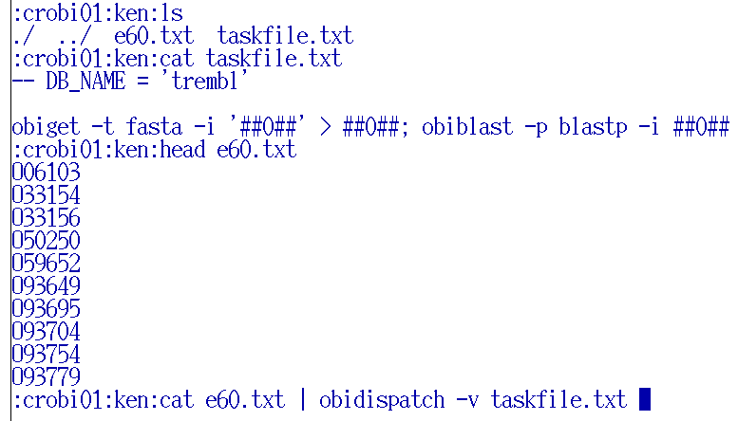
OBIEnv DEMO
Task File
List of entries (for queries)
Job Dispacher

Slide 16
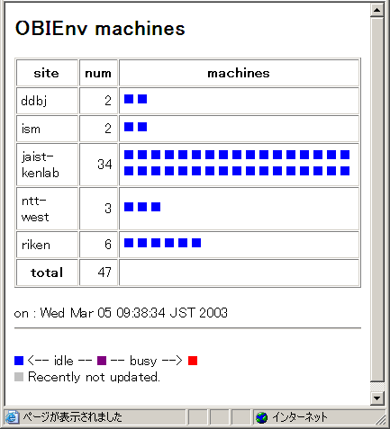
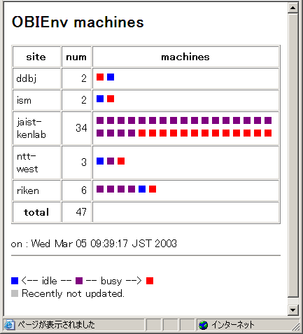
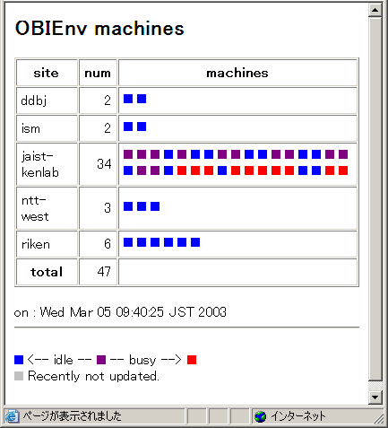
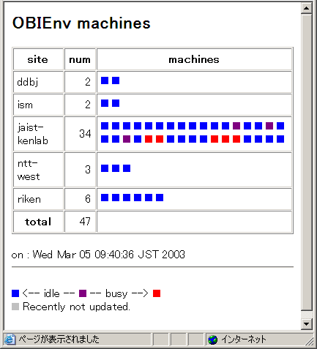
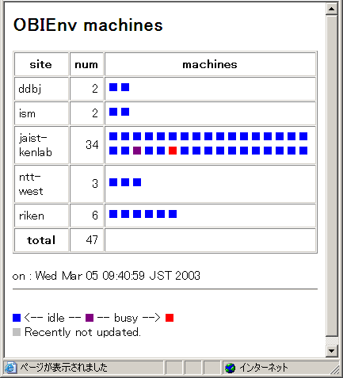

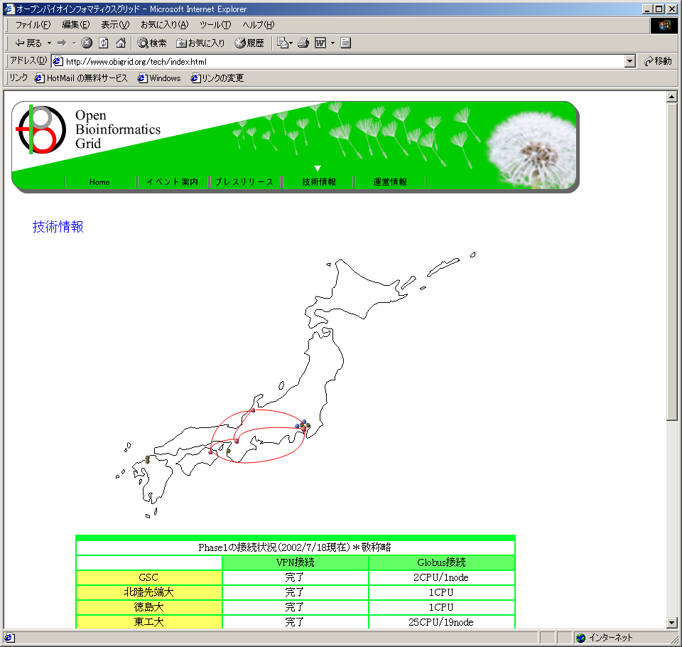
OBIEnv Demo

Slide 17
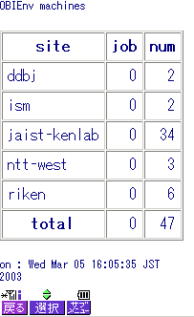
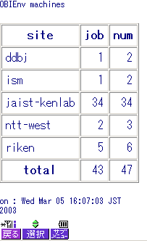



Monitoring via Mobile Phone :-)

Slide 18
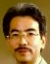
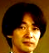
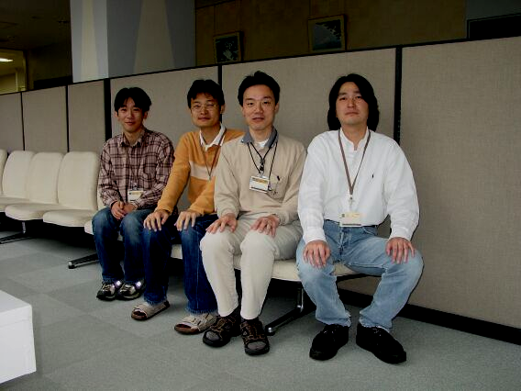
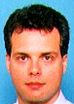
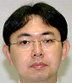
OBIEnv Project
Akihiko Konagaya (RIKEN)
Kenji Satou (JAIST)
Shin'ichi Tsuji (HNES)
Yasuhiko Nakashima (HNES)
Defago Xavier (JAIST)
Tomoyuki Yamamoto (JAIST)
... and all the collaborators
scattered among OBIGrid!!
boss
core members
advisers

