Slide 1
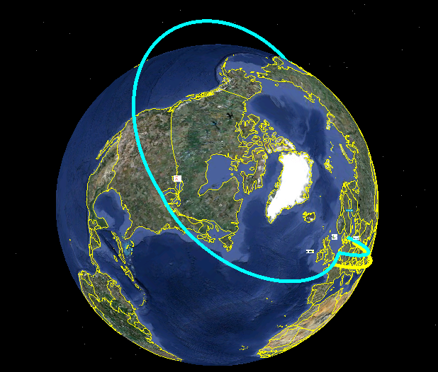
Network Service Interface (NSI)
Bringing about seamless global circuits

Slide 2

NSI – Making Global Connections
NSI is brought to you by OGF
open to all …. so join in now!

Slide 3















NSI – Making Global Connections
NSI – partnership of research networks and industry

Slide 4

NSI – Making Global Connections
Grids and Clouds need NSI
Networks are often been taken for granted by Clouds and Grids
Networks performance sensitive to distance and congestion
Longer distances may require using more than one provider
NSI delivers Networks as a manageable resource

Slide 5

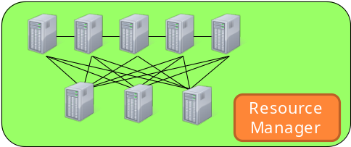


The Inter-DC connectivity challenge
(1) Ｒｅｑｕｅｓｔ
(3) Use
Inter-DC
network
(2) Provide

Slide 6
Managing complex networks in Clouds
A simple API to support connectivity management
Network should be just another resource – easy integration with scheduling of computing resources
Dynamic assignment of bandwidth, VLAN ids etc.
Compatibility with monitoring systems for virtual infrastructures while keeping isolation
Global reach: multi-provider enabled solution

Slide 7
NSI is both a framework and a protocol
NSI provides a framework for multiple services:
  Connection service
  http://forge.gridforum.org/sf/go/doc16014?nav=1
This demo uses NSI protocol version 1.sc
© 2006 Open Grid Forum

Slide 8
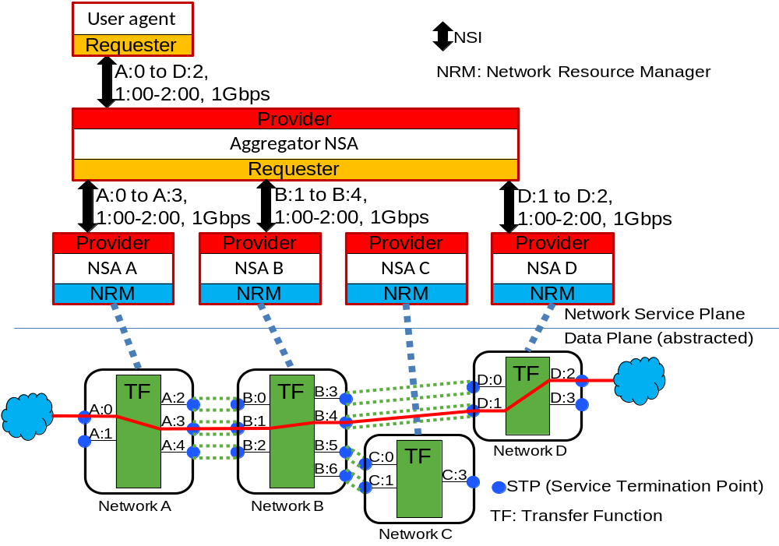
NSI architecture

Slide 9
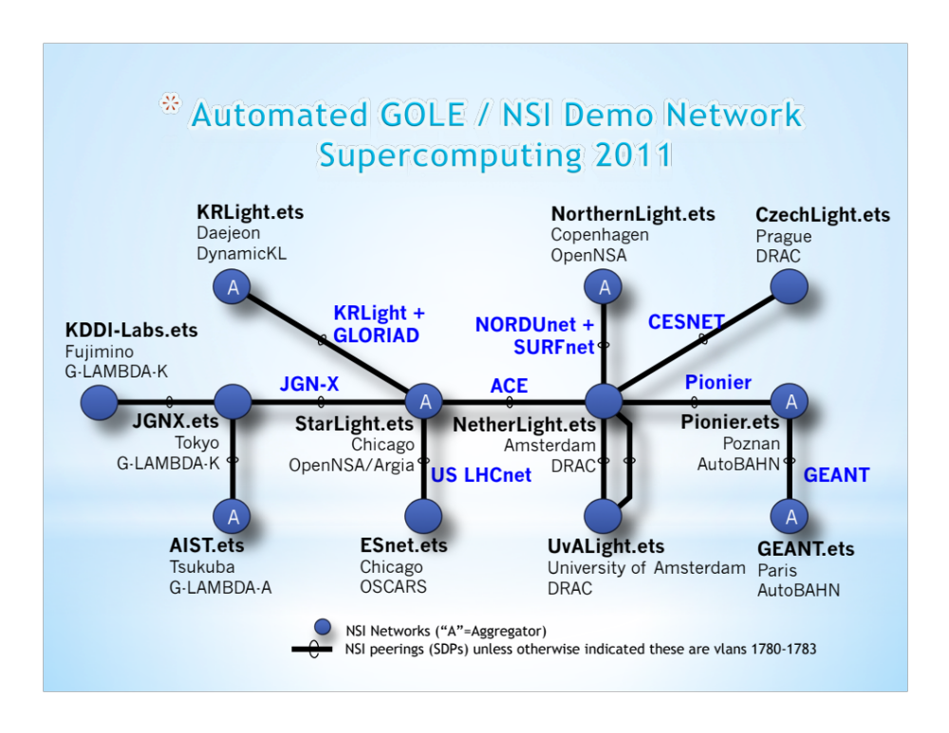
The NSI Demo at SC2011

Slide 10
Existing NSI implementations:
OpenNSA – NORDUnet (Copenhagen, DK)
DRAC – SURFnet (Amsterdam, NL)
AutoBAHN – GEANT (Poznan, PL)
G-LAMBDA-A - AIST (Tsukuba, JP)
G-LAMBDA-K – KDDI Labs (Fujimino, JP)
DynamicKL – KISTI (Daejeon, KR)
OSCARS – ESnet (Berkeley, US)

