Slide 1








SDOs Collaboration on networked Resourced Management (SCRM) - WG
Jay Unger & Mark Carlson, SCRM-WG co-chair
Hiro Kishimoto, Acting Liaison Area Director
SCRM-WG session
June 27th, 2005 (GGF14)
DMTF

Slide 2
GGF Intellectual Property Policy
All statements related to the activities of the GGF and addressed to the GGF are subject to all provisions of Appendix B of GFD-C.1, which grants to the GGF and its participants certain licenses and rights in such statements. Such statements include verbal statements in GGF meetings, as well as written and electronic communications made at any time or place, which are addressed to any GGF working group or portion thereof,
Where the GFSG knows of rights, or claimed rights, the GGF secretariat shall attempt to obtain from the claimant of such rights, a written assurance that upon approval by the GFSG of the relevant GGF document(s), any party will be able to obtain the right to implement, use and distribute the technology or works when implementing, using or distributing technology based upon the specific specification(s) under openly specified, reasonable, non-discriminatory terms. The working group or research group proposing the use of the technology with respect to which the proprietary rights are claimed may assist the GGF secretariat in this effort. The results of this procedure shall not affect advancement of document, except that the GFSG may defer approval where a delay may facilitate the obtaining of such assurances. The results will, however, be recorded by the GGF Secretariat, and made available. The GFSG may also direct that a summary of the results be included in any GFD published containing the specification.

Slide 3
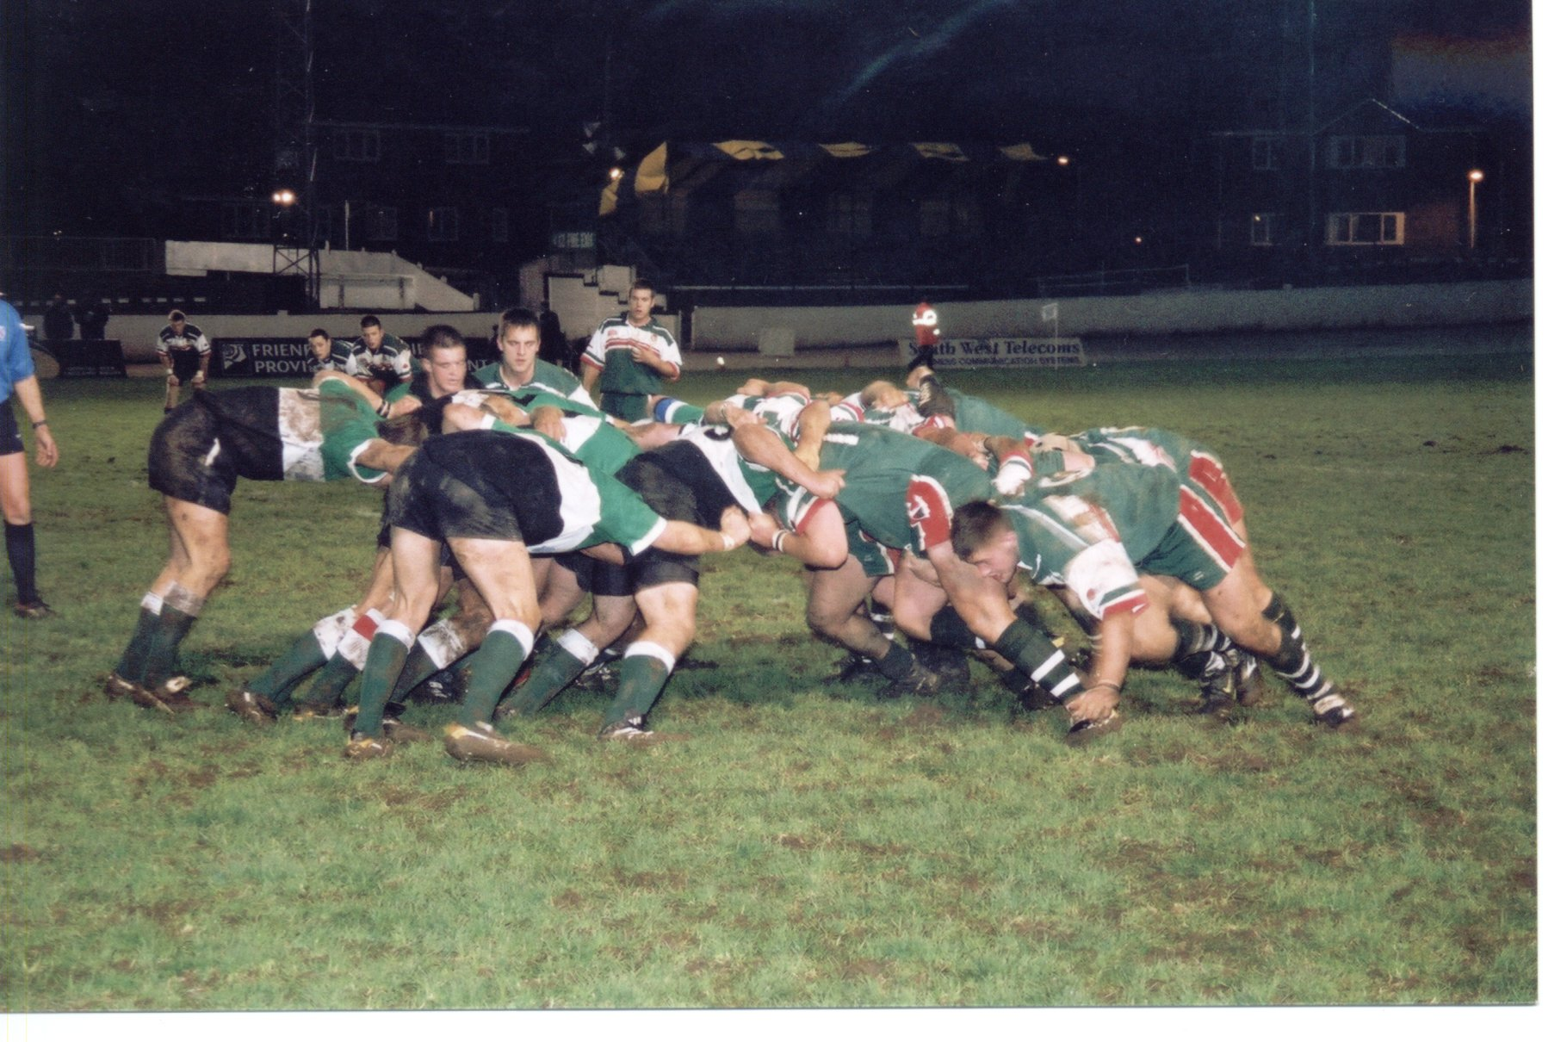
Definition
scrum (skrŭm) n.
[in sports] particularly Rugby, a group of attacking players from each team who come together with their heads down and arms joined, and push against each other, trying to take control of the ball
[General] when a group of people push each other to get to a place or obtain something
[in management] an agile method for project management, in use since at least 1990. It has been called a "hyper-productivity tool", and has been documented to dramatically improve productivity in teams previously paralysed by heavier methodologies.
GIVE BLOOD PLAY RUGBY

Slide 4
GGF Liaison Area
GGF new areas
Standard Areas
Architecture, Application, Compute, Data, Infrastructure
Management, Security
Liaison
Community Areas
Grid operation, Industry app, Major Grid Projects, …
Operation Areas
Event, Finance, IT, Marketing, Sponsorship

Slide 5
GGF Liaisons
Forum level one-to-one liaisons
  EGA – John Tollefsrud, SNIA – Dave Martin
  W3C – Dave De Roure, IETF – Cees De Laat
  OASIS – Dave Snelling, WS-I – Olle Mulmo
  DMTF – Tom Roney
WG/RG level liaisons
  Many
Forum level round table style collaboration
  SCRM – Jay Unger and Mark Carlson

Slide 6
SCRM-WG History
First powwow (2004 summer)
  Start open discussion about scope and goal
Tele conference once or twice a mounth
Reach rough consensus on scope and goal
  The management of resources used in a network by means of structured data standards
  Landscape chart/document and chart of definitions and taxonomy
Start Information gathering
Second powwow (2005 winter)
  Draw up SCRM-WG formation schedule
SCRM-WG
  GFSG approved just before GGF14 and have the first session

Slide 7
Motivation
“Industry standard distributed computing” – enabling research and industry to communicate, collaborate and transact commerce
  The integration, virtualization and management are required
The journey toward this vision is a “winding road”
  Overlapping terms, taxonomies and efforts
Closer collaboration would be best interests
  Avoid overlapping efforts and competing specifications
  Share common frameworks, taxonomy, roadmaps, etc.
  Increase efficiency and deliver more effective results faster

Slide 8
Motivation of GGF/OGSA
Consequence of the successful completion of the OGSA Use Case and Architecture documents
  The magnitude and scope of the work that still needs to be done is greater than the OGSA-WG or GGF
A lot of related work is already carried out in other SDOs

Slide 9
Round Table Style collaboration
Most SDOs already have many one-to-one liaison relationships
  Effective and productive for handling specific issues
SCRM-WG is a round table-style collaboration
  Provides a "bird's eye view" of this broad and complicated technical area
  Helping further the work already underway between these leading SDOs

Slide 10
Deliverables
Informational standards landscape document
  An annotated list of interacting standards that enable management of networked resources
  Including some information on gaps, overlaps, current status and expected timeframes for milestones
Informational high level “roadmap” style document
  Will be developed in parallel but on a slightly longer schedule
  Consisting of a consolidated and converged glossary of terminology and a broad taxonomy of existing and emerging standards and technologies

Slide 11
Related Specification Summary
List up related existing specifications developed by each SDO and gather their summary
One sheet per specification
  Identification
  Source
  Subject
  Optional info

Slide 12
List of Specification
SDO | # of specs
DMTF | 3
GGF | 10
IETF | 19
ITU-T | 1
OASIS | 8
SNIA | 1
TMF | 5
W3C | 10
Total 57 specs
Now 23 summary ware written

Slide 13
W3C Specifications
SOAP Version 1.2 Part 1: Messaging Framework
SOAP Version 1.2 Part 2: Adjuncts
SOAP Message Transmission Optimization Mechanism
Resource Representation SOAP Header Block
"Web Services Description Language (WSDL) Version 2.0 Part 1: Core Language"
"Web Services Description Language (WSDL) Version 2.0 Part 2: Predefined Extensions"
"Web Services Description Language (WSDL) Version 2.0 Part 3: Bindings"
Web Services Addressing 1.0 - Core
Web Services Addressing 1.0 - SOAP Binding
Web Services Addressing 1.0 - WSDL Binding

Slide 14
DMTF & SNIA specifications
DMTF
  CIM Infrastructure Specification
  CIM Schema
  SMASH
SNIA
  SMI-S(ANSI INCITS 388-2004)

Slide 15
GGF Specifications
Open Grid Services Architecture version 1.0
OGSA Basic Profile version 1.0
CDDLM Foundation Document
CDDLM SmartFrog-Based Language Specification
CDDLM XML-Based Language Specification
CDDLM Component Model Specification"
CDDLM Deployment API Specification"
Application Contents Service Specification
Job Submission Information Model (JSIM)
Web Services Agreement Specification (WS-Agreement)

Slide 16
ITU-T & TMF specification
ITU-T
  M.3016.0 Security for the Management Plane: Overview
  M.3016.1 Security for the Management Plane: Security Requirements
  M.3016.2 Security for the Management Plane: Security Services
  M.3016.3 Security for the Management Plane: Security Mechanisms
  M.3016.4 Security for the Management Plane: Profile Proforma
  M.3050 series: Enhanced Telecom Operations Map
  M.3060 Principles for the Management of Next Generation Networks
TMF
  NGOSS (New Generation Operations Systems and Software)
  Lifecycle & methodology
  eTOM
  SID
  Architecture

Slide 17
IETF Specifications
RFC 2578 - Structure of Management Information Version 2
(SMIv2). K.
RFC 2579 - Textual Conventions for SMIv2.
RFC 2580 - Conformance Statements for SMIv2.
RFC 3410 - Introduction and Applicability Statements for Internet-Standard Management Framework.
RFC 3411 - An Architecture for Describing Simple Network Management Protocol (SNMP) Management Frameworks.
RFC 3412 - Message Processing and Dispatching for the Simple Network Management Protocol (SNMP).
RFC 3413 - Simple Network Management Protocol (SNMP) Applications.
RFC 3414 - User-based Security Model (USM) for version 3 of the Simple Network Management Protocol (SNMPv3).
RFC 3415 - View-based Access Control Model (VACM) for the Simple Network Management Protocol (SNMP).
RFC 3416 - Version 2 of the Protocol Operations for the Simple Network Management Protocol (SNMP).

Slide 18
IETF Specifications (contiued)
RFC 3417 - Transport Mappings for the Simple Network Management Protocol (SNMP).
RFC 3418 - Management Information Base (MIB) for the Simple Network Management Protocol (SNMP).
RFC 3419 - Textual Conventions for Transport Addresses.
RFC 3430 - Simple Network Management Protocol Over Transmission Control Protocol Transport Mapping.
RFC 3584 - Coexistence between Version 1, Version 2, and Version 3 of the Internet-standard Network Management Framework.
RFC 3444 - On the Difference between Information Models and
Data Models.
RFC 3535 - Overview of the 2002 IAB Network Management Workshop.
"NETCONF Configuration Protocoldraft-ietf-netconf-prot-05, draft-ietf-netconf-ssh-04.txt, draft-ietf-netconf-beep-05.txt, draft-ietf-netconf-soap-04.txt"

Slide 19
OASIS Specifications
"Web Service Distributed Management (WSDM) Management using Web Service (MUWS)"
"Web Service Distributed Management (WSDM) Management of Web Service (MOWS)"
Data Center Markup Language framework specification
Web Service Base Notification
Web Serivce Topic
Web Service Resource Property
Web Service Resource Lifetime
Installable Unit Deployment Descriptor Specification

Slide 20
Other Input
OGSA roadmap document v1.0
Web Services Management Roadmap Document (IBM, CA & HP)
Any other?

Slide 21
Opportunities - Obstacles
Many specifications to survey
  Huge amount of good work is already done !
Technical experts are all volunteers that are already stretched by present activities
  Maybe cooperation will lighten the load !
  Eventually !!
Contentious issues, company agendas, standards politics etc.
  Technical experts want to work together !
  I hope !!

Slide 22
Operation Information
Project Web page
  https://forge.gridforum.org/projects/scrm
Project mailing list
  scrm-wg@ggf.org
Bi-weekly phone call
  Proposal: Thursday 5-6pm CDT
    Starting July 8th

Slide 23

Build Trust & Community
“Trust is the hardest thing to find and the easiest to lose.” Unknown
“I have great faith in fools –
- my friends call it self-confidence” Edgar Allan Poe

Slide 24
Panel Discussion &
Q & A

