Slide 1
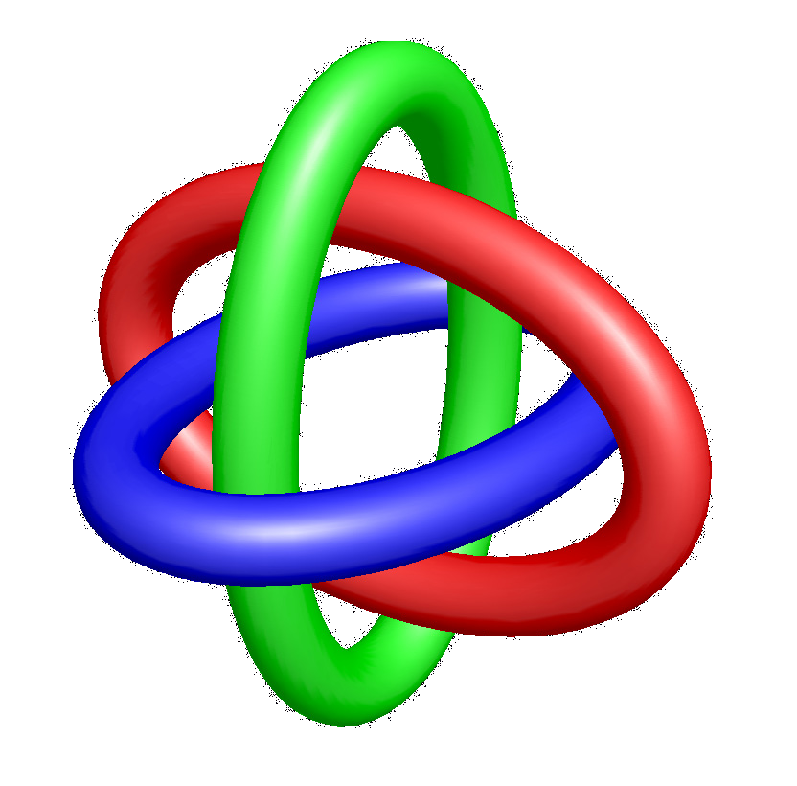
Scientific Annotation Middleware:
Data/Metadata
Access/Transformation Services
On/Off the Grid
James D. Myers
Pacific Northwest National Laboratory

Slide 2


Scientific Annotation Middleware (SAM) Project
Jim Myers, Alan Chappell, Matt Elder, Mike Peterson, Prasad Saripalli, (Elena Mendoza) -
Pacific Northwest National Laboratory
Al Geist, Jens Schwidder, David Jung - Oak Ridge National Laboratory
Develop a lightweight, flexible middleware to support the creation and use of metadata and annotations
  Notes, provenance, classification, scientific metadata, …
Enable the sharing of annotations among portals and problem solving environments, software agents, scientific applications, electronic notebooks, …
Improve the completeness, accuracy, and availability of the scientific record.

Slide 3
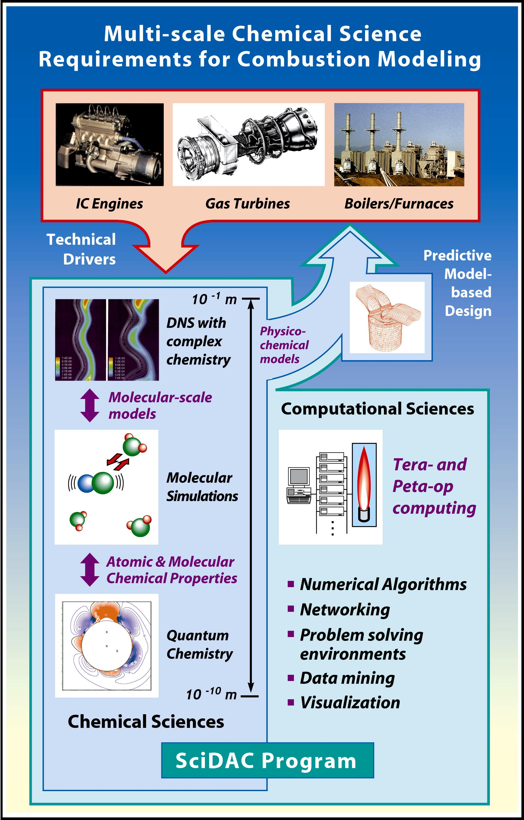
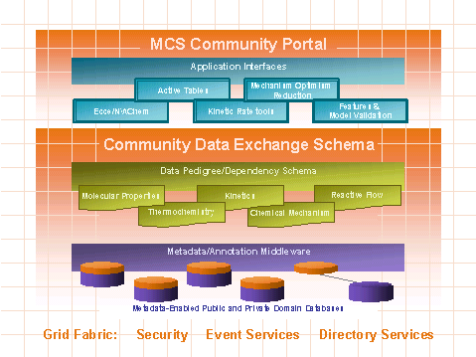








Collaboratory for Multiscale Chemical Science (CMCS)
Larry Rahn
rahn@sandia.gov
Sandia National Laboratories
http://cmcs.ca.sandia.gov

Slide 4
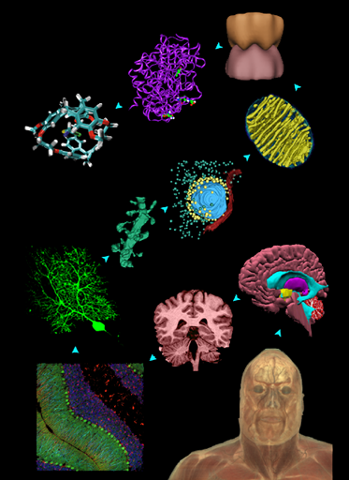
The NPACI “Vision” for Neuroscience
Enable new understanding of the brain by linking data about macroscopic brain function to its molecular and cellular underpinnings
Federate distributed multiscale brain map data
Accommodate associated Large Scale Computational Challenges
Provide Infrastructure for Construction of more accurate Models and more Realistic Simulations of Brain Activity
Scales of NS from Maryann Martone
Slide from Mark Ellisman, UCSD

Slide 5
A note about standards
Standards are good, but
  They represent a common model of what is being described and how it is used
  Which information is data and which is metadata depends on your application
Preserving the original data and mapping to current standard(s) is more powerful and becoming manageable
  XML/OWL are not just human understandable, they are machine understandable

Slide 6
Next-generation E-Notebooks
How do we track
  Data Pedigree
  Community Annotation
  Feature Detection
  Categorization
  Project Organization
  Endorsement
  Records information
  Instrument logs
  Workflow
  Copy Locations
At a global scale?
Between group and community data systems?
Across communities with different standards?
To provide the deep, complete, living record paper notebooks once were – in a 21^{rst} century science environment?

Slide 7
21^{rst} Century Science Environment
Notebook
Instrument/
Model
Data Grid
Analysis/
Visualization
Federate across public/private systems
Provide semantic translation between systems’ data and metadata
Support records management across systems
Scientific
Databases
Collaboration
Community
Annotation Service
Data Pedigree
Remote Process Monitoring
Experiment
Automation
Scientific Data
Exploration
Web Portal

Slide 8
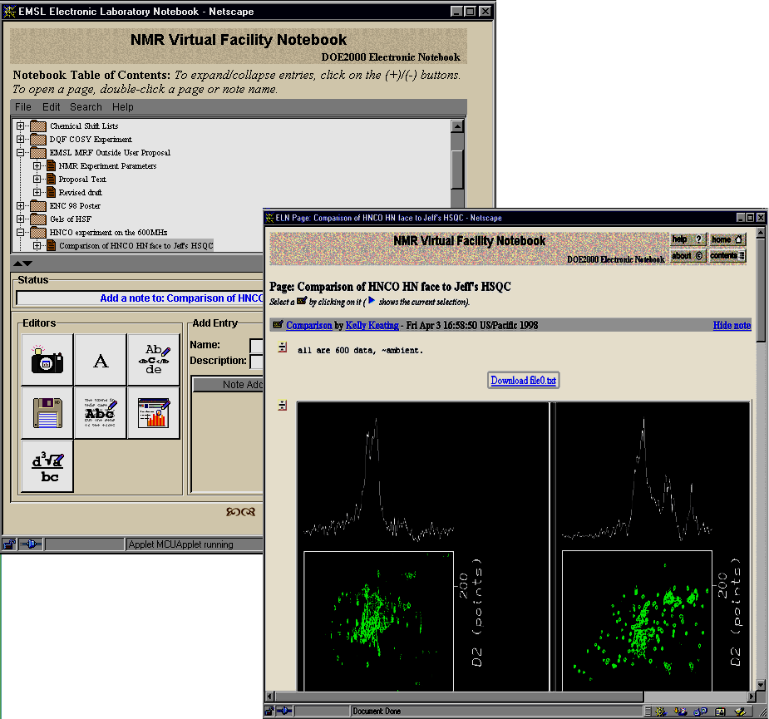
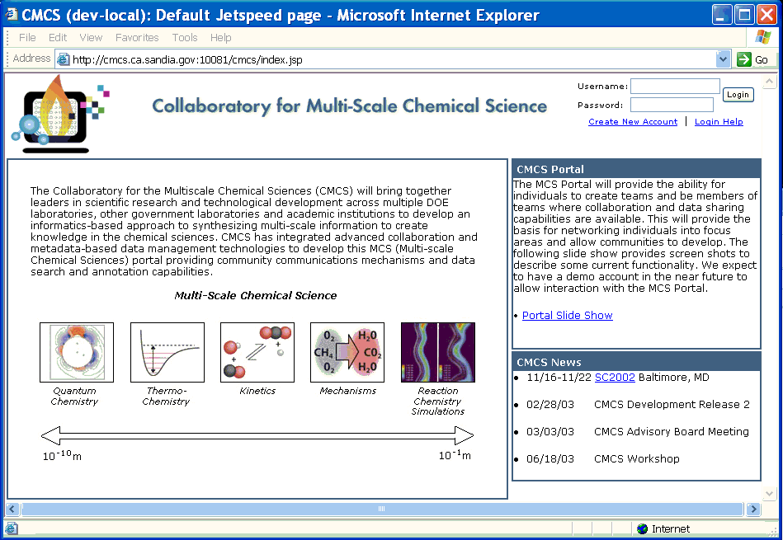
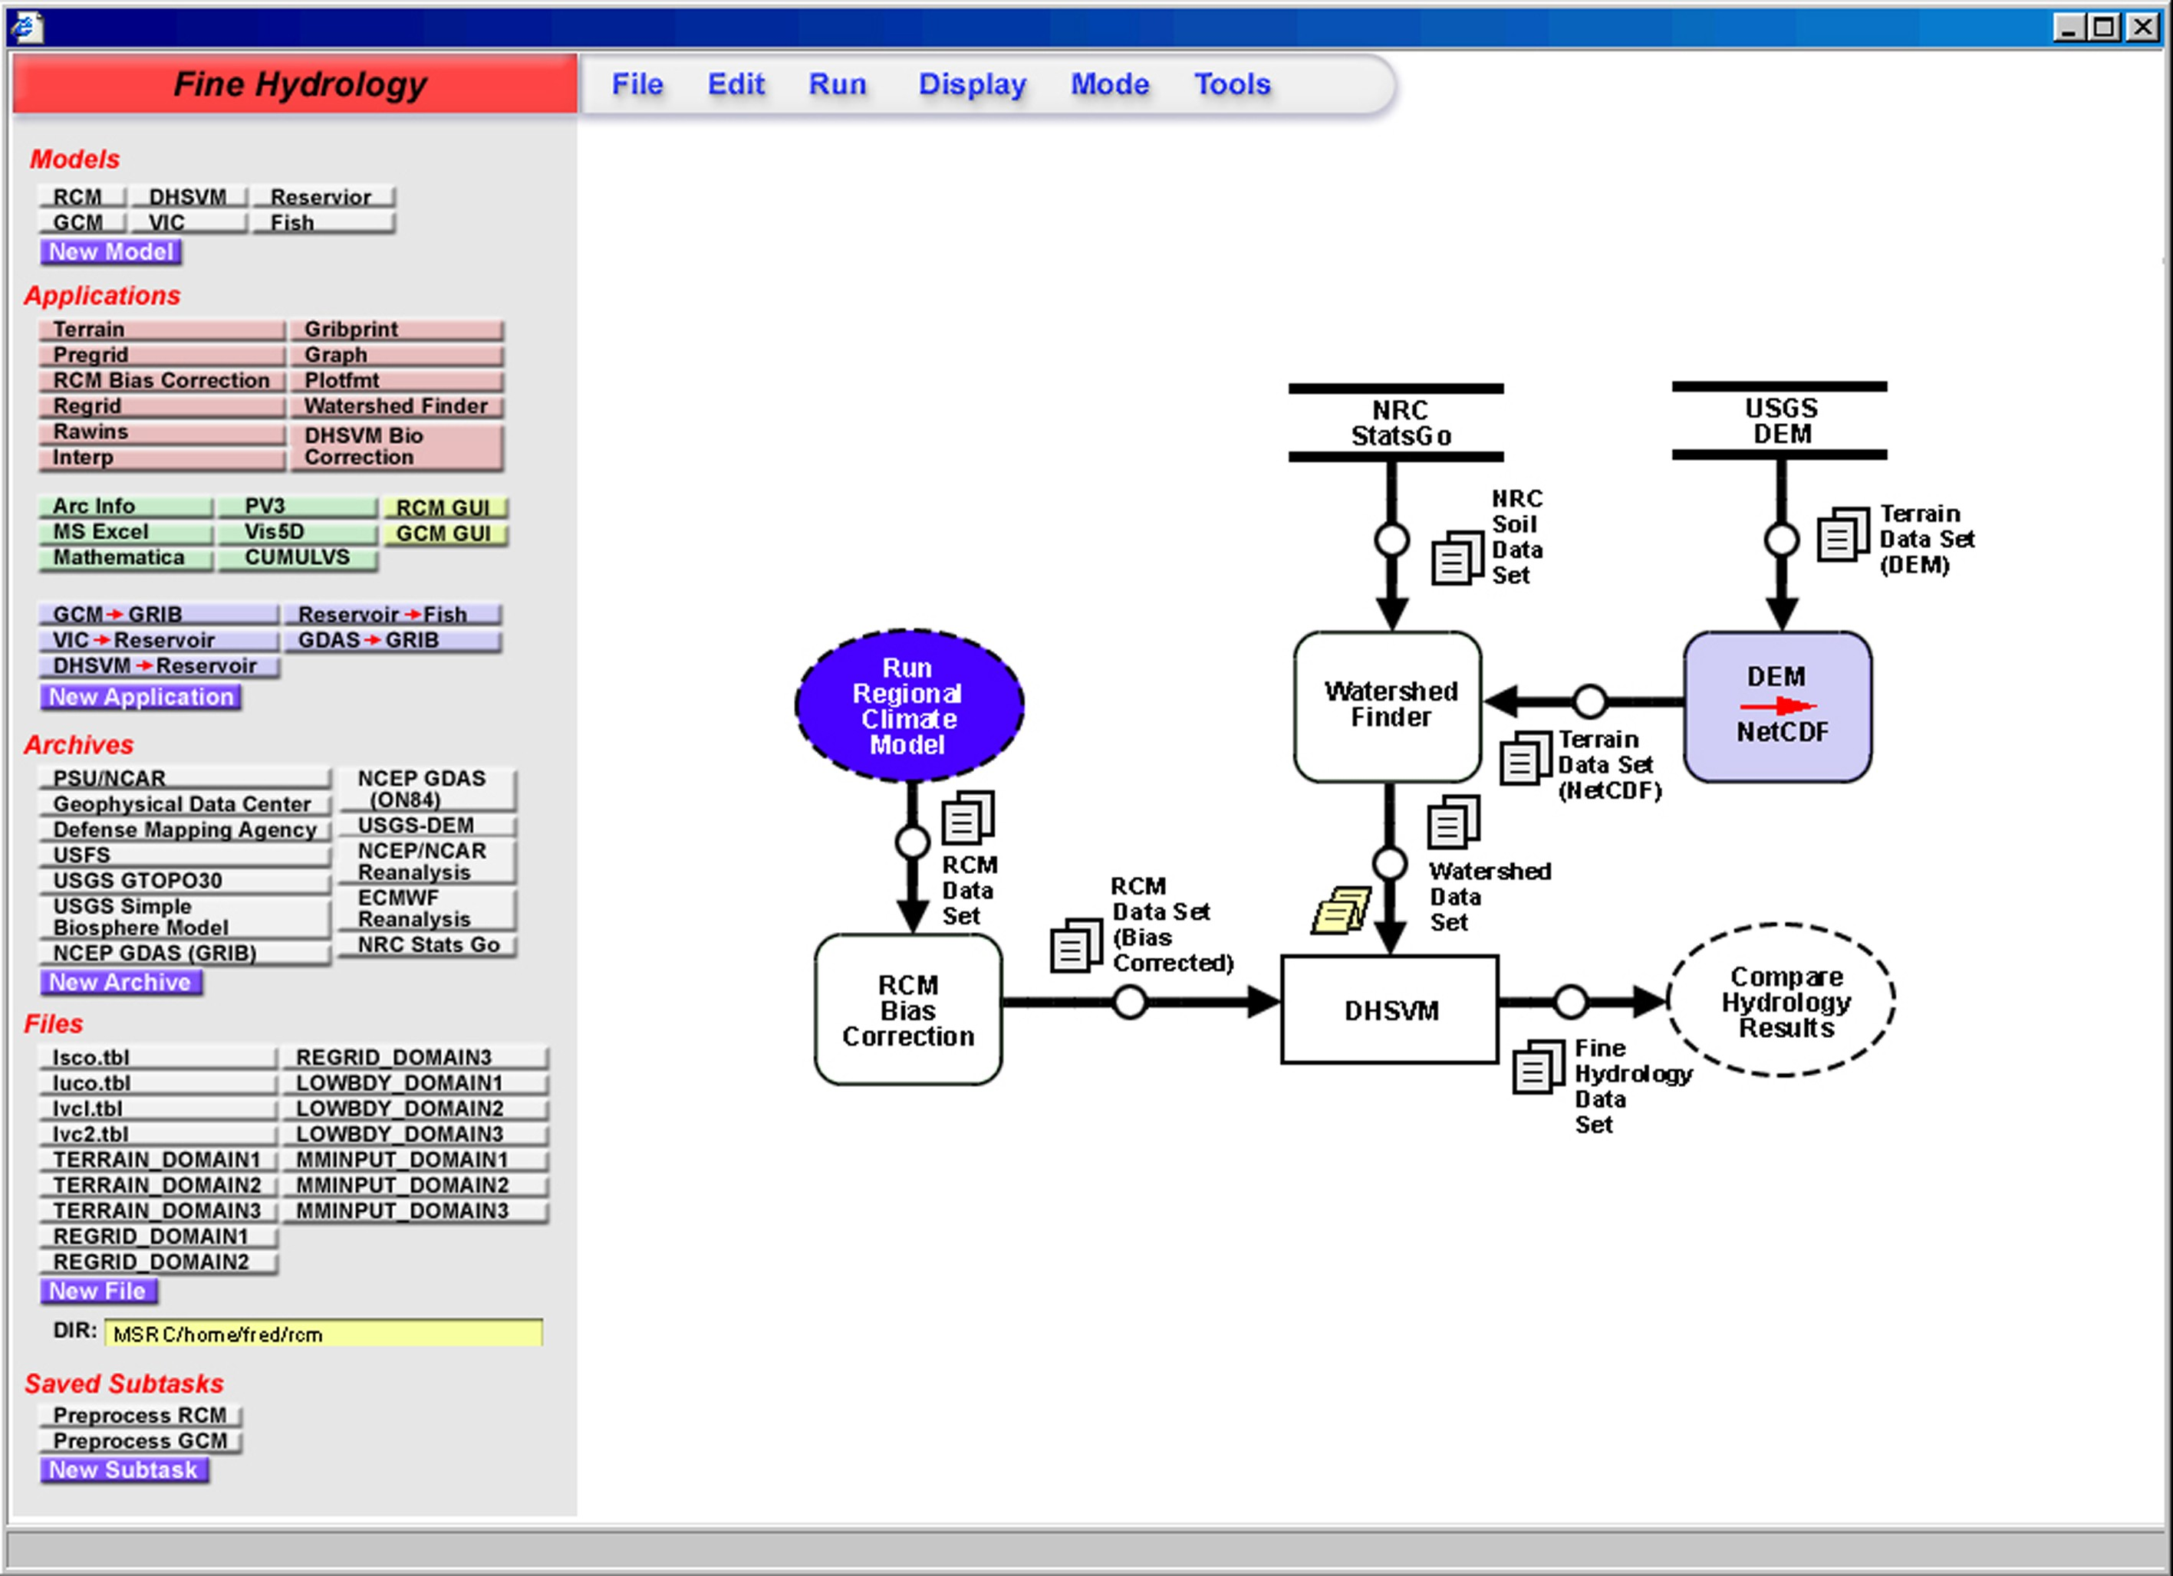
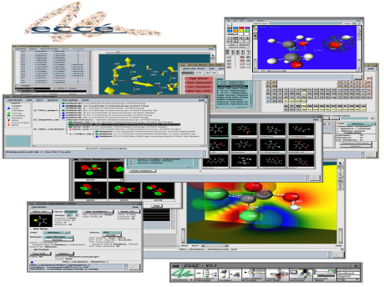
SAM Architecture
Database
Notebook Services
Semantic Services
Web
DAV, DASL, JMS, SAM Extensions
DAV, JDBC, GridFTP
Metadata Services
DataGrid

Slide 9
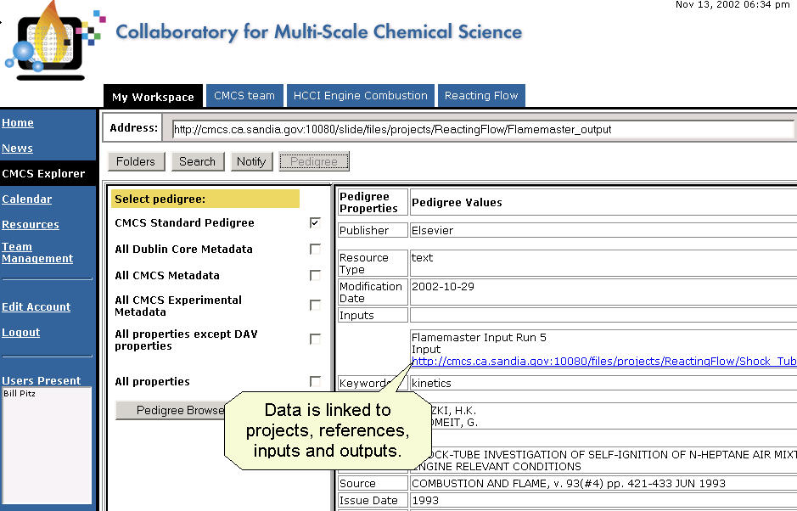

SAM Metadata Services Layer
Jakarta Slide DAV server plus configurable:
  Property Generation from binary/ASCII/XML files
  Resource Translation
  Mapping to Data Store(s)
  JMS Events for access and changes
  Authentication/Authorization model
DAV+
Fortran
Application
SAM
DAV
‘Local
Disk’
JMS
DataGrid

Slide 10
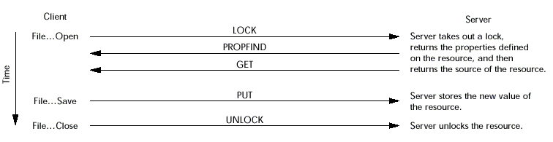
Distributed Authoring and Versioning (DAV)
An early web service
Put/Get data with arbitrary properties (dynamic)
Properties can be discovered and accessed independently
DASL, Versioning, Transactions, …

Slide 11
Example
Binary → XML → Properties
Translation of Chemistry Data
SAM-based Electronic Notebook
CMCS Portal/Pedigree Browser
DAV+
Fortran
Application
SAM
DAV
‘Local
Disk’
JMS
DataGrid

Slide 12
Federating Stores
(assign Java classes as providing storage – stores can access databases, files, Grid…)
<definition>
<store name="jdbc">
<nodestore classname="slidestore.reference.JDBCDescriptorsStore">
<parameter name="driver">org.hsqldb.jdbcDriver</parameter>
<parameter name="url">jdbc:hsqldb:${store.base}/slidestructure</parameter>
<parameter name="user">sa</parameter>
<parameter name="password"></parameter>
</nodestore>
<securitystore>
<reference store="nodestore" />
</securitystore>
<lockstore>
<reference store="nodestore" />
</lockstore>
<revisiondescriptorsstore>
<reference store="nodestore" />
</revisiondescriptorsstore>
<revisiondescriptorstore>
<reference store="nodestore" />
</revisiondescriptorstore>
<contentstore classname="slidestore.reference.FileContentStore">
<parameter name="rootpath">${store.base}</parameter>
<parameter name="version">true</parameter>
<parameter name="resetBeforeStarting">false</parameter>
</contentstore>
</store>
<scope match="/" store="jdbc" />
</definition>

Slide 13
XML Store Definition
Define Properties
<property>
<name>referencetype</name>
<namespace>http://purl.oclc.org/NET/cmcs/exp/schema/</namespace>
<dbField>"NIST_referencetype"</dbField>
</property>
<property>
<name>nist_reaction_url</name>
<namespace>http://purl.oclc.org/NET/cmcs/exp/schema/</namespace>
<dbField>"NIST_reactions"</dbField>
</property>
…
</NODE>
Define Content
<NODE name ="references">
<RESULTSET
collectionCount="20"
maxCount = "500"
collection="true"
driver="org.postgresql.Driver"
db="jdbc:postgresql://kinetics.nist.gov:5432/ktdb"
user="ktdbuser"
password="ktdata"
properties="referenceProperties">
SELECT squib,
reftyp,
authors,
title,
journal,
volume,
edition,
supplement,
page_start,
page_end,
orig_page,
year,
book_title,
editor,
publisher,
address,
comment
FROM biblio
</RESULTSET>
</NODE>

Slide 14
Extensible Scientific Interchange Language (XSIL) /
Binary Format Description (BFD) language
XSIL (Roy Williams, CalTech) - XML Encoding and Java code for scientific data
  Ints, floats, vectors, arrays, time series, …
  Can describe the byte structure of external data files/streams (encoding, byte order,…)
  Can have link(s) to external data
BFD (Alan Chappell, Jim Myers, PNNL) XML Encoding and Java code for describing binary/ascii files
  Bug fixes, removed ambiguities
  Parameterized logic (if, while, for…)
  Parameterized Stream interface
Being used as input for Grid Forum Data Format description Language (DFDL) standard
<XSIL>
<Param Name="date" Type="String" />
<Param Name="Program Version" Type="float" />
<Param Name="numColumns" Type="int" />
<Array Name="data" Type="float">
<Dim>
<XBFDvalue-of select
="/XSIL/Param[@Name='numColumns']" />
</Dim>
<Dim>6</Dim>
</Array>
<Stream Encoding="Binary" Type="Remote“
XBFDstreamnumber="0" />
</XSIL>

Slide 15
Dynamic Translation
(discoverable via hastranslations property)
Example from CMCS
<SAM:inputtype>
<DC:format>text/x-xml-reactingflow</DC:format>
<SAM:translation>
<SAM:translatorused xlink:title="FlameMaster Input"
xlink:href="reactingFlow2FlameMaster.xsl" />
<DC:format>text/plain</DC:format>
</SAM:translation>
…
<SAM:translation>
<SAM:translatorused xlink:title="Simple View"
xlink:href="reactingFlow2HTML_no_namespace.xsl" />
<DC:format>text/html</DC:format>
</SAM:translation>
</SAM:inputtype>

Slide 16
SAM Semantic Services Layer
SAM Metadata Layer plus configurable:
  Translation of DAV Properties to RDF Triples
  RDF-based Mapping of Properties
  RDF-based Data Translation
  …
NIST DB
ELN Notes
ELN Notes
Flamemaster Input
ELN Notes
Model Parameters
Datafile 5
PriME Project
Flamemaster v 2.7
Experiment 4
Literature Reference
Model defaults
Website
Community Annotations

Slide 17
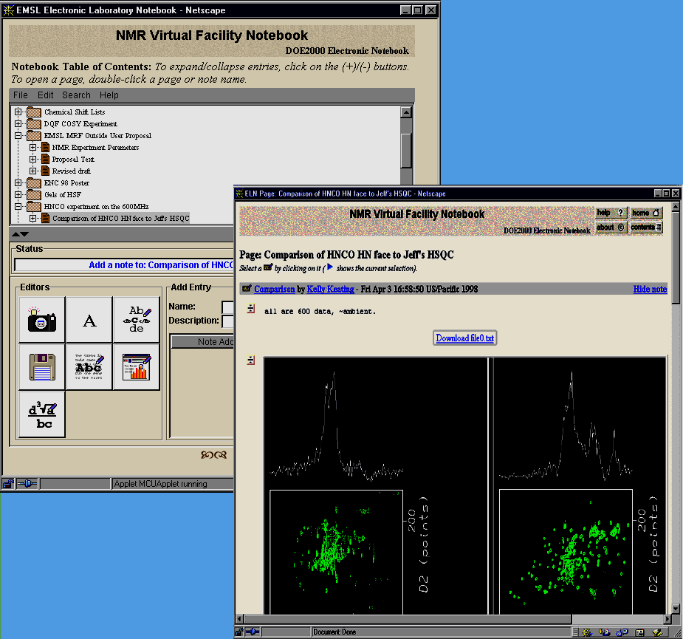
SAM Notebook Services Layer
SAM Metadata and Semantic Layers plus:
  Notebook Management, Page Display, …
  Digital Signatures
  Notarized Timestamps
  Data/Signature Migration Capabilities
  Notebook API, Notebook Components
“DOE2000” ELN 5.0 Client works with SAM-based Server
  Launched via CMCS Portal
  Can reference existing CMCS Data
  Data “in” ELN is available via CMCS Explorer
  ELN shares CMCS Viewers
  ELN “hasELNEntry” relationships can be part of CMCS pedigree

Slide 18
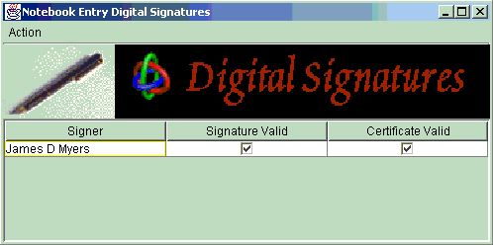
Electronic Laboratory Notebook 5.0
Securable, shared WWW based space
Interactive input of results into notebook
Rich media types (text, images, files, 3D structures, voice, animations, video, ...)
Querying/ Searching
Automation of
  Data/Metadata input from instruments and calculations
  Access to full datasets

Slide 19
Scientific Annotation Middleware – managing evolving metadata
Support multiple perspectives, workflows, goals
  Different users
  Different applications
  Different partial standards
  Common view of data sources
Allow ownership/independence of resources to be maintained
Delay costs until benefits can be realized
Integrating/federating independent producers/consumers of pedigree/annotation information
http://www.scidac.org/SAM/

Slide 20
Can we build Collaboratories that…
Dynamically evolve
Support multiple perspectives, workflows, goals
Support cycling between solo and group work
Span project and community level collaboration
Integrate science and communication
Are assembled/configured versus hand-crafted
Have low maintenance costs
Provide reporting for non-traditional contributions
Minimize up-front costs to users
Integrate versus engulf
Are comprehensive (there’s always one more program to integrate NOW)

Slide 21

Acknowledgments
  Mathematical, Information and Computational Sciences Division of the Office of Science
U.S. Department of Energy
  Mathematical, Information and Computational Sciences Division of the Office of Science
Pacific Northwest National Laboratory
  Pacific Northwest National Laboratory is a multiprogram national laboratory operated by Battelle Memorial Institute for the U.S. Department of Energy under Contract DE-AC06-76RL0 1830

Slide 22

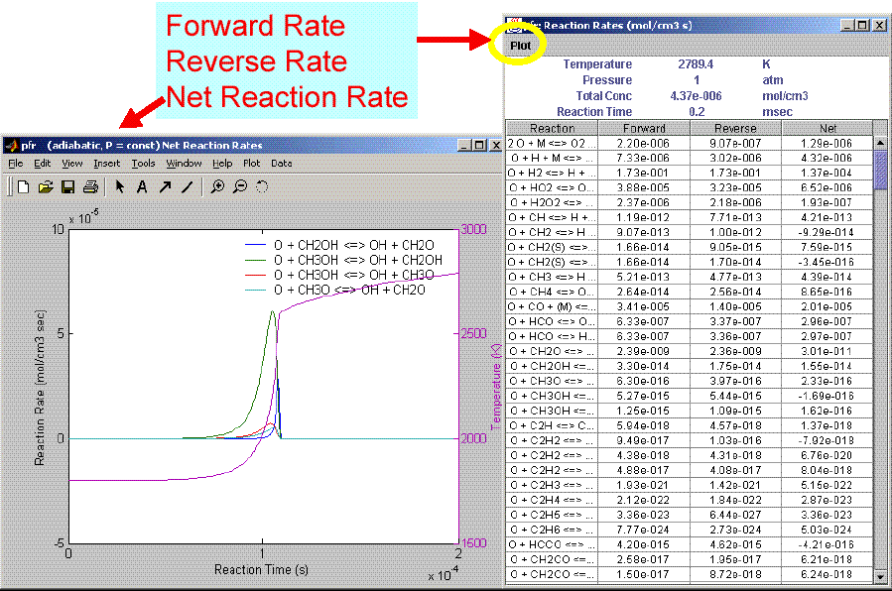
Adaptive Infrastructure Enables Application Integration
Browser,
EMail
REACTIONLAB
launch
ECCE
ELN 5.0
DAV
DAV+SAM NS
MCS Portal
NWCHEM/
GRID RESOURCES
Portlet
API
Portlet
API
Shared Data Repository
Active Table
SAM
Mime-type Assignment
Metadata Extraction
Translation
Pedigree Relationships
SAM
Web service
Fitdat
CMCS/DAV
API
CMCS/DAV
API
Notification
Web service
Notification
API
Notification
API
Grid Fabric
Federation ML
NIST
Kinetics
DB

