Slide 1
Building SDN with OGF NSI and OpenFlow
Takahiro Miyamoto
KDDI R&D Laboratories Inc.

Slide 2
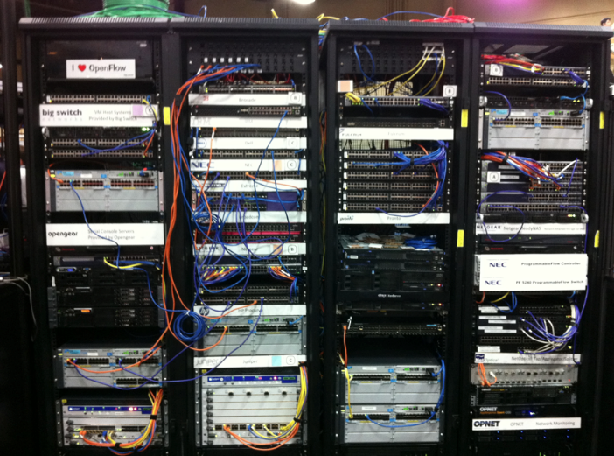
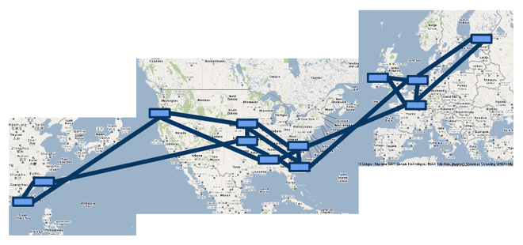
Software Defined Network
Software Defined Network (SDN) will be applied to various network.
Local-area (datacenter) network
Global-wide network
Most use cases target network operators who own physical network.
In my talk, I focus on virtual network over multiple networks.

Slide 3
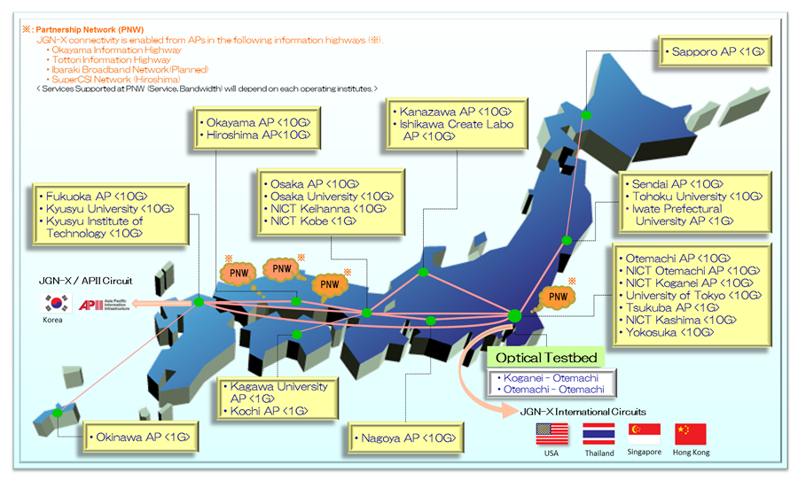
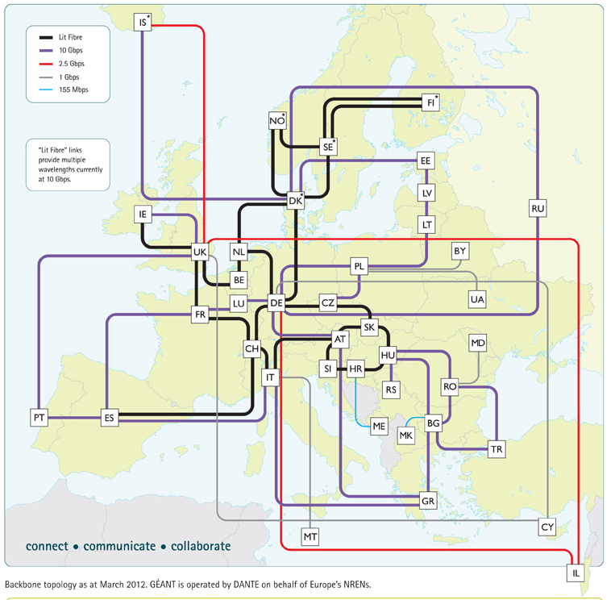


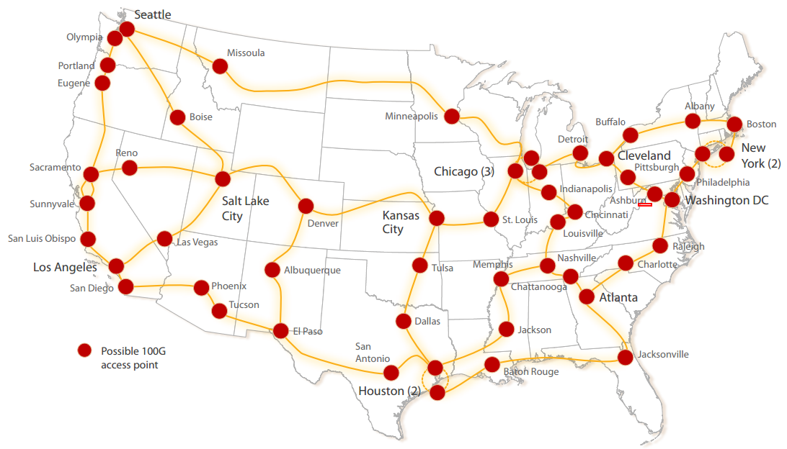

SDN over multiple networks

Slide 4
SDN over multiple networks
How to create virtual (overlay) network topology?

Slide 5
SDN over multiple networks
SDN over multiple networks should be built with two steps.
Create network skeleton.
Node
Link
Control network behavior.
➔ OGF Network Service Interface
➔ OpenFlow
Link
Network skeleton
Software defined network
Node

Slide 6
OGF Network Service Interface (NSI)
NSI is designed to allow Grid, Cloud and other applications to mange network connectivity.
NSI also supports provider-to-provider circuit request.
NSI provides a framework for multiple services:
Connection service
Topology exchange service

Slide 7
ConnectionService (NSI-CS)
Create point-to-point connections.
Support advanced reservation and immediate provisioning.
NSI-CS is promising service to create “Link” for network skeleton.

Slide 8
SwitchingService (NSI-SS)
Be a new NSI service to realize multipoint network.
Not a part of NSI yet.
Introduce a new endpoint called Switching Point (SP).
SwitchingService (SS)
create/delete SwitchingPoint
SP
ConnectionService (CS)
Connect between STPs
STP
STP
SDP

Slide 9
OpenFlow switch on NSI-SS
SP is virtual OpenFlow switch.
SP is created via NSI-SS.
IP address of virtual OpenFlow switch is returned via NSI-SS.
OpenFlow controller connects to the virtual OpenFlow switch.
SP
STP_b
STP_a
STP_c
OpenFlow controller
urn:ogf:network:example.com:2012:stp_a ➔ port 1
urn:ogf:network:example.com:2012:stp_b ➔ port 2
urn:ogf:network:example.com:2012:stp_c ➔ port 3
NSI-SS is promising service to create “Node” for network skeleton.

Slide 10
Building SDN with OGF NSI and OpenFlow
1. Create network skeleton with NSI-CS and NSI-SS.
2. Control network behavior with OpenFlow.
OpenFlow controller
Korea
Japan
US
EU
Hong Kong

Slide 11
Conclusion
SDN requires two network definitions.
Network skeleton
Transfer behavior ➔ OpenFlow
OGF NSI is suitable to define network skeleton.
ConnectionService = Link
SwitchingService = Node
OGF NSI is essential technology in global-wide SDN era.

