Slide 1
Security using ACLs
Raju Shah
raju@force10networks.com

Slide 2
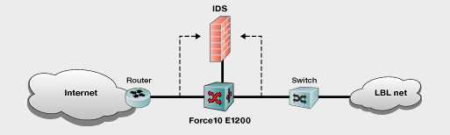
LBL - Security application
IDS monitors the traffic on both sides of the E1200 switch/router
Installs a filter in the E1200 as soon as threat is detected to block offending traffic
Monitors the ACL – remove if not used
What was important
  Deployment speed of the rule
  Scale
  Ensure no holes created while rule is being applied or removed from hardware
  Traffic for other ports or ACL rules is unaffected
  Automated way of inserting, monitoring and removing of rules
http://www.force10networks.com/applications/profiles-lblids.asp

Slide 3






GRID - Security application suggestion
MANAGEMENT APP /
AUTHENTICATION
M
STORAGE
USER
B
S
USER
G
A
Grid
Outside
Inside
5 permit any to M
10 permit A to G
15 permit B to G
500 deny all
5 Permit G to A
10 permit G to B
15 permit G to S
500 deny all
User A submits a request for use of Grid services G by using application M
Management App does the verification and authentication, and grants access by:
  Install ACL rule 10 on the outside interface, permitting A to send traffic to G
  Install ACL rule 5 on the inside interface, permitting G to send results back to A
User B requests services which may require access to their stored data S
  Install ACL rule 15 on the outside interface
  Install ACL rule 10 on the inside interface
  Install ACL rule 15 on the inside interface to allow G access to stored data

Slide 4
GRID - Security application suggestion
MANAGEMENT APP /
AUTHENTICATION
M
STORAGE
USER
B
S
USER
G
A
ROUTER
Grid
Outside
Inside
5 permit any to M
10 permit A to G
15 permit B to G
500 deny all
5 Permit G to A
10 permit G to B
15 permit G to S
500 deny all
What’s Important:
  Only allow valid users access to the Grid
  No impact to existing traffic when new rules are applied
  No leaks when rules are added or deleted
  Speed, important, but not critical
  Scaling the number of rules
What can intelligent middleware do?
  Fine grain control, ie only allow specific protocol/port numbers
  Only allow cluster nodes G10 thru G50 for user B access to Storage node Sb
  Keep track of packet and byte counts for possible accounting/billing purposes
  . . . . . .

Slide 5
Thank You

