Slide 1
SensorNet: Wide-Area Infrastructure for Interoperable Sensor Networks
- Info-D Use Cases
Mallikarjun Shankar, Ph.D.
Computational Science and Engineering Division
Oak Ridge National Laboratory shankarm@ornl.gov

Slide 2
Outline
SensorNet Goals
  Standards
  Typical deployments
Operational Prototypes
  Node device
  Infrastructure
Data-Sharing/Dissemination Scenarios

Slide 3
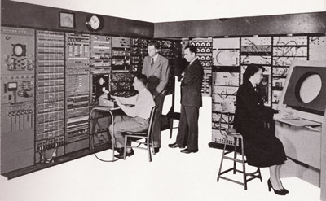
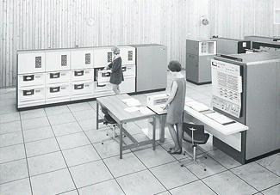
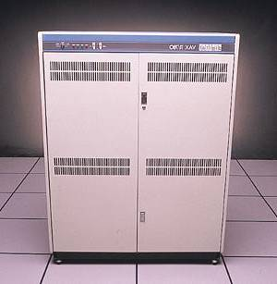
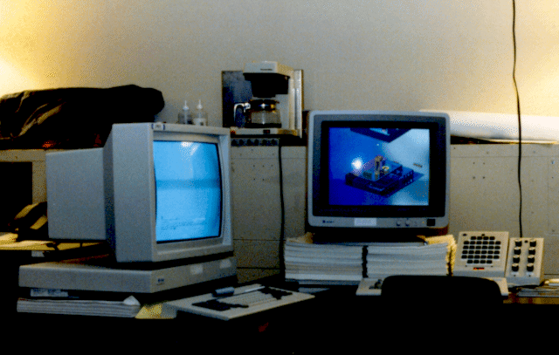
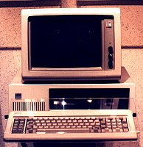
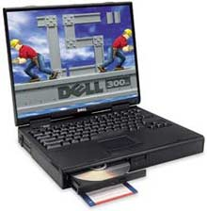
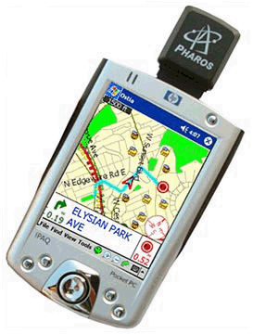
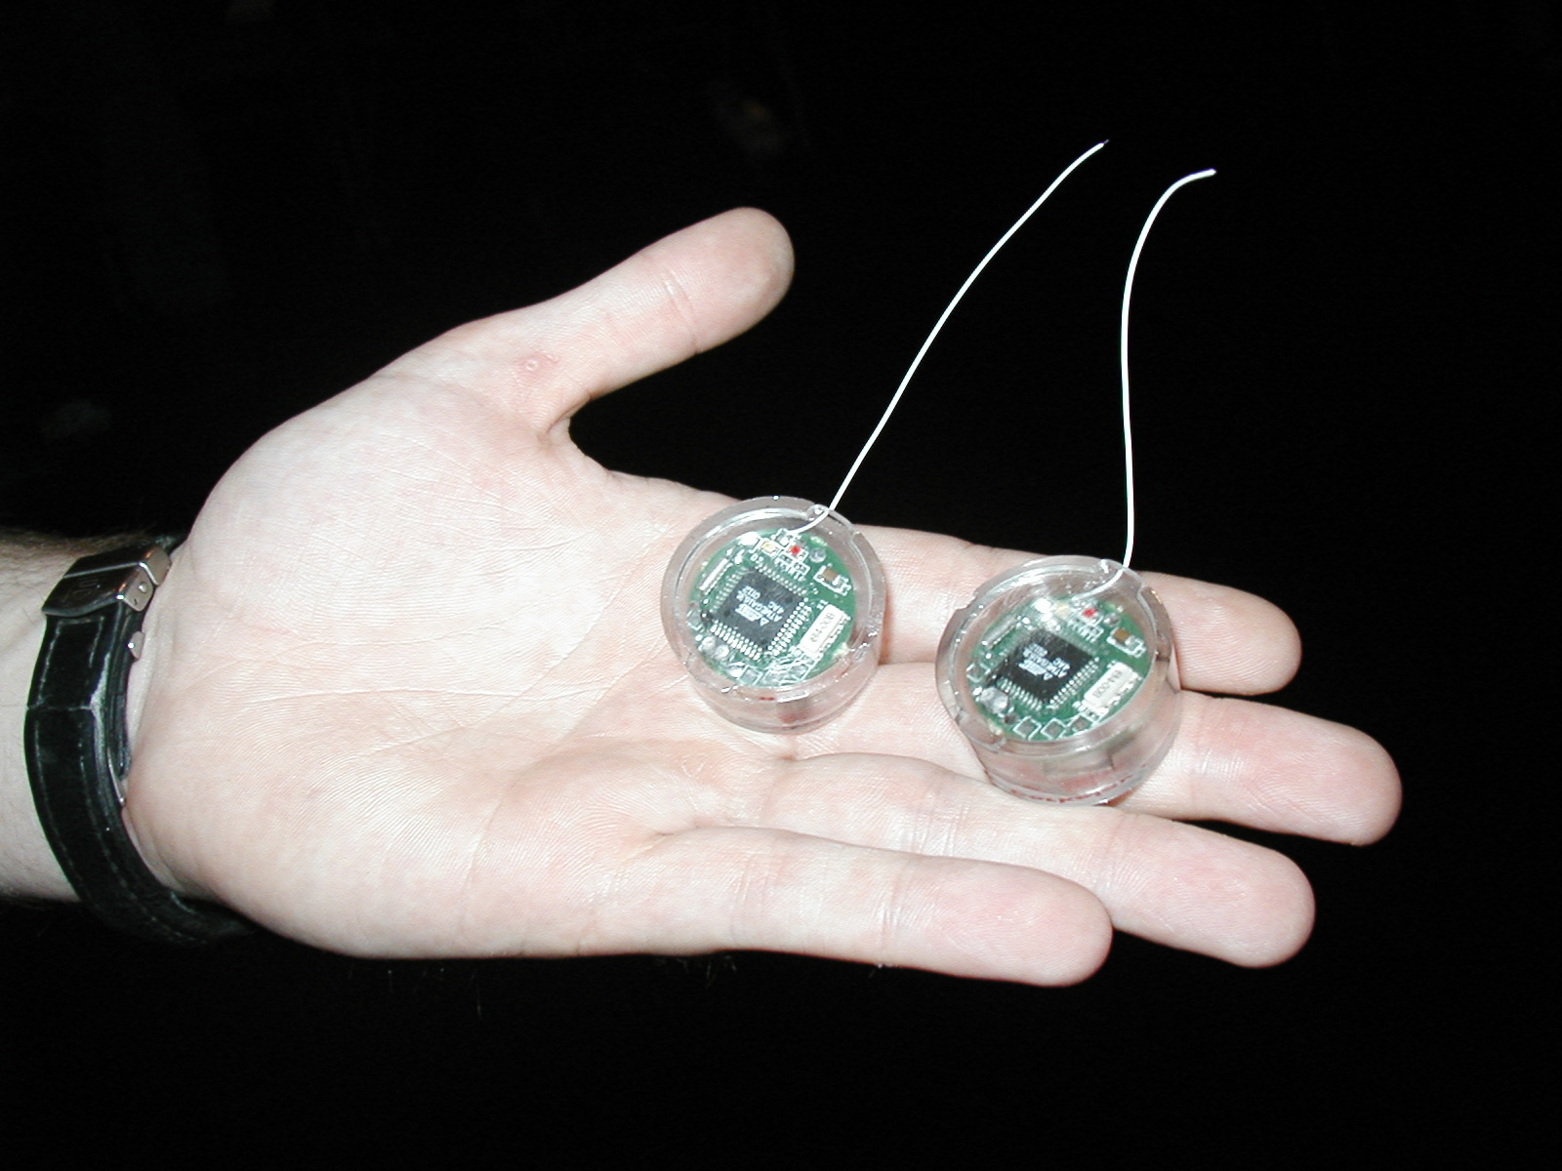
Proliferation of IT revolution: Bell’s Law
number Crunching
data Storage
Log (people per computer)
productivity
interactive
1
streaming
information
to/from physical
world
Year
1980
Adapted from D. Culler 2004

Slide 4

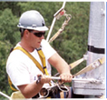
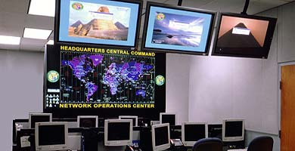
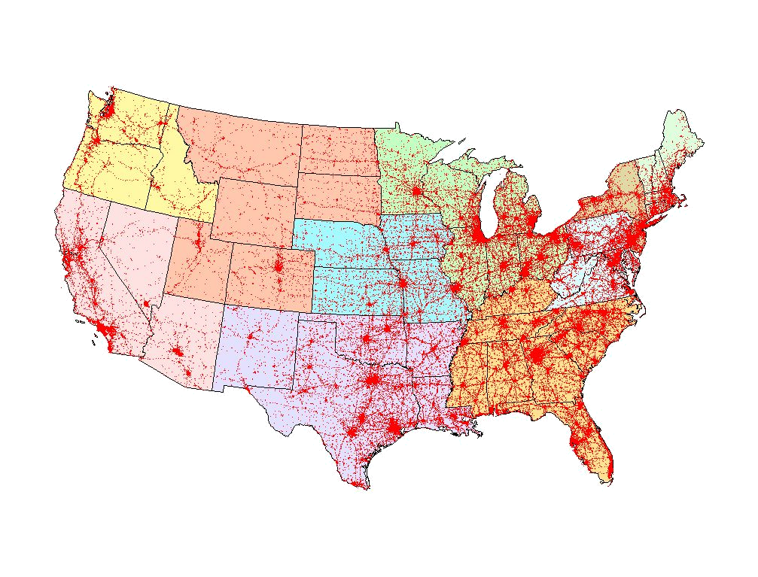

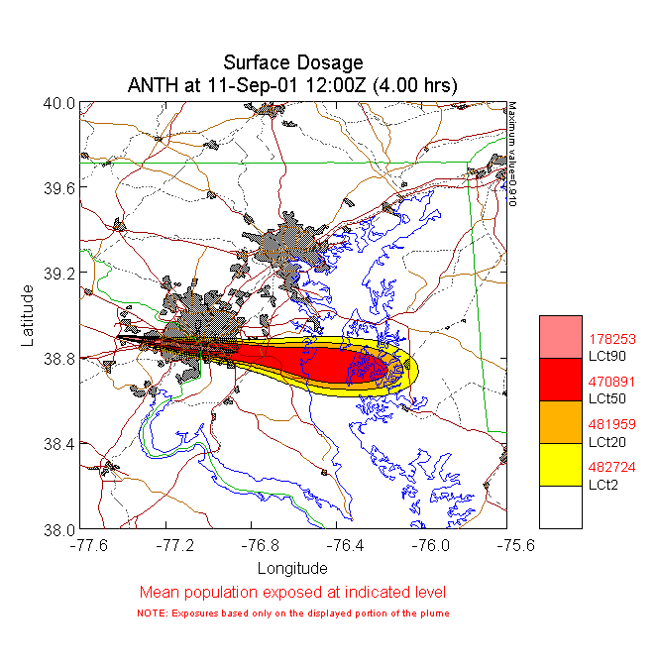
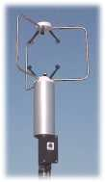
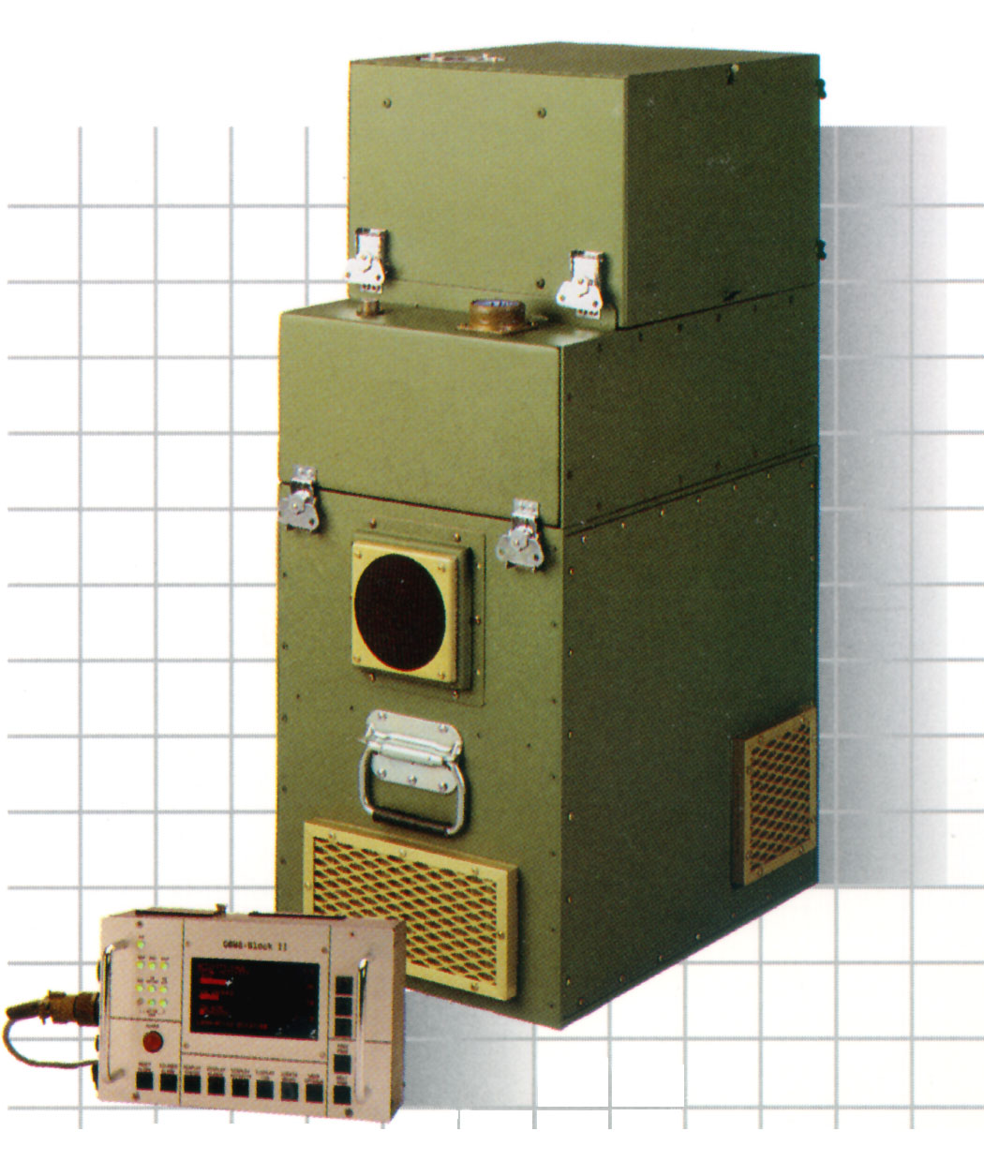
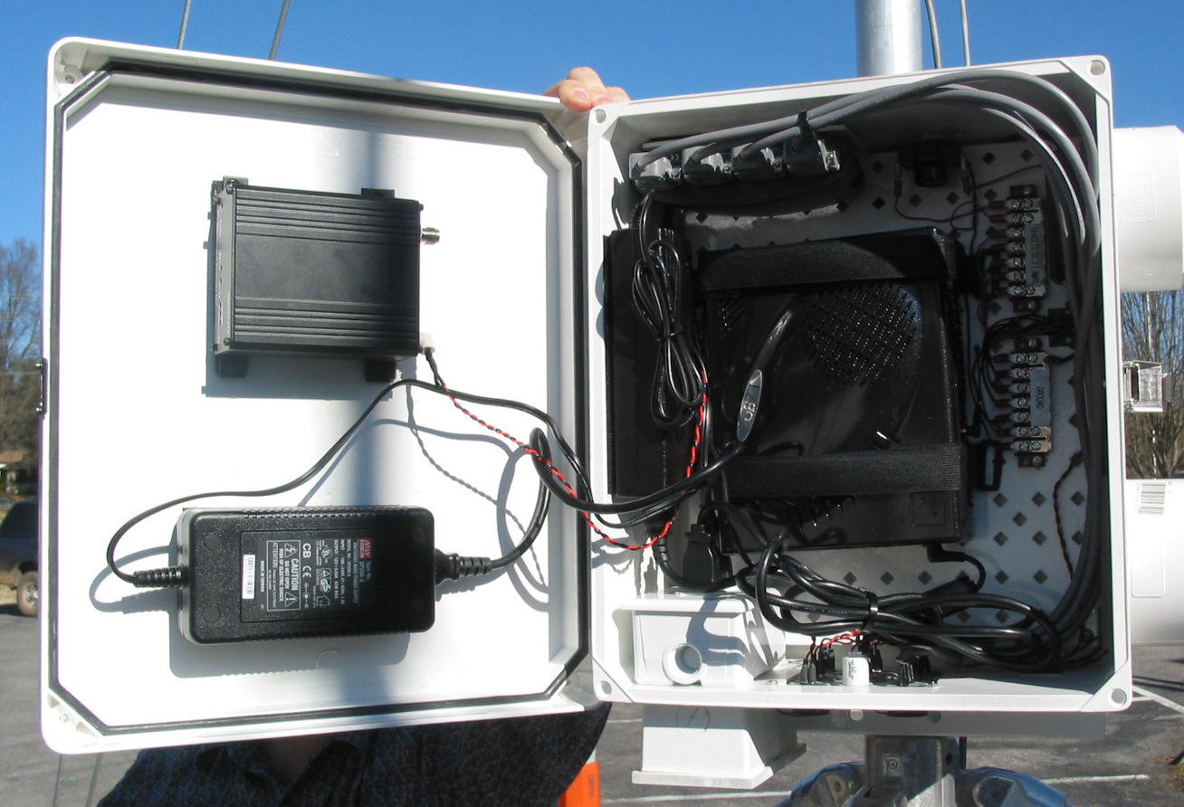
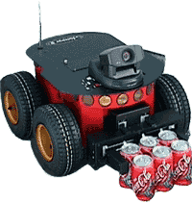
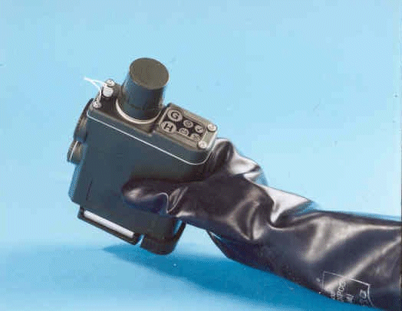
SensorNet Goals
To catch big fish you need a big net – Ancient Proverb
Distributed Operations
Centers
Automated Hazards
Analysis
First Responders
Strategic Sites
Sensor Systems
Control and Enhanced Communications
Ubiquitous Sensing for Protection and Utility

Slide 5
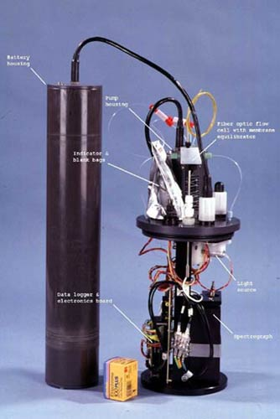
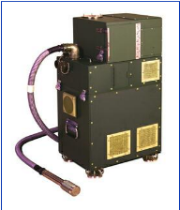

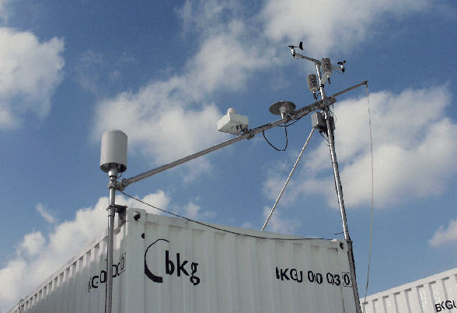
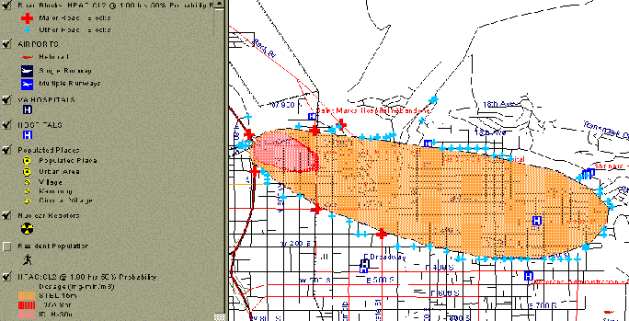
Data-Sharing through a Standards based Framework
Many Sensors
Many Applications
Net-Centric
Enterprise
Services/ Global Information Grid
Open
Geo-
spatial
Services
(OGC’s
Web
Feature
Services)
IEEE
1451
&
TEDS
Command-and-Control
Field and End-User
Support
Pervasive,
Securable,
Scalable,
Interoperable
and Reliable
Plug
and Play
Open and
Extensible
Non-Proprietary
Analysis, Modeling, and Prediction

Slide 6
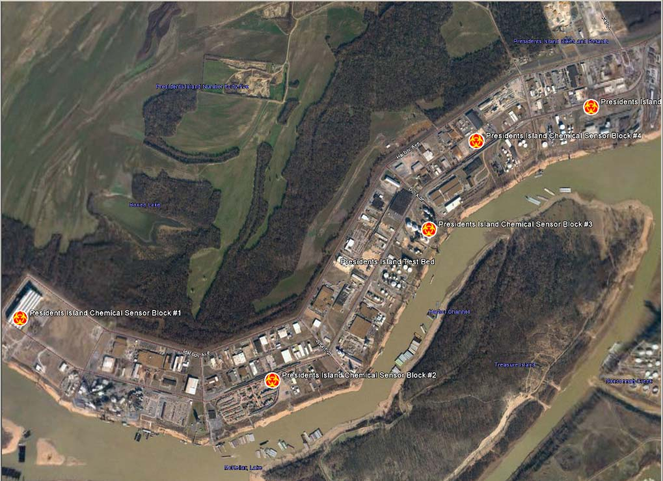
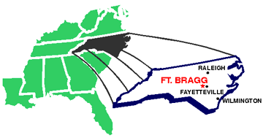
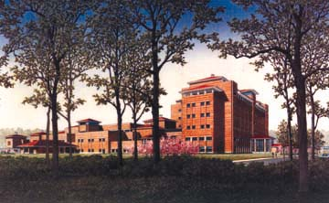
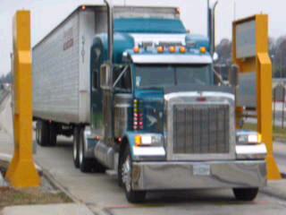
Sample Deployments
Wireline+Powered Deployments
Pre-defined Analysis
Integrating Multiple Sources of Data
Notes:
Powered deployments.
Not layer 1 and 2, but layer 3-4 and above.
Class of sensors determine the kind of sensor net you want..
Integrating data from multiple sources
Thus dispelling the myth of traffic..

Slide 7
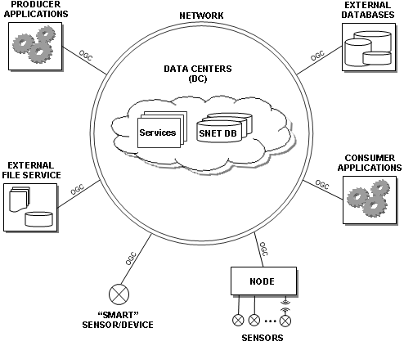
Information-Sharing Clouds
Notes:
Big concern is information sharing in systematic ways..
User community wants a variety of sensors, share the data, develop frameworks to make things
interoperate. If we show how relevant science/algorithms integrate with the deliverable, that is always
a win.

Slide 8
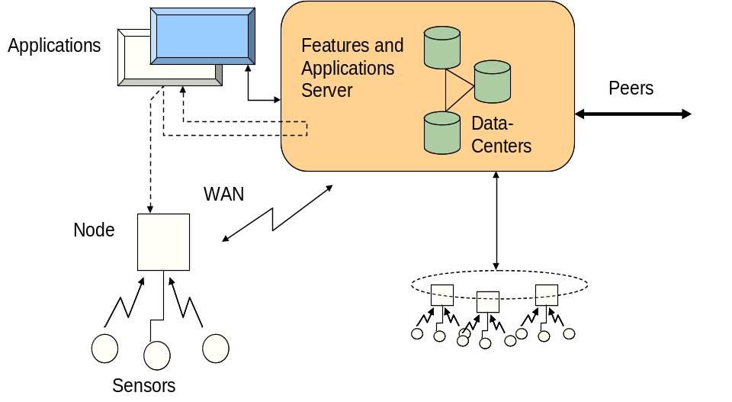
SensorNet Node
Edge of SensorNet (< few thousand feet control)
Sensor Agnostic
  Serial cable, Ethernet, Wireless
  IEEE 1451
Connectivity with SensorNet
  Interaction with Regional Data Center (RDC)
  Basic Services (Open Geospatial Consortium, etc.)
Notes:
Where is the first site of interoperability..
The last mile device.. in our design, called the Node
Layered scheme.. this is the analog of the gateway..

Slide 9
SensorNet Node
Services are available to Regional Data Centers as well as external users
Config
Data Store
(Web) Server
  Control
  Auth
  Data Services
“last-mile” link on CDMA, Ethernet, Wireless LANS, MANS, Satellite, etc.
Legacy Codes
E.g., Sprint Session
USB Mux.
TEDS
1451.1 NCAP
STIM
Other
…
1451.X Stubs
n
Sensors Wrapper
Comm. Mode Control
Mounted Node with satellite and CDMA connections:
Wireline
Wireless
Sensors: CBRNE + Weather + Image + ...
Notes:
Sharing signals – wide-area cdma works ok
Powered links
Sensors are legacy
There are others – ORACLE edge server talking about RFID’s, commercial companies in this space..

Slide 10
Networked Deployment Scenario
Sensor Data Alternate Pathways
Open Application and Model Access
Data Brokers
Sensors + Location and Connectivity
Plant, Region, or Urban Area
Data Features
Data Center and Services
Mobile Node
First Responders
Netcentric: Peer-to-Peer Autonomous Decision Making Capability
Remote and Field Sensors

Slide 11
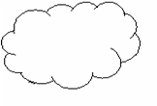
A Sample Architectural View
User
User
Application to Data-Store
Node to Data Center
Apps
Apps
Portals
Data
Sets
Data
Sets
Collectors/Receivers
S
S
S
Node
Node
S
S
S
S
S
S
Node
Node
S
S
S
Diagram Courtesy: G. Minden, 2003
Notes:
Node up to next level (collector neq push to pull)

Slide 12
Data-Sharing Services
<Subscription>
Anomaly?
  Filter:
    GeoLocation
    TimeWindow
  Type:
  TrafficData
</Subscription>
publication
Services
<snet:TrafficData>
  <snet:TrafficSpike>
    <gml:location>
    </gml:location>
    <snet:description>
    - --- --- ---
    </snet:description>
  </snet:TrafficSpike>
</snet:TrafficData>
SensorNet and External Sources
subscription
Services Directory
Ontology and Normalization
Notes:
First need to extract
Shared vocabulary/ontology – Take Alex’s slides
(Ubiq needs this, we all need it..)

Slide 13
Application Context: SensorNet Data Considerations
Data Sharing
  Naming
  Representation/Storage
Data Management
  Placement/Extraction
  Filtering/Caching
Security
  Auth/Access
  Zones
Notes:
Say this is a spatial + temporal + information space problem
Extraction includes placement..

Slide 14
Scenario A (Initiation/Startup)
Field installation of sensor. Sensor starts collecting and submitting data
Sensor data aggregated at a local node which makes it available to (i) local data center and to (ii) applications that access the node.
Node sends sensor data periodically to local data-center.

Slide 15
Scenario B (Steady State)
Sensor to Data-Center
  Periodic data from Node arrives at Data-Center
  Periodic data from Local Data Center exchanged with peer or higher-level (Regional) Data Center
Data-Center to Data-Center and Application to Data-Center
  Periodic polling requests for data-subset (spatio-temporal bounding box)

Slide 16
Scenario C – Alert Event
Alert event takes place and Alert Message is sent from Node to Local-Data Center
Local Data Center sends Alert to all subscribers of alert message types

Slide 17
Use Cases: Startup and Data-Read
Case 1. User Installer sets up field sensor and expects data to appear in data-base for application (Scenario A and B)
Case 2. User at operations center expresses interest in certain sensor data.
  Scenario B and C
(Stop reading is symmetric in reverse)

Slide 18
Use Case: Alert Configuration
User sets up alert threshold for sensor levels in a spatio-temporal window.
  Language as well as specific implementation TBD, currently WNS and SAS
Alerts get published to subscribers to the alert service

Slide 19
Requirements
R0 | Subscribers select publishers | Applications and Peer-Data Centers select Data Centers (spatio-temporally, with sensor types)
R1 | Subscribers select messages | Data-center selects particular sensor Type/Location/Time-window
R2 | Publishers select consumers | Sensors pre-configured to destination
R3 | Publishers/subscribers use vocab to select messages | Standardized format for message transfer. Message types are raw data from software/hardware agents/sensors.
R4 | Subscribers specify messages published | Not clear -- Selection of data-sources automatically selects messages published here.
R5 | Subscribers define event by querying data src | Event-listener subscribes for the interesting event from the sensor alerting service.
R6 | Subscribers correlate events to form composites | N/A. Because this is application internal or service internal.
R7 | Consumers specify dynamically how/when msgs received | Some alert requests are specified at higher priority.
R8 | Consumers limit messages received
R9 | Consumers retrieve past messages | Historical search from applications to Data-Centers and Nodes.
R10 | Pubs/Subs/Consumers define QoS | Requests must meet performance metrics (Outside Info-D?)
R11 | Pubs/Subs/Consumers have Identity Managmt | Access control. And authorization accompanies all requests.
R12 | Filters composable | Query request must allow fairly sophisticated query syntax.

Slide 20
Use Cases
User/operator
Common operational picture (COP) application
Hazard and effects model
Node sensor data update
Others?

Slide 21
User/Operator Use Cases
User views SensorNet assets in a geographic region
User views data associated with a SensorNet asset
User manipulates overlays

Slide 22
User/Operator Use Cases
User views SensorNet assets in a geographic region
  User navigates the common operational picture (COP) viewer to a region of interest
  Appearing on the map display are icons representing assets known to SensorNet. If the scale is such that Nodes in an area cannot be shown individually, an icon representing a group of nodes is displayed.
  The standard icons indicate the type of assets available at a Node or location and which of those assets are active or online. Alert state assets will be indicated by color (red) and other visual means, such as blinking the icon.
  A list of overlays and themes applicable to the current geographic region and the present time to a user-defined look-ahead is provided. By default, all overlays are visible.
  User zooms the display in or out
  This results in a refresh of the icons representing SensorNet assets to match the new scale.
  User clicks on an icon
  The display zooms to the bounding box of the Node(s) represented by the icon, and the COP is refreshed accordingly.

Slide 23
User/Operator Use Cases
User views data associated with a SensorNet asset
  User clicks on an icon representing a Node or asset
  A Node display page is brought up in a viewer. The page reports the current status and latest readings from all assets at the Node. For camera assets, the latest frame is displayed.
  User selects an individual asset on the page
  An asset display page is produced in a viewer giving the recent history of readings in textual and/or graphic form for the selected asset. For cameras, the result is a streaming video page if available.
  User right-clicks on an icon
  A popup menu with items for each asset at the Node and any supplemental information or functions is displayed. Selecting a menu item results in the asset display page as described above.

Slide 24
User/Operator Use Cases
User manipulates overlays
  User selects overlays and themes to toggle their display on the COP
  Display of selected overlays is toggled on and off.

Slide 25
User Subscribes to Events
Get all events
Limit by geographical region
Limit by event type
Limit by sensor and user defined criteria

Slide 26
COP Application Use Cases
(Includes a Web application)
Application initializes
Application updates
Application terminates

Slide 27
COP Application Use Cases
Application initializes
  Application obtains the list of service URLs for the region
  Application sends a RegisterForEventNotification message to register interest in all sensor-related alerts or events
  The application instance’s request is stored by the notification service.
  Application sends GetAssets (registry [WRS] request?) and GetFeatures messages specifying the geographic region, time, and look-ahead time
  The service responds with a document containing descriptions of Nodes and their assets including references to URLs for Node and asset pages as well as popup menu items and the like. Overlays are also displayed.
  Application displays the assets and other data
  SCS DescribeSensor for SensorML on individual sensors

Slide 28
COP Application Use Cases
Application updates
  Either a configuration-defined timeout since the last update expires or the user changes the geographic region (e.g., zoom or pan) and/or the look-ahead time.
  Application sends GetAssets and GetFeatures messages specifying the geographic region, time, and look-ahead time
  The service responds with a document containing descriptions of Nodes and their assets including references to URLs for Node and asset pages as well as popup menu items and the like. Overlays are also displayed.
  Application displays the assets and other data

Slide 29
COP Application Use Cases
Application updates
  Application receives an event
  Application sends GetAssets and GetFeatures messages specifying the geographic region, time, and look-ahead time
  The service responds with a document containing descriptions of Nodes and their assets including references to URLs for Node and asset pages as well as popup menu items and the like. Overlays are also displayed.
  Application displays the assets and other data

Slide 30
COP Application Use Cases
Application terminates
  Application sends an UnregisterForEventNotification message
  The notification service removes the application’s registraion.

Slide 31
Hazard and Effects Model Use Cases
Model initializes
Model receives alert notification
Model terminates

Slide 32
Hazard and Effects Model Use Cases
Model receives alert notification
  Model not currently activated:
    Model examines the alert message to determine the source term type. The time of the message becomes the base time for the model scenario.
    Model sends a GetAssets message specifying a region around the alert location to obtain descriptions of assets
    Model sends GetAssetData and GetAssetHistory messages to retrieve data applicable for building source term and weather inputs.
    Model begins the transport and dispersion calculation.
  Model currently activated:
    Model stores the information in the alert message to refine the source term at the next calculation time step, or if the alert occurs sufficiently distant from the current scenario, a new model instance is launched for a new scenario.

Slide 33
Hazard and Effects Model Use Cases
Model receives alert notification (cont’d)
  Model completes a time step
    Based on the type of source term, the model computes one or more human effects results. The calculation is resumed.
  If output data for the simulation time step exist for a previous iteration, they are removed via a UpdateModelData message (keep previous data).
  The new results are stored via an InsertModelData message.

Slide 34
Node Sensor Data Update Use Cases
Node loses sensors/assets
  Node sends a RemoveAssets message
  The message identifies sensors or assets no longer available at the node.
Node updates
  Node sends an UpdateAssetData message
  Data for some collection of sensors and/or assets at the Node are provided in an update message to the RDC service. Most likely, these updates will occur according to some established update cycle.
Node alerts
  Node sends an alert Event message
  This published event is propogated to all clients whose registered interest matches the event

Slide 35
Summary
Sensor networks for protection and utility built on a mixed hierarchical and peering-based architecture
Middleware requires systematic data-sharing and interoperability over the wide-area
http://www.sensornet.gov
Notes:
prototyping experiences
wider –adoption – killer APP

Slide 36
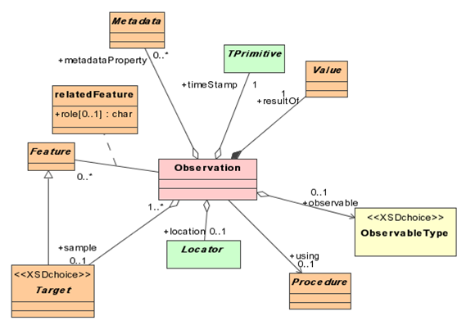
System Middlewares: OGC, Grid, ..., CORBA, ...
<ows:ObservedValue>
<ows:observable>
<ows:ParameterisedObservable gml:id=“TMband1">
<ows:baseObservable xlink:href="#radiance"/>
<ows:parameter>
<ows:TypedValue>
<ows:axis xlink:href="#wavelength"/>
<ows:value>
<gml:ValueExtent>
<gml:low><gml:Quantity uom="#um">0.45</gml:Quantity></gml:low>
<gml:high><gml:Quantity uom="#um">0.52</gml:Quantity></gml:high>
</gml:ValueExtent>
</ows:value>
</ows:TypedValue>
</ows:parameter>
</ows:ParameterisedObservable>
</ows:observable>
<ows:value>
<gml:Quantity uom="#uV">52.</gml:Quantity>
</ows:value>
</ows:ObservedValue>
From OGC’s OWS3 Standards Drafts
Notes:
Sensor Models & Encodings
Sensor identification
Sensor constraints
Observables and response characteristics
Platform to which the sensor is attached
etc
Observation Models & Encodings
Weather
Chemical, Biological, Radiation
Imagery
etc

Slide 37
OGC SensorML Example
<Sensor id="davis7911">
<identifiedAs>
<Identifier type=" http://myTermsDictionary.xml#longName">
Davis Anemometer 7911
</Identifier>
</identifiedAs>
<locatedUsing>
<GeoPositionModel>
<description>
<Discussion>Location of weather station on roof of the National Space Science and Technology Center Building at 320 Sparkman Dr., Huntsville, AL 35805
</Discussion>
</description>
<sourceCRS xlink:href="http://myPlatform.xml#platformCRS"/>
<referenceCR xlink:href=" http://myCRSDictionary.xml #EPSG:4329"/>
<usesParameters>
<LatLonAlt id="platformLocation">
<latitude>
<Quantity uom="http://myUnitsDictionary.xml#degrees">34.72450</Quantity>
</latitude>
<longitude>
<Quantity uom="http://myUnitsDictionary.xml#degrees">-86.94533</Quantity>
</longitude>
<altitude>
<Quantity uom=" http://myUnitsDictionary.xml#degrees">20.1169</Quantity>
</altitude>
</LatLonAlt>
</usesParameters>
</GeoPositionModel>
</locatedUsing>
</Sensor>
<measures>
<Product id="windSpeed">
<identifiedAs>
<Identifier type="shortName">Wind Speed</Identifier>
</identifiedAs>
<observable xlink:href=" http://myTermsDictionary.xml#shortName >
<Phenomenon>wind speed</Phenomenon>
</observable>
<derivedFrom>
<ResponseModel>
<usesParameters>
<BasicResponse>
<resolution>
<TypedQuantity
uom="http://myUnitsDictionary.xml#metersPerSecond"> 0.1
</TypedQuantity>
</resolution>
<samplePeriod>
<Quantity uom=" http://myUnitsDictionary.xml#seconds">2.25</Quantity>
</samplePeriod>
</ BasicResponse>
</usesParameters>
</ResponseModel >
</ derivedFrom >
</ Product >
</measures>
Source: SensorML Recommendation Paper, Dr. Michael Botts, UAH

