Slide 1
CIM-based Grid Schema
Working Group
(CGS-WG)
GGF9
Chicago, IL October 2003

Slide 2
GGF9 Overall Agenda
Review of agenda (5 mins)
Session One (Tuesday 7-Oct, 2PM, Huron Room)
  JSIM (Final?) Status Report
Session Two (Wednesday 8-Oct, 2PM, Ohio Room)
  SRIM Introduction
Other business (5 mins)

Slide 3
Session One Agenda
Overview
Latest UML
Latest Specification
Plan for Submission

Slide 4
Overview
JSIM work began following GGF5 in June 2002.
The JSIM Specification grew, and then shrunk as elements of our model were adopted as Experimental by CIM 2.8.
It is our goal to influence CIM to make it more appropriate for Grid usage, so we have been successful in that regard.

Slide 5
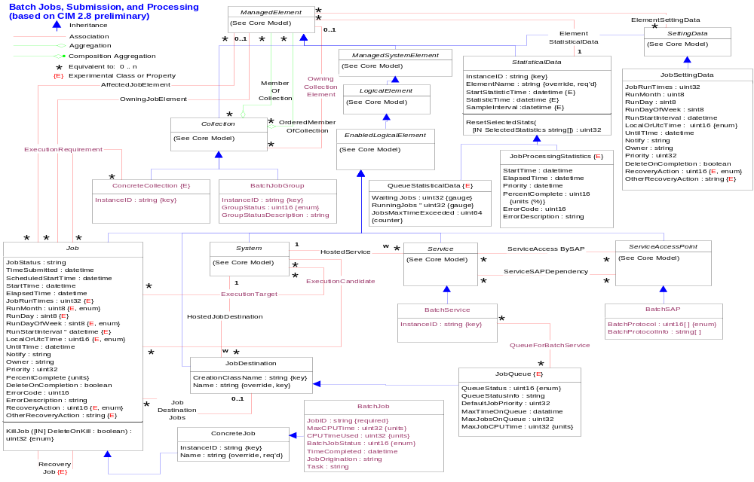
JSIM UML

Slide 6
JSIM Specification
See CGS GridForge site: Meeting Materials, GGF9

Slide 7
JSIM Specification
Experimental Classes in CIM 2.8 (from JSIM)
  JobQueue
  QueueStatisticalData
  JobProcessingStatistics
  Concrete Collection
Experimental Associations
  RecoveryJob
Modified Classes
  Job
  JobSettingData
  StatisticalData
  Concrete Collection
New Classes to be Submitted for CIM 2.9
  BatchService
  BatchSAP
  BatchJob
  BatchJobGroup
New Associations
  QueueForBatchService
  ExecutionCandidate
  ExecutionTarget
  ExecutionRequirement
  OwningCollectionElement

Slide 8
JSIM Plans
Current JSIM Specification to be submitted to GGF for Public Comment as a Draft Standard.
We need to encourage queueing system developers to utilize the JSIM classes.

Slide 9
Other Business?

