Slide 1
Grid Resource Allocation Agreement Protocol
Jim Pruyne, Wolfgang Ziegler
GRAAP-WG
28-30 June, 2005 (GGF14 in Chicago)

Slide 2
GGF Intellectual Property Policy
All statements related to the activities of the GGF and addressed to the GGF are subject to all provisions of Appendix B of GFD-C.1, which grants to the GGF and its participants certain licenses and rights in such statements. Such statements include verbal statements in GGF meetings, as well as written and electronic communications made at any time or place, which are addressed to any GGF working group or portion thereof,
Where the GFSG knows of rights, or claimed rights, the GGF secretariat shall attempt to obtain from the claimant of such rights, a written assurance that upon approval by the GFSG of the relevant GGF document(s), any party will be able to obtain the right to implement, use and distribute the technology or works when implementing, using or distributing technology based upon the specific specification(s) under openly specified, reasonable, non-discriminatory terms. The working group or research group proposing the use of the technology with respect to which the proprietary rights are claimed may assist the GGF secretariat in this effort. The results of this procedure shall not affect advancement of document, except that the GFSG may defer approval where a delay may facilitate the obtaining of such assurances. The results will, however, be recorded by the GGF Secretariat, and made available. The GFSG may also direct that a summary of the results be included in any GFD published containing the specification.

Slide 3
GRAAP Sessions at GGF14
#1 June 28, 2:30 pm (this session)
Implementation experience
#2 June 29, 4:00 pm
Work on last open issues of spec
#3 June 30, 11:00 am
GRAAP futures

Slide 4
Implementation Experience
Wolfgang Ziegler
GRAAP-WG #1
28-30 June, 2005 (GGF14 in Chicago)

Slide 5
Session Agenda
Sign-in sheets
Agenda of GRAAP Session #1
Presentations of Agreement Usage
      Asit Dan, IBM
      Philipp Wieder, FZJ
      Tiziana Ferrari
      Toshiyuki Nakata, NEC
      Wolfgang Ziegler, FHG
Discussion

Slide 6
WS-Agreement Implementation
WS-Agreement implementation
infrastructure for protocol support
and it’s use for job scheduling.
Presentation of Asit Dan, IBM

Slide 7
Web Services Agreement-based Resource Negotiation in UNICORE
The work described now uses WS-Agreement as
a foundation to integrate a dynamic resource
management system including QoS mechanisms
into the UNICORE Grid system.
Presentation of Philipp Wieder, FZJ

Slide 8
WS-Agreement Implementation
Agreement Service for Resource
Reservation and Allocation.
Presentation by Jim Pruyne on behalf
of Tiziana Ferrari, CNAF

Slide 9
Use of WS-Agreement in the Business Grid Project
Using WS-Agreement together with
JSDL for submitting business
applications such as a web-3tier
Application?
Presentation of Toshiyuki Nakata, NEC

Slide 10
Agreement Implementation in the VIOLA Project
Using WS-Agreement for
Advance Reservation & Co-allocation
of Compute and Network Resources
Oliver Wäldrich, FhG
Wolfgang Ziegler, FhG
Philipp Wieder, FzJ

Slide 11
The Use-Case: VIOLA
Vertically Integrated Optical testbed for Large Applications
Technical project Goals:
  deploy and operate a regional optical testbed in North-Rhine-Westfalia with an extension to Bavaria and a link to GÈANT
  test advanced network equipment and network architectures
  develop Software for user-driven dynamical provision of bandwidth
  deploy a UNICORE-based Compute Grid with Meta-Scheduling capabilities (compute & network resources) on the testbed
  develop/enhance advanced Grid- and Virtual Reality applications
To achieve the last three of these goals a MetaScheduling Service
for Co-allocating Arbitrary Types of Resources is necessary

Slide 12
VIOLA Project Facts
Partially funded by German Federal Ministry of Education
and Research
Budget: 16 M€, 27,5 PJ
Grant period: May 2004 – April 2007
Consortium:
  DFN – German Science Network (consortium leader)
  Research Centre Jülich
  Fraunhofer IMK
  Fraunhofer SCAI
  Research Centre caesar
  University of Bonn
  Technical University Bonn-Rhein-Sieg
  Technical University of Aachen (RWTH)
  T-Systems International
  Alcatel
  Siemens
  GasLINE (associated)

Slide 13
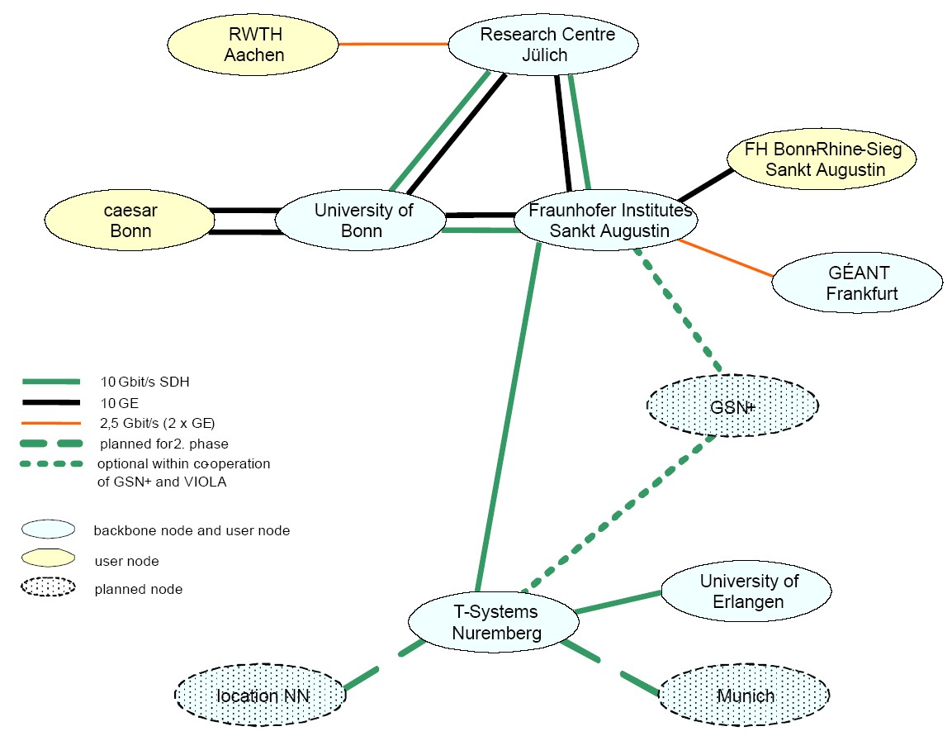
VIOLA Network
VIOLA - Networking
  Deployment and operation of the testbed,
  test of advanced network equipment
  Signaling and reservation
    bandwidth- and
    QoS-reservations
    in the network
    interfaces for user-driven
    reservation:
    immediate and in advance
Notes:
Kleine Textänderungen

Slide 14
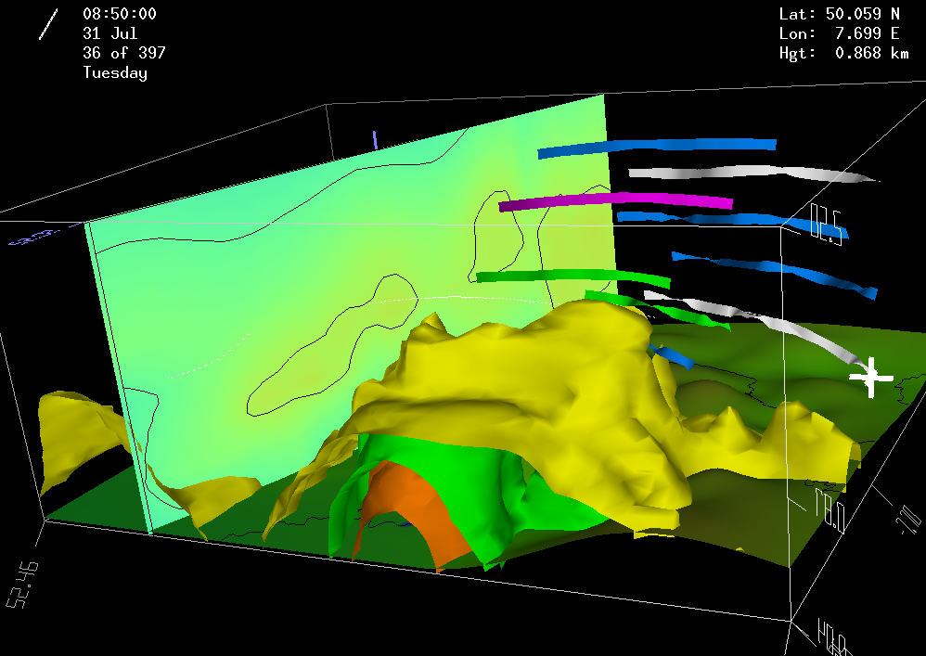
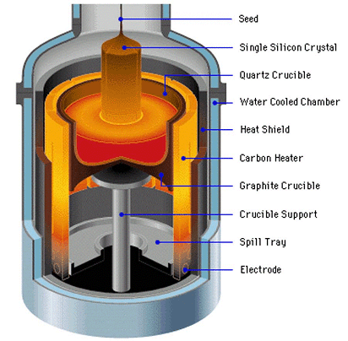
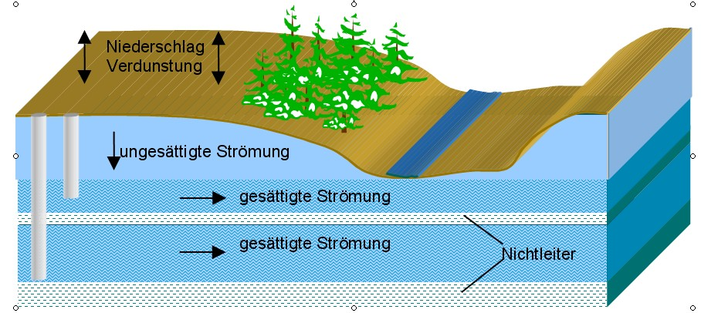
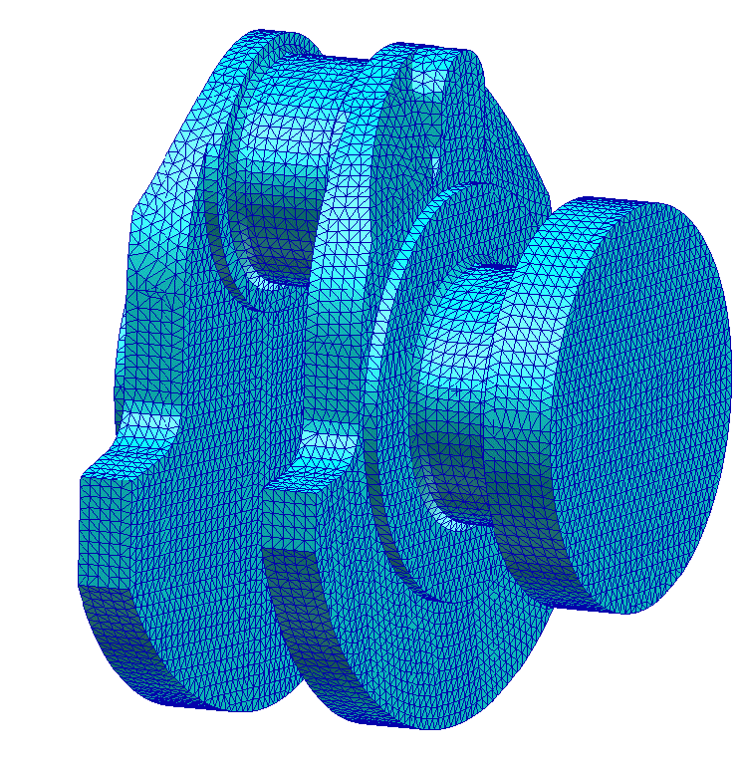
VIOLA Applications
VIOLA-Applications: distributed Simulations
(Multi-physics, Tele-collaboration)
  MetaTrace: Simulation of pollutant transport in groundwater with distributed SMP-Clusters (FZJ)
  TechSim: Distributed simulation of crystal growth and biosensors (Caesar)
  AMG-OPT: Parameter optimization and optimal algebraic solvers – Mechanical structure (SCAI)
  KoDaVis-Atmo: Collaborative visualization of
  huge atmospheric datasets (FZJ)
Notes:
Kleine Textänderungen

Slide 15
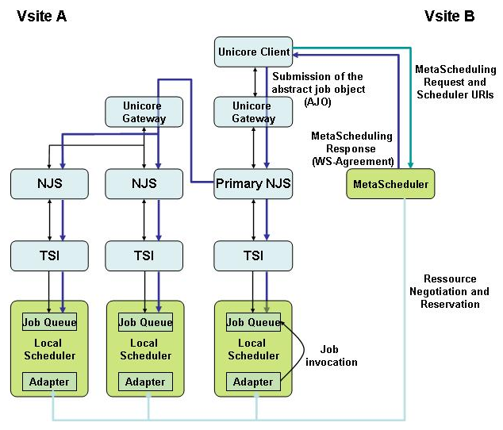
Meta Scheduler & Agreements
Co-Allocation of Resources
for distributed Applications
in Grids
  Based on independent local
  scheduling systems
  (EASY, FZJS, PBS-pro, CCS,
  GridEngine)
  Negotiation of common
  timeslots with local systems
  Use of WS-Agreement
  Integration into
  UniCore-Client
  Status: MetaScheduler running,
  Agreement processing impl.
  Integration with UniCore
  almost completed,

Slide 16
Properties of local RMS
Full backfill algorithm
Estimation of worst case start/stop for each job (preview)
Node range specification
Start time specification (AT-jobs)
Special resource requirement specification
„very low priority“ jobs (Z-jobs)
Communication friendly node allocation strategy
Portable: available on different parallel machines
Graphical user interface
Status information available via WEB interface
Priority scheme (project, resources, waited time)
Notes:
As a public domain product, EASY comes with source. It is written in Perl, and has got a lot of enhancements in order to make it a comfortable tool for our users, to optimize the overall system throughput, and to handle a variety of special scheduling requests.

Slide 17
Hosting Environment
Hosting environment of the VIOLA
WS-Agreement implementation:
  Apache Tomcat
  Axis 1.2 Final
  Sun Java SDK 1.4.2
class generation works at all without problems.

Slide 18
WS-Agreement
Samples (1)
1_GetResourceProperty (template):
<GetResourcePropertyRequest
xmlns="http://www.ibm.com/xmlns/stdwip/web-services/WS-ResourceProperties"
xmlns:wsag="http://www.ggf.org/namespaces/ws-agreement">wsag:Template</GetResourcePropertyRequest>
2_template:
<?xml version="1.0"?>
<GetResourcePropertyResponse
xmlns:xsd="http://www.w3.org/2001/XMLSchema"
xmlns:xsi="http://www.w3.org/2001/XMLSchema-instance"
xmlns="http://www.ibm.com/xmlns/stdwip/web-services/WS-ResourceProperties"
xmlns:wsrp="http://www.ibm.com/xmlns/stdwip/web-services/WS-ResourceProperties">
xsi:type="wsrp:GetResourcePropertyResponse"
<wsag:AgreementTemplateType xmlns:wsag="http://www.ggf.org/namespaces/ws-agreement">
<wsag:Name xsi:type="xsd:NCName">WS-AgreementTemplate</wsag:Name>
<wsag:Context xsi:type="wsag:AgreementContextType"/>
<wsag:Terms xsi:type="wsag:TermTreeType"/>
<wsag:CreationConstraints><wsag:Item wsag:name="nodes_available">
<wsag:Location xsi:type="xsd:string">//wsag:ServiceDescriptionTerm/job:JobType/job:numberofnodes</wsag:Location>
<xsd:simpleRestrictionModel>

Slide 19
WS-Agreement
Samples (2)
<xsd:facets>
<xsd:minInclusive xsd:value="1" xsi:type="xsd:numFacet">
<xsd:fixed xsi:nil="true"/>
<xsd:id xsi:nil="true"/>
</xsd:minInclusive>
<xsd:maxInclusive xsd:value="14" xsi:type="xsd:numFacet">
<xsd:fixed xsi:nil="true"/>
<xsd:id xsi:nil="true"/>
</xsd:maxInclusive>
<xsd:enumeration xsi:type="xsd:noFixedFacet">
<xsd:id xsi:nil="true"/>
<xsd:value xsi:type="xsd:string">scai</xsd:value>
</xsd:enumeration>
</xsd:facets>
<xsd:facets>
<xsd:minInclusive xsd:value="1" xsi:type="xsd:numFacet">
<xsd:fixed xsi:nil="true"/>
<xsd:id xsi:nil="true"/>
</xsd:minInclusive>
<xsd:maxInclusive xsd:value="20" xsi:type="xsd:numFacet">
<xsd:fixed xsi:nil="true"/>
<xsd:id xsi:nil="true"/>
</xsd:maxInclusive>
<xsd:enumeration xsi:type="xsd:noFixedFacet">
<xsd:id xsi:nil="true"/>

Slide 20
WS-Agreement
Samples (3)
<xsd:value xsi:type="xsd:string">zam</xsd:value>
</xsd:enumeration></xsd:facets>
</xsd:simpleRestrictionModel>
</wsag:Item>
</wsag:CreationConstraints>
</wsag:AgreementTemplateType>
</GetResourcePropertyResponse>
3_createAgreementInput (offer):
<?xml version="1.0" encoding="UTF-8"?>
<createAgreementInput
xmlns:soapenv="http://schemas.xmlsoap.org/soap/envelope/"
xmlns:xsd="http://www.w3.org/2001/XMLSchema"
xmlns:xsi="http://www.w3.org/2001/XMLSchema-instance"
xmlns="http://www.ggf.org/namespaces/ws-agreement">
<AgreementOffer xsi:type="wsag:AgreementType" xmlns:wsag="http://www.ggf.org/namespaces/ws-agreement">
<Context xsi:type="wsag:AgreementContextType"/>
<Terms xsi:type="wsag:TermTreeType">
<All xsi:type="wsag:TermCompositorType">
<ServiceDescriptionTerm wsag:ServiceName="JOB_1">
<job:JobType xmlns:job="http://www.gridforum.org/namespaces/job">
<job:executable xsi:type="xsd:string">/bin/dosomething</job:executable>

Slide 21
WS-Agreement
Samples (4)
<job:arguments xsi:type="job:ArgumentsType"/>
<job:numberOfNodes xsi:type="xsd:integer">3</job:numberOfNodes> <job:duration xsi:type="xsd:integer">10</job:duration>
<job:startTime xsi:type="xsd:dateTime">2005-06-20T07:59:18.875Z</job:startTime>
<job:Site xsi:type="job:SiteType">
<job:name>ZAM</job:name>
<job:metajobId xsi:nil="true"/>
<job:destination>http://packcs-e0.scai.fraunhofer.de/zam</job:destination>
<job:credentials>
<job:username>site_user</job:username>
<job:password></job:password>
</job:credentials>
</job:Site>
</job:JobType>
<job:JobType xmlns:job="http://www.gridforum.org/namespaces/job">
<job:executable xsi:type="xsd:string"></job:executable>
<job:arguments xsi:type="job:ArgumentsType"/>
<job:numberOfNodes xsi:type="xsd:integer">5</job:numberOfNodes>
<job:duration xsi:type="xsd:integer">10</job:duration>
<job:startTime xsi:type="xsd:dateTime">2005-06-20T07:59:18.875Z</job:startTime>
<job:Site xsi:type="job:SiteType">
<job:name>SCAI</job:name>
<job:metajobId xsi:nil="true"/>
<job:destination>http://packcs-e0.scai.fraunhofer.de/scai</job:destination>
<job:credentials>

Slide 22
WS-Agreement
Samples (5)
<job:username>site_user</job:username>
<job:password></job:password>
</job:credentials>
</job:Site>
</job:JobType>
</ServiceDescriptionTerm>
</All>
</Terms>
</AgreementOffer>
</createAgreementInput>
4_createAgreementResponse (agreement):
<?xml version="1.0" encoding="utf-8"?>
<createAgreementResponse
xmlns:xsd="http://www.w3.org/2001/XMLSchema"
xmlns:xsi="http://www.w3.org/2001/XMLSchema-instance"
xmlns="http://www.ggf.org/namespaces/ws-agreement">
<createdAgreementEPR>
<ns1:Addressxmlns:ns1="http://schemas.xmlsoap.org/ws/
2003/03/addressing">http://metascheduler:80</ns1:Address>
<ns2:PortType xmlns:ns2="http://schemas.xmlsoap.org/ws/2003/03/addressing">{
http://www.ggf.org/namespaces/ws-agreement}CreateAgreementInputType</ns2:PortType>

Slide 23
WS-Agreement
Samples (6)
<ns3:SiteType xmlns:ns3="http://www.gridforum.org/namespaces/job">
<ns3:name>meta</ns3:name>
<ns3:metajobId>meta-id-09876</ns3:metajobId>
<ns3:destination xsi:nil="true"/><ns3:credentials xsi:nil="true"/>
</ns3:SiteType>
<ns4:SiteType xmlns:ns4="http://www.gridforum.org/namespaces/job">
<ns4:name>scai</ns4:name>
<ns4:metajobId>bss-id-12345</ns4:metajobId><ns4:destination xsi:nil="true"/>
<ns4:credentials xsi:nil="true"/>
</ns4:SiteType>
<ns5:SiteType xmlns:ns5="http://www.gridforum.org/namespaces/job">
<ns5:name>zam</ns5:name>
<ns5:metajobId>bss-id-09876</ns5:metajobId>
<ns5:destination xsi:nil="true"/>
<ns5:credentials xsi:nil="true"/>
</ns5:SiteType>
</createdAgreementEPR>
</createAgreementResponse>

Slide 24
WS Agreement
Implementation Problems (1)
Problem 1: (spec should change)
Template → OfferItem
<xs:complexType name="OfferItemType">
<xs:sequence>
<xs:element ref="wsag:Location"/>
<xs:group ref="xs:simpleRestrictionModel" minOccurs="0"/>
</xs:sequence>
<xs:attribute name="name" type="xs:string"/>
</xs:complexType>
simpleRestrictionModel is not supported by Axis today
→ generation of required classes only possible with slim (patched) XMLSchema
(workaround!)
→ working implementation requires much knowledge → huge effort

Slide 25
WS Agreement
Implementation Problems (2)
Problem 2: (spec has already changed)
TermCompositorType:
xs:complexType name="TermCompositorType">
<xs:sequence>
<xs:choice maxOccurs="unbounded">
<xs:element name="ExactlyOne" type="wsag:TermCompositorType"/>
<xs:element name="OneOrMore" type="wsag:TermCompositorType"/>
<xs:element ref="wsag:All"/>
<xs:element name="ServiceDescriptionTerm" type="wsag:ServiceDescriptionTermType"/>
<xs:element name="ServiceReference" type="wsag:ServiceReferenceType"/>
<xs:element name="ServiceProperties" type="wsag:ServicePropertiesType"/>
<xs:element name="GuaranteeTerm" type="wsag:GuaranteeTermType"/>
</xs:choice>
</xs:sequence>
</xs:complexType>
seems to be a little mixed up
ServiceDescriptionTerm, ServiceReference, ServiceProperties, GuaranteeTerm could be
represented by a separate object
→ that would result in a more clear structure (as described in the specification)

Slide 26
WS Agreement
Implementation Problems (3)
Problem 3: (should be worked out)
Features of current EndPointReference probably not sufficient
→ how to address AgreementState, AgreementAcceptance
No session IDs (Agreement IDs) in Agreement context
How to identify an agreement instance?
For each Agreement a new server has to be started?
URL-encoding like approach?
Possible better solution: Usage of Agreement context
Agreement IDs (analogue to http session-IDs) in Agreement Context
Advantage: one server for multiple requests, load balancing,…
Disadvantage: ResourcePoperties must probably be extended/changed

Slide 27
WS Agreement
Implementation Problems (4)
Problem 4:
Missing appropriate Job description language to describe “complex” jobs
(not in focus of GGF WGs currently?)
JSDL
  e.g. missing starttime…
Problem 5:
How to transport information about user?
Authentication
  User Credentials (e.g. Certificate)
  (in context of Agreement?)

Slide 28
Implementation approaches?
We used the axis framework to generate beans
which process the requests
Another solution could be DOM-based processing.
Experience of other implementations?
Benefits of the different approaches?
Environment & Purpose relevant for decision about technology?
How to guarantee interoperability?

Slide 29
Framework for WS-Agreement
Specification with Apache Axis
Experience made and Problems
encountered when implementing
WS-Agreement
Presentation of Dominic Battré, University of Paderborn,

Slide 30
Time for
Discussion

Slide 31
Next Sessions
Don’t miss
Spec Issues, 4 pm, June 29
GRAAP Futures, 11 am, June 30

