Slide 1
SRM-iRODS Interface Development
WeiLong UENG
Academia Sinica Grid Computing
wlueng@twgrid.org

Slide 2
What is iRODS
Integrated Rule-Oriented Data-management System
From SRB (Storage Resource Broker) to iRODS
A community-driven, open source, data grid software solution

Slide 3
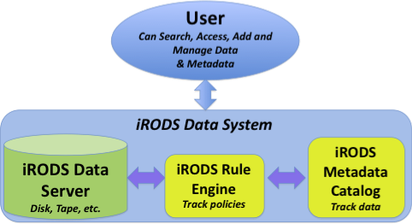
iRODS Archiecture

Slide 4
iRODS features
High-performance network data transfer
A unified view of disparate data
Support for a wide range of physical storage
Easy back up and replication
Manages metadata
Controlled access
Policies, Rules and Micro-services
Workflows
Management of large collections

Slide 5
iRODS Applications
Data grids - Share data
Project level data sharing
Digital libraries - Publish data
Specify data context, provide standard services
Persistent archive - Preserve data
Build reference collections
Real-time sensor systems - Federate data
Manage real-time data distribution
Workflow systems - Analyze data
Integrate client- & server-side workflows

Slide 6
Why SRM?
Storage Elements (SE) can use different type of technologies
CASTOR, dCache, DPM, BeStMan,...,etc.
DRM (Disk Resource Manager)/TRM (Tape Resource Manager) /HRM (Hierarchical Resource Manager)
Grid middleware needs to access files with an uniform interface
Manage storage resources
Not a file transfer protocol

Slide 7
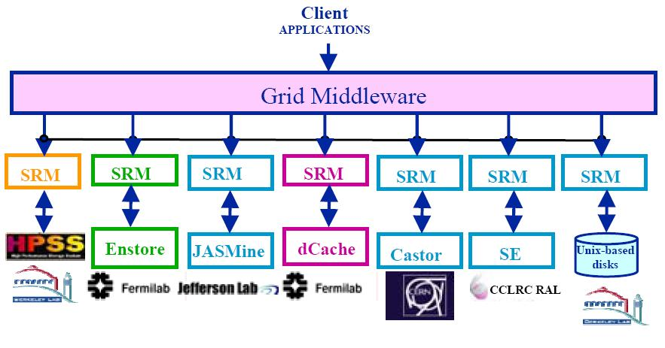
What is SRM?

Slide 8
What is SRM?
Storage Resource Managers (SRMs) are middleware components
whose function is to provide
dynamic space allocation
file management
on shared storage resources on the Grid
Different implementations for underlying storage systems are based on the same SRM specification

Slide 9
SRM features
Provides space management
Provides an uniform access interface
Manages DRM/Tape/HRM
Does not transfer files itself.
Manage the life time of file

Slide 10
SRMs role in grid
SRMs role in the data grid architecture
Shared storage space allocation & reservation
important for data intensive applications
Get/put files from/into spaces
archived files on mass storage systems
File transfers from/to remote sites, file replication
Negotiate transfer protocols
File and space management with lifetime
support non-blocking (asynchronous) requests
Directory management
Interoperate with other SRMs

Slide 11
Client and Peer-to-Peer Uniform Interface
...
Client’s site
Uniform SRM
interface
Client
(command line)
client
Client
Program
Disk
Cache
Storage
Resource
Manager
Disk
Cache
network
Storage
Resource
Manager
Storage
Resource
Manager
Storage
Resource
Manager
...
...
...
MSS
Disk
Cache
Disk
Cache
Disk
Cache
Disk
Cache
Disk
Cache
Site 1
Site 2
Site N

Slide 12
SRM: Main concepts
Space reservations
Dynamic space management
Pinning file in spaces
Support abstract concept of a file name: Site URL
Temporary assignment of file names for transfer: Transfer URL
Directory management and authorization
Transfer protocol negotiation
Support for peer to peer request
Support for asynchronous multi-file requests
Support abort, suspend, and resume operations
Non-interference with local policies

Slide 13
Site URL and Transfer URL
Provide: Site URL (SURL)
URL known externally – e.g. in Replica Catalogs
e.g srm://fct01.grid.sinica.edu.tw:8443/axis/services/srm?/AS/home/wlueng.ASGC/testFile1.dat
Get back: Transfer URL (TURL)
Path can be different from SURL – SRM internal mapping
Protocol chosen by SRM based on request protocol preference
e.g gsiftp://t-ap20.grid.sinica.edu.tw:2811/AS/home/wlueng.ASGC/testFile1.dat
One SURL can have many TURLs
Files can be replicated in multiple storage components
Files may be in near-line and/or on-line storage
In a light-weight SRM (a single file system on disk)
SURL may be the same as TURL except protocol
File sharing is possible
Same physical file, but many requests
Needs to be managed by SRM implementation

Slide 14
Transfer protocol negotiation
Negotiation
Client provides an ordered list of preferred transfer protocols
SRM returns first protocol from the list it supports
Example
Client provided protocols list: bbftp, gridftp, ftp
SRM returns: gridftp
Advantages
Easy to introduce new protocols
User controls which transfer protocol to use
How it is returned?
The protocol of the Transfer URL (TURL)
Example: gsiftp://t-ap20.grid.sinica.edu.tw:2811/AS/home/wlueng.ASGC/testFile1.dat

Slide 15
SRM v2.2 Interface
Data transfer functions to get files into SRM spaces from the client's local system or from other remote storage systems, and to retrieve them
srmPrepareToGet, srmPrepareToPut, srmBringOnline, srmCopy
Space management functions to reserve, release, and manage spaces, their types and lifetimes.
srmReserveSpace, srmReleaseSpace, srmUpdateSpace, srmGetSpaceTokens
Lifetime management functions to manage lifetimes of space and files.
srmReleaseFiles, srmPutDone, srmExtendFileLifeTime
Directory management functions to create/remove directories, rename files, remove files and retrieve file information.
srmMkdir, srmRmdir, srmMv, srmRm, srmLs
Request management functions to query status of requests and manage requests
srmStatusOf{Get,Put,Copy,BringOnline}Request, srmGetRequestSummary, srmGetRequestTokens, srmAbortRequest, srmAbortFiles, srmSuspendRequest, srmResumeRequest
Other functions include Discovery and Permission functions
srmPing, srmGetTransferProtocols, srmCheckPermission, srmSetPermission, etc.

Slide 16

When iRODS met SRM
Make iRODS an archival system of gLite-based e-Infrastructure.
Support flexible lifetime policy for files
Impose the VO-based resource policy and security control to iRODS as the Grid infrastructure.

Slide 17
SRM-iRODS implementations

Slide 18
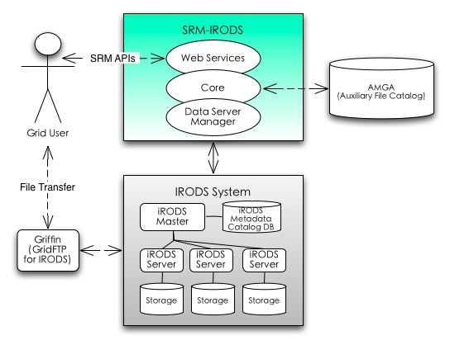
SRM-iRODS Archiecture

Slide 19
Use Case: putting files
Create a new LFN entry in LFC, return a SURL.
srmPrepateToPut (SURL)
Transfer the file to iRODs use GridFTP
srmPutDone (SURL)
iRODS

Slide 20
Use Case: getting files
Query the file catalog to retrieve the SURL from the LFN.
srmPrepateToGet (SURL)
Transfer the file (read)
srmReleaseFile (SURL)
iRODS

Slide 21

Information in Auxiliary File Catalog
Enabling Grids for E-sciencE
AMGA server, it stores partial filecatalog, resource and iRODS host information…
Users Information
Resources Information
Files Information
Space Metadata
Resource States
…
7

Slide 22
Architecture Overview
Enabling Grids for E-sciencE
Put a file (SURL)
Web Service
Default space is available? If yes, some files need to be uploaded
SURL->Path
Core
Auxiliary filecatalog
(AMGA)
Data server management
iCAT Server
(GSI enabled)
Non iCAT
(+DSI)
Non iCAT
(+DSI)
Non MES
Non MES
Non MES+DSI
SRB storage
space
13

Slide 23
Architecture Overview (cont.)
Enabling Grids for E-sciencE
Return TURL
Web Service
Yes, default space is ready and this file has been set to pinned.
Transfer to TURL
Core
Auxiliary Filecatalog
(AMGA)
Data server management
iCAT Server
(GSI enabled)
Non iCAT
(+DSI)
Non iCAT
(+DSI)
Non MES
Non MES
Non MES+DSI
SRB storage
space
14

Slide 24
Architecture Overview (cont.)
Enabling Grids for E-sciencE
Web Service
Core
Auxiliary Filecatalog
(AMGA)
Upload a file(gridftp)
Data server management
iCAT Server
(GSI enabled)
Non iCAT
(+DSI)
Non iCAT
(+DSI)
Non MES
Non MES
Non MES+DSI
SRB storage
space
15

Slide 25
Architecture Overview (cont.)
Enabling Grids for E-sciencE
put file done
Set this file has been uploaded and unpinned
Web Service
SURL -> Path
Core
Auxiliary Filecatalog
(AMGA)
Data server management
iCAT Server
(GSI enabled)
Non iCAT
(+DSI)
Non iCAT
(+DSI)
Non MES
Non MES
Non MES+DSI
SRB storage
space
16

Slide 26
Architecture Overview (cont.)
Enabling Grids for E-sciencE
The Status of PutDone
Web Service
Return the Status of PutDone
Core
Auxiliary filecatalog
(AMGA)
Data server management
iCAT Server
(GSI enabled)
Non iCAT
(+DSI)
Non iCAT
(+DSI)
Non MES
Non MES
Non MES+DSI
SRB storage
space
17

Slide 27
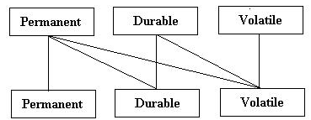
Support Flexible File/Space Types
SRM system has a caching mechanism and has to take care of SRM issues like file lifetime, space management,…,etc.
Permanent space
Volatile space
Durable space
Implementation
Use AMGA as auxiliary catalog and record all space usage, space type, and some file metadata inside.

Slide 28
Checking Disk Status
Web Service
Update status of each resource
Auxiliary Filecatalog
(AMGA)
Core
Resource info
Data server management
Logical Resource info
iRODSInfoServer
Resource info
Resource info
iCAT Server
(GSI enabled)
Storage
space
Storage space
28

Slide 29
Checking Disk Status
How to get the disk usage of the space?
Need to know the free and used space on iRODS server
iRODS provide the mechanism to monitor resource usag: SL_DISK_SPACE
We need to know the usage
Space management
Implementation
iRODSInfoServer:
Deployed on iRODS master server

Slide 30
Progress
Enabling Grids for E-sciencE
Space Management Functions
srmReserveSpace
srmReleaseSpace
srmUpdateSpace
srmGetSpaceMetaData
srmChangeSpaceForFiles
srmGetSpaceTokens
Permission Functions
srmSetPermission
srmCheckPermission
srmGetPermission
Directory Functions.
srmMkdir
srmRmdir
srmRm
srmLs
srmMv
Data Transfer Functions
srmPrepareToGet
srmBringOnline
srmPrepareToPut
srmCopy
srmStatusOfCopyRequest
srmReleaseFiles
srmPutDone
srmAbortRequest
srmSuspendRequest
srmResumeRequest
srmGetRequestSummary
srmGetRequestTokens
Discovery Functions
srmGetTransferProtocols
srmPing
23

Slide 31
SRM API: srmPing
srmPing(): used to verify the responsiveness of the service, to retrieve the SRM version and other internal information.

Slide 32
SRM API: srmPrepareToPut
srmPrepareToPut(): used to write files into the storage. Upon the client’s request, SRM prepares a TURL so that client can write data into the TURL.
Lifetime (pinning expiration time) is assigned on the TURL.
Target space token and SURLs
Asynchronous operation (typically)
Request token returned by SRM service
Request status may be checked through srmStatusOfPutRequest() with the returned request token.

Slide 33
SRM API: srmPrepareToGet
srmPrepareToGet(): used to bring files upon the cilent’s request. It assigns TURL so that client can access the file.
Source SURLs
Asynchronous operation (typically)
Request token returned by SRM service
Request status may be checked through srmStatusOfGetRequest() with the returned request token.
Similar function: srmBringOnline(), bring files online but do not return TURLs.

Slide 34
SRM API: srmStatusOfPut/GetRequest
srmPrepareOfPutRequest(): used to check the status of the previously request srmPrepareToPut. Client can get target TURLs if the status is SRM_SUCCESS.
srmPrepareOfGetRequest(): used to check the status of the previously request srmPrepareToGet. Client can get source TURLs if the status is SRM_SUCCESS.

Slide 35
SRM API: srmPutDone and srmReleaseFiles
srmPutDone(): used to notify the SRM that the client completed the file transfer(s) to the TURL(s). This should normally follow srmPrepareToPut.
srmReleaseFiles(): used to release pins on the previously requested “copies” of the SURLs. This function normally follows srmPrepareToGet and srmBringOnline functions.

Slide 36
SRM API: srmReserveSpace and srmGetSpaceMetadata
srmReserveSpace(): used to reserve a space in advance for the upcoming requests to get some guarantee on the file management.
srmGetSpaceMetadata(): used to get information of a space. Space token must be provided, and space tokens are returned upon a completion of a space reservation through srmReserveSpace.

Slide 37
Synchronous and Asynchronous
SRM service provides two class of methods:
Asynchronous methods (non-blocking call)
Synchronous methods (blocking call)

Slide 38
Asynchronous Operations
Enabling Grids for E-sciencE
CopyClient 1
CopyClient 2
CopyClient 3
CopyClient n
Push case
Pull case
22

Slide 39
Progress
The 1st stage:
Core Functions
Space Management Functions.
Permission Functions.
Directory Functions.
Data Transfer Functions.
Discovery Functions.
AMGA DB Schema
iRODS Server Manager
iRODSInfoServer

Slide 40
Progress (Cont.)
2nd stage
Internal space management functions
Use a thread to recycle expired space
Asynchronous operation
Space functions
Transfer functions

Slide 41
References
SRM working group:
http://sdm.lbl.gov/srm-wg/
iRODS:
https://www.irods.org/
AMGA:
http://amga.web.cern.ch/amga
Globus:
http://www.globus.org
CoG:
http://wiki.cogkit.org/index.php/Main_Page
Axis:
http://ws.apache.org/axis/
Notes:
These URLs just for your reference

