Slide 1
STP and TF
how they work
Tomohiro Kudoh

Slide 2
STP is a point to which a network provides connection service
Each STP belongs to just one network
  All the edge points to which a network wants to provide a connection service should be STPs.
  An STP connected to another network or end node should be paired with the corresponding STP of the connected network/node.
  A network can make STPs which are not connected to other network/node.
In other words: (John’s perspective)
  A network has edges and the edge points are called STPs.
  When networks or end nodes connect to each other they connect STPs.

Slide 3
Case 1: link is owned and managed(1)
Slot 1
Slot 2
Slot 3
Switch 1
Switch 1
Switch 2
Network Boundary
Network Boundary

Slide 4
Case 1: link is owned and managed(2)
Network A
Network B
Network C
Slot 1
Slot 2
Slot 3
Switch 1
Switch 1
Here, three STPs
are mapped
to a physical port
(c.f. VLANs)
Switch 2
STP

Slide 5
Case 1: link is owned and managed(3)
Network A
Network B
Network C
TF
TF
(admission
control
only)
TF

Slide 6
Case 2: link belongs to one of the networks(1)
Slot 1
Slot 2
Slot 3
Switch 1
Switch 1
Switch 2
Network Boundary

Slide 7
Case 2: link belongs to one of the networks(2)
Network A
Network B
Slot 1
Slot 2
Slot 3
Switch 1
Switch 1
Switch 2

Slide 8
Case 2: link belongs to one of the networks(2)
Network A
Network B
TF
TF

Slide 9
Case 3: link is not owned and managed(1)
Slot 1
Slot 2
Slot 3
Switch 1
Switch 1
Switch 2
Network Boundary

Slide 10
Case 3: link is not owned and managed(2)
Network A
Network B
Slot 1
Slot 2
Slot 3
Switch 1
Switch 1
Switch 2

Slide 11
Case 3: link is not owned and managed(3)
Network A
Network B
TF
TF
Logically equivalent to “Case 2”

Slide 12
STP and SDP
Network A
Network B
STP of a network
SDP is a pair of STPs of network A and B

Slide 13
Sample configuration
network A and B are
  Connected using one GbE (green) and one 10GbE (red)
  VLAN 1-8 on the green cable, no VLAN on the red cable
Network Boundary
Slot 1
Slot 2
Slot 3
GbE, VLAN 1-8 can be used
Switch 1
Switch 1
Port 8
Port 2
10GbE, No VLAN
Switch 2
Port 13
Port 7
Network A
Network B

Slide 14
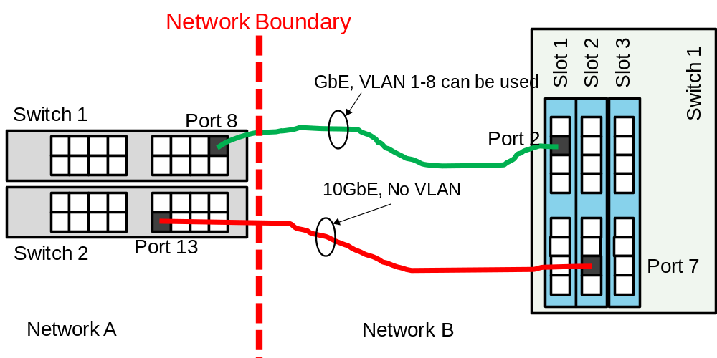
Logical transport view and internal mappings
Logical view (topology)
Network A internal mapping:
  Switch 1/Port8 : X1
  Switch1/Port8/VLAN1: : X1/1
  Switch 1/Port8/VLAN8 : X1/8
  Switch 2/Port13 : X2
Network B internal mapping:
  Switch 1/Slot1/Port2 : YI
  Switch 1/Slot1/Port2 /VLAN1 : Ya
  Switch 1/Slot1/Port2 /VLAN8: Yh
  Switch 1/Slot2/Port7 : YJ
STP: X1/1
STP: Ya
STP: X1/2
STP: Yb
STP: X1
STP: YI
STP: X1/8
STP: Yh
STP: X2
STP: YJ
Network A
Network B
STP:X1, YI : GbE
STP X1/1 – X1/8, Ya-Yh : VLAN on GbE
STP X2, YJ: 10GbE
Note: STP names are just symbols (labels) and do not necessarily correspond to physical implementation such as VLANs.

Slide 15
How it works
Only logical topology (left hand side of the previous slide) is advertised to requesters
  (assume network A and B have edge A and Z respectively)
  Requester NSA divides connection (A-Z )to (A-X1/2) and (Yb-Z), and requests these to network A and B respectively.
Network A receives the connection request (A-X1/2)
  Then Network A internally translates X1/2 to Switch1/Port8/VLAN2
  Checks its own calendar for availability of the internal connection, and grants the request. (Of course, similar translation should be done for A too.)
Network B does the same thing for the request (Yb-Z)
When the reserved time arrives:
  Network A provisions physical connection:(A-Switch1/Port8/VLAN2)
  Network B provisions physical connection:(Switch1/Slot1/Port2/VLAN2-Z)
In this way, connection (A-Z) is successfully provisioned.

Slide 16
STP (revisited) (1)
STP is an logical label which can be used in a connection request to designate a termination point of intra-network connection.
  For a case, "VLANS on Ethernets on SONET on Waves," if requesting a wavelength is allowed, the wavelength should be an STP. Same for SONET or Ethernet. In such cases, STPs are hierarchically multiplexed.

Slide 17
STP (revisited) (2)
An STP is a label which is associated with a physical entity such as [switch 1, port3, vlan 2].
  Intra-network connection request designates a pair of STPs. In other words, when requesting a connection, only an STP can be used to designate an edge of the connection.
All possible STP should be listed and somehow advertised (in reality, wildcard like representation should be allowed)
  When provisioned, an STP instance is generated from a STP.
SDP is a conceptual name of a pair of STPs of two networks.
  The pairing should be decided in advance by (out of NSI) negotiation between two networks.
  SDP does not necessarily have an identifier.
The information which will be advertised by a network is:
1. A list of STP of the network
2. A list of STP of other networks which are paired to its STPs. (i.e.
STPs at the other end of SDPs).
3. Transfer Function matrix of the network

Slide 18
Another example
Network A
Network B
a1
TF
a2
b1
TF
b2
SDP
The paired STPs, (a2, b1) is an SDP
By requesting
  connect(a1, a2) to network A
  connect(b1, b2) to network B
a1-b2 is connected.
NetworkA advertises:
  I have a1 and a2.
  a2 is connected to b1 of networkB
  TF: I can connect a1 and a2
NetworkB advertises:
  I have b1 and b2.
  b1 is connected to a2 of networkA
  TF: I can connect b1 and b2
By gathering these information from networks, topology information sufficient for discovery can be constructed.

