Slide 1
Healthgrid
White Paper
Medical Imaging and Epidemiology
Tony Solomonides on behalf of
The Healthgrid Association
Notes:
Based on the Healthgrid White Paper.
Written in the spirit of the HealthGrid Association, taking account of the views of its members and presentations at its two conferences to date.
I have a few electronic copies of the 2004 proceedings if you are interested.

Slide 2
Introduction
What is a health grid?
  combines grid, health and e-Science
  oriented to biomedical advances
  supports evidence-based healthcare
Notes:
What do we mean when we speak of a health grid?
It borrows ideas from the Grid and from e-Science – a collaborative view of science based on a highly connected computational infrastructure.
It aspires to provide an integration platform for genomic advances with medical practice – whether at an individual level (‘personalized healthcare’) or at an epidemiological level.
It also aspires to integrate knowledge of the patient with medical knowledge – the best data available on the patient to be coupled with the best evidence for his/her treatment.
In Europe the sequence of events is probably best described this way: e-Science came first; Grid projects were funded; funding for Grid projects was best justified by showing some worthwhile potential applications outside science; health was pre-eminent as a worthwhile application area; so e-Health projects were funded in their own right.

Slide 3
History
DG Information Society Technologies
  funds projects
  brings them together in Sept 02
  supports conference call
HealthGrid 2003 – Lyon, Jan 03
HealthGrid Association incorporated
HealthGrid 2004 –
Clermont-Ferrand, Jan 04
HealthGrid ‘White Paper’, June 04
HealthGrid 2005 – Oxford, Apr 05
Notes:
What do we mean when we speak of a health grid?
It borrows ideas from the Grid and from e-Science – a collaborative view of science based on a highly connected computational infrastructure.
It aspires to provide an integration platform for genomic advances with medical practice – whether at an individual level (‘personalized healthcare’) or at an epidemiological level.
It also aspires to integrate knowledge of the patient with medical knowledge – the best data available on the patient to be coupled with the best evidence for his/her treatment.
In Europe the sequence of events is probably best described this way: e-Science came first; Grid projects were funded; funding for Grid projects was best justified by showing some worthwhile potential applications outside science; health was pre-eminent as a worthwhile application area; so e-Health projects were funded in their own right.

Slide 4
Principal Themes
A personal view …
Integration
Levels of life & knowledge: correspondence & convergence
Virtuality
Issues of ethics and security

Slide 5
Integration
medical and bioinformatics
patient information and medical knowledge
‘gold standard’ evidence and practice-based evidence
patient data – images, labs, history
trust and ethical issues

Slide 6
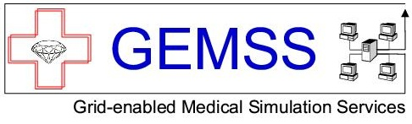
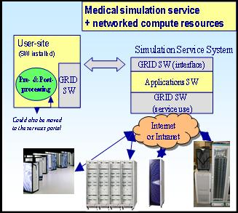
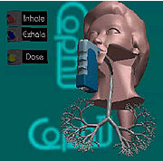
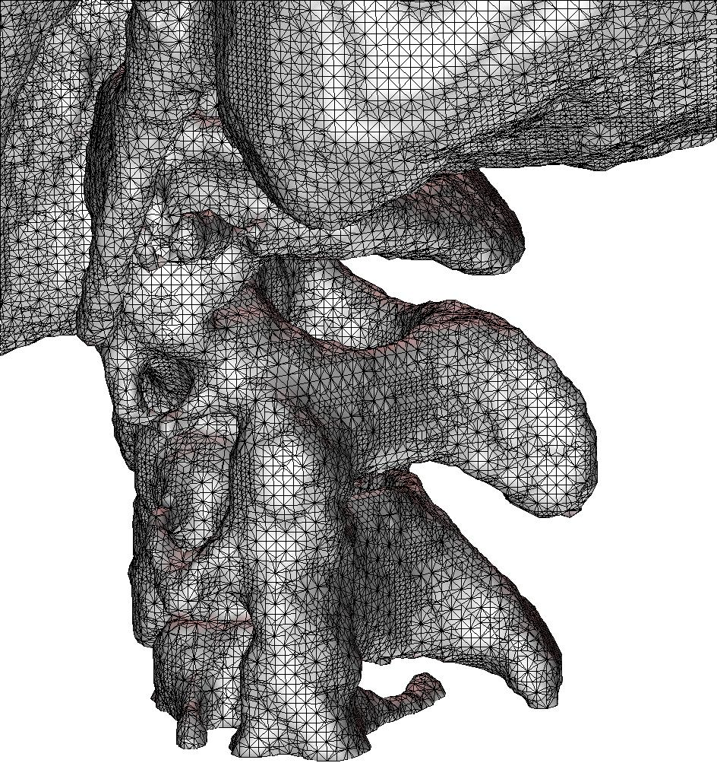
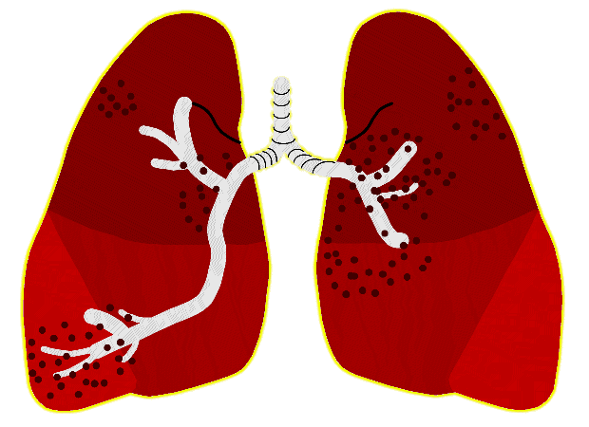

Example 1
Computational Grid
Grid
Software
Simulation &
Imaging
Bio-numeric modelling
Medical Expertise
Legal Aspects
Secure & lawful Grid provision of medical services
Build 6 Grid-enabled medical prototype applications
Build suitable middleware on top of common standards
Install and evaluate a GEMSS test-bed
Anticipate privacy, security & other legal concerns
Taken from Gerhard Engelbrecht

Slide 7
Applications
Name | Domain | Class
Maxillofacial surgery simulation | Medicine – pre-surgical planning | On demand / distributed supercomputing
Neurosurgery support | Medicine – intra-operative planning | On demand
Radiotherapy planning | Medicine – Monte Carlo treatment simulation | On demand / distributed supercomputing
Inhaled drug delivery planning | Medicine – air flow dynamics | On demand / distributed supercomputing
Cardio-vascular system simulation | Medicine – blood flow dynamics | On demand
Advanced image reconstruction | Medicine – nuclear / in vivo diagnostics | On demand
Taken from Gerhard Engelbrecht

Slide 8

Example 2 Knowledge / Collaboration Grid
to prototype a pan-European distributed database of mammographic images using grid technologies
to provide a demonstrator for use in epidemiological studies, quality control and validation of computer aided detection algorithms
technology attitude: reuse

Slide 9

MammoGrid
Hospital Italy
Local
Analysis
Local
Analysis
University Database
Local
Query
Local
Query
Query
Result
Local
Analysis
Local
Query
GRID
Healthcare Institute
Clinician’s Workstation
Local
Analysis
Local
Query
Distributed data
Distributed analyses
Knowledge is stored alongside data
Active (meta-)objects manage various versions of data and algorithms
Small network bandwidth required
Hospital UK
Shared meta-data
Analysis-specific data
Notes:
In MammoGrid we use the Grid to link together Hospitals, Image Analysis centres, Healthcare Institutes and Universities for the purpose of federated breast image analysis. A clinican sitting at her workstation can summon exemplars from many diverse sources (‘find me the 10 most similar images to that of a selected women – for example on drug therapy, or under stress’) regardless of the location of those images and potentially across a diverse geographical area.
Queries are farmed out to where the data is resident and, provided the participating body has granted access to its data, handled locally. In other words multiple geographically separated institutes can be dynamically constituted into one or more ‘Virtual Organisations’ to resolve clinicians queries.

Slide 10
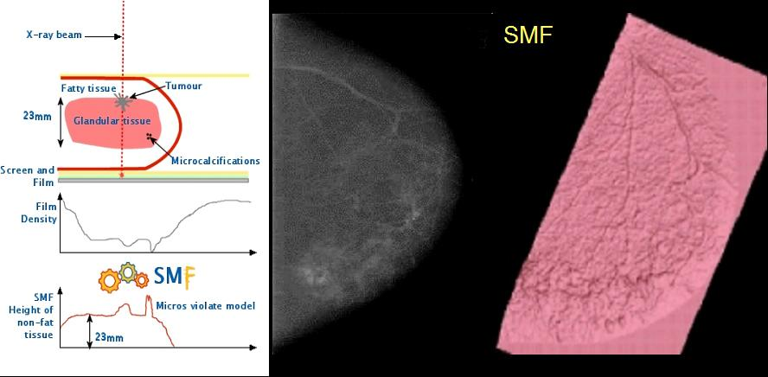
Standard Mammogram Form
Notes:
At the heart of this development is a sophisticated mathematical model of mammography, beginning with the nature of the radiation generated and proceeding to simulate anode effects, energy distribution, scatter and beam hardening, anti-scatter grid and screen glare. The model also accounts for machine settings (kVp, mAs, Daec) and film speed and gradient.

Slide 11


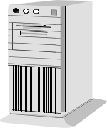
Grid Architecture
Workstations
Workstations
MG W/s
(‘‘MAS’’)
GRID
VPN
CERN
Udine
MammoGrid Data
MammoGrid Data
GridBox
High Security Level
MammoGrid Data
MammoGrid Data
GridBox
GridBox
Oxford
Cambridge
MG W/s
(‘‘MAS’’)

Slide 12
Grids and Imaging 1
Diagnosis
  comparison, ‘find-one-like-it’
Epidemiology
  virtual databases
  large enough for significant statistics
Mass screening programmes
  diagnosis and epidemiology
  ‘alarms’ possible
Therapy planning
  targetting, implantation, surgery

Slide 13
Grids and Imaging 2
Problems of heterogeneity …
  Images and interpretations
    non-standard DICOM
  Imaging conditions
    standardization
  Incompatibilities of systems
    proprietary PACS, etc
Ethical, Legal and Security Issues …
  someone ‘ELSI’ will take care of these?

Slide 14
Grids and Imaging 3
Service Oriented Architecture
  grid services can deal with heterogeneity
  grid services can be used to plan workflow
  examples include annotation, detection, analysis, registration, aggregation and visualization services
Optimistically …
  ‘ELSI’ negotiations may be implemented through services

Slide 15
Convergence
Levels of life
Levels of knowledge
  medicine and genomics
  ‘molecular medicine’
  ‘individualized healthcare’

Slide 16
Bio-social being & pathology
PATHOLOG
I
ES
Population
I
NB
I
OMED
Public Health
Informatics
Disease
Genomic
Epidemiology
Medical
Informatics
Patient
Pharmacogenetics
Tissue, organ
Molecular and
Image-based
diagnosis
Medical
Imaging
Molecular, genetic
Bioinformatics
Taken from Fernando Martín-Sánchez

Slide 17
Virtuality
virtual human
  simulation
virtual databases
  epidemiology
  comparative studies
training
  performance
  quality assurance

Slide 18
Ethics &c
use of data in care and in research
data provenance
privacy / confidentiality
security
national / EU legal framework
… extending the concept of a ‘virtual organization’
& building negotiation into the infrastructure

Slide 19
Principal Themes
A personal overview …
Integration of medical data and knowledge
Convergence of biology and medicine
Management of ethics and trust

Slide 20
More information
Web refs
  http://lyon2003.healthgrid.org/program.php
  http://clermont2004.healthgrid.org/program.php
  http://www.healthgrid.org/
HG2004 Proceedings
‘White paper’
  http://www.healthgrid.org/download.php (June 2004)

Slide 21
Healthgrid
Thank you … questions?

Slide 22
Healthgrid
Thank you … questions?

