Slide 1

Biomanufacturing Grid for rapid response to emerging infectious diseases:
Workflow Integration for data, computational and bioinstrumentation grids
Tan Tin Wee (NUS),
Lim Teck Sin (KOOPrime),
Lim Beng Siong (SIMTech),
Robert Gay (NTU)
Funded by A*STAR
TSRP Pilot Program

Slide 2
Examples of Successful e-Science Integrated Workflows
BioInformation Integration
UK eScience Taverna/MyGrid
BioInstrument Integration
Joint Centre for Structural Genomics – workflow integration for high throughput determination of protein structural folds (UCSD, SDSC, Stanford SSRL et al)

Slide 3

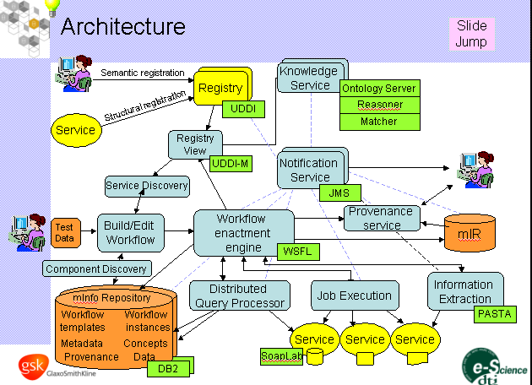
Screenshot of Carole Goble’s talk (2004)
Taverna, GUI for myGrid is a collaboration between the European Bioinformatics Institute (EBI),
IT Innovation, the Rosalind Franklin Centre for Genomic Research (RFCGR),
Newcastle Computer Science faculty, Newcastle Centre for Life,
Manchester Computer Science faculty and the Nottingham University Mixed Reality Lab.

Slide 4
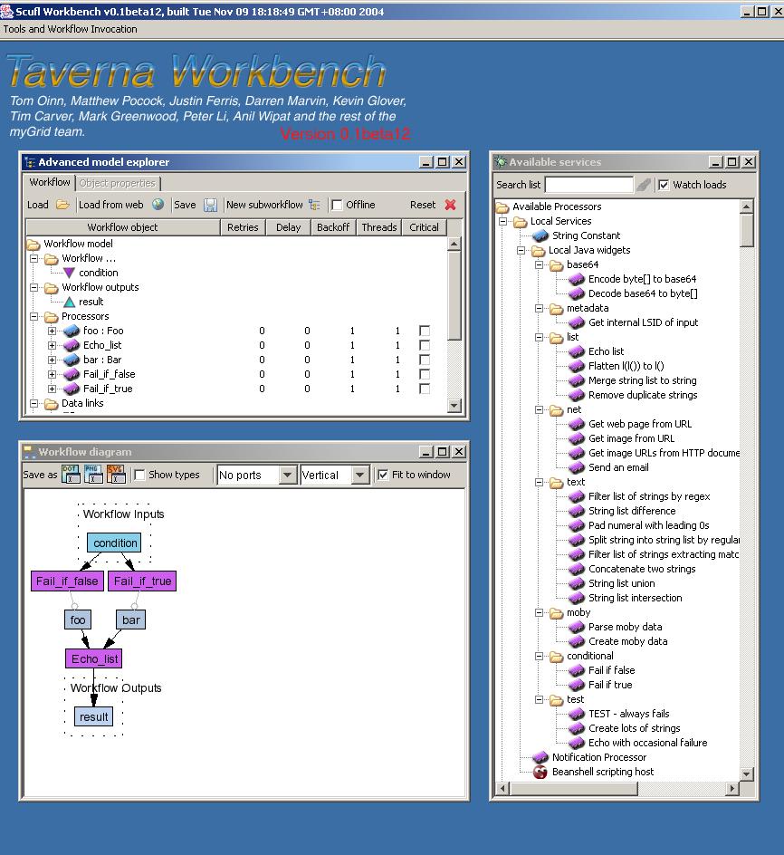


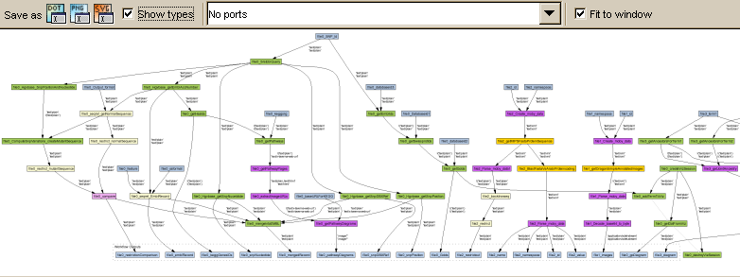
Exemplar 1:Database + Computational + Grid Computing Integration

Slide 5




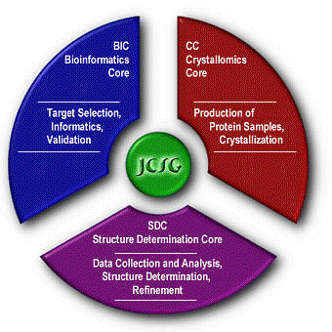

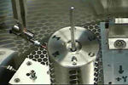
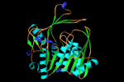


© John Wooley, JCSG/UCSD 2003

Slide 6


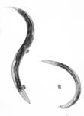
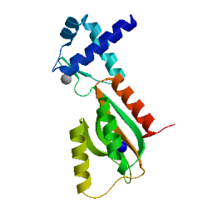
The Industrial Scale Discovery PipeLine of JCSG
HT Pipeline Processes, Bottlenecks and Leaks
target
selection
cloning
expression
purification
harvesting
imaging
crystallization
bl xtal mounting
xtal screening
data collection
phasing
tracing
publication
annotation
struc. validation
struc. refinement
© John Wooley, UCSD 2003
Exemplar 2: Instrumentation (synchrotrons)
+ Database + Computational Integration
PDB
Notes:
The JCSG Pipeline
Progress has been made in automating nearly all of the steps in this pipeline. Some of the steps are well defined and strictly procedural, such as oligo design, amplification, expression, first pass purification, and crystallization. The excellent robotic systems developed at GNF work well for these steps in the pipeline. Other stages are more complex, and require judgements based on accumulated human experience, such as evaluating gels, mounting and freezing crystals, assessing diffraction quality, refining and validating protein structures. Progression of samples through these steps is currently increased by web-based interfaces and scripts created to assist the user and through the conversion of human tasks into code where possible (see III.A.2.c). Underlying our pipeline strategy is the assumption that, in year 3, our pipeline throughput will continue to accelerate from the increased connectivity between process steps. Figure 18 Bottleneck analysis of the JCSG pipeline using data mining and systems integration. Leaks are illustrated by blue drips, scheduling and resource access bottlenecks by yellow connections and major process bottlenecks by red connections.
As year 3 progresses, we expect to see a secondary gain from improvements in the overall process that are driven by systematic examination of successes and failures to date. This data mining approach has already been applied in the development of the next tier of the T. maritima crystallome analysis as described earlier. Figure 18 illustrates an extensive analysis of the JCSG pipeline at the end of the initial two year period. Extensive data mining was conducted to identify leaks (blue drops) where gene targets are lost due to processing problems such as the challenges of the C. elegans proteome or loss due to insolubility, bottlenecks due to a lack of resources (green bottlenecks), lack of dedicated instrumentation such as crystallization robotics and beamlines (yellow bottlenecks) and process flow challenges (red bottlenecks). A number of initial feedback loops have already been established throughout the pipeline and are in routine production.

Slide 7
Bioinformation Integration
BioInstrumentation Integration
BioManufacturing Integration
To build an integrated generic grid platform that extends eScience to eManufacturing
To deploy this in a life science use-case scenario of rapid R&D response to emerging infectious disease.
To support “re-use and re-purpose”

Slide 8
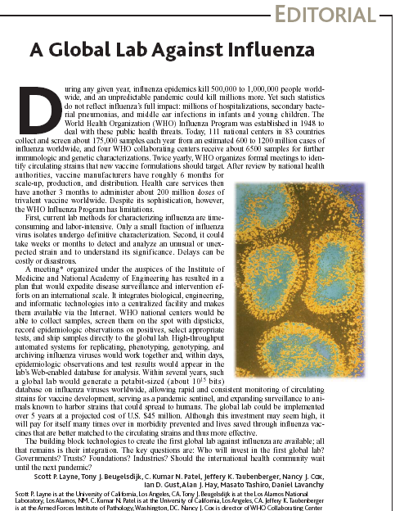
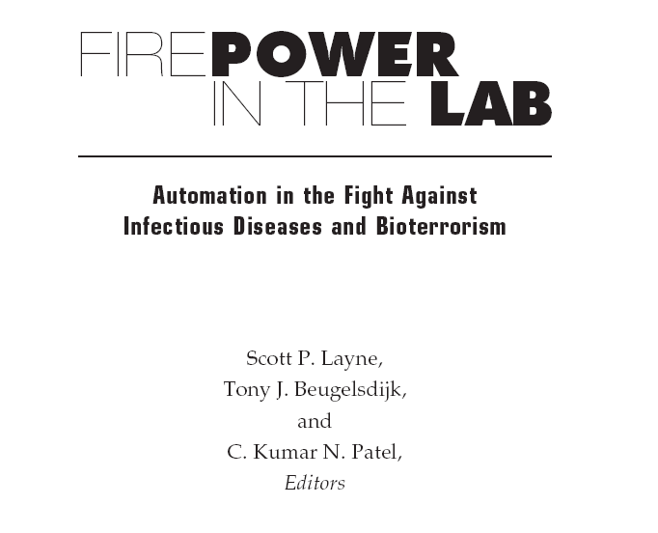
US National Academy of Sciences
http://books.nap.edu/catalog/9749.html
Science Vol 293 Sep 2001
www.sciencemag.org

Slide 9

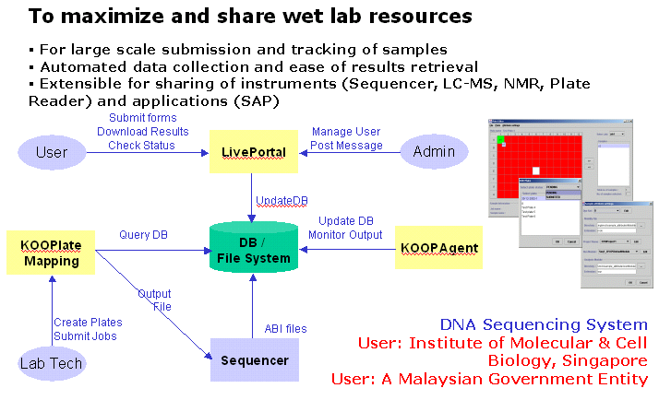
Example 1: Workflow Integration for
Automated DNA Sequencing
Notes:
At Institute of Molecular & Cell Biology, a portal is developed to facilitate the submission of samples for DNA sequencing. The portal allows the Sequencing department to automate the emailing of sequenced results to users, thus increasing the productivity and facilitating the working relationship for both the department and users.
“By allowing users to submit their requests on-line, this not only saves time and paper but also reduces transcription errors. Upon job completion, users are automatically informed via email and this feature is highly appreciated by users.
The online submission also means that all requests can now be loaded onto a database that allows us to retrieve information like the number of requests per lab/person for monthly reports. With the expected expansion of the DNA Sequencing Service, such a flexible system will help us meet new requirements.”
- Dr Alice Tay, Principal Coordinator, DNA Sequencing Facility, Institute of Molecular and Cell Biology

Slide 10
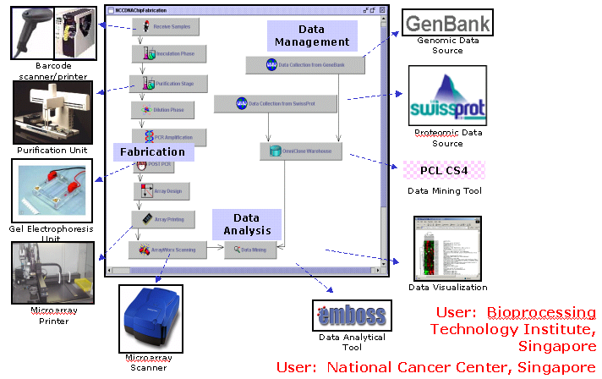
Example 2: Workflow Integration for MicroArray Design and Fabrication
Notes:
Described is a snapshot of a set of processes that fabricate DNA microarrays, collects data generated from hybridised microarrays, consolidates data from on-line sites and facilitates analysis of the data. The KOOPlatform is used to organize the processes.
The KOOP Microarray System is divided into 3 modules:
On the left side, you can see the wet lab work that is carried out in an automated manner where feasible. This is the Microarray Fabrication Module.
On the right side, you can see the dry side where data is collected from sources such as GenBank and SwissProt and stored in the data warehouse. This is the Microarray Data Management Module.
Coming together, data mining is carried out to provide an analysis, as well as, providing a comprehensive view of the information. This is the Microarray Analysis Module.

Slide 11
Proof of Concept
Unknown
Infectious
Agent
Automated DNA
Sequencing
Complete Genome/
Sufficient Data
Semi-Automated
Oligonucleotide
Design
Automated
Microarray
Fabrication
Nucleotide Probes
Automated
Oligonucleotide/
Probe Synthesis
Lead Primer
Targets
Prototype
DNA Chips
Semi-Automated
Diagnostic
Assays
Re-Design
of Probes
No
Yes
Deployable
Diagnostic
DNA Chips
Large Scale
Manufacture of
DNA Chips

Slide 12
Proof of Concept
Workflow Pipeline
Control Layer
Data/Information Flow Layer
Materials Layer

Slide 13
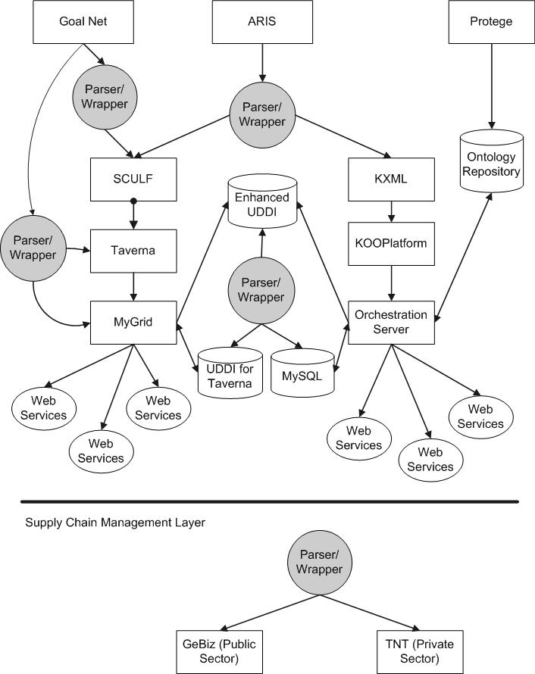

Slide 14
Data/Info Layer Analysis
Sample Processing
Generate ArrayId
Homology Search w GRIDBLAST
DNA Sample Plate Mapping
Generate Experiment
Seq Annotation w GenBank
Hybridize Array with Sample
DNA Sequencing
SendGeneListFile to ProbeDesign
Collect Microarray Results
Collect ABI data
ProbeDesign
Perform Single-array Normalization
Store ABI data
Send ProbeList to Oligo Synthesizer
Filter data
QualityCheck
Probe QC
Cross normalization
Vector Masking
Send CompletedProbeList to Microarray Discovery System
Discovery & prediction with PCL/CS4
Vector Trimming
Map ProbeToPlates
Visualize with MGM or HCluster
Contigs Assembly
Configure Microarray Printer
Generate Hits for Field test
WetLab
Visuals/Programs

Slide 15
Data/Info Layer Analysis
Viral/Bacterial/Pathogen isolate
Recloning
Amplification
Sample Processing
DNA Sample Plate Mapping
Chromosome
walking
DNA Sequencing
Collect ABI data
Store ABI data
QualityCheck
Gap Filling
Vector Masking
Vector Trimming
Contigs Assembly
next
WetLab
Visuals/Programs

Slide 16
Data/Info Layer Analysis
Homology Search w GRIDBLAST/
FPGA-accelerated SSEARCH
previous
Seq Annotation w GenBank
SendGeneListFile to ProbeDesign
ProbeDesign
In Silico PCR
Send ProbeList to Oligo Synthesizer
CLUSTALW/Treeview
Probe QC
SSEARCH/BLAST
Send CompletedProbeList to Microarray Discovery System
PCR Primer Design
(e.g. Primer3, Synamatix, Novusgene)
Amplify Probes
Map ProbeToPlates
next
Configure Microarray Printer
WetLab
Visuals/Programs

Slide 17
Data/Info Layer Analysis
Generate ArrayId
previous
Generate Experiment
Clinical Sample Preparation
Hybridize Array with Sample
Collect Microarray Results
Perform Single-array Normalization
Filter data
Cross normalization
Discovery & prediction with PCL/CS4
Visualize with MGM or HCluster
Primer/Probe Selection/Re-Design
Generate Hits for Field test
WetLab
Visuals/Programs
Scale up Manufacturing

Slide 18



Materials Requirement Analysis and
Integration with Supply Chain Manufacturing
DNA
Sequencer
Oligonucl
Synthesizer
HPLC
purificatn
Microarray Fabricator
Microarray analyser
Materials requirements analysis & planning
flexible forecasting
planning,
scheduling
materials replenishment
execution tools
maximize production environment
Materials
Supply
Chain
Collaborative Planning, Forecasting, and Replenishment (CPFR) where manufacturers, distributors, and retailers jointly work together to plan, forecast, and replenish products.

Slide 19
Supporting layers
GoalNet high level model decomposition and scheduling optimising system
Protégé ontology deployment for life science diagnostic manufacturing
Aris UML modeling of integrated workflows
Supply chain manufacturing and materials analysis systems
Laboratory LIMS systems

Slide 20














Project Partners and Collaborators
Vendors and Suppliers
R&D TO DIAGNOSTIC KITS

Slide 21
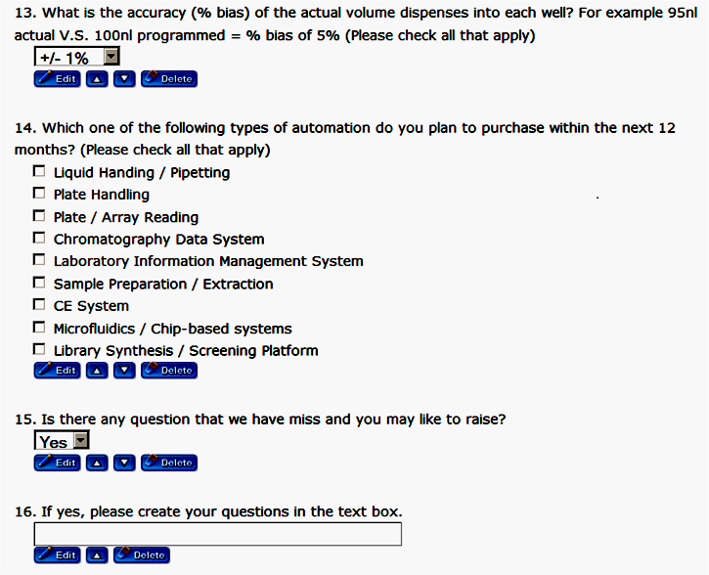
A Cooperative On-line Design Establishment for a High-throughput Automated Reconfigurable Line Integration
Unique Features – On-the-fly question creation
Benefits to the Line Designers
A collaborative on-line questionnaire design with ad-hoc questions and choices creation facilities to allow discovery of inert needs
Faster and cost effective in capturing customer feedback and common needs
Easier to manage the process of gathering and validating ideas, suggestions, concepts or feature from multiple customers
Reduce design time of complex automated lines.

Slide 22




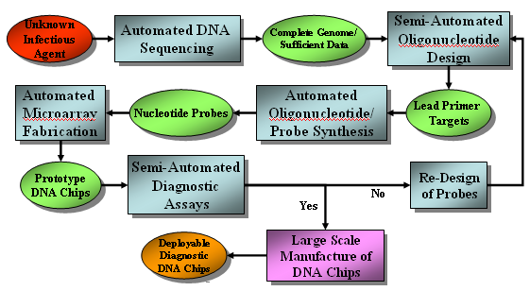
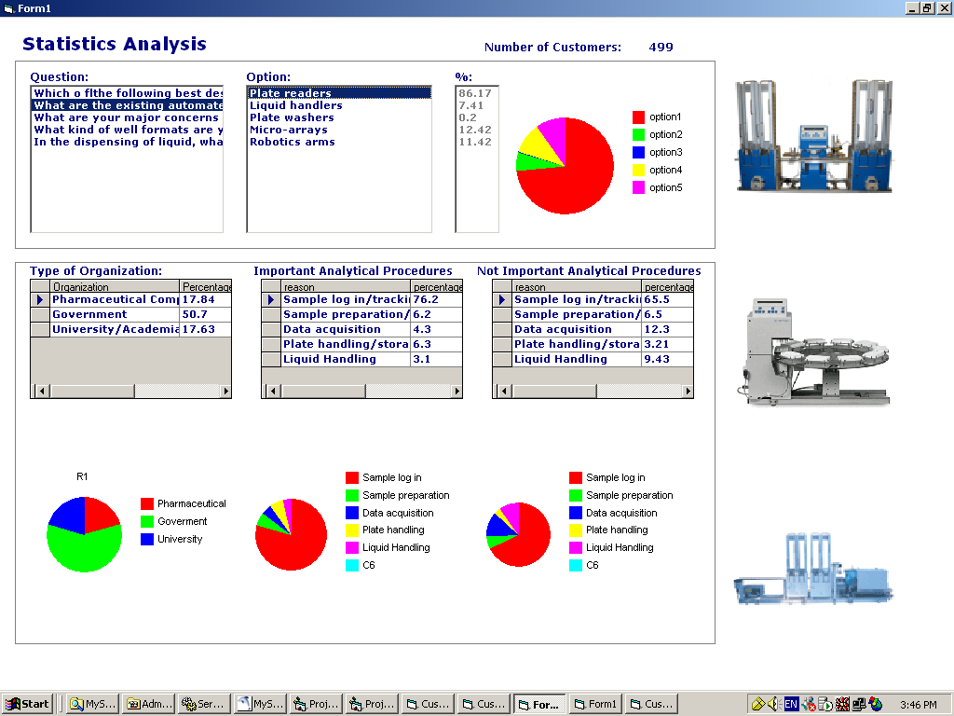
Online Design of Automated Laboratory Integration,
ODALI SYSTEM
CHALLENGES and GOALS
COLLABORATION
The designer of high throughput automated reconfigurable laboratory lines faces many challenges. These include the need to cater not only for biological and chemical variability, but a range of subset disciplines such as biotechnology, and biochemistry. The combinatorial experiments conducted on the specimens (cells, compounds, molecules, DNA, RNA) handled in each area will affect the choice and costs associated with the automated specimen/liquid/plates handling, processing, tracking/ logging, screening, amplification, expression, sequencing, synthesis, analysis and total line integration management.
PROJECT DESCRIPTION
An on-line design requirements acquisition system and unmet needs discovery system to address the above challenges and aims, consisting of:
A Cooperative On-line Design Establishment for a High-throughput Automated Reconfigurable Line Integration (CODE HARLI) with ad-hoc questions and choices creation facilities.
An Intelligent Priority Requirements, Unmet Needs Trend Analysis, Clustering and Correlation System.
Automated Laboratory Workflow
INDUSTRY RELEVANCE / BENEFITS
The ODALI system eliminates potential line design error and helps to prioritise the must-have/nice-to-have features from the truly missing gaps and unmet needs. It cuts down the survey, design and trend analysis time in the automated laboratory line manufacturing industry. It enables hardware, software and system integration to capture the true requirements rather than to built equipment based on in-house gut feelings. Highly applicable to the development of automated lines ranging from life science experiments to semiconductor fabrication.
An Intelligent Priority Requirements, Unmet Needs Trend Analysis, Clustering and Correlation System

Slide 23
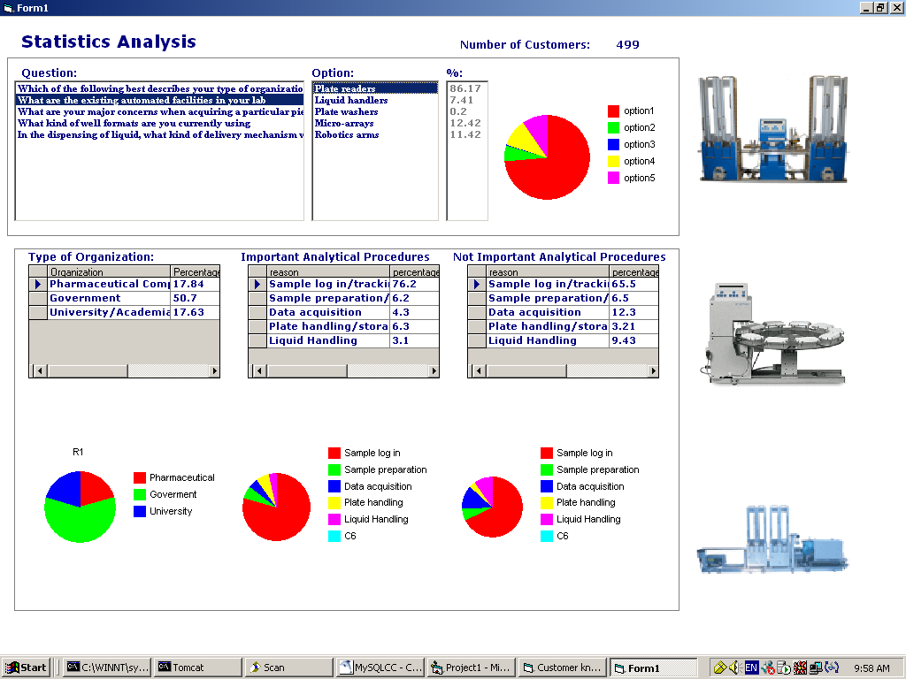
An Intelligent Priority Requirements, Unmet Needs Trend Analysis, Clustering and Correlation System
Sample multi-preference and reasoning analysis
Benefits to the Line Designers
Discovery of user’s inert needs with statistical analysis & multi-preference requirements
Faster explication of customer’s motivations with reasoning analysis
Enable greater configurability and flexibility of resultant lines.

Slide 24
BioInformation
BioInstrumentation
BioManufacturing
Grid-enabled
Instruments
MetaData
Grid
Grid-enabled
DataSources
Grid-enabled
Compute Resources
Grid-enabled
Materials Supply

Slide 25

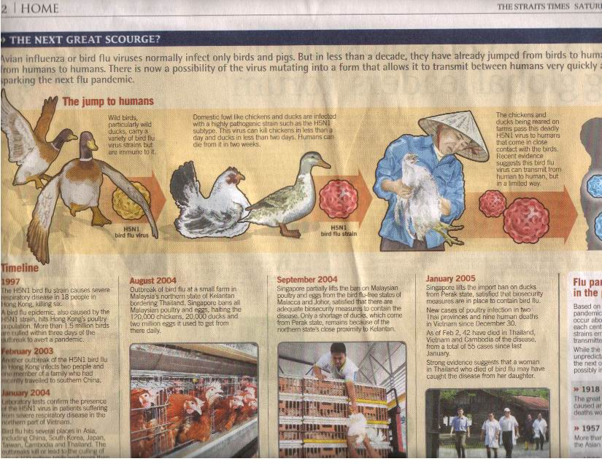


Slide 26
Bird Flu Mutant strains?
From Viral Isolate to Diagnostic Chip In x months?
Unknown
Infectious
Agent
Automated DNA
Sequencing
Complete Genome/
Sufficient Data
Semi-Automated
Oligonucleotide
Design
Automated
Microarray
Fabrication
Nucleotide Probes
Automated
Oligonucleotide/
Probe Synthesis
Lead Primer
Targets
Prototype
DNA Chips
Semi-Automated
Diagnostic
Assays
Re-Design
of Probes
No
Yes
Deployable
Diagnostic
DNA Chips
Large Scale
Manufacture of
DNA Chips

Slide 27
Conclusion
If ever we need to do this, we need to do it now!
Asia is the epicenter of predictable and unpredicatable calamities, epidemics etc.
Killer Flu (1997), Nipah virus (1998/99), SARS (2003) [Tsunami (2004)]
How about other regions? Ebola? West Nile virus? Low cost flights make for rapid dissemination.
Unpreparedness spells pandemic if we cannot cope with these outbreaks at source.
Life Science and Biomedical Grids can help!

