Slide 1
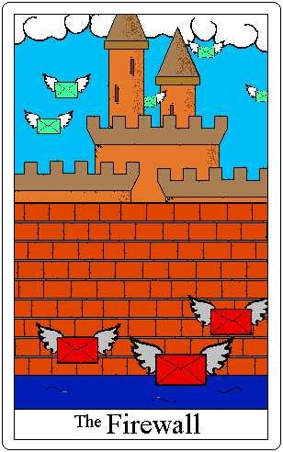
Firewall Issues
Research Group
GGF-15 Oct 4 2005 Boston, Ma
Leon Gommans - University of Amsterdam
Inder Monga - Nortel Networks

Slide 2
Trusted Network Connect Architecture and GridFTP
Leon Gommans - University of Amsterdam lgommans@science.uva.nl

Slide 3
Content
Trusted Network Connect (TNC) Architecture
TNC and gridftp Garage Door Opener
Extensible Authentication Protocol (EAP)

Slide 4
Trusted Network Connect Architecture
Part of Trusted Computing Group (TCG) work (www.trustedcomputinggroup.org)
Relevant document:
  TNC Architecture for interoperability v1.0
Show / discuss relevance to Grids.

Slide 5
TNC Scope and Goals
Allow networks to enforce policy regarding the security state of endpoints.
Security state determined by set of integrity measurements of an endpoint.
Network access is granted depending on evaluation of endpoint security state.
TNC defines architecture for access control and authorization.
Leverages existing access control mechanisms such as IEEE 802.1X
Defines interoperable interfaces using attributes considering software state, endpoint compliance and platform authentication.

Slide 6
TNC Platform Authentication
Concerns two aspects in TCG realm:
Proof of identity using a non-migratable Attestation Identity Key - see:
  www.trustedcomputinggroup.org/groups/glossary
Proof of integrity
  May trust the user (PKI cert., proxy cert.)
  May trust the connection (SSL, IPSec)
  But who trusts the platform ?
    Laptop, PDA moving in and out Enterprise Network
    Inter-machine communication trust is established via conformance.

Slide 7
TNC Architecture
Provides framework to achieve a multi-vendor network standard providing:
  Platform authentication
  Endpoint policy compliance
  Access policy
  Assessment, Isolation and Remediation

Slide 8
TNC Architecture cont.
Access
Requestor (AR)
Policy
Enforcement
Point (PEP)
Policy
Decision
Point (PDP)
Domain 1
Domain 2
Domain 3

Slide 9
TNC Architecture cont.
AR
PEP
PDP
Integrity
Measurement
Layer
Integrity
Measurement
Collectors
IF-M
Integrity
Measurement
Verifiers
IF-IMC
IF-IMV
Integrity
Evaluation
Layer
TNC
Client
IF-TNCCS
TNC
Server
IF-T
Network
Access
Layer
Access
Requestor (AR)
Policy
Enforcement
Point (PEP)
Network
Access
Authority
IF-PEP
Supplicant
VPN Client etc.
802.1X Switch / Firewall
VPN Gateway
AAA server

Slide 10


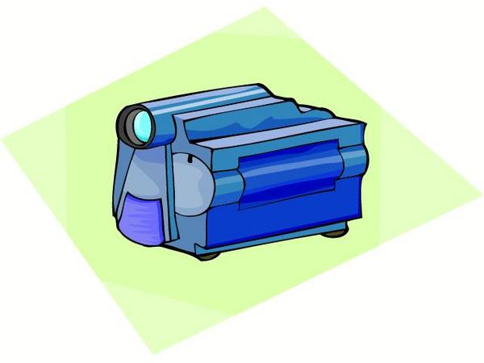
Globus XIO
Network Protocol
Driver
Network Protocol
Network Protocol
Globus XIO
Application
Driver
Disk
Driver
Special Device
Source: The Globus Alliance

Slide 11
Globus XIO Framework
Moves the data from user to driver stack.
Manages the interactions between drivers.
Assist in the creation of drivers.
  Asynchronous support.
  Close and EOF Barriers.
  Error checking
  Internal API for passing operations down the stack.
User API
Driver Stack
Transform
Framework
TNC AR
Transport
Source: The Globus Alliance

Slide 12
gridftp Garage Door Opener
RFT
Service
GridFTP
Server
GridFTP
Server
F/W GDO
TNC AR
F/W GDO
TNC AR
EAP
EAP
Virus
check
Patch
levels
Other
IMC’s
Virus
check
Patch
levels
Other
IMC’s
TNC
PEP
TNC
PDP
Firewall Application
profiles
Virus
check
Patch
levels
Other
IMV’s

Slide 13
Extensible Authentication Protocol
RFC 3748
Reliable peer-peer protocol over a data link (PPP, IEEE-802) without requiring IP.
Used to allow authentication on:
  Dial-in access using PPP
  802.1X port based switches
  802.11 Wireless LANs
Purpose: Support a flexible dialog between a back-end EAP server and a peer that needs authentication.

Slide 14
EAP cont.
Peer Pass-through Authenticator Authentication
Server
+-+-+-+-+-+-+ +-+-+-+-+-+-+
| | | |
|EAP method | |EAP method |
| V | | ^ |
+-+-+-!-+-+-+ +-+-+-+-+-+-+-+-+-+-+-+-+-+-+ +-+-+-!-+-+-+
| ! | |EAP | EAP | | | ! |
| ! | |Peer | Auth.| EAP Auth. | | ! |
|EAP ! peer| | | +-----------+ | |EAP !Auth.|
| ! | | | ! | ! | | ! |
+-+-+-!-+-+-+ +-+-+-+-!-+-+-+-+-+-!-+-+-+-+ +-+-+-!-+-+-+
| ! | | ! | ! | | ! |
|EAP !layer| | EAP !layer| EAP !layer | |EAP !layer|
| ! | | ! | ! | | ! |
+-+-+-!-+-+-+ +-+-+-+-!-+-+-+-+-+-!-+-+-+-+ +-+-+-!-+-+-+
| ! | | ! | ! | | ! |
|Lower!layer| | Lower!layer| AAA ! /IP | | AAA ! /IP |
| ! | | ! | ! | | ! |
+-+-+-!-+-+-+ +-+-+-+-!-+-+-+-+-+-!-+-+-+-+ +-+-+-!-+-+-+
! ! ! !
! ! ! !
+-------->--------+ +--------->-------+
Pass-through Authenticator

Slide 15
Conclusions
TNC Architecture seems worth while to follow its progress.
Use of EAP as IF-T is a recommendation - Firewall vendor support ?
UvA and ANL will work on prototype implementation
Functional design expected by next GGF.

