Slide 1
The TWIST Use Case
GGF Transaction Management Research Group
- Tony Fletcher
tony.fletcher@choreology.com

Slide 2
Reference and acknowledgement
I was first introduced to this use case by Bill Specht (Currenex) and Matthew Arrott (ex-Currenex now with CommerceNet) at a W3C WS-Choreography meeting, where it was offered as an example of a medium complexity application protocol that is in real use. They have given me permission to sue within other standards groups and specifically the GGF TM-RG.
Taken from TWISTWholesaleTradeRequirements.doc Draft Version 0.51, March 25, 2004
See also www.TWISTstandards.org

Slide 3
Use case outline (1)
In this use case a trading service is being used to route requests and prices between buyer and seller. The buyer has also elected to use a credit service provided by the trading service. There are two price makers in the example (in general there can be more), only one can win.
The process begins when the Buyer sends a priceRequest to the Trading Service. The request indicates which sellers will see the request.
Prior to sending the request credit is checked on both of these. In this example all is well and the credit is reserved for both after which a priceRequest is sent to each of the sellers.

Slide 4
Use case outline (2)
The sellers in turn check credit for the buyer. Although the diagram indicates these processes are sequential, they need not be. Again all credit is OK in this example and priceResponses are sent back to the service which forwards these on to the buyer.
The buyer accepts the price from SellerA. The service then informs SellerA that the price is accepted and to SellerB a simple notDone (cancel) is issued.
SellerA will the drawDown the credit used while SellerB will replenish the credit.
After the priceAcceptanceAck is delivered to the buyer, sellerA’s credit will be drawDown and sellerB’s credit will be replenished. This requires two messages one for each counterparty.

Slide 5
Trading service architecture
Buyer
Trading
service
TS
Credit
. . .
Seller N
Seller A
Seller B
Credit A
Credit B
Credit N

Slide 6
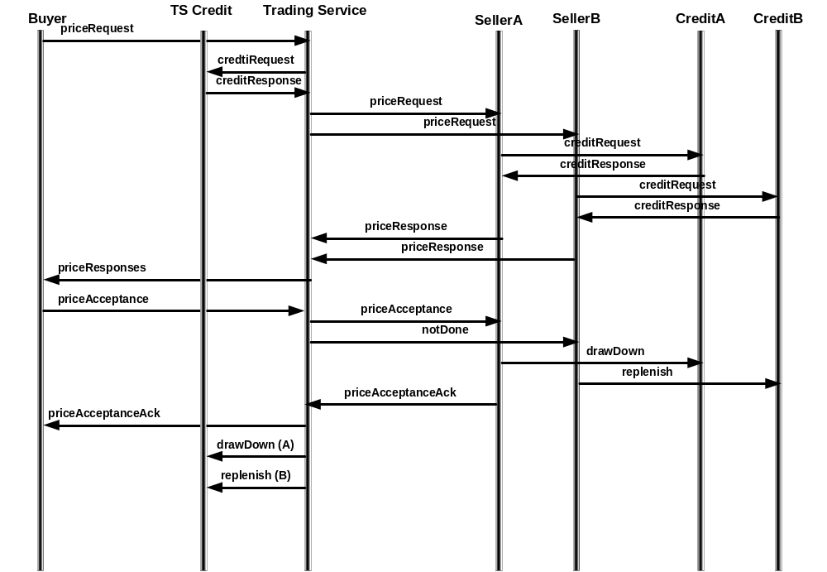
Original TWIST scenario 7.2.7

Slide 7
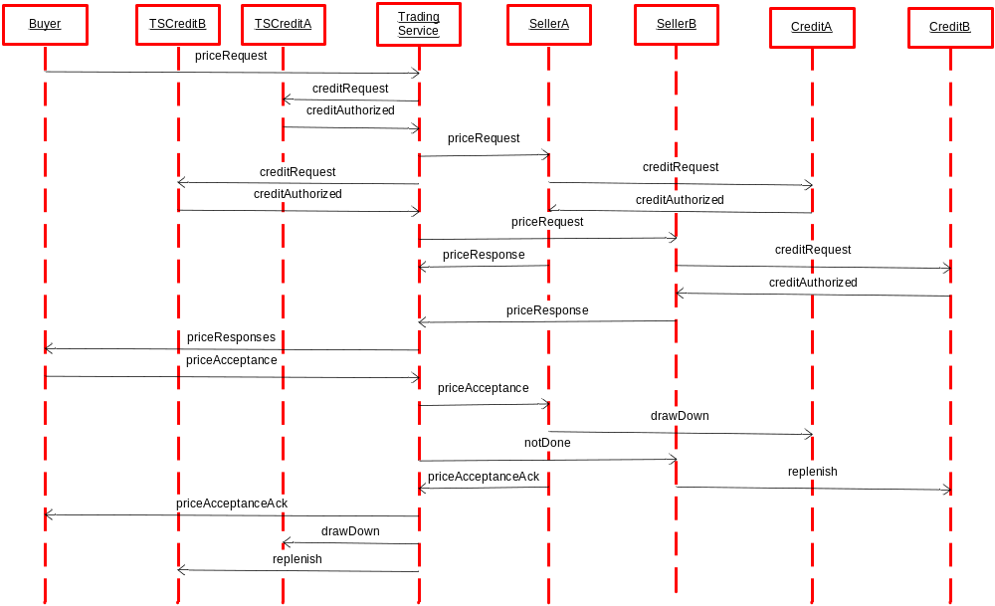
Adding two TSCredit roles, for Sellers A and B

Slide 8
With transaction boundaries

Slide 9
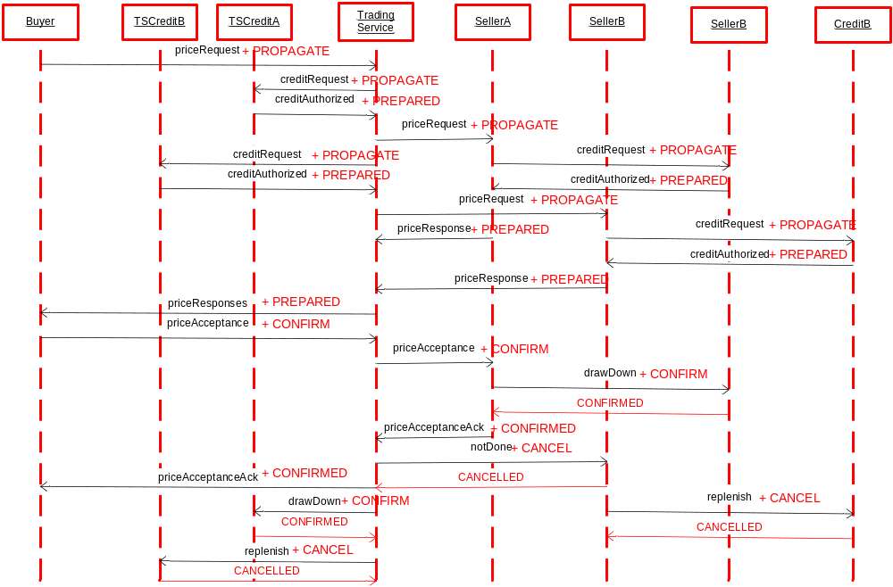
With transaction signals

Slide 10
Each transaction follows the same pattern:
App Request + PROPAGATE transaction context
  In TWIST, that’s a “Conversation”.
App Provisional Response + PREPARED
App Conclusion + CONFIRM or CANCEL the provisional response
(optional App Ack) + CONFIRMED or CANCELLED

Slide 11
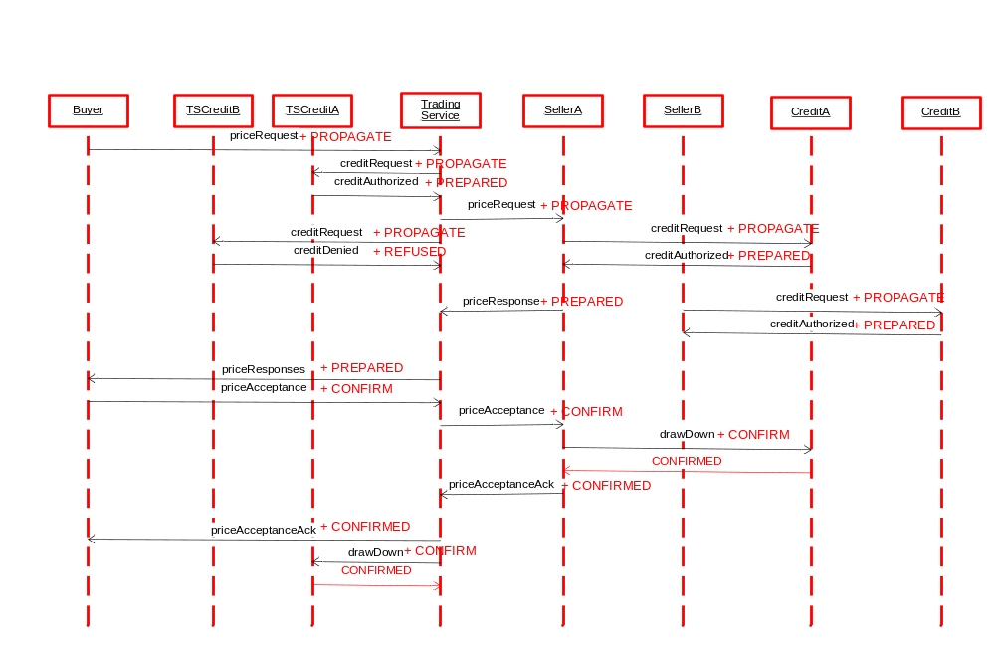
Something goes wrong: creditDenied for SellerB

Slide 12
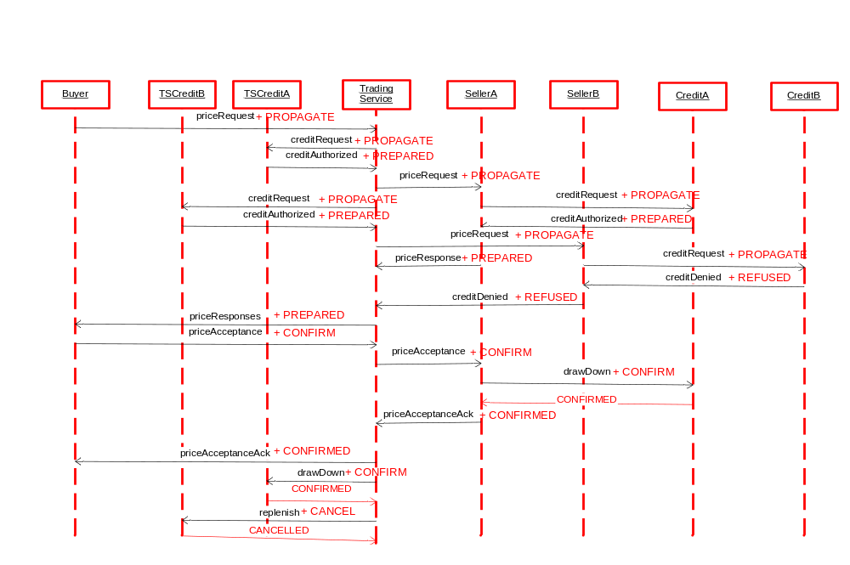
Something else goes wrong: CreditB denies credit to Buyer

Slide 13
Revised pattern:
App Request + PROPAGATE transaction context
Choice:
  App refuses request + REFUSED
  Sequence:
    App Provisional Response + PREPARED
    App Conclusion + CONFIRM or CANCEL the provisional response
    (optional App Ack) + CONFIRMED or CANCELLED

Slide 14
Derived requirements (1)
The aim is to provide transactional integrity over all of the interactions and relationships in this diagram such that:
R9 No manual reconciliation will be required to repair transactional inconsistencies.
R10 Each interaction will be guaranteed to achieve not only reliable delivery of the message, but also reliable processing of the message.

Slide 15
Derived requirements (2)
R11 Each set of participants will agree on the outcome of their business transaction, that is, no case will arise where one party thinks a transaction succeeded and the other thinks it failed or doesn’t know the outcome.
R12 If a participant or network connection fails temporarily, when it comes back up, the participant will automatically recover and resynchronize with its counter-parties.
R13 A coordinating party such as the Trading Service will be able to monitor the state of all its interactions with all counter-parties.

Slide 16
Derived requirements (3)
Additional requirements:
R14 Ability to handle many transactions simultaneously with a fast response time.
R15 Ability to support a variable number of participants in the transaction (in this case sellers and their credit providers.
R16 Ability to be able to selectively cancel parts of a transaction while confirming other parts.
R17 Ability to be able to use commit / cancel mechanisms other than do the work then compensate if need to cancel.

Slide 17
Banging the Transactions Drum !
Business analysts hate to (often refuse to) handle exceptions.
  Witness the TWIST scenarios…
Exceptions in business coordination scenarios multiply like rabbits.
A good business transaction protocol will handle many exceptions, eg:
  Recover and realign regardless of end-system or comms failures.
  Resolve collisions in a defined manner.
  Handle timeouts.
  Handle either side deciding to give up (i.e. app triggered exception) at any time.
Good business transaction management software will handle all protocol exceptions.
Most of those exceptions can safely be ignored by the business analysts.

Slide 18
Conclusion (1)
A use case from the financial instrument trading sector.
Not overtly Grid, but may be needed to run in a Grid environment
  to get the required throughput
  because this company / sector has moved its distributed applications to the Grid (and may be some of its internal ones as well.
Uses a generic division of outcome
  ‘confirm’ for positive outcome – trade successful
  ‘cancel’ to remove a potential seller from the trade and to mean the whole trade is off – negative outcome.

Slide 19
Conclusion (2)
When doing the ‘forward’ trade, the buyer can freely choose which instrument to buy, how much to buy, what price is acceptable and constitutes a good deal, and exactly when conditions are right to buy.
So for the forward trade the buyer has several degrees of freedom and will only proceed with the trade if they are satisfied it is a good deal.
If do not use a transaction and need to ‘undo’ the deal afterwards then the trading service needs to sell that particular instrument, that quantity and within a narrow time window, so has to take whatever price they can and will nearly always make a loss relative to the forward deal – degrees of freedom very limited.
Therefore wrapping in a transaction which allows the trade to be agreed tentatively (provisionally) and then confirmed or cancelled is very beneficial.

