Slide 1
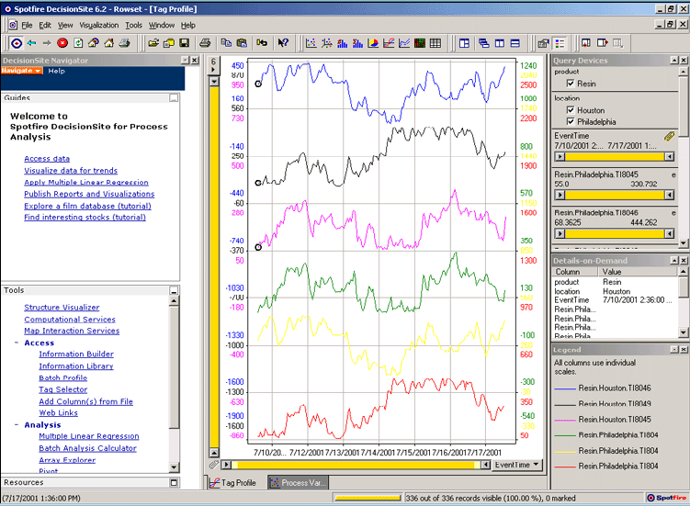
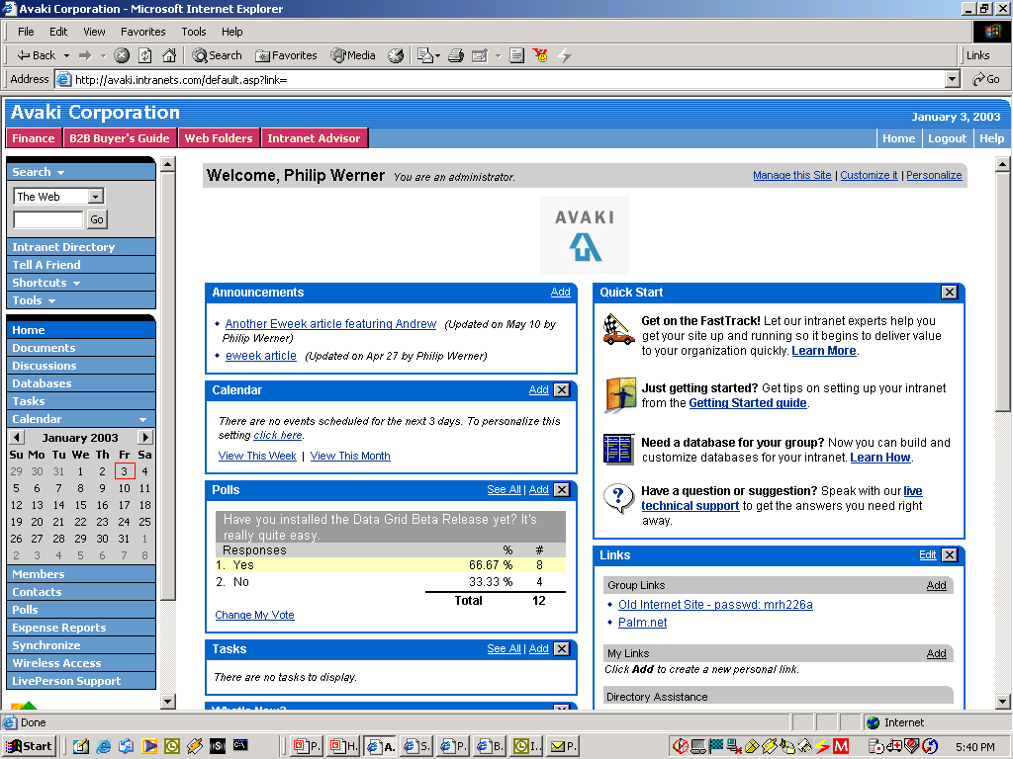

Case Study: Business Intelligence &
Customer Data
Customer Data
Customer Order Information
Oracle
SAP
DB2
Siebel
SQL
Stored
Procedure
XSLT
Results
XML
XSLT
XML
Results
XML
Data Grid
Company wants real-time integrated view of customer buying behavior
Data resides in various distributed CRM & ERP systems
Grid allows developers and apps to access and integrate customer data sources together in real time--across many distributed databases
Customer
Support
Web-based
Dashboard
(Identifies Likely
Buyers of New Product)
VP Marketing
Notes:
Here’s an example of how a company can use Avaki Data Grid to integrate data from multiple systems. In this case, a large, distributed insurance company has customer, policy, and claims data in a number of individual systems that support different product lines. Marketing specialists and other business managers need integrated views of this information that will help them enhance the company’s marketing strategy, such as: all the different policies held by a single customer, all the different customers from a single geographic location, and so on.
This diagram shows two systems that have customer data. In this case, Avaki is used as a netural integration layer that can take data out of both the Oracle and DB2 databases that are supporting two different applications, and also some data out of a file server, and combine all this data for use by a marketing dashboard and a business intelligence application. XSL transformations are used to provide the data in a particular XML format that is used by the application.
In the data grid, an architect can specify the sequence of transformations and updates that ultimately create the views of the data required by the business analysts. In this case, no intermediate data mart or data warehouse is needed.
By deploying a data grid, the company has eliminated the need for users to access remote databases directly. Instead, users sign onto their local systems and are automatically able to access data via the data grid. This saves significant time for the DBAs who manage each database; they no longer have to manage remote user access, and need only specify who should have access to the data objects that represent their data. Data is not moved and does not leave their control.
The IT organization, which thought it might have to create a data warehouse, now has a low-overhead infrastructure for making data available to users and applications for analysis. With this infrastructure in place, data owners and developers can meet requests for additional data more quickly.
Through the data flow definitions and cache configurations, architects can “dial” the freshness of the data to meet business requirements. Static reference data does not need to be updated at all, while customer data is updated frequently enough to show recent selling trends. As a result, the organization has fresher, more accurate data from which to make important business decisions.

Slide 2

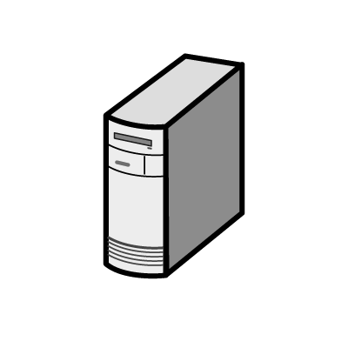
Case Study: Data Grid Provisioning Data to
Cluster-Based Analytical Application
R&D
West Coast
Engineering
East Coast
QA/Testing Outsourcer India
Data Grid
Data Grid
Data Grid
Company has centralized HPC cluster running compute-intensive applications
Source data for analyses distributed among 3 global sites, one of them an external partner
Highly manual data-sharing processes increase costs/errors, and hinder time-to-results
Grid enables secure, automatic provisioning of remote data to HPC cluster—feeding CPUs more data faster
Headquarters
Illinois
Forward Proxy Data Caches of Remote Data
Data Grid
Analytical
Applications
Centralized
Compute Cluster

