Slide 1
The NorduGrid Information System
Balázs Kónya
GGF5
21-24 July, 2002, Edinburgh

Slide 2
what is this talk about?
  a working implementation of a
  Grid information model:
representation of information
  technical implementation (LDAP, ...)

Slide 3
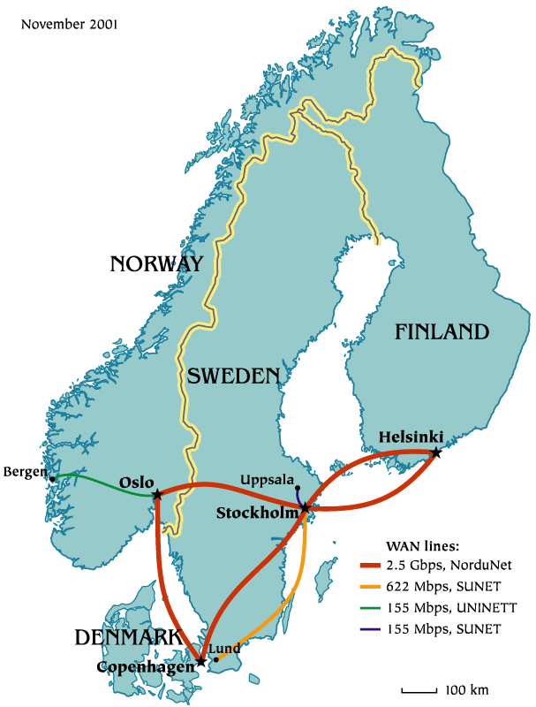
NorduGrid Project
www.nordugrid.org
Create a Grid infrastructure in Nordic countries
Operate a production quality Testbed
Expose the infrastructure to end-users of different scientific communities
Survey current Grid technologies
Pursue basic research on Grid Computing
Develop Middleware Solutions

Slide 4
NorduGrid Project
operates a production Grid Testbed composed of clusters
  “An overview of a Grid Architecture for Scientific Computing” http://arxiv.org/abs/cs.DC/0205021
develops the missing Middleware pieces, plugs the holes of the Globus:
  job submission, monitoring (extended RSL)
  gridftp-based replacement of the GRAM (gridmanager)
  broker
  information model
NorduGrid toolkit: extension of the Globus toolkit

Slide 5
NorduGrid: participants
Copenhagen University: Niels Bohr Institute, Research Center COM, DIKU
Oslo University, Bergen University
Lund University, Uppsala University, Stockholm University, KTH
Helsinki Institute of Physics

Slide 6

Grid Information System
resource characterization / description
resource discovery
monitoring of services / resources
Data Management
Resource & Job
Management
Information System
    The nerve system of the Grid
    information is a
    critical resource on the Grid
+ security

Slide 7
Why is it so complicated?
large number of resources
  => scalability
diverse heterogeneous resources
  => characterization?
decentralized, automatic maintenance
efficient access to dynamic data
quality and reliability of information
  => fake information can 'kill' the Grid

Slide 8
The challenge
Grid users always want prompt access to all the information
inevitable compromise:
load on the Grid <=> up-to-dateness
  try to avoid continuous monitoring
  generate information on demand (pull model)
  apply elaborate caching and keep track of validity of the data (ttl)
  organize “information producers” into some kind of topology (i.e. hierarchy)

Slide 9
Solution provided by the
Globus Toolkit
Monitoring and Discovery Services (MDS 2.1)
  comes as a part of Globus ToolkitTM version 2.0
  “de facto” standard information system
  OpenLDAP based implementation
  general framework for creating Grid Information Systems
    information model (MDS schema)
    providers (populate the schema)
    GRIS (Grid Resource Information Service), LDAP backend, presents the information for the consumers
    GIIS (Grid Index Information Service), LDAP backend, link together GRISes, build hierarchy, caching

Slide 10
limitations of MDS 2.1
not suitable for describing clusters
  the schema simply forgot about clusters
  single machine, “host” based representation
  each node of a cluster needs to run a GRIS
  users are not interested in most of the MDS attributes
  cluster management/batch system information is badly represented (hidden)
insufficient job information
buggy providers
overcomplicated schema
MDS 2.1 has never been widely deployed

Slide 11
demand for a better model
at the end of 2001 NorduGrid aimed to have a production Testbed with a usable and reliable information system:
  within a finite amount of time
  based upon the Globus MDS framework
  with a new cluster-based model
  simple & natural mirror of our Testbed architecture
on the other hand at that time
  no GridForum standards, no available common Grid Information Model
  unrelated, uncoordinated efforts within the GridForum
  preliminary theoretical results won't help you to run a Testbed

Slide 12
recipe for creating your own MDS based information system
Model your own Testbed architecture, define the Grid objects. Formulate this in an LDAP schema
Structure your objects (LDAP entries) into a GRIS Tree
Implement providers to populate the LDAP entries
Create a topology of GRISes -> GIIS hierarchy

Slide 13
technical overview
NorduGrid Information System:
  built upon the MDS 2.1 LDAP backends
  the NorduGrid schema gives a natural representation of our resources
    clusters (queues, jobs, users)
    storage elements
    replica catalog
  efficient providers fill the entries of the schema
  each “grid unit” runs its own GRIS
  GRISes are organized into a dynamic country-based GIIS hierarchy

Slide 14
DIT of a cluster
cluster
queue
jobs
users
queue
job-01
job-02
job-03
user-01
user-02
jobs
users
job-04
job-05
user-01
user-02
user-03

Slide 15
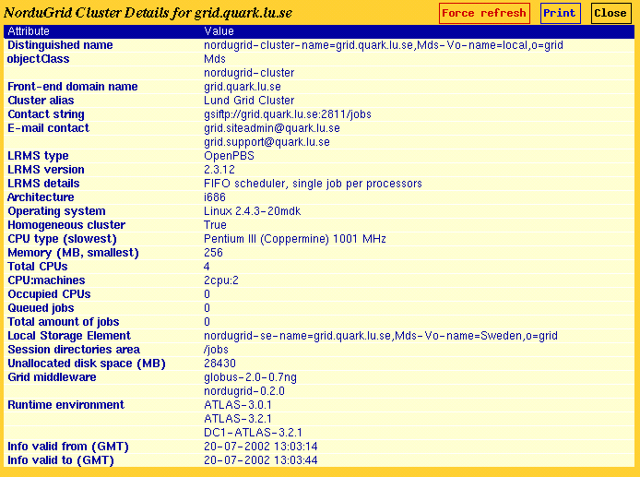
cluster entry

Slide 16
DIT of a cluster
cluster
queue
jobs
users
queue
job-01
job-02
job-03
user-01
user-02
jobs
users
job-04
job-05
user-01
user-02
user-03

Slide 17
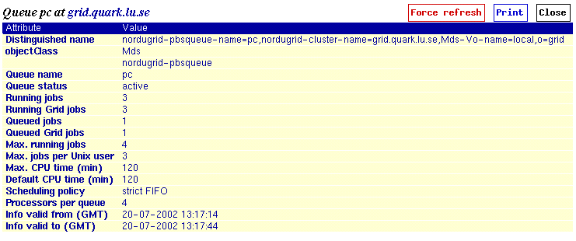
queue entry

Slide 18
DIT of a cluster
cluster
queue
jobs
users
queue
job-01
job-02
job-03
user-01
user-02
jobs
users
job-04
job-05
user-01
user-02
user-03

Slide 19
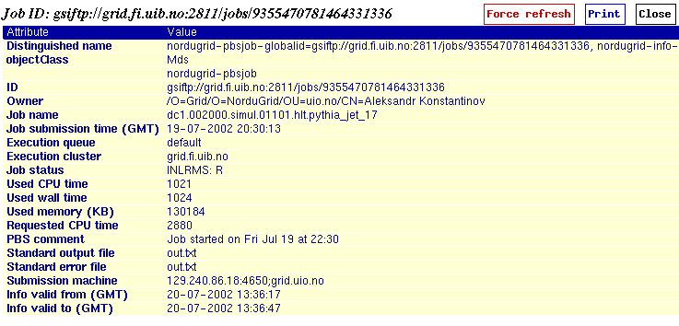
job entry
job status monitoring = information system query

Slide 20
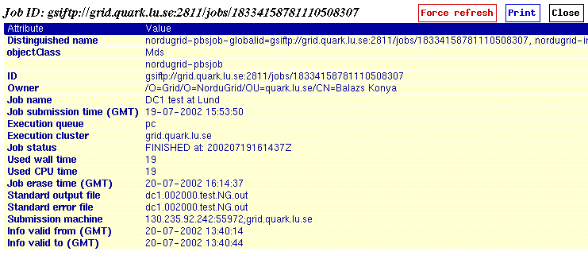
another job entry
- the job entry is generated on the execution cluster
- when the job is completed and the results are retrieved
the job disappears from the information system

Slide 21
DIT of a cluster
cluster
queue
jobs
users
queue
job-01
job-02
job-03
user-01
user-02
jobs
users
job-04
job-05
user-01
user-02
user-03

Slide 22

personalized information
user based information is essential on the Grid:
  users are not really interested in the total number of cpus of a cluster, but how many of those are available for them!
  number of queuing jobs are irrelevant if the submission gets immediately executed
  instead of total disk space the user's quota is interesting
nordugrid-authuser objectclass
  freecpus
  diskspace
  queuelength

Slide 23
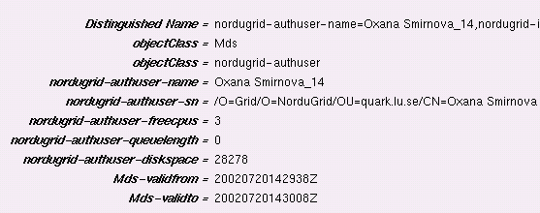
user entry

Slide 24
available information:
SE, RC (preliminary)
Storage Element
  se-baseurl
  gsiftp://bambi.quark.lu.se:2811/gamma/scratch
  se-freespace
  se-authuser
Replica Catalog
  rc-baseurl
  ldap://grid.uio.no:389/rc=NorduGrid,dc=nordugrid,dc=org
  rc-authuser
these objectclasses are 'under construction' they will gain real importance with the NorduGrid Storage Manager

Slide 25
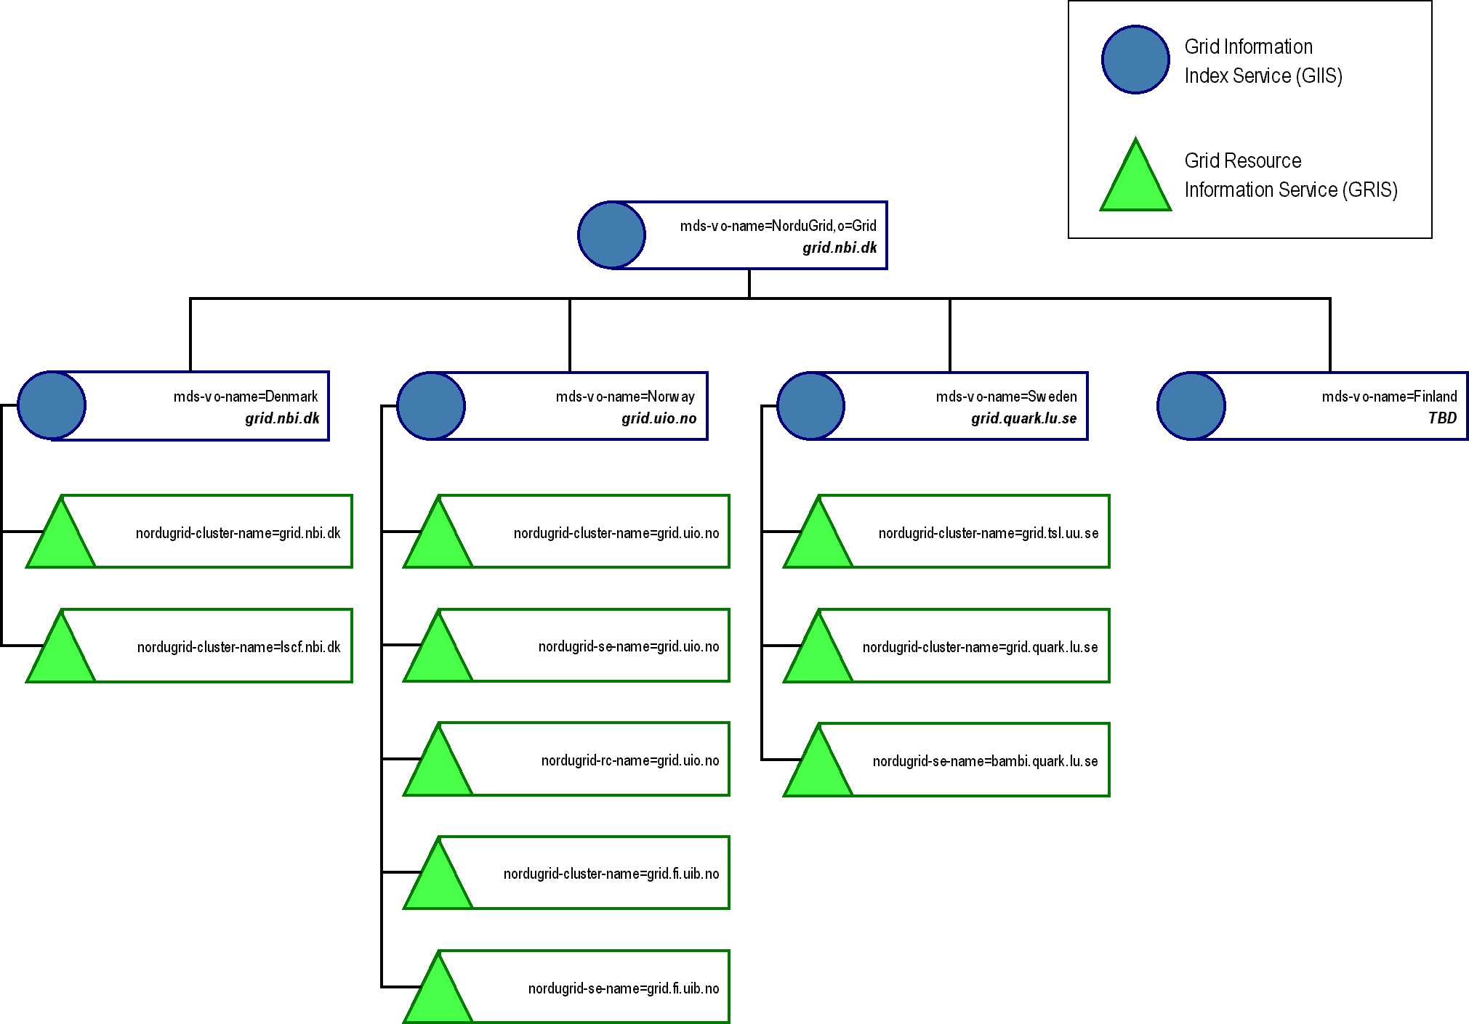
Hierarchy
Hierarchy of GRISes/GIISes

Slide 26
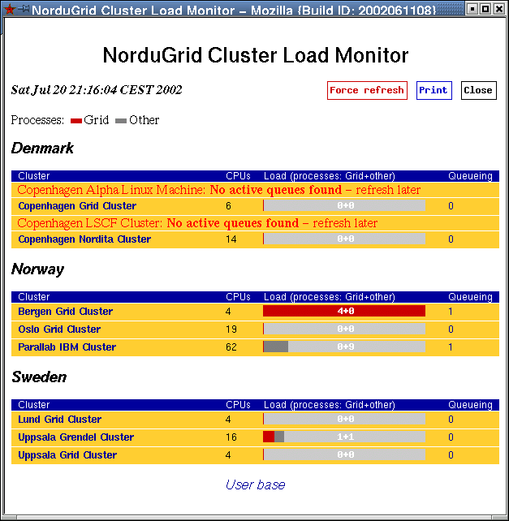
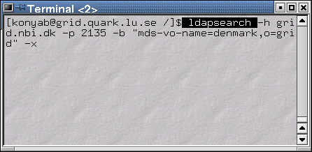
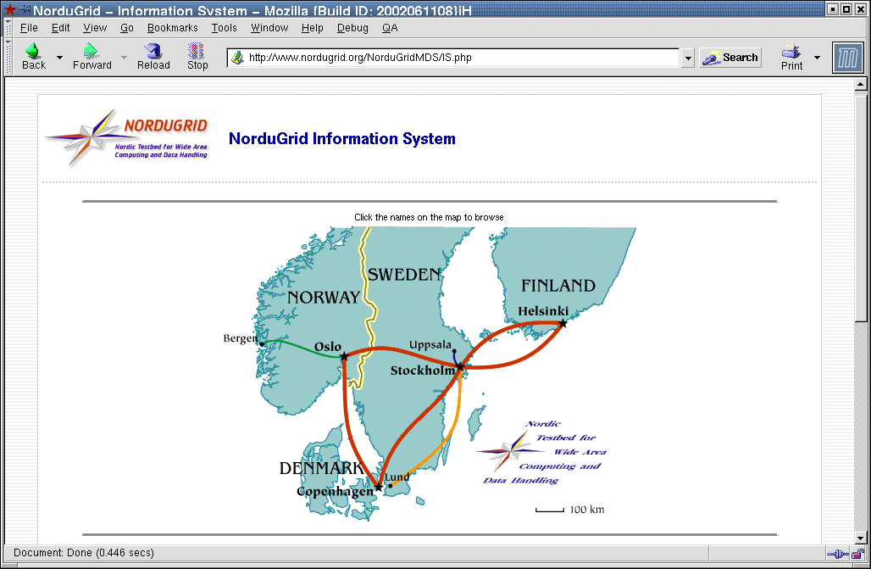
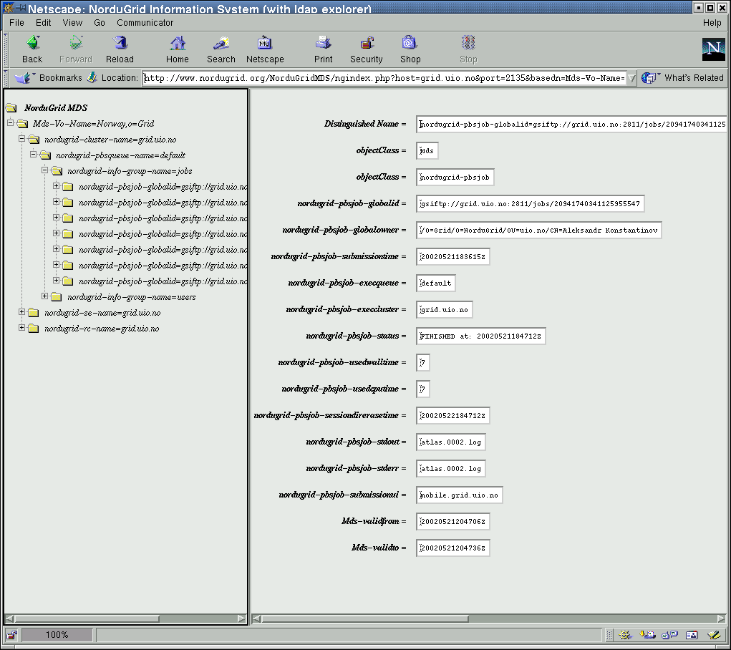
interfaces
The information system speaks LDAP, easy to interface:
  users with command line ldapsearch
  ng-userinterface (submission, brokering, job monitoring) through LDAP C API
  Load Monitor, MDS browser through PHP LDAP API

Slide 27
broker & jobsubmission
searches through the NorduGrid Testbed for available clusters
loops through all the clusters and selects those queues (possible targets) where:
  the user is authorized to run
  the requested software (RuntimeEnvironment) is available
  the cluster & queue parameters match the job requests
selects a job destination from the matching targets
  randomly selects among the free resources (where user-freecpus >0)
  in case there are no free matching resources some of the “load” attributes (i.e. user-queuelength) are taken into account

Slide 28
a brokering session
[konyab]$ ./ngsub -d 1 -f ~/gm_test/ui_sleep.rsl
User subject name: /O=Grid/O=NorduGrid/OU=quark.lu.se/CN=Balazs Konya
Remaining proxy lifetime: 5 hours, 1 minute
Initializing LDAP connection to grid.nbi.dk:2135
Initializing LDAP query to grid.nbi.dk:2135
Getting LDAP query results from grid.nbi.dk:2135
Initializing LDAP connection to grid.uio.no
Initializing LDAP connection to grid.fi.uib.no
Initializing LDAP connection to fire.ii.uib.no
Initializing LDAP connection to grid.nbi.dk
Initializing LDAP connection to ns1.nordita.dk
Initializing LDAP connection to hepax1.nbi.dk
Initializing LDAP connection to lscf.nbi.dk
Initializing LDAP connection to grid.tsl.uu.se
Initializing LDAP connection to grendel.it.uu.se
Initializing LDAP connection to grid.quark.lu.se
Initializing LDAP query to grid.uio.no
Initializing LDAP query to grid.fi.uib.no
Initializing LDAP query to fire.ii.uib.no
Initializing LDAP query to grid.nbi.dk
Initializing LDAP query to ns1.nordita.dk
Initializing LDAP query to hepax1.nbi.dk
Initializing LDAP query to lscf.nbi.dk
Initializing LDAP query to grid.tsl.uu.se
Initializing LDAP query to grendel.it.uu.se
Initializing LDAP query to grid.quark.lu.se
Getting LDAP query results from grid.uio.no
Getting LDAP query results from grid.fi.uib.no
Getting LDAP query results from fire.ii.uib.no
Getting LDAP query results from grid.nbi.dk
Getting LDAP query results from ns1.nordita.dk
Getting LDAP query results from hepax1.nbi.dk
Getting LDAP query results from lscf.nbi.dk
Getting LDAP query results from grid.tsl.uu.se
Getting LDAP query results from grendel.it.uu.se
Getting LDAP query results from grid.quark.lu.se
Cluster: Oslo Grid Cluster (grid.uio.no)
Queue: default
Queue accepted as possible submission target
Cluster: Oslo Grid Cluster (grid.uio.no)
Queue: veryshort
Queue rejected because it does not match the XRSL specification
Cluster: Bergen Grid Cluster (grid.fi.uib.no)
Queue: default
Queue accepted as possible submission target
Cluster: Parallab IBM Cluster (fire.ii.uib.no)
Queue: dque
Queue rejected because user not authorized
Cluster: Copenhagen Grid Cluster (grid.nbi.dk)
Queue: long
Queue accepted as possible submission target
Cluster: Copenhagen Grid Cluster (grid.nbi.dk)
Queue: short
Queue accepted as possible submission target
Cluster: Copenhagen Nordita Cluster (ns1.nordita.dk)
Queue: p-long
Queue rejected because it does not match the XRSL specification
Cluster: Copenhagen Nordita Cluster (ns1.nordita.dk)
Queue: p-medium
Queue rejected because it does not match the XRSL specification
Cluster: Copenhagen Nordita Cluster (ns1.nordita.dk)
Queue: p-short
Queue rejected due to status: inactive
Cluster: Copenhagen Alpha Linux Machine (hepax1.nbi.dk)
Queue: long
Queue rejected due to status:
Cluster: Copenhagen Alpha Linux Machine (hepax1.nbi.dk)
Queue: short
Queue rejected due to status:
Cluster: Copenhagen LSCF Cluster (lscf.nbi.dk)
Queue: gridlong
Queue rejected due to status:
Cluster: Copenhagen LSCF Cluster (lscf.nbi.dk)
Queue: gridshort
Queue rejected due to status:
Cluster: Uppsala Grid Cluster (grid.tsl.uu.se)
Queue: default
Queue accepted as possible submission target
Cluster: Uppsala Grendel Cluster (grendel.it.uu.se)
Queue: workq
Queue accepted as possible submission target
Cluster: Lund Grid Cluster (grid.quark.lu.se)
Queue: pc
Queue accepted as possible submission target
Cluster: Lund Grid Cluster (grid.quark.lu.se)
Queue: pclong
Queue rejected because it does not match the XRSL specification
Uppsala Grendel Cluster (grendel.it.uu.se) selected
queue workq selected
Job submitted with jobid grendel.it.uu.se:2119/jobmanager-ng/223411027195684

Slide 29
Summary
NorduGrid Testbed runs over an MDS based, hierarchically distributed Information System
We have designed and implemented an information model which
  naturally maps our architecture
  contains job information
  cluster oriented
  provides user-based information
  simple, functional and extensible
Our system continuously evolves as new sites & users provide their feedback

Slide 30
Future
our work is not “THE” information model, but can serve as a good starting point
The Grid needs a common information model
without a common schema the futureTestbeds of different Grid projects will not be able to talk to each other!
The GGF should coordinate these efforts
we hope that our experience can contribute to this challenge

Slide 31
www.nordugrid.org
The NorduGrid core team :
Mattias Ellert
Aleksandr Konstantinov
Balázs Kónya
Jakob Langgaard Nielsen
Oxana Smirnova
Anders Wäänänen

