Slide 1

Molecular Modeling Automation
UNC-IBM Collaboration
Dr. Alex Tropsha
Terry O’Brien
Notes:
take what we've learned in other industries

Slide 2


Automated QSAR Workflow for Computer-Aided Drug Discovery
An eminent leader in enabling an integrated, flexible infrastructure for scientific research and development – the IBM Life Sciences Framework
UNC’s Molecular Modeling Lab – a pioneer in technologies for the development of effective, robust, and validated tools for computer-aided drug discovery
+
A perfect match to jointly produce a
web-enabled, automated predictive QSAR modeling solution that can be deployed to the North Carolina Biogrid.

Slide 3
Project Objectives
1. Web-enable UNC’s predictive QSAR
modeling tools.
2. Automate the QSAR model development
and validation process.
3. Deploy the QSAR modeling solution on
the MCNC Biogrid.

Slide 4
Project Fundamentals
What is QSAR?
Quantitative Structure-Activity Relationship – a mathematical representation of a relationship between a given property and structural attributes of chemicals.
P = f (X)
where
P: Target Property (pharmacological activity, ADME, Toxicity,
physicochemical property, etc.)
X: A set of Molecular Descriptors (molecular weight, # hydrogen bond donors/acceptors, # rotatable bonds, graph and information-theoretic indices,
molecular orbital parameters, etc.)

Slide 5
Project Fundamentals
Why Use QSAR models?
To minimize costly and time-consuming experiments,
thus accelerating selection of chemicals with a desired
property profile.
Typical applications:
  drug discovery
  agrochemical design
  environmental risk assessment
Users:
  pharmaceutical and biotech companies
  FDA, EPA
  Academic and industrial researchers

Slide 6
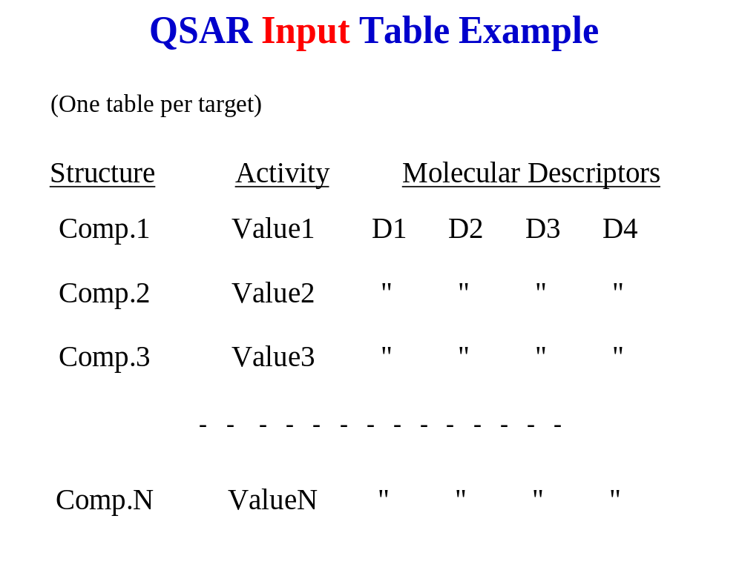

Slide 7
Predictive QSAR Workflow
Y-Randomization
Multiple Training Sets
11
Training Sets
Variable Selection LOO QSAR Models
ca. 760 QSAR Models
Original
Dataset
Split into Training and Test Sets
48
Cpds
Only accept models that have a
q² > 0.6
R² > 0.6
Multiple
Test Sets
11
Test Sets
Activity Prediction
ca. 140
Validated Predictive Models
Validated Predictive Models with High Internal & External Accuracy

Slide 8
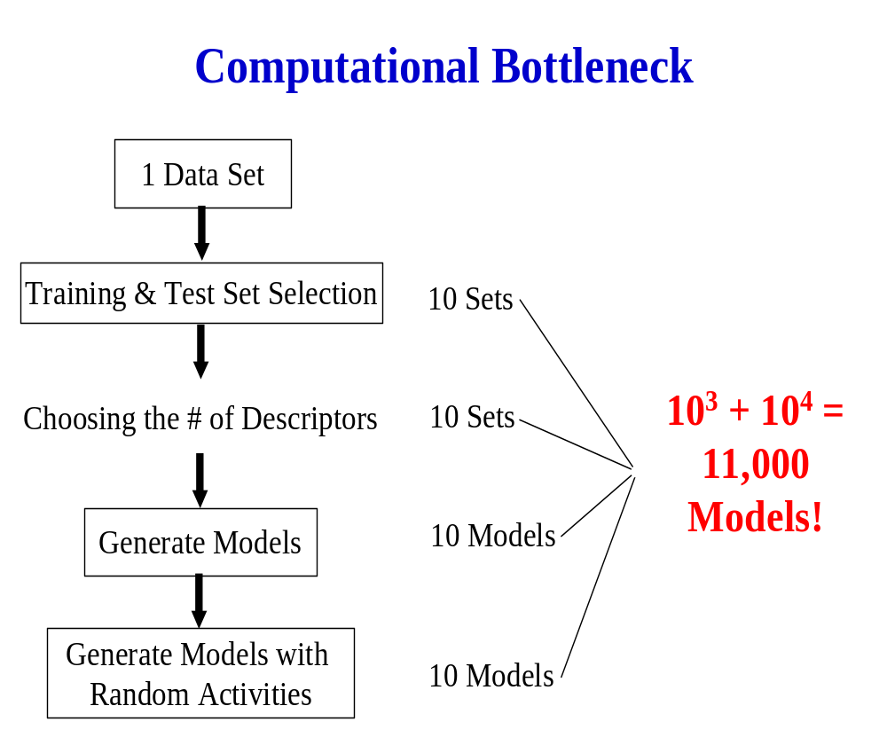

Slide 9
QSAR Model Generation – How Long?
Sample dataset: Antitumor Agents Inhibiting Tubulin Polymerization
  ≈ 300 Compounds
  10-12 Minutes Computation Time / kNN Model
  11,000 Models * 10 Minutes/Model =
  76.4 Days !
  On a Grid with 100 Processors →
  18 ⅓ Hours

Slide 10



Deployment on Grid
NCSC / RTP
IBM
LTO Library
NC State / Raleigh
Campus
Net
IBM p690
Gig-E
Client
Workstation
SunFire V880
FC Switch
Gig-E
FC
UNC / Chapel Hill
Campus
Net
Sun T3
SunFire 3800
NCREN
(OC-48)
Gig-E
Client
Workstation
IBM eServer 1300
IBM eServer 1300
Duke / Durham
10/100
Campus
Net
Development
& Staging
LAN
Client
Workstation
Gig-E
Client
Workstation
IBM eServer 1300
Take advantage of distributed parallel processing
“Build and Test Model” box explodes to many thousand of invocations
per run
Each invocation of Build & Test Model can be run in parallel
(multiple invocations may read the same files as input).
Ideal application for Grid enabling

Slide 11
Middleware Technologies
IBM DB2 Database
IBM HTTP Server
IBM WebSphere Application Server EE
  Workflow runtime
IBM WebSphere Portal Server
IBM WebSphere Studio Application Developer IE
  Development tools for applications
LSF (Platform Computing non-IBM)
  Cluster scheduler
GRID Middleware (future non-IBM)
  Globus Toolkit
  Avaki

Slide 12
Web Enabling and Automation
Portal Server
Integration Server
HTTP
WebSphere
Grid
Server
App Svr
WebSphere App Svr
Browser
WebSphere
IBM Portal Server
SOAP
Workflow
QSAR
Model
Builder
QSAR Solution
QSAR Workflow
Portlet
DB
Scripts
SOAP
Create web services for the QSAR programs
WebSphere App Svr
Develop a web browser interface (portlet)
Web
Services
Create and optimize the predictive QSAR
modeling workflow that ties the web services
and data flows together
Java
Wrappers
QSAR
Applications
Application Server

Slide 13
Portal
Job Management Scenario
  Model Jobs
  Screening jobs
Collects all input for all applications in workflows
Displays results of workflow
  Data read from DB2
  Visualization
    Spotfire
    Chime (Molecular Structures)
Communicates with workflow via WebServices over SOAP (no on-demand).

Slide 14
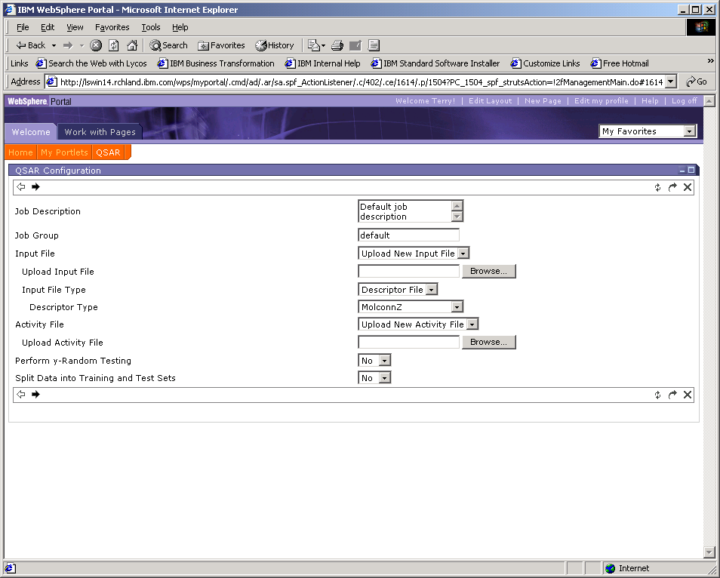
IBM Confidential

Slide 15
Integration/Application
Static workflow.
  Application integration
  Non-changeable, run same flow many times.
Workflow modeling tool is WebSphere Studio Application Developer – Integration Edition
  Graphical workflow modeling tool
  All activities have a Web Service description (WSDL)
    WebService via Java-bindings
  Custom Java snippets
  Data transformation via Java-beans (setters/getters)
Workflow runtime is WebSphere Application Server –Enterprise Edition
  Workflows “packaged” as EJB
  WebService proxy interface allow invocation of Workflow

Slide 16
Initial Application State
1. Set of “C” programs.
2. Written for a single user, interactive.
printf(“Enter parm”);
scanf(“%s”,parm1);
3. Output is files written to the cwd
4. Main objective was Not to change the
design/architecture of “C” programs
5.Could not run “flow” because of the number of files and invocations of programs.

Slide 17
Integration/Application
Created Java wrapper for “C” programs
  Defined input/output parameters
  Override stdin/stdout.
  Read files and put results in DB2 for portal
Generate WebService from Java Wrapper using WSAD.
When adding a activity to the flow, the tool generates Java Beans to represent interface messages.
  Wrote Java snippets that perform the get’s/set’s on the generated Java beans.
Graphically link the activities and java snippets into a control flow.

Slide 18
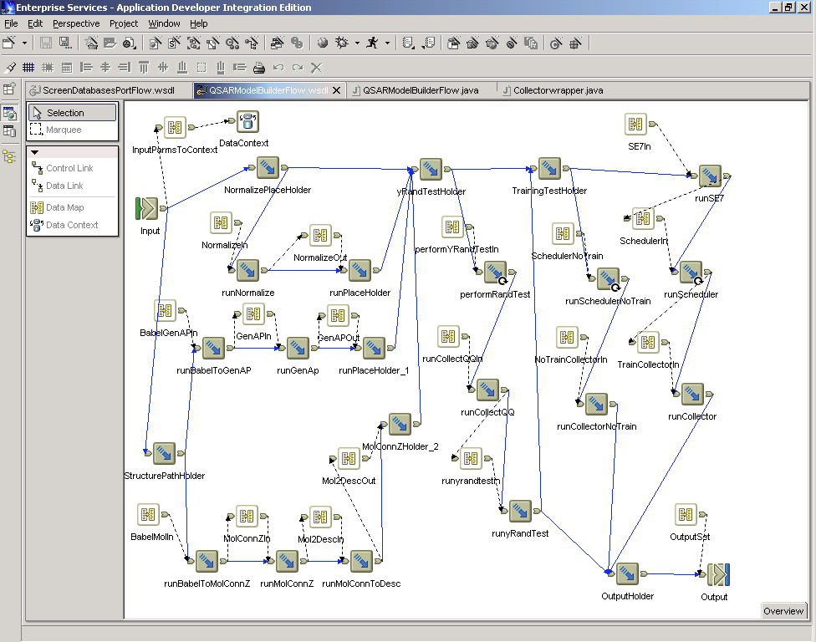

Slide 19
Grid
Avaki Data Grid
  File system to contain “C” executables, input/output files
Globus Toolkit 2.4.2
  Job Manager with the LSF plugin
  Simple CA with MyProxy to cache certificates
No other middleware on Grid
  Administration overhead
  All GRID programs are “C” programs

Slide 20
GRID
Partially Implemented Java version of GGF Distribute Resource Management Application API (DRMAA) working draft of Spec 1.0
  Asynchronous Jobs (fork/exec)
  Globus Toolkit 2.4 Jobs
Scheduler Java wrapper
  Create Job template
  Invoke job_run() to submit a job that invokes a “C” program to build models.
Collector Java wrapper
  Wait() to wait for a specific job to complete
  Reads results from file system and put into DB2 for portlet

Slide 21
IBM Portal
Server
IBM WAS
Server
Grid
Servers
Browser
Panel Flow
Panel Presentation
Visualization
(SPOTFIRE)
QSAR Model
Mini-
workflow
User 1
scheduler
collector
QSAR Model
Mini-
workflow
Workflow user1
User 2
scheduler
collector
Workflow user2
/avaki/qsarmodel/jobs/id/…
Avaki
Data Grid
DB2

Slide 22
Project Participants
IBM
Project Lead: Madhu Gombar (RTP)
Overall Lead: Rich DuLaney (Boca Raton)
Technical Lead: Bill Rapp (Rochester)
Framework Development: Terry O’Brien (Rochester)
Michael Blocksome (Rochester)
James DeVries (Rochester)
UNC
Overall Lead: Dr. Alex Tropsha
Project Manager: Dr. Alexander Golbraikh
Technical Lead: Scott Oloff

