Slide 1
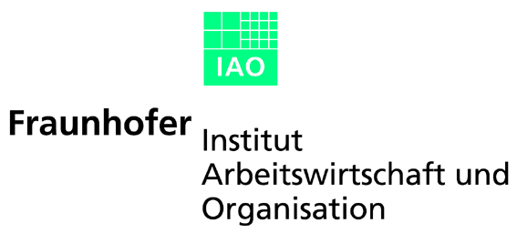
eXegrid – Workflow Support and Resource Management
PGM-RG Workshop, GGF8, Seattle, June 26th 2003

Slide 2
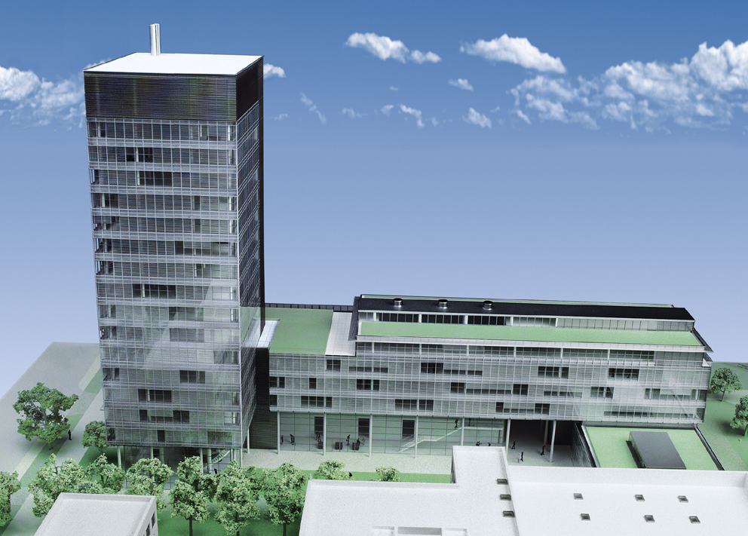
Profile of the Fraunhofer-Gesellschaft
Founded in: 1949
Staff of 12 000 (2002)
Research volume of 1 billion Euro (2002)
57 research establishments, operating
as independent »Profit-Centers«

Slide 3

Locations in Germany
Aachen, Berlin, Braunschweig, Bremen, Chemnitz,
Cottbus, Darmstadt, Dortmund, Dresden, Duisburg,
Efringen-Kirchen, Erlangen, Euskirchen, Frankfurt,
Freiburg, Freising, Golm, Halle, Hannover,
Holzkirchen, Ilmenau, Itzehoe, Jena, Kaiserslautern,
Karlsruhe, Magdeburg, München, Nürnberg,
Oberhausen, Paderborn, Pfinztal, Rostock, Saarbrücken,
Sankt Augustin, Sankt Ingbert, Schmallenberg,
Stuttgart, Teltow, Wentheim, Würzburg

Slide 4
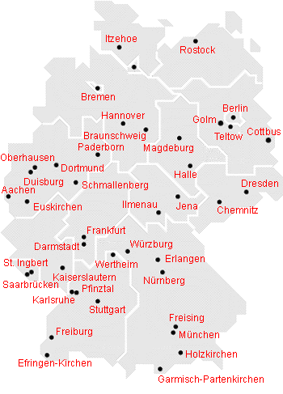
Fraunhofer Gesellschaft
57 Institutes
mainly engineering
Production technology
IT
Microelectronics
Material Sciences
Energy and Building
Life Sciences
12000 Scientists

Slide 5

International locations
Fraunhofer USA
Boston (Massachusetts), Pittsburgh (Pennsylvania),
Plymouth (Michigan), Providence (Rhode Island),
Newark (Delaware), College Park (Maryland), Peoria (Illinois)
Fraunhofer Asia
Beijing (China), Singapore, Jakarta (Indonesia), Tokyo (Japan)

Slide 6
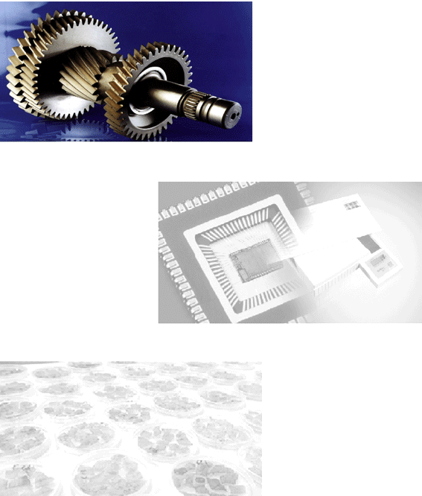
Research fields
– Materials technology, component behaviour
– Production technology, manufacturing engineering
– Information and communications technology
– Microelectronics, microsystems technology
– Sensor systems, testing and measurement technology
– Process technology
– Energy and building technology
– Environmental and health research
– Technical and economic studies
– Information transfer

Slide 7
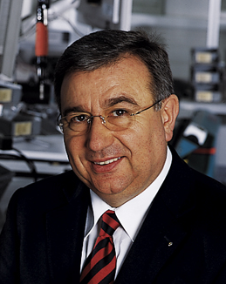
Director
Univ. Prof. Dr.-Ing. Dieter Spath

Slide 8
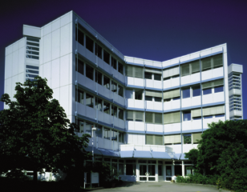
Profile
Founded in: 1981
Staff of 140 (2002)
21,5 million Euro research volume (2002)
Location: Stuttgart
Website: www.iao.fraunhofer.de

Slide 9
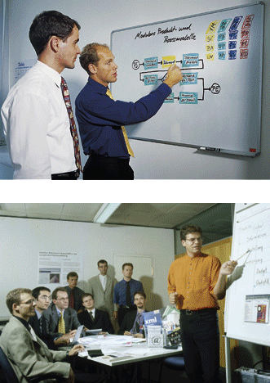
Business areas of the institute
– Innovative Work Environments and Human Resources – Customer Communication and Care
– Enterprise Information Systems
– E-Business
– Multimedia Systems and Learning Environments – Enterprise Strategies and Business Processes
– Virtual Engineering
– Integrated Software Development
– Development and Management of Services
– Grid Computing

Slide 10
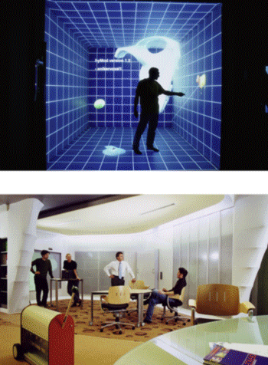
Demo Centers (selection)
– Electronic Business Innovation Center
– Engineering Solution Center (ESC)
– Immersive Driving Simulator
– Knowledge Media Lab
– E-Factory
– New Media Communication Lab (NMC)
– Office Innovation Center (OIC)
– 6-sided-CAVE »HyPI 6«

Slide 11
Cooperation
Fraunhofer IAO and the Institute for Human Factors and Technology Management (IAT) of the University of Stuttgart work in close cooperation
• Basic research at the university, application-oriented science and economic practice are combined
• Practical implementation in industrial projects
• Close cooperation due to proximity and shared projects

Slide 12
eXegrid
An open source approach for the industrial use of grids

Slide 13
Main assumptions
Grid Job can be a very complex workflow
(there is a difference between grid jobs and common jobs)
No user interaction for job scheduling and data transfer
Mapping between software and hardware must be automated
Need for a Grid Application DescriptionLanguage → GADL
Job submission as easy as possible

Slide 14
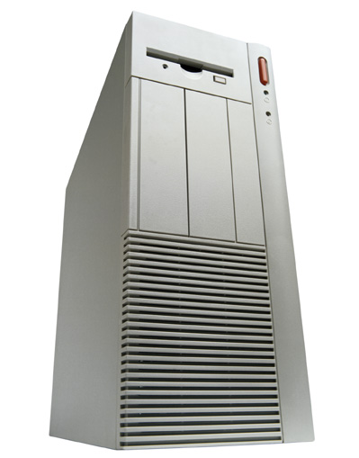




eXegrid in brief
Web Portal
Problem
Resource
Information
Build and
control Jobs
Authentication/
Security
Selected
Resources
Resource and Accounting
Information
Job Builder
Send and
control Jobs
Grid Job
Workflow
Job Handler
Scheduler
Load information

Slide 15
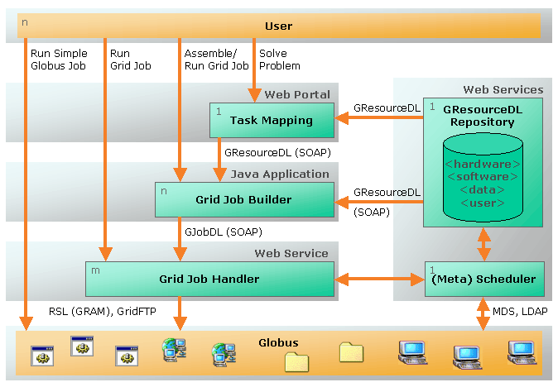
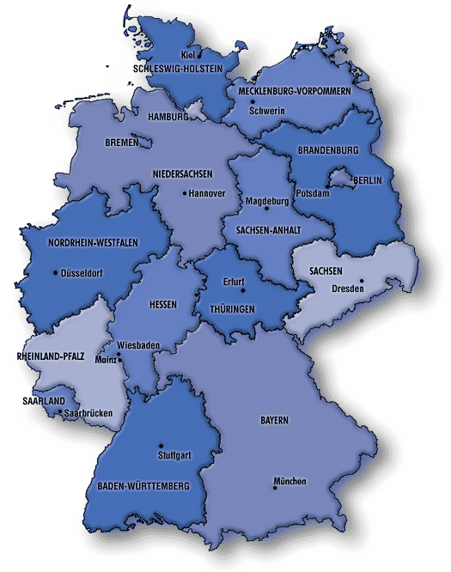
Overview Grid Access + current network

Slide 16
Grid Application Description Language (GADL)
GADL Set of XML-based description languages needed to define and to execute grid applications
The GADL consists of:
GResourceDL Description of resources
GJobDL Description of grid jobs
→ Set of resources + workflow
GInterfaceDL Interface definition of software components
GDataDL Description of data

Slide 17
GADL: Grid Resource Description Language (GResourceDL)
GResourceDL Description language for categorization and description of resources
Used to select suitable resources to solve a given problem (task mapping)
Definition of dependencies between resources
Extension of resource descriptions with inheritance allows formulation of recursive descriptions
Everything is a resource! Software components
Hardware resources
Measuring devices
Data

Slide 18
GResourceDL example that depends on other resources
<?xml version="1.0" encoding="ISO-8859-1" ?>
<!DOCTYPE fhrgResources (View Source for full doctype...)>
<fhrgResources>
<resource id="sleep" type="software">
...
<dependencies type="depends">
<resourceRef id="linux" type="softwareClass" />
<resourceRef id="glibc6" type="softwareClass" />
<resourceRef id="x86" type="hardwareClass" />
</dependencies>
...
</fhrgResources>
depends, conflicts, provides, suggests

Slide 19
GResourceDL example that provides other resources
<?xml version="1.0" encoding="ISO-8859-1" ?>
<!DOCTYPE fhrgResources (View Source for full doctype...)>
<fhrgResources>
...
<resource id="de-fhrg-first_harlekin" type="hardware">
<dependencies type="provides">
<resourceRef id="x86" type="hardwareClass" />
<resourceRef id="network-ethernet-100" type="hardwareClass" />
<resourceRef id="linux-kernel-2-4-18" type="softwareClass" />
<resourceRef id="glibc6" type="softwareClass" />
</dependencies>
<authorization>
<userGroup id="all" read="true" write="false" />
<userGroup id="first" read="true" write="true" execute="true" />
</authorization>
</resource>
</fhrgResources>

Slide 20
The Web Portal – on the outside
User
Security Proxy
Web Portal
Internet
HTML info
servlets for dynamic
requests,
e.g. task mapping
web-/grid-services
grid tools
resource repository
user data repository
Globus client node
FhRG certificate
input data
requests
ID check
mapping to
Globus
account
access
rights on
web portal

Slide 21
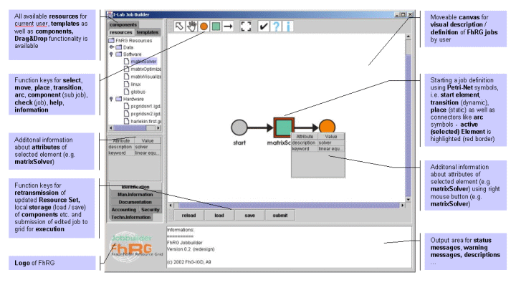
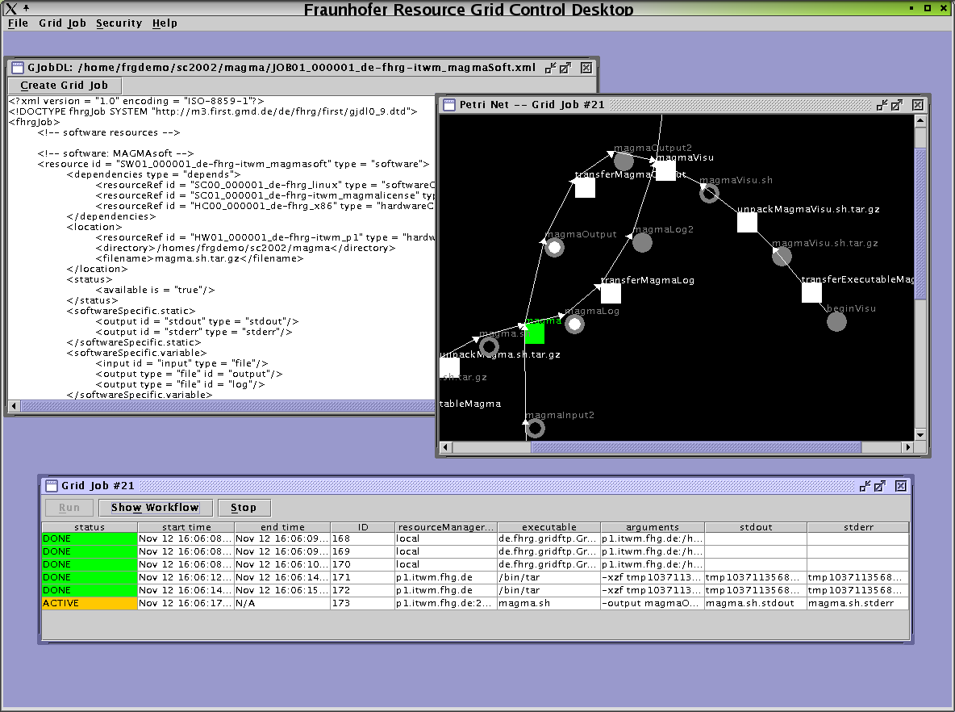
Building and executing a Grid Job
Job Builder
grid service request for
resource information (GRDL)
build grid applications
start Job Handler with
job parameters (GJDL)
Job Handler
map software to resources
generate atomic jobs
ask broker for compute
resources
start and control jobs via
Globus

Slide 22
Petri Nets
Places Files, buffers, control places (active, done, ...)
Transitions Software components, control transitions
Arcs from places to transitions (Place is input place of transition)
Arcs from transitions to places (Place is output place of transition)
Tokens Data
Rules A transition is activated if all input places are filled with tokens and all output places have not reached their maximum capacity of tokens
Refinement A transition can be replaced by a Petri Net

Slide 23
Control and Data Flow as a Petri Net
Control place
Control transition
Data place (linked to a file)
Software transition (linked to a software component)
start
exit status
stdin
stdout
stderr
input 1
input 2
output 1

Slide 24
GADL: Grid Job Definition Language (GJobDL)
Problem Description of complex workflows of grid jobs
DAG Directed Acyclic Graph (see e.g. Condor)
no bidirectional coupling (interaction)
no loops
PARENT A CHILD B C
PARENT B C CHILD D
Petri Nets Graphical flow control of discrete systems
A
B
C
D
A
A
B
B

Slide 25
Description of Petri Nets in XML
PNML Petri Net Markup Language
(modified from Jüngel, Kindler, Weber; HU-Berlin)
<place id="start">
<initialMarking>
<value type="boolean" op="eq">true</value>
</initialMarking>
</place>
<place id="output"/>
<transition id="program"/>
<arc type="P2T" id="arc1">
<placeRef id="start" />
<transitionRef id="program" />
</arc>
<arc type="T2P" id="arc2">
<transitionRef id="program"/>
<placeRef id="output" />
</arc>
start
output
program

Slide 26
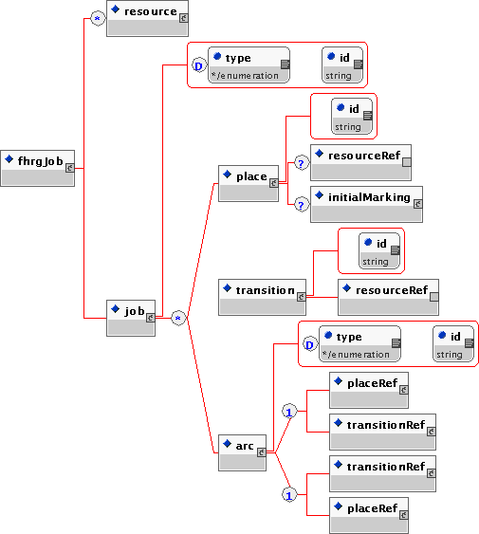
GJobDL
A

Slide 27
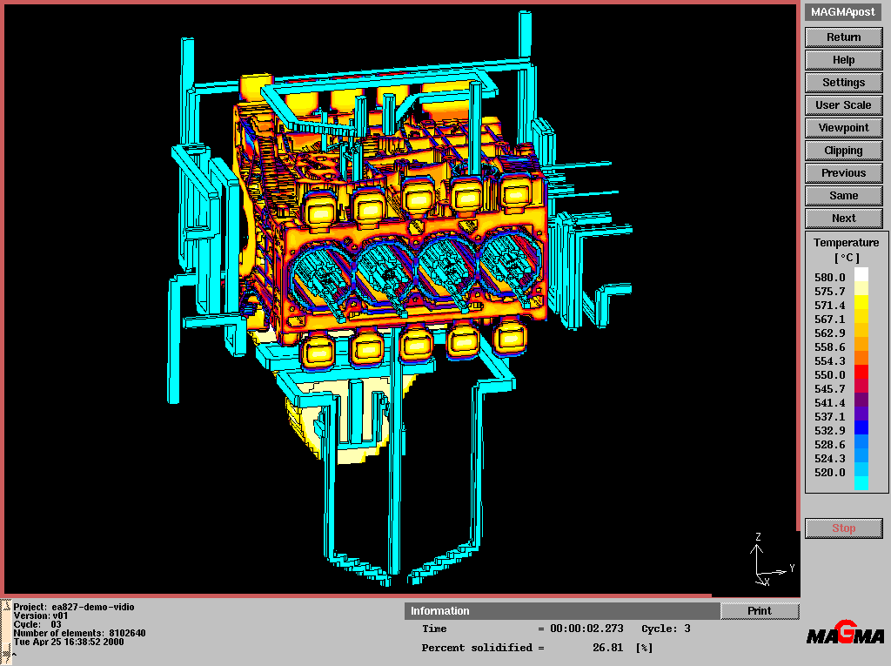
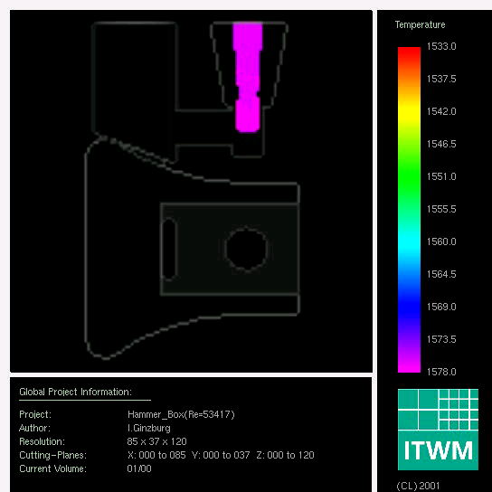
MAGMAsoft Simulation Environment for foundries a commercial application
A simple example of FhRG usage

Slide 28
MAGMAsoft : Use your laptop and some remote site to solve the simulation prolem
magma
magmaVisu
end
start
exit status
start
exit status
stdout
stdout
input
input
stderr
stderr
output
magmaData
log
magmaLog

Slide 29
GridFTP with Petri Nets using refinement
remote file
local file
program
remote file
local file
local file
GridFTP
program

Slide 30
MAGMAsoft with refinement ( file transfers are inserted automatically)
transferExecutable(magma)
transferExecutable(magmaVisu)
magmaVisu.sh.tar.gz
magma.sh.tar.gz
unpack()
unpack()
magma.sh
magmaVisu.sh
transferData(magma)
transferData(magmaVisu)
magma
magmaVisu
end
start
exit status
start
exit status
stdout
stdout
stderr
transferData(magmaVisu)
magmaData
stderr
input
output
log
magmaLog

Slide 31
Tools that help
Visualisation of the
Grid Job
Grid Job Description
Jobhandler:
Runs the complete
Job sequence

Slide 32
Simple Petri Nets
begin
B
end
A
D
C
failed
B
begin
end
A
done
C

Slide 33
Petri nets: while( condition = true ) do
condition = true
A
end
condition = false

Slide 34
FhRG Loop
begin
end
count < 7
count ≥ 7
transferExecutable(addHostname)
addHostname
unpack()
start
exit status
HostList
oldHostList
stdin
stdout
newHostList
input
stderr
transferData(addHostname)
transferData(addHostname)

Slide 35
Workflow and Dataflow management with Petri Nets
failed
begin
cat.sh
done
failed
start
exit status
d25.dat
end
stdin
stdout
stderr
cat.sh
done
input 1
input 2
output 1
d25-26.dat
start
exit status
d26.dat
stdin
stdout
stderr
d25-27.dat
input 1
d27.dat
input 2
output 1

Slide 36
Eramas –
System Architecture
User
with information request
ERAMAS
Web Interface
Server X₁
other
potential service systems
FIRST
IBB
DGC
Repository
Meta database
Main Server
Input / Output
Server X₂
…
Server X_{n}
Internet
Server A₁,A₂...A_{n}
Atmospheric transport models
(incl. local
databases)
Server I₁,I₂...I_{n}
Information
systems
(databases, online measurements etc.)
Server AZ₁,AZ₂...AZ_{n}
Models for the aeration region
(incl. local
databases)
Server G₁,G₂...G_{n}
Groundwater models
(incl. local
databases)
Server E₁,E₂...E_{n}
Exposition
models
(incl. local
databases)
Server B₁,B₂...B_{n}
Assessment models
(incl. local
databases)
Fraunhofer FIRST
DGC
IBB

Slide 37
Pollutant Transport in the Atmosphere
begin
diapar.in
dwm.out
dwminput
Diagnostic wind model
dwm.out
lacon.dat
User interface
oro.in
oro.in
latim.dat
Lagrangian model
momat.dat
lapos.dat
momet.dat
mit95.out
Preprocessing
Monte-Carlo, evaporation
morel.dat
conv.out
movar.dat
var.out

Slide 38
Parts of our eXecution grid
Grid Application Description Language
incl. GJobDL based on Petri nets and able to handle very complex workflows
Jobbuilder : user interface for creating grid job workflows
Jobhandler : managing the execution
resource broker
web portal for secure access, task mapping ,...
grid repository : Resource descriptions, User rights, ..
based on Globus but independent of Globus
easily portable to OGSI
role based security

Slide 39
Thank you for your attention!
Questions?

Slide 40
Contact Information http://www.fhrg.fhg.de
Juergen Falkner
Fraunhofer IAO
Nobelstr. 12
D-70569 Stuttgart, Germany
Tel : +49-(0)711-970-2414
Fax: +49-(0)711-970-2401
E-Mail: Juergen.Falkner@iao.fraunhofer.de
Dr. Franz-Josef Pfreundt
(FhRG Project Manager)
Fraunhofer ITWM
Europaallee 10
D-67657 Kaiserslautern, Germany
Tel : +49-(0)631-303-1800
Fax: +49-(0)631-303-1811
E-Mail: Pfreundt@itwm.fraunhofer.de

Slide 41
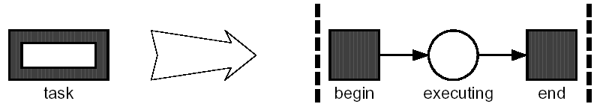
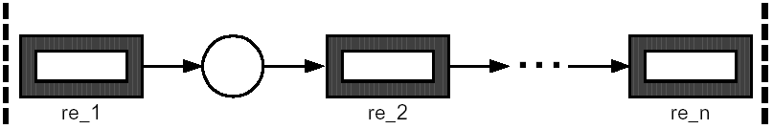
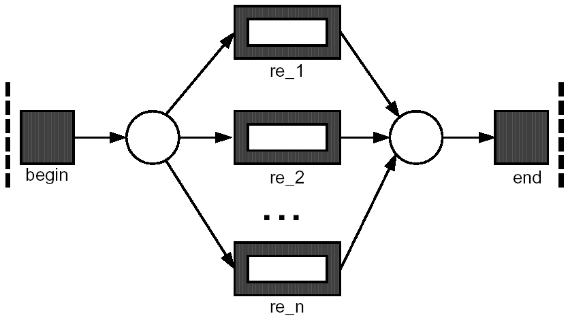
Petri Nets
(from van der Aalst und Kumar, 2000)
Task
Sequence
Choice

Slide 42
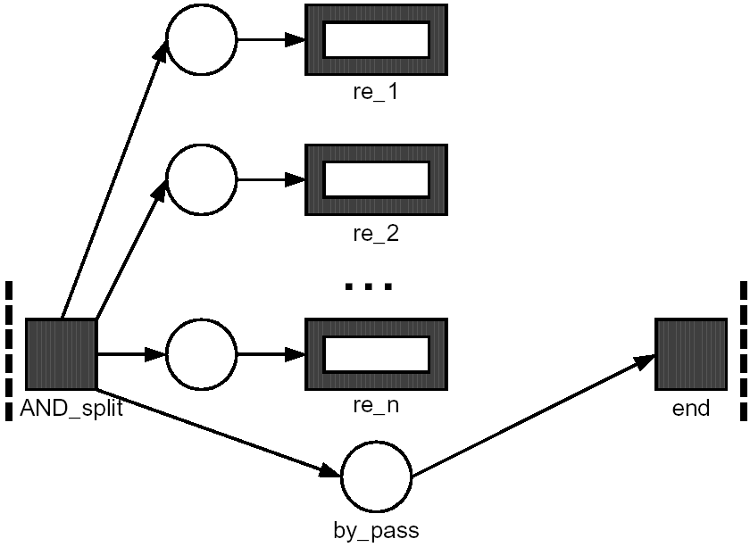
Petri Nets
Parallel execution without synchronization

Slide 43
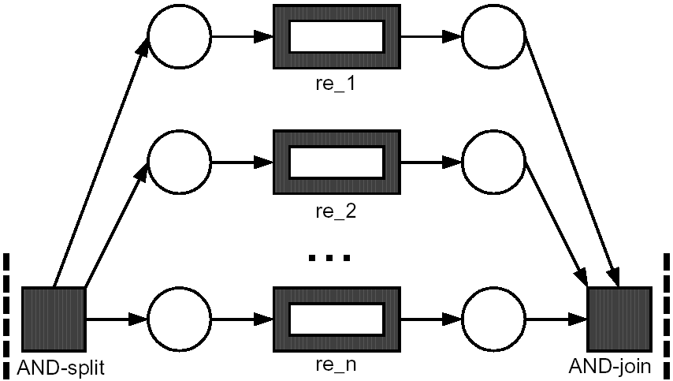
Petri Nets
Parallel execution with synchronization

Slide 44
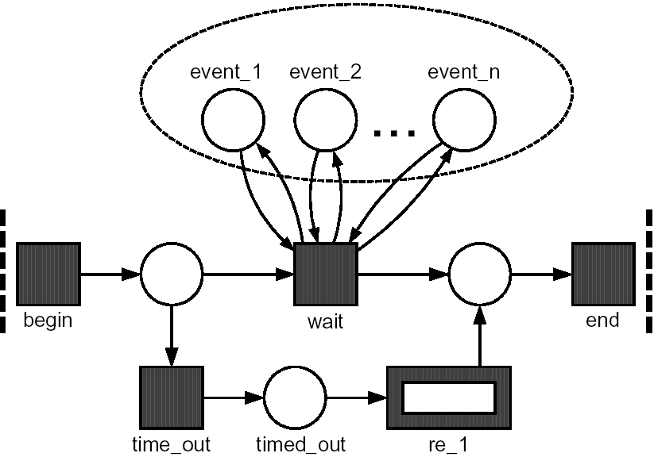
Petri Nets
Wait all with time out

Slide 45
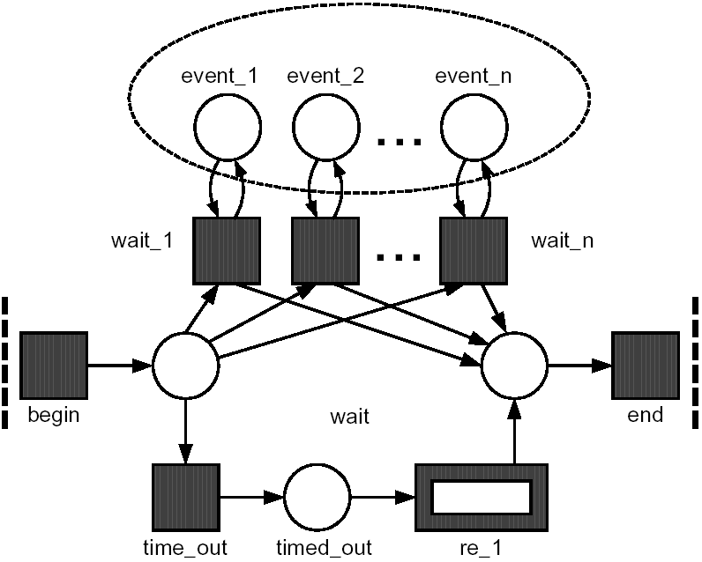
Petri Nets
Wait any with time out

