Slide 1

Application Contents Service
Overview

Slide 2

What is ACS?
Specification for the ACS repository.
  ACS: Application Contents Service
Application Contents Repository Interface (ARI)
  WSRF interface for ACS repository to create, retrieve, update and delete archives in the repository
Application Contents Archive Format (AAF)
  Information schema for repository operations for contents in an archive. Information for lifecycle operations is presented in contents in a archive.
Application
Archive
Deployment, data staging, workflow, etc.
Subscribe
requests
Notify
response
contents
Application
Producer
Application
Repository
Application
Consumer

Slide 3


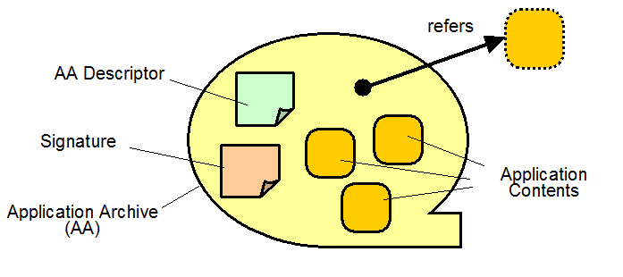


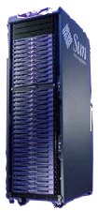
Example workflow
Federated PKI enabled
Secure Repository
1. Develop application
and Store in repository
ARI
2. Update application, make final build.
3. Search/Lookup instance and submit task.
AAF
ACS
EPR
4. Retrieve (recursively) all components not local which are needed, comparing, checking, security, etc
Entry Point
Distributes to nodes
EMS, JSDL, CDDLM, GRAM
The Grid
Grid nodes

Slide 4

Who create archives?
Business Activity Managers
  Create Archive for later use in job submission.
Later one can submit new jobs just referring the archive.
Business Activity
Manager
submit job
Job
Info.
EPR
Job
Manager
CRUD
ACS
AA Document
Get Content
EPR
create
job
Business Activity
Manager
EPR
Deployment
Service
EPR
Job
EPR
ACS scope
target
resources
Grid System
out of scope

Slide 5
AA and job
  Archives can be reused
    for repetitive jobs execution or
    for separate jobs running simultaneously
Job A
EPR
refers
job status
execution log etc ...
AA
refers
Job B
application
contents
EPR

Slide 6
What’s in an ACS Archive?
Any files for a unit of task in grid systems
  Each is called as an Application Contents.
  Application Contents are opaque object to the ACS.
AA Descriptor (AAD)
  AAF defines an XML Schema
  Universal access method to the contents by consumers
  References to the external storage are pending for future extension.
Possible ACS 2.0 extension

Slide 7
More advanced usage
Once archives in the ACS repository created,
They can be easily managed and moved around.
One can submit new jobs referring the archive.
Consumers
ACS
Producer
Job
Replicator
ACS
Job
ACS
Job

Slide 8
ACS as an OGSA service
ACS
Application
Archive
Application Repository
Candidate Set Generator (Work -Resource mapping)
Provisioning
Deployment
Configuration
Information Services
Execution Planning Services
Reservation
Service
Container
Persistent State Handle Service
Job Manager
Accounting Services

Slide 9
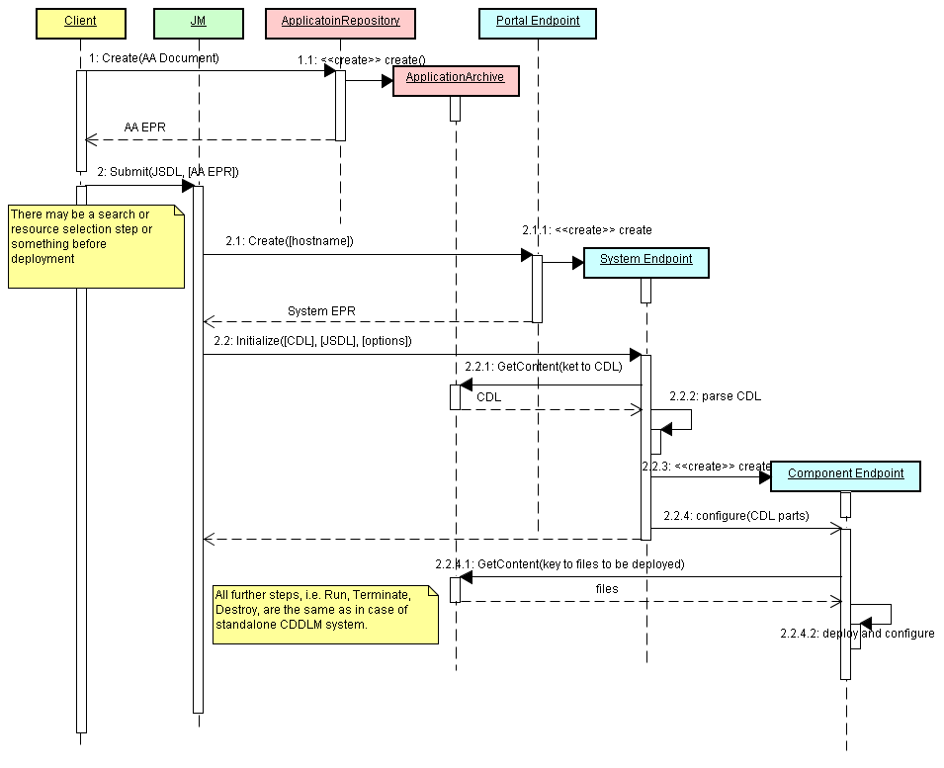
CDDLM Interactions

Slide 10
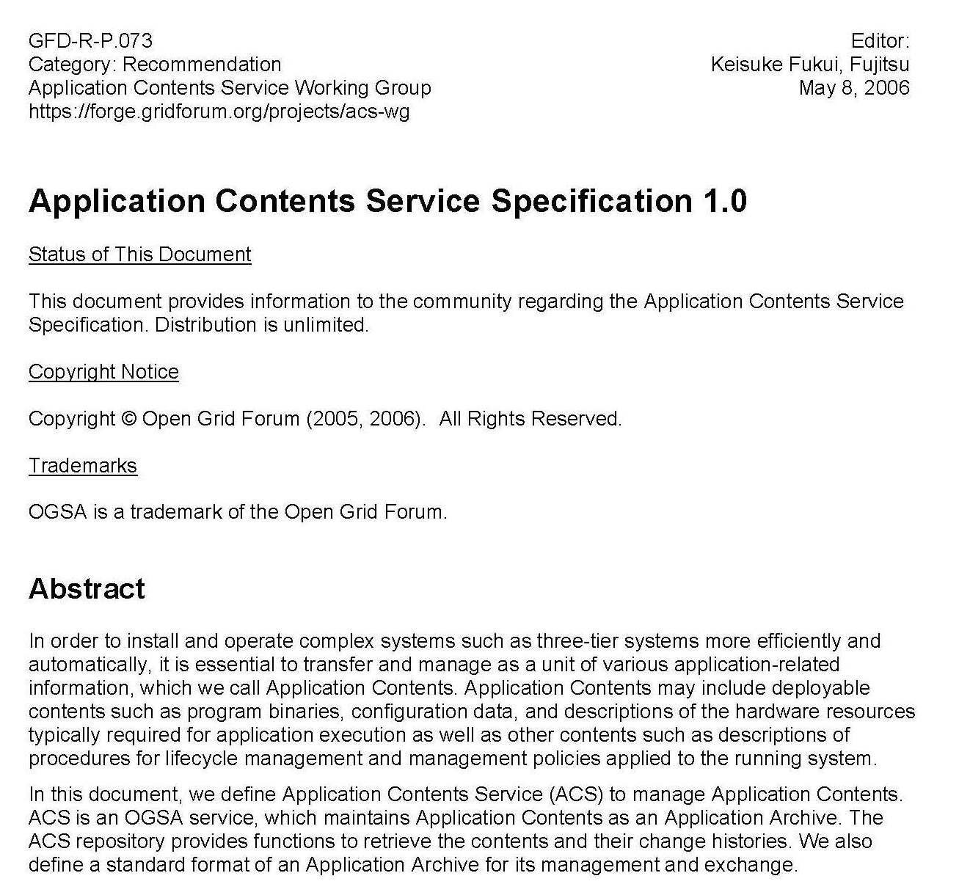
ACS Specification 1.0
81 pages in total
  Normative specification and non-normative text description
  Normative XML Schema for Archive Format and Repository I/F
Cover page looks like this->
Now you can see the specification as GFD-R-P.073 on the GGF Document Series page:
  http://www.ggf.org/gf/docs/?final

Slide 11
ACS purpose, goal and its example instance

Slide 12
Among the design goals (1)
“Define composable, narrowly-focus, evolvable Grid services”,
quoted from the GGF16 OGSA panel discussion.
  Coexistent with other specs., e.g., JSDL, CDL, etc.
  Existing & emerging security standards
  Interoperability among various grid middleware (e.g., diversity of policies, profiles)

Slide 13
Among the design goals (2)
Simple, minimal and generic, like a standard for the electricity supply.
  Number of pins and shapes of the plug, voltage and frequency, etc.
  Works with every type of appliances that operates over the home electric power line.

Slide 14
Projection
As a composable, narrowly-focus, evolvable Grid service, ACS spec. 1.0 excluded some conceivable topics:
  Heavily dependent topics with other service
  Advanced details that may be matured incremental or gradual manner, e.g., app. metadata generalization.
These may be revisited after the adoption of the 1.0 spec. and can be inputs to the extension or profile specification that compliments gaps to what is needed.

Slide 15

Overall structure of Sample AA
sampleAA.zip
aad.xml
cdl/
full-example-1.xml
full-example-2.xml
full-example-3-acs.xml
jsdl/
jsdl.xml
application/
service.war
data/
init-data.zip

Slide 16

Collaboration with Services
ACS
CDDLM
BES
JM
resource
user
?
?
IS
?
RSS
JM : Job Manager RSS: Resource Selection Service
IS: Information Service BES: Basic Execution Service
CDDLM: Configuration Description Deployment and Lifecycle Management

Slide 17
Collaboration with Services
ACS
AA EPR
CDDLM
AA
BES
JM
resource
user
?
?
IS
?
RSS
The user creates Application Archive as zip file and send it to ACS repository. ACS repository creates ApplicationArchive WS-Resource and return its Endpoint Reference (AA EPR).
JM : Job Manager RSS: Resource Selection Service
IS: Information Service BES: Basic Execution Service
CDDLM: Configuration Description Deployment and Lifecycle Management

Slide 18
Collaboration with Services
AA
ACS
CDDLM
AA EPR
JSDL
JSDL
BES
JM
AA EPR
resource
user
Allocate
resource
?
?
IS
?
RSS
The user submits a job to Job Manager (JM), along with the AA EPR and JSDL document.
JM passes the JSDL to RSS and RSS allocates resources for the job.
JM : Job Manager RSS: Resource Selection Service
IS: Information Service BES: Basic Execution Service
CDDLM: Configuration Description Deployment and Lifecycle Management

Slide 19
Collaboration with Services
AA
ACS
CDL
CDDLM
AA EPR
JSDL
BES
JM
AA EPR
resource
user
?
?
IS
?
RSS
JM passes the JSDL to RSS and RSS allocates resources for the job.
JM retrieves CDL from ACS repository.
JM requests CDDLM service to start deployment passing CDL.
JM : Job Manager RSS: Resource Selection Service
IS: Information Service BES: Basic Execution Service
CDDLM: Configuration Description Deployment and Lifecycle Management

Slide 20
Collaboration with Services
war
AA
data
ACS
CDDLM
AA EPR
JSDL
BES
JM
AA EPR
resource
user
?
?
IS
?
RSS
JM passes the JSDL to RSS and RSS allocates resources for the job.
JM retrieves CDL from ACS repository.
JM requests CDDLM service to start deployment passing CDL.
CDDLM retrieves install artifacts (war file and initial data file) from ACS repository and install them on the allocated resource.
JM : Job Manager RSS: Resource Selection Service
IS: Information Service BES: Basic Execution Service
CDDLM: Configuration Description Deployment and Lifecycle Management

Slide 21
Collaboration with Services
AA
ACS
CDDLM
AA EPR
JSDL
BES
JM
AA EPR
resource
user
?
Execute job
?
IS
?
RSS
JM passes the JSDL to RSS and RSS allocates resources for the job.
JM retrieves CDL from ACS repository.
JM requests CDDLM service to start deployment passing CDL.
CDDLM retrieves install artifacts (war file and initial data file) from ACS repository and install them on the allocated resource.
JM requests BES (Basic Execution Service) to execute job passing JSDL.
JM : Job Manager RSS: Resource Selection Service
IS: Information Service BES: Basic Execution Service
CDDLM: Configuration Description Deployment and Lifecycle Management

Slide 22
Collaboration with Services
AA
ACS
CDL
CDDLM
war
data
AA EPR
JSDL
JSDL
BES
JM
AA EPR
resource
user
?
?
JSDL
IS
?
RSS
Thus, each OGSA service retrieves its meta-data on demand. Each doesn’t need to know the meta-data used by others.
JM : Job Manager RSS: Resource Selection Service
IS: Information Service BES: Basic Execution Service
CDDLM: Configuration Description Deployment and Lifecycle Management

Slide 23
aad.xml
<?xml version="1.0" encoding="UTF-8" ?>
<aaf:AAD xmlns:aaf="http://schemas.ggf.org/acs/2005/10/aaf"
xmlns:ds="http://www.w3.org/2000/09/xmldsig#" xmlns:xsi="http://www.w3.org/2001/XMLSchema-instance"
xmlns:bar="http://www.example.ggf.org/">
<aaf:AAID>
<aaf:Name>http://www.foo.ggf.org/sample-webapp</aaf:Name>
<aaf:Version>1.0.0</aaf:Version>
</aaf:AAID>
<aaf:Author>
<aaf:Name>Foo Software Inc.</aaf:Name>
<aaf:Description xml:lang="en">home page is http://www.foo.org/</aaf:Description>
<aaf:Location><aaf:Country>United States</aaf:Country></aaf:Location>
</aaf:Author>
<aaf:Descriptions>
<aaf:Description>sample web app</aaf:Description>
</aaf:Descriptions>
<aaf:AccessConstraint dialect="urn:oasis:names:tc:xacml:1.0:policy">
<xacml:Policy xmlns:xacml="urn:oasis:names:tc:xacml:1.0:policy">
...
</xacml:Policy>
</aaf:AccessConstraint>
<aaf:Contents>
<aaf:Content type="aaf:DeploymentDescriptor">
<aaf:Pathname>cdl/full-example-3-acs.xml</aaf:Pathname>
<ds:DigestMethod algorithm="http://www.w3.org/2000/09/xmldsig#sha1"/>
<ds:DigestValue>MTIzNDU2Nzg...</ds:DigestValue>
</aaf:Content>
<aaf:Content type="aaf:DeploymentDescriptor">
<aaf:Pathname>cdl/full-example-2.xml</aaf:Pathname>
<ds:DigestMethod algorithm="http://www.w3.org/2000/09/xmldsig#sha1"/>
<ds:DigestValue>Ads9EwsDfsS...</ds:DigestValue>
</aaf:Content>
<aaf:Content type="aaf:DeploymentDescriptor">
<aaf:Pathname>cdl/full-example-1.xml</aaf:Pathname>
<ds:DigestMethod algorithm="http://www.w3.org/2000/09/xmldsig#sha1"/>
<ds:DigestValue>LdFswrDSsd9qA...</ds:DigestValue>
</aaf:Content>
<aaf:Content type=“bar:JobDescriptor">
<aaf:Pathname>jsdl/jsdl.xml</aaf:Pathname>
<ds:DigestMethod
Algorithm="http://www.w3.org/2000/09/xmldsig#sha1"/>
<ds:DigestValue>ADSfdp9Nz1...</ds:DigestValue>
</aaf:Content>
<aaf:Content type="bar:ApplicationBinary">
<aaf:Pathname>application/service.war</aaf:Pathname>
<ds:DigestMethod algorithm="http://www.w3.org/2000/09/xmldsig#sha1"/>
<ds:DigestValue>MjM0NTY3ODk...</ds:DigestValue>
</aaf:Content>
<aaf:Content type="bar:UserData">
<aaf:Pathname>data/init-data.zip</aaf:Pathname>
<ds:DigestMethod algorithm="http://www.w3.org/2000/09/xmldsig#sha1"/>
<ds:DigestValue>NDU2Nzg5MDE...</ds:DigestValue>
</aaf:Content>
</aaf:Contents>
<ds:Signature>...</ds:Signature>
</aaf:AAD>

Slide 24
aad.xml
<?xml version="1.0" encoding="UTF-8" ?>
<aaf:AAD xmlns:aaf="http://schemas.ggf.org/acs/2005/10/aaf"
xmlns:ds="http://www.w3.org/2000/09/xmldsig#" xmlns:xsi="http://www.w3.org/2001/XMLSchema-instance"
xmlns:bar="http://www.example.ggf.org/">
<aaf:AAID>
<aaf:Name>http://www.foo.ggf.org/sample-webapp</aaf:Name>
<aaf:Version>1.0.0</aaf:Version>
</aaf:AAID>
<aaf:Author>
<aaf:Name>Foo Software Inc.</aaf:Name>
<aaf:Description xml:lang="en">home page is http://www.foo.org/</aaf:Description>
<aaf:Location><aaf:Country>United States</aaf:Country></aaf:Location>
</aaf:Author>
<aaf:Descriptions>
<aaf:Description>sample web app</aaf:Description>
</aaf:Descriptions>
<aaf:AccessConstraint dialect="urn:oasis:names:tc:xacml:1.0:policy">
<xacml:Policy xmlns:xacml="urn:oasis:names:tc:xacml:1.0:policy">
...
</xacml:Policy>
</aaf:AccessConstraint>
<aaf:Contents>
<aaf:Content type="aaf:DeploymentDescriptor">
<aaf:Pathname>cdl/full-example-3-acs.xml</aaf:Pathname>
<ds:DigestMethod algorithm="http://www.w3.org/2000/09/xmldsig#sha1"/>
<ds:DigestValue>MTIzNDU2Nzg...</ds:DigestValue>
</aaf:Content>
<aaf:Content type="aaf:DeploymentDescriptor">
<aaf:Pathname>cdl/full-example-2.xml</aaf:Pathname>
<ds:DigestMethod algorithm="http://www.w3.org/2000/09/xmldsig#sha1"/>
<ds:DigestValue>Ads9EwsDfsS...</ds:DigestValue>
</aaf:Content>
<aaf:Content type="aaf:DeploymentDescriptor">
<aaf:Pathname>cdl/full-example-1.xml</aaf:Pathname>
<ds:DigestMethod algorithm="http://www.w3.org/2000/09/xmldsig#sha1"/>
<ds:DigestValue>LdFswrDSsd9qA...</ds:DigestValue>
</aaf:Content>
<aaf:Content type=“bar:JobDescriptor">
<aaf:Pathname>jsdl/jsdl.xml</aaf:Pathname>
<ds:DigestMethod
Algorithm="http://www.w3.org/2000/09/xmldsig#sha1"/>
<ds:DigestValue>ADSfdp9Nz1...</ds:DigestValue>
</aaf:Content>
<aaf:Content type="bar:ApplicationBinary">
<aaf:Pathname>application/service.war</aaf:Pathname>
<ds:DigestMethod algorithm="http://www.w3.org/2000/09/xmldsig#sha1"/>
<ds:DigestValue>MjM0NTY3ODk...</ds:DigestValue>
</aaf:Content>
<aaf:Content type="bar:UserData">
<aaf:Pathname>data/init-data.zip</aaf:Pathname>
<ds:DigestMethod algorithm="http://www.w3.org/2000/09/xmldsig#sha1"/>
<ds:DigestValue>NDU2Nzg5MDE...</ds:DigestValue>
</aaf:Content>
</aaf:Contents>
</aaf:AAD>
  Identification
  consists of Name (URI) and Version
<aaf:AAID>
<aaf:Name>http://www.foo.ggf.org/sample-webapp</aaf:Name>
<aaf:Version>1.0.0</aaf:Version>
</aaf:AAID>

Slide 25
aad.xml
<?xml version="1.0" encoding="UTF-8" ?>
<aaf:AAD xmlns:aaf="http://schemas.ggf.org/acs/2005/10/aaf"
xmlns:ds="http://www.w3.org/2000/09/xmldsig#" xmlns:xsi="http://www.w3.org/2001/XMLSchema-instance"
xmlns:bar="http://www.example.ggf.org/">
<aaf:AAID>
<aaf:Name>http://www.foo.ggf.org/sample-webapp</aaf:Name>
<aaf:Version>1.0.0</aaf:Version>
</aaf:AAID>
<aaf:Author>
<aaf:Name>Foo Software Inc.</aaf:Name>
<aaf:Description xml:lang="en">home page is http://www.foo.org/</aaf:Description>
<aaf:Location><aaf:Country>United States</aaf:Country></aaf:Location>
</aaf:Author>
<aaf:Descriptions>
<aaf:Description>sample web app</aaf:Description>
</aaf:Descriptions>
<aaf:AccessConstraint dialect="urn:oasis:names:tc:xacml:1.0:policy">
<xacml:Policy xmlns:xacml="urn:oasis:names:tc:xacml:1.0:policy">
...
</xacml:Policy>
</aaf:AccessConstraint>
<aaf:Contents>
<aaf:Content type="aaf:DeploymentDescriptor">
<aaf:Pathname>cdl/full-example-3-acs.xml</aaf:Pathname>
<ds:DigestMethod algorithm="http://www.w3.org/2000/09/xmldsig#sha1"/>
<ds:DigestValue>MTIzNDU2Nzg...</ds:DigestValue>
</aaf:Content>
<aaf:Content type="aaf:DeploymentDescriptor">
<aaf:Pathname>cdl/full-example-2.xml</aaf:Pathname>
<ds:DigestMethod algorithm="http://www.w3.org/2000/09/xmldsig#sha1"/>
<ds:DigestValue>Ads9EwsDfsS...</ds:DigestValue>
</aaf:Content>
<aaf:Content type="aaf:DeploymentDescriptor">
<aaf:Pathname>cdl/full-example-1.xml</aaf:Pathname>
<ds:DigestMethod algorithm="http://www.w3.org/2000/09/xmldsig#sha1"/>
<ds:DigestValue>LdFswrDSsd9qA...</ds:DigestValue>
</aaf:Content>
<aaf:Content type=“bar:JobDescriptor">
<aaf:Pathname>jsdl/jsdl.xml</aaf:Pathname>
<ds:DigestMethod
Algorithm="http://www.w3.org/2000/09/xmldsig#sha1"/>
<ds:DigestValue>ADSfdp9Nz1...</ds:DigestValue>
</aaf:Content>
<aaf:Content type="bar:ApplicationBinary">
<aaf:Pathname>application/service.war</aaf:Pathname>
<ds:DigestMethod algorithm="http://www.w3.org/2000/09/xmldsig#sha1"/>
<ds:DigestValue>MjM0NTY3ODk...</ds:DigestValue>
</aaf:Content>
<aaf:Content type="bar:UserData">
<aaf:Pathname>data/init-data.zip</aaf:Pathname>
<ds:DigestMethod algorithm="http://www.w3.org/2000/09/xmldsig#sha1"/>
<ds:DigestValue>NDU2Nzg5MDE...</ds:DigestValue>
</aaf:Content>
</aaf:Contents
</aaf:AAD>
  Human-readable information
  includes Author and Description
<aaf:Author>
<aaf:Name>Foo Software Inc.</aaf:Name>
<aaf:Description xml:lang="en">home page is http://www.foo.org/</aaf:Description>
<aaf:Location><aaf:Country>United States</aaf:Country></aaf:Location>
</aaf:Author>
<aaf:Descriptions>
<aaf:Description lang=“en”>sample web app</aaf:Description>
</aaf:Descriptions>

Slide 26
aad.xml
<?xml version="1.0" encoding="UTF-8" ?>
<aaf:AAD xmlns:aaf="http://schemas.ggf.org/acs/2005/10/aaf"
xmlns:ds="http://www.w3.org/2000/09/xmldsig#" xmlns:xsi="http://www.w3.org/2001/XMLSchema-instance"
xmlns:bar="http://www.example.ggf.org/">
<aaf:AAID>
<aaf:Name>http://www.foo.ggf.org/sample-webapp</aaf:Name>
<aaf:Version>1.0.0</aaf:Version>
</aaf:AAID>
<aaf:Author>
<aaf:Name>Foo Software Inc.</aaf:Name>
<aaf:Description xml:lang="en">home page is http://www.foo.org/</aaf:Description>
<aaf:Location><aaf:Country>United States</aaf:Country></aaf:Location>
</aaf:Author>
<aaf:Descriptions>
<aaf:Description>sample web app</aaf:Description>
</aaf:Descriptions>
<aaf:AccessConstraint dialect="urn:oasis:names:tc:xacml:1.0:policy">
<xacml:Policy xmlns:xacml="urn:oasis:names:tc:xacml:1.0:policy">
...
</xacml:Policy>
</aaf:AccessConstraint>
<ds:Signature>...</ds:Signature>
<aaf:Contents>
<aaf:Content type="aaf:DeploymentDescriptor">
<aaf:Pathname>cdl/full-example-3-acs.xml</aaf:Pathname>
<ds:DigestMethod algorithm="http://www.w3.org/2000/09/xmldsig#sha1"/>
<ds:DigestValue>MTIzNDU2Nzg...</ds:DigestValue>
</aaf:Content>
<aaf:Content type="aaf:DeploymentDescriptor">
<aaf:Pathname>cdl/full-example-2.xml</aaf:Pathname>
<ds:DigestMethod algorithm="http://www.w3.org/2000/09/xmldsig#sha1"/>
<ds:DigestValue>Ads9EwsDfsS...</ds:DigestValue>
</aaf:Content>
<aaf:Content type="aaf:DeploymentDescriptor">
<aaf:Pathname>cdl/full-example-1.xml</aaf:Pathname>
<ds:DigestMethod algorithm="http://www.w3.org/2000/09/xmldsig#sha1"/>
<ds:DigestValue>LdFswrDSsd9qA...</ds:DigestValue>
</aaf:Content>
<aaf:Content type=“bar:JobDescriptor">
<aaf:Pathname>jsdl/jsdl.xml</aaf:Pathname>
<ds:DigestMethod
Algorithm="http://www.w3.org/2000/09/xmldsig#sha1"/>
<ds:DigestValue>ADSfdp9Nz1...</ds:DigestValue>
</aaf:Content>
<aaf:Content type="bar:ApplicationBinary">
<aaf:Pathname>application/service.war</aaf:Pathname>
<ds:DigestMethod algorithm="http://www.w3.org/2000/09/xmldsig#sha1"/>
<ds:DigestValue>MjM0NTY3ODk...</ds:DigestValue>
</aaf:Content>
<aaf:Content type="bar:UserData">
<aaf:Pathname>data/init-data.zip</aaf:Pathname>
<ds:DigestMethod algorithm="http://www.w3.org/2000/09/xmldsig#sha1"/>
<ds:DigestValue>NDU2Nzg5MDE...</ds:DigestValue>
</aaf:Content>
</aaf:Contents>
</aaf:AAD>
  Access Constraint and Signature
  Access control policy can be specified by XACML or other language.
  AAD is recommended to be digitally-signed by means of XML-Signature.
<aaf:AccessConstraint dialect="urn:oasis:names:tc:xacml:1.0:policy">
<xacml:Policy xmlns:xacml="urn:oasis:names:tc:xacml:1.0:policy">
... (xacml description sits here)
</xacml:Policy>
</aaf:AccessConstraint>
<ds:Signature xmlns:ds="http://www.w3.org/2000/09/xmldsig#">
...(XMLSignature sits here)
</ds:Signature>

Slide 27
  List of Contents
  All entries need to be listed. Each entry can have its type which is used in “GetContents” operation of ACS.
aad.xml
<aaf:Contents>
<aaf:Content type="aaf:DeploymentDescriptor">
<aaf:Pathname>cdl/full-example-3-acs.xml</aaf:Pathname>
<ds:DigestMethod algorithm="http://www.w3.org/2000/09/xmldsig#sha1"/>
<ds:DigestValue>MTIzNDU2Nzg...</ds:DigestValue>
</aaf:Content>
<aaf:Content type="aaf:DeploymentDescriptor">
<aaf:Pathname>cdl/full-example-2.xml</aaf:Pathname>
....
</aaf:Content>
<aaf:Content type="aaf:DeploymentDescriptor">
<aaf:Pathname>cdl/full-example-1.xml</aaf:Pathname>
....
</aaf:Content>
<aaf:Content type=“bar:JobDescriptor">
<aaf:Pathname>jsdl/jsdl.xml</aaf:Pathname>
....
</aaf:Content>
<aaf:Content type="bar:ApplicationBinary">
<aaf:Pathname>application/service.war</aaf:Pathname>
...
</aaf:Content>
<aaf:Content type="bar:UserData">
<aaf:Pathname>data/init-data.zip</aaf:Pathname>
...
</aaf:Content>
</aaf:Contents>
<?xml version="1.0" encoding="UTF-8" ?>
<aaf:AAD xmlns:aaf="http://schemas.ggf.org/acs/2005/10/aaf"
xmlns:ds="http://www.w3.org/2000/09/xmldsig#" xmlns:xsi="http://www.w3.org/2001/XMLSchema-instance"
xmlns:bar="http://www.example.ggf.org/">
<aaf:AAID>
<aaf:Name>http://www.foo.ggf.org/sample-webapp</aaf:Name>
<aaf:Version>1.0.0</aaf:Version>
</aaf:AAID>
<aaf:Author>
<aaf:Name>Foo Software Inc.</aaf:Name>
<aaf:Description xml:lang="en">home page is http://www.foo.org/</aaf:Description>
<aaf:Location><aaf:Country>United States</aaf:Country></aaf:Location>
</aaf:Author>
<aaf:Descriptions>
<aaf:Description>sample web app</aaf:Description>
</aaf:Descriptions>
<aaf:AccessConstraint dialect="urn:oasis:names:tc:xacml:1.0:policy">
<xacml:Policy xmlns:xacml="urn:oasis:names:tc:xacml:1.0:policy">
...
</xacml:Policy>
</aaf:AccessConstraint>
<aaf:Contents>
<aaf:Content type="aaf:DeploymentDescriptor">
<aaf:Pathname>cdl/full-example-3-acs.xml</aaf:Pathname>
<ds:DigestMethod algorithm="http://www.w3.org/2000/09/xmldsig#sha1"/>
<ds:DigestValue>MTIzNDU2Nzg...</ds:DigestValue>
</aaf:Content>
<aaf:Content type="aaf:DeploymentDescriptor">
<aaf:Pathname>cdl/full-example-2.xml</aaf:Pathname>
<ds:DigestMethod algorithm="http://www.w3.org/2000/09/xmldsig#sha1"/>
<ds:DigestValue>Ads9EwsDfsS...</ds:DigestValue>
</aaf:Content>
<aaf:Content type="aaf:DeploymentDescriptor">
<aaf:Pathname>cdl/full-example-1.xml</aaf:Pathname>
<ds:DigestMethod algorithm="http://www.w3.org/2000/09/xmldsig#sha1"/>
<ds:DigestValue>LdFswrDSsd9qA...</ds:DigestValue>
</aaf:Content>
<aaf:Content type=“bar:JobDescriptor">
<aaf:Pathname>jsdl/jsdl.xml</aaf:Pathname>
<ds:DigestMethod
Algorithm="http://www.w3.org/2000/09/xmldsig#sha1"/>
<ds:DigestValue>ADSfdp9Nz1...</ds:DigestValue>
</aaf:Content>
<aaf:Content type="bar:ApplicationBinary">
<aaf:Pathname>application/service.war</aaf:Pathname>
<ds:DigestMethod algorithm="http://www.w3.org/2000/09/xmldsig#sha1"/>
<ds:DigestValue>MjM0NTY3ODk...</ds:DigestValue>
</aaf:Content>
<aaf:Content type="bar:UserData">
<aaf:Pathname>data/init-data.zip</aaf:Pathname>
<ds:DigestMethod algorithm="http://www.w3.org/2000/09/xmldsig#sha1"/>
<ds:DigestValue>NDU2Nzg5MDE...</ds:DigestValue>
</aaf:Content>
</aaf:Contents>
</aaf:AAD>

Slide 28
cdl/*.xml
Here we extends their sample CDL so that CDDLM service can retrieve install artifacts from ACS repository.
“ACSWebApp” has attribute
named “archive” to specify
endpoint reference of
ApplicatoinArchive WS-Resource.
<?xml version="1.0"?>
<cdl:cdl xmlns:cdl=http://www.gridforum.org/namespaces/2005/02/cddlm/CDL-1.0 ....>
<cdl:import location="full-example-2.cdl" namespace="http://example.org/webapp-template"/>
<cdl:configuration>
<ACSWebApp cdl:extends="t:WebApp">
<archive cdl:type="EndpointReference" cdl:lazy="true"/>
</ACSWebApp>
</cdl:configuration>
<cdl:system>
<WebApplication cdl:extends="ACSWebApp">
<t:application>application/service.war</t:application>
<t:applicationPath>/SampleService</t:applicationPath>
<t:dbname>jdbc/SampleService</t:dbname>
<t:data>data/init-data.zip</t:data>
<t:dbuser>myapp</t:dbuser>
<t:dbpassword>pass</t:dbpassword>
</WebApplication>
</cdl:system>
</cdl:cdl>
Locations of the install artifacts
are specified using path in Application Archive.

Slide 29
jsdl/jsdl.xml
ACS may be contain Job Description in Application Archive but this is
still under discussion at OGSA-EMS.
application/service.war
data/init-data.zip
Install artifacts.

