Slide 1

OGSA F2F meeting (day two)
Nov. 10, 2006 in Tampa

Slide 2

OGF IPR Policies Apply
“I acknowledge that participation in this meeting is subject to the OGF Intellectual Property Policy.”
Intellectual Property Notices Note Well: All statements related to the activities of the OGF and addressed to the OGF are subject to all provisions of Appendix B of GFD-C.1, which grants to the OGF and its participants certain licenses and rights in such statements. Such statements include verbal statements in OGF meetings, as well as written and electronic communications made at any time or place, which are addressed to:
    the OGF plenary session,
    any OGF working group or portion thereof,
    the OGF Board of Directors, the GFSG, or any member thereof on behalf of the OGF,
    the ADCOM, or any member thereof on behalf of the ADCOM,
    any OGF mailing list, including any group list, or any other list functioning under OGF auspices,
    the OGF Editor or the document authoring and review process
Statements made outside of a OGF meeting, mailing list or other function, that are clearly not intended to be input to an OGF activity, group or function, are not subject to these provisions.
Excerpt from Appendix B of GFD-C.1: ”Where the OGF knows of rights, or claimed rights, the OGF secretariat shall attempt to obtain from the claimant of such rights, a written assurance that upon approval by the GFSG of the relevant OGF document(s), any party will be able to obtain the right to implement, use and distribute the technology or works when implementing, using or distributing technology based upon the specific specification(s) under openly specified, reasonable, non-discriminatory terms. The working group or research group proposing the use of the technology with respect to which the proprietary rights are claimed may assist the OGF secretariat in this effort. The results of this procedure shall not affect advancement of document, except that the GFSG may defer approval where a delay may facilitate the obtaining of such assurances. The results will, however, be recorded by the OGF Secretariat, and made available. The GFSG may also direct that a summary of the results be included in any GFD published containing the specification.”
OGF Intellectual Property Policies are adapted from the IETF Intellectual Property Policies that support the Internet Standards Process.
Notes:
IPR Notices Note Well for OGF meetings

Slide 3
Future schedule
Identify tasks and priorities
Gaps and holes
OGF19 session plan
Telecon schedule
Next interim F2F

Slide 4
OGSA direction and priority (1)
EMS scenario and architecture
  Scenario document “v1.0” is close to complete
  Another scenario document “v1.1/capability” is TBD
Information modeling
  Process Guideline (#1)
  Container info model (#2)
  Info modeling and schema (#3)
  Info modeling profile (#4)
Roadmap v1.1
  Group review until OGF editor submission
OGSA and EGA reference model
  HPC usecase and other usecases
  Glossary
  CIM and dependency graph

Slide 5
OGSA direction and priority (2)
Security architecture/roadmap
  OGSA-AuthZ WG
  Basic Security Profile – AuthN
Deployment service
Workflow
QoS
Logging and billing
Eventing
Design pattern
  Factory pattern

Slide 6
Gaps and holes
EMS Architecture document
Information services
Self-* services
SAGA-API

Slide 7
Telecon Topics
Monday
  EGA reference model (Hiro, Paul)
  Roadmap (Chris)
Thursday
  Information modeling (Ellen, Fred)
  EMS Arch scenarios (Andreas)
  Security (Alan)

Slide 8
Telecon Schedule (1)
2006/11/13 | Mon | 4-6pm CT | No-call (SC06)
2006/11/16 | Thur | 7-9am | No-call (SC06)
2006/11/20 | Mon | 4-6pm | EGA reference model
2006/11/23 | Thur | 7-9am | No-call (Thanksgiving)
2006/11/27 | Mon | 4-6pm | Roadmap
2006/11/30 | Thur | 7-9am | Information modeling EMS Arch scenarios
2006/12/4 | Mon | 4-6pm | EGA reference model
2006/12/7 | Thur | 7-9am | Security
2006/12/11 | Mon | 4-6pm | Roadmap
2006/12/14 | Thur | 7-9am | Information modeling EMS Arch scenarios

Slide 9
Telecon Schedule (2)
2007/1/8 | Mon | 4-6pm CT | EGA reference model Roadmap
2007/1/11 | Thur | 7-9am | Security
2007/1/15 | Mon | 4-6pm | No-call (Martin Luther King Day)
2007/1/18 | Thur | 7-9am | Information modeling EMS Arch scenarios
2007/1/22 | Mon | 4-6pm | Roadmap
2007/1/25 | Thur | 7-9am | OGF19 prep

Slide 10
OGF19 and OGF20
OGF19
  Chapel Hill NC
  Jan. 29 (M) ~ Feb. 2 (F)
  WG sessions and workshop only
OGF20
  Manchester
  May 7 (M) ~ 11 (F)
  Major event

Slide 11
OGF19 sessions
Information modeling (2?)
  Info modeling and schema (#3)
  Info modeling profile (#4)
OGSA and EGA reference model
EMS session
  EMS arch scenarios
  EMS and data services
  Deployment service
Security
  BSP authentication

Slide 12
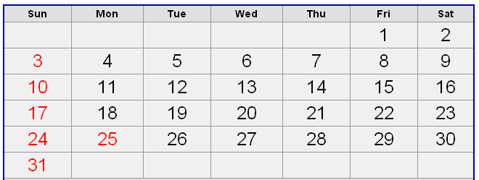
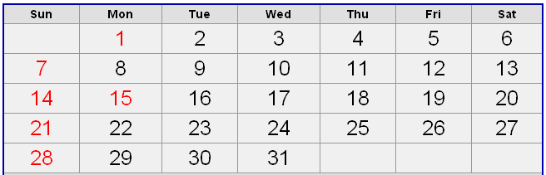
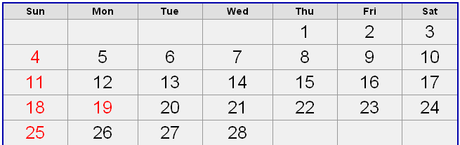
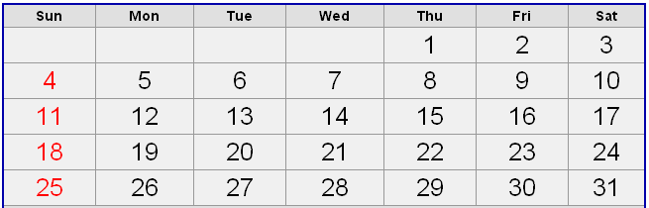
Next interim F2F?
December
January
GFSG
MDC
OGF19
February
March
OGF19

Slide 13
Full Copyright Notice
Copyright (C) Open Grid Forum (2006). All Rights Reserved.
This document and translations of it may be copied and furnished to others, and derivative works that comment on or otherwise explain it or assist in its implementation may be prepared, copied, published and distributed, in whole or in part, without restriction of any kind, provided that the above copyright notice and this paragraph are included on all such copies and derivative works.
The limited permissions granted above are perpetual and will not be revoked by the OGF or its successors or assignees.
Notes:
OGF Full Copyright Notice if necessary

