Slide 1
Network Markup Language WG
XML Topology Schema Update
Martin Swany

Slide 2
OGF IPR Policies Apply
“I acknowledge that participation in this meeting is subject to the OGF Intellectual Property Policy.”
Intellectual Property Notices Note Well: All statements related to the activities of the OGF and addressed to the OGF are subject to all provisions of Appendix B of GFD-C.1, which grants to the OGF and its participants certain licenses and rights in such statements. Such statements include verbal statements in OGF meetings, as well as written and electronic communications made at any time or place, which are addressed to:
    the OGF plenary session,
    any OGF working group or portion thereof,
    the OGF Board of Directors, the GFSG, or any member thereof on behalf of the OGF,
    the ADCOM, or any member thereof on behalf of the ADCOM,
    any OGF mailing list, including any group list, or any other list functioning under OGF auspices,
    the OGF Editor or the document authoring and review process
Statements made outside of a OGF meeting, mailing list or other function, that are clearly not intended to be input to an OGF activity, group or function, are not subject to these provisions.
Excerpt from Appendix B of GFD-C.1: ”Where the OGF knows of rights, or claimed rights, the OGF secretariat shall attempt to obtain from the claimant of such rights, a written assurance that upon approval by the GFSG of the relevant OGF document(s), any party will be able to obtain the right to implement, use and distribute the technology or works when implementing, using or distributing technology based upon the specific specification(s) under openly specified, reasonable, non-discriminatory terms. The working group or research group proposing the use of the technology with respect to which the proprietary rights are claimed may assist the OGF secretariat in this effort. The results of this procedure shall not affect advancement of document, except that the GFSG may defer approval where a delay may facilitate the obtaining of such assurances. The results will, however, be recorded by the OGF Secretariat, and made available. The GFSG may also direct that a summary of the results be included in any GFD published containing the specification.”
OGF Intellectual Property Policies are adapted from the IETF Intellectual Property Policies that support the Internet Standards Process.
Notes:
IPR Notices Note Well for OGF meetings

Slide 3
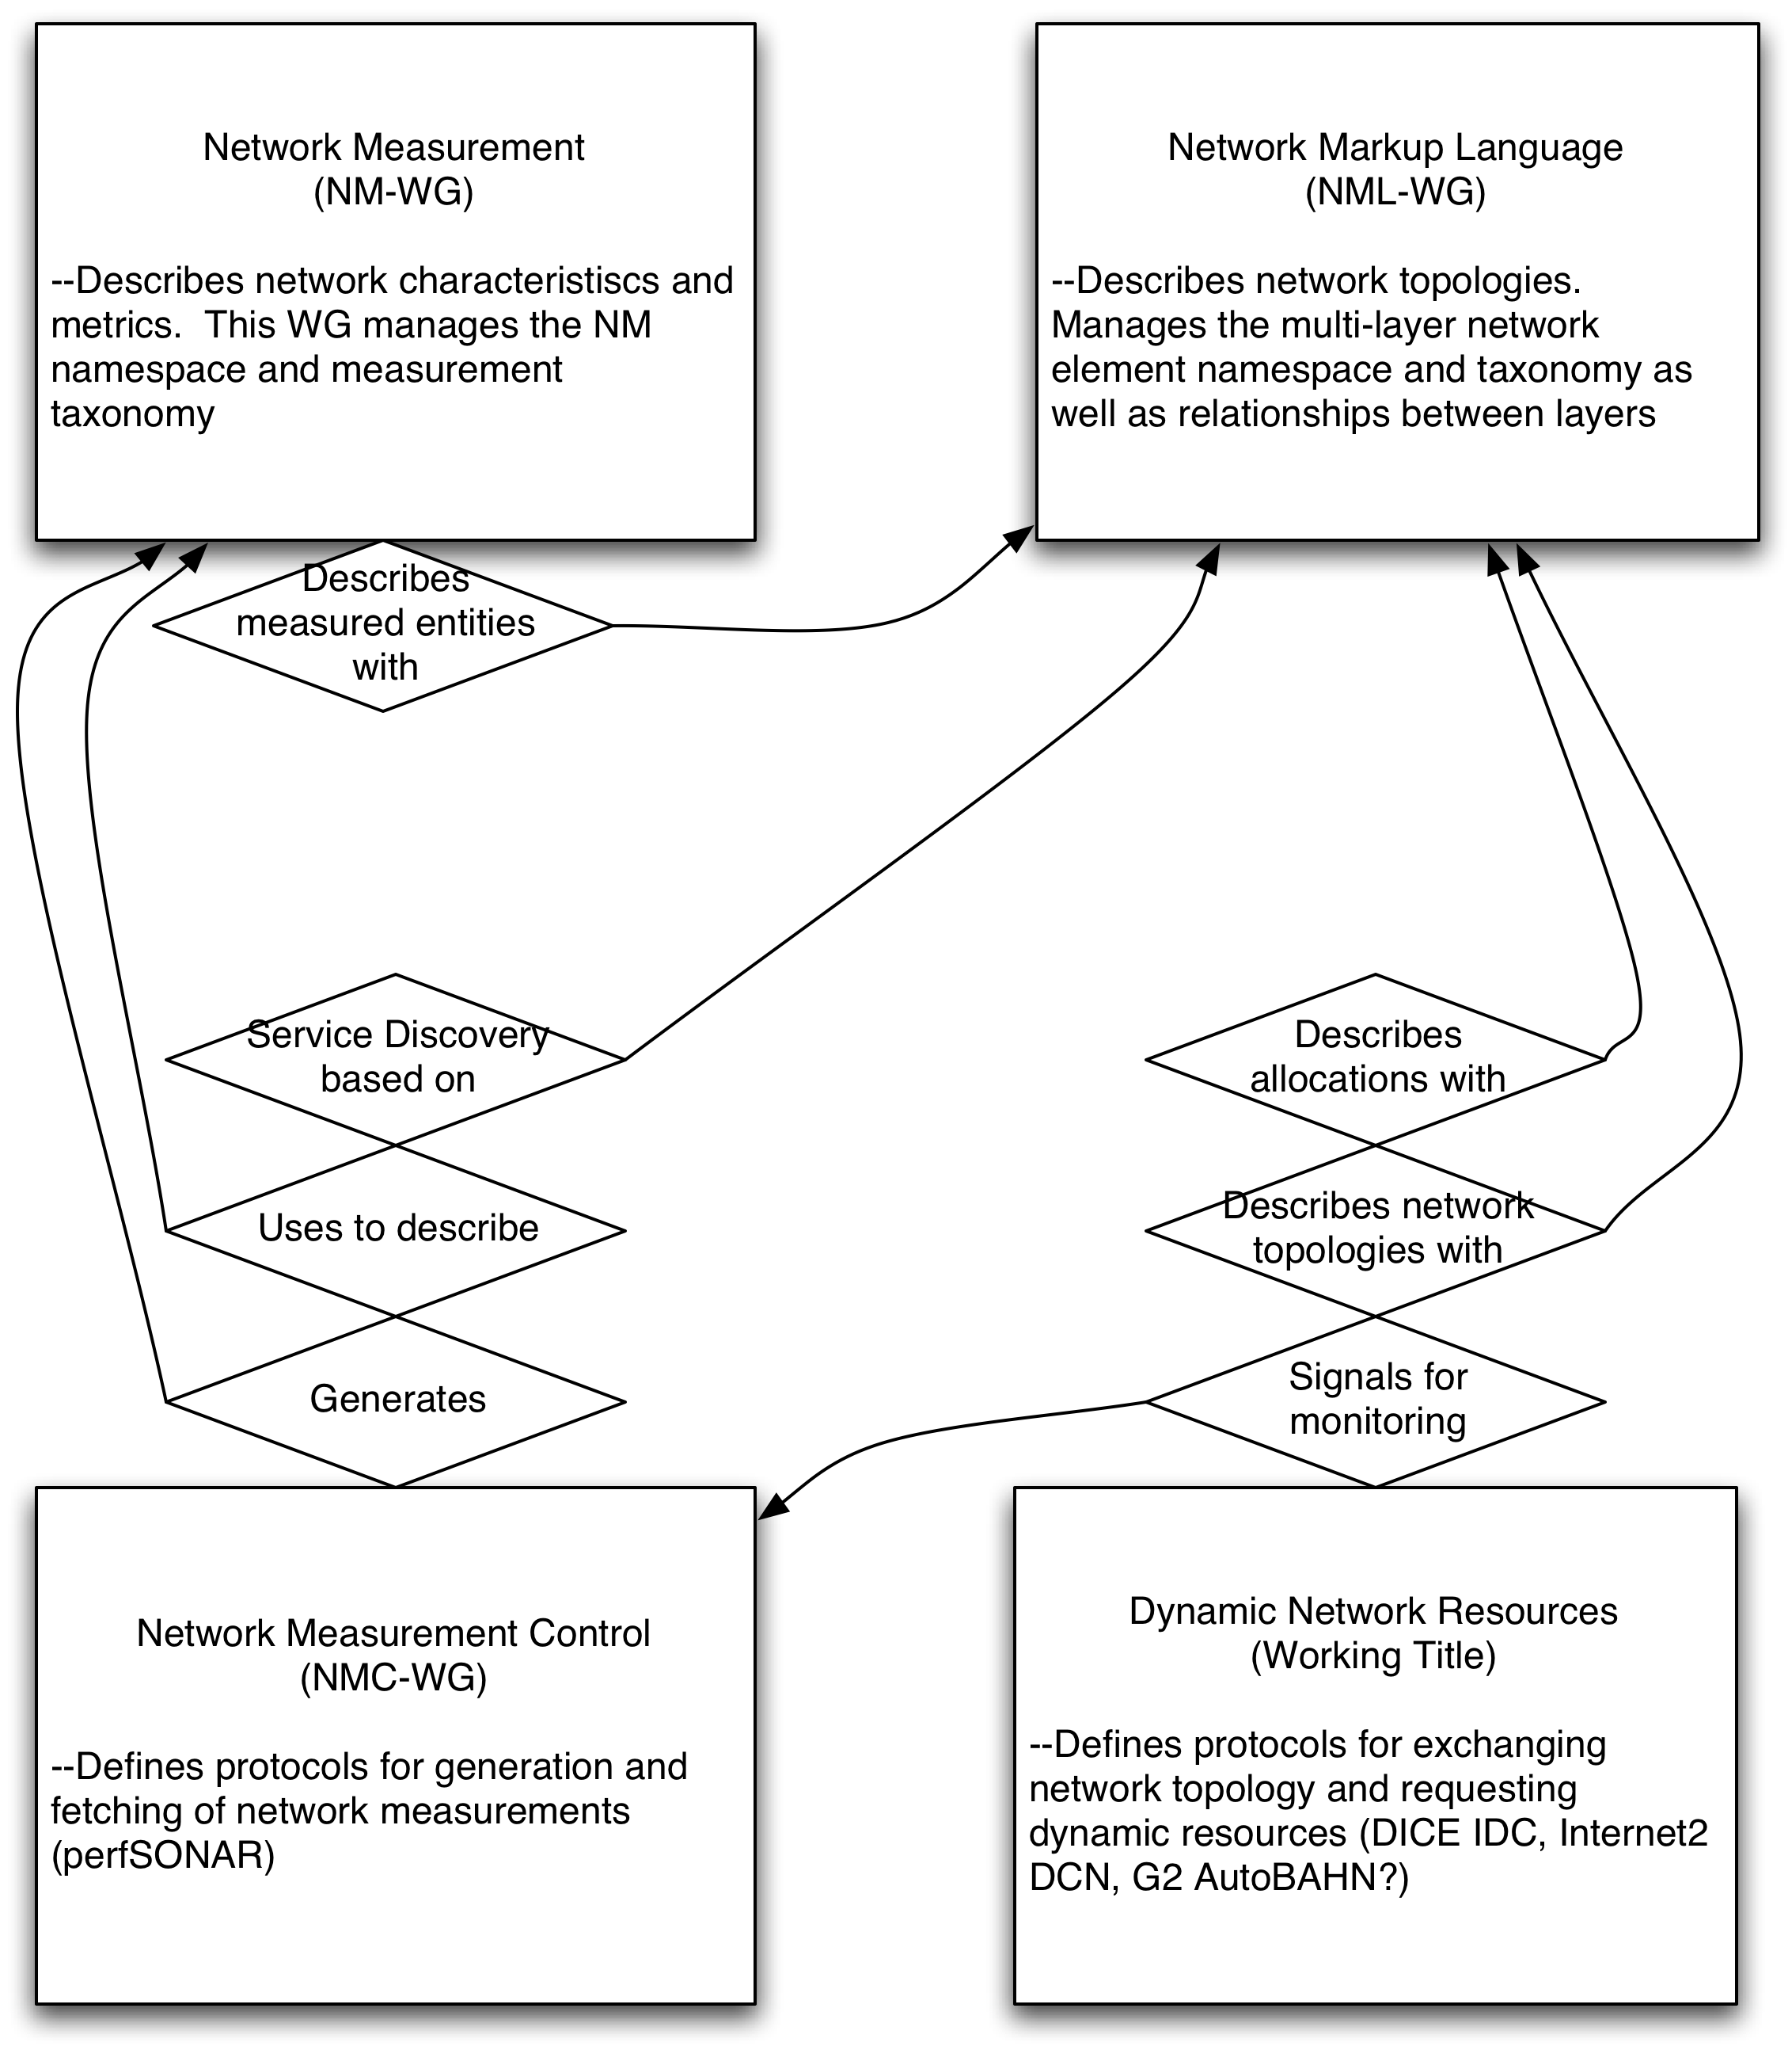
Relationships with other WGs

Slide 4
NURN
urn:ogf:network:domain=dcn.internet2.edu
urn:ogf:network:domain=* (this)
urn:ogf:network:domain=dcn.internet2.edu:* (is shorthand for)
urn:ogf:network:domain=dcn.internet2.edu:node=*:port=*:link=*

Slide 5
Elements
Use namespaces to differentiate between e.g. ethernet/port and TCP/port
Service
Node
Port
Link
  Two kinds
Network
Path
  Both network and path could be abstracted to “group”
Relation
Lifetime
Address

Slide 6
Current Status of nmtopo
Recent revisions to the document and schema
  https://anonsvn.internet2.edu/svn/nmwg/doc/nm-topo
In use by DICE IDC
In use by parts of perfSONAR
Intended to harmonize with “NDL”-style rendering
  Common object model

