Slide 1

PGI Working slides
Understanding OGSA-BES Tunings – V.01
Morris Riedel (FZJ – Jülich Supercomputing Centre & DEISA) et al.
OGF PGI Co-Chair

Slide 2
OGF IPR Policies Apply
“I acknowledge that participation in this meeting is subject to the OGF Intellectual Property Policy.”
Intellectual Property Notices Note Well: All statements related to the activities of the OGF and addressed to the OGF are subject to all provisions of Appendix B of GFD-C.1, which grants to the OGF and its participants certain licenses and rights in such statements. Such statements include verbal statements in OGF meetings, as well as written and electronic communications made at any time or place, which are addressed to:
    the OGF plenary session,
    any OGF working group or portion thereof,
    the OGF Board of Directors, the GFSG, or any member thereof on behalf of the OGF,
    the ADCOM, or any member thereof on behalf of the ADCOM,
    any OGF mailing list, including any group list, or any other list functioning under OGF auspices,
    the OGF Editor or the document authoring and review process
Statements made outside of a OGF meeting, mailing list or other function, that are clearly not intended to be input to an OGF activity, group or function, are not subject to these provisions.
Excerpt from Appendix B of GFD-C.1: ”Where the OGF knows of rights, or claimed rights, the OGF secretariat shall attempt to obtain from the claimant of such rights, a written assurance that upon approval by the GFSG of the relevant OGF document(s), any party will be able to obtain the right to implement, use and distribute the technology or works when implementing, using or distributing technology based upon the specific specification(s) under openly specified, reasonable, non-discriminatory terms. The working group or research group proposing the use of the technology with respect to which the proprietary rights are claimed may assist the OGF secretariat in this effort. The results of this procedure shall not affect advancement of document, except that the GFSG may defer approval where a delay may facilitate the obtaining of such assurances. The results will, however, be recorded by the OGF Secretariat, and made available. The GFSG may also direct that a summary of the results be included in any GFD published containing the specification.”
OGF Intellectual Property Policies are adapted from the IETF Intellectual Property Policies that support the Internet Standards Process.
Notes:
IPR Notices Note Well for OGF meetings

Slide 3
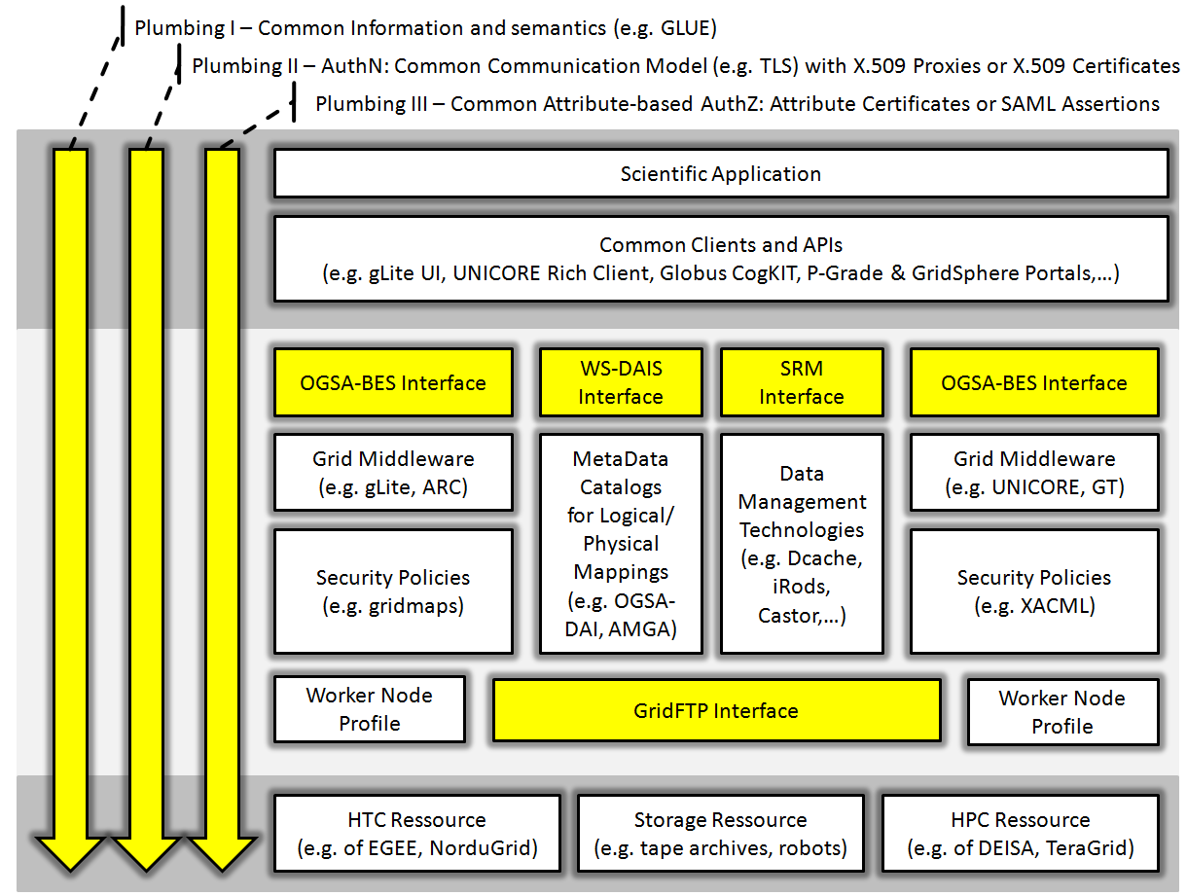
Ecosystem – Overview

Slide 4
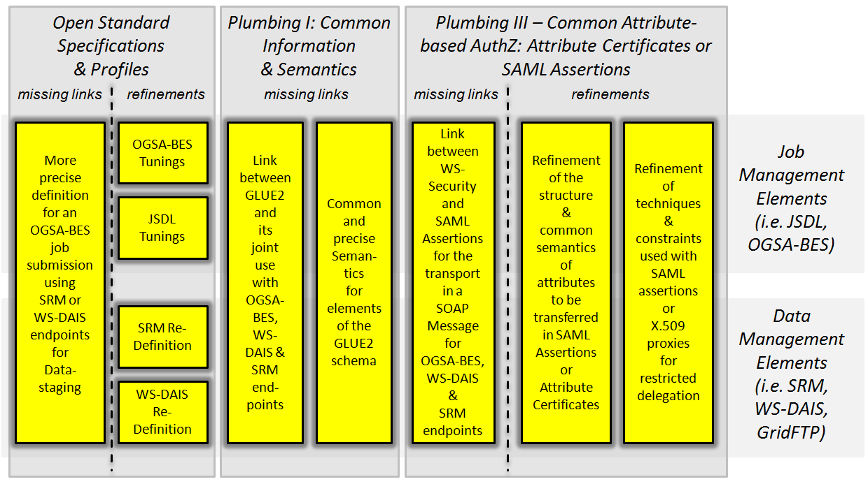
Ecosystem – Missing Links, Tunings & Refinements

Slide 5
Approach
The most fundamental goal is to satisfy the use cases perfomed by end-users in the production Grids
Term ‘OGSA-BES Tunings’ are only a pointer to the work in the larger Grid context
Whether PGI can extend/profile OGSA-BES or not for satisfying the use cases is still open
The slides provide ‘input content’ for the community and are not final and thus subject to discussion
List of operations and other content rather represents a collection of requirements

Slide 6
OGSA-BES Tunings

Slide 7
OGSA-BES Tunings – Issues (1)
Atomic nature
  Job submission interface without precise definition how the outcome can be obtained
  There are several standards out there and there are ways of how all these can be plugged into the OGSA-BES standards
  Problem have having too much possibilities
  At least one output mechanism should be defined as default
  Output transfer is tighly coupled with storage functionality
Conclusion
  Core Job Submission, Storage, and File Transfer functionality must be seen as one atomic entity allowing possible ways of extending
  (Cp. The need for this atomic entity was earlier identified by Riedel et al. in UniGrids Paper about UNICORE Atomic Services [1] )
  We need a job interface aligned with storage and file transfer functionality

Slide 8
OGSA-BES Tunings – Issues (2)
Up-to-date and precise information
  Real users really care about the system and its capabilities
  GLUE2 attributequery?
Conclusion
  TBD

Slide 9
OGSA-BES Tunings – Issues (3)
Clarify Resource Model
  TBD: WS-RF and the problem of WS-RF based clients that access the endpoint and thus are not able to work with BES
  Specify it as mandatory or not – but not leaving it open!
Conclusion
  TBD

Slide 10
OGSA-BES Tunings – Issues (4)
Multiple batch queues (Mulitple shares)
  Aka Request Routing, a user may need to request /select the queue directly and then the GES must ensure that the job ends up on the right queue: this is the routing.
  Applies if GES is acting as a single interface serving multiple resources
  Supercomputing-UNICORE - Grid: Only one GES per resource - Multiple batchqueues per resource (exposed for end-users) only for demonstrations, benchmarking, etc. – exposed is really rather rare but make sense for using only queues that reserved cpus (i.e. reservation use case) for a specific interop use case that execute sources at the same time on different resources (i.e. for quantifing uncertainties)
  Grid: The reason to have multiple batch queues behind a single CE is that we may have a PBS cluster where the worker nodes use linux version X.Y, another LSF cluster where the worker nodes use linux version Z.W, with different configurations and/or different characteristics (CPU speed, memory size etc) and the user can send jobs to one or the other, depending on his/her requirements - The matching of the requirements is currently done by e.g. the WMS, not by e.g. CREAM CE
  Also, in ARC there not right now, but at some time we had such setups where two clusters are accessed by one GES element basically
  The GES should allow users to define their ‘preferred share’ if authorized (attribute: shares for authZ?)
Conclusion / Question
  How to specify this exactly – maybe even as part of an URI? (UNICORE Gateway is doing similar things)
  One GES instance may provide access to different clusters → routing required
  why not just setup another GES so end put with one GES per cluster→ unnecessary overhead → how do you specify that one share is not available?
  We have two deployment models here one GES/resource or one GES/multiple resources

Slide 11
OGSA-BES Tunings – Issues (5)
Brokering
  The user sumbits single jobs (not workflows) and those are being forwarded to execution services
  But there are no dependencies between the forwarded jobs
  Like a GES on a higher level (should this be in the scope?) – maybe related to routing
Conclusion
  TBD

Slide 12
OGSA-BES Tunings – CreateActivity (1)
Operation to create a single activity
  createActivity() Operation
  In: ‘tuned JSDL’
  Out: ID uniquely identifying the newly created activity
  Out: location to achieve that end-users can use clients to manually stage any input data into the job sandbox (or fetch data after execution)
  (→ satisfy requirement for ‘data push’)
  Fault: Exception when activity could be not created (+reason)
  Note: both pieces of ‘out information’ per activity should be available also via a kind of listing properties of the computational endpoint service
  Requirement for data push: the end-user must have the ability to specify that the activity should be only created – not started yet
  Requirement for data push: the end-user starts the activity explicitly once the input-data has been transported to the stage-in location
  Validation of ‘tuned JSDLs’: how to handle unsupported/unrecognized activity descriptions, which parts are mandatory/optional → exceptions?

Slide 13
OGSA-BES Tunings – CreateActivity (2)
Conclusion / Questions
  Location of the sandbox must be more tighly coupled with the service endpoint
  Question arises whether this information should be always in the outcome since not every time the end-users intended to stage manually
  We possibly need an ‘IN: Initial State’ to indicate whether the activities should be directly starting or waiting to be explicitly started

Slide 14
OGSA-BES Tunings – CreateMultipleActivity (1)
Operation to create multiple activities
  createMultipleActivities() Operation
  In: list of ‘tuned JSDLs’
  Out: Unique identifier and sandbox location for each created activities
  Fault: Exception when activity could be not created (+reason)
  Same requirements have to be satisfied for ‘data push’ as in the CreateActivity() operation – only valid for each of the activities

Slide 15
OGSA-BES Tunings – CreateMultipleActivity (2)
Conclusion / Questions
  Question arises if end-users create 1000 activities with this operation for ‘many-task computing jobs’, should we really explicitly start all of them?!
  Alternative: Define Operation ‘CreateBulkActivities’ that take care of these ‘job types’ and use createMultipleActivities() only for a reasonable number of jobs
  We possibly need an ‘IN: Initial State’ to indicate whether the activities should be directly starting or waiting to be explicitly started

Slide 16
OGSA-BES Tunings – ChangeStatus (1)
Operation to change the status of a single activity
  changeStatus() Operation
  In: unique identifier of an activity
  In: New planned status of this activity (out of well-defined set)
  Out: New Status of the activity (out of well-defined set)
  Fault: Exception when change of status of activity is not allowed
  Requirement for state changes: A suitable state model having a ‘fine-granular’ list of commonly agreed states between the middlewares
  Note: Could be used to explicitly start an activity (if it was not started directly → used to satisfy data push requirement)

Slide 17
OGSA-BES Tunings – ChangeStatus (2)
Conclusion / Questions
  Relatively trivial operation – but it depends heavily on a well defined set of states in the state model (common agreement absolutely necessary)

Slide 18
OGSA-BES Tunings – ChangeMultipleActStatus (1)
Operation to change the status of multiple activities
  changeMultipleStatus() Operation
  In: list of identifier
  In: New planned status of each activity (out of well-defined set)
  Out: New Status of each activity (out of well-defined set)
  Fault: Exception for each activity when change of status of the corresponding activity is not allowed
  Same requirements apply as for ChangeStatus in terms of a well-defined set of commonly agreed states in the state model

Slide 19
OGSA-BES Tunings – ChangeMultipleActStatus (2)
Conclusion / Questions
  Relatively trivial operation – but it depends heavily on a well defined set of states in the state model (common agreement absolutely necessary)

Slide 20
OGSA-BES Tunings – TerminateActivity (1)
Operation to terminate an activity
  terminateActivity() Operation
  Cp. terminateActivity() operation of OGSA-BES
  In: unique activity identifier
  Out: Feedback whether activity has been terminated correctly
  Fault: Exception if activity could not been terminated

Slide 21
OGSA-BES Tunings – TerminateActivity (2)
Conclusion / Questions
  How we specify if the terminate operation was succesful – what is the OUT at this operation in this case (e.g. TRUE, former ID)?

Slide 22
OGSA-BES Tunings – TerminateMultipleActivities (1)
Operation to terminate multiple activities
  terminateMultipleActivities() Operation
  Cp. terminateActivity() operation of OGSA-BES
  In: list of unique activity identifier
  Out: Feedback whether activities have been terminated correctly
  Fault: (list of) exception if activities could not been terminated

Slide 23
OGSA-BES Tunings – TerminateMultipleActivities (2)
Conclusion / Questions
  What if we specify terminate of 100 different activities and for each activity there will be an exception (e.g. due to communication problem), how we specify the FAULT element

Slide 24
OGSA-BES Tunings – PurgeActivity (1)
Operation to purge an activity
  purgeActivity() Operation
  ‘Purging’ refers to remove all termporary files and other temporary resources allocated to this activity (e.g. clear the storage place used for data-staging)
  Compared to TerminateActivity(): After terminateActivity() the activity still exists in the services in a suitable ‘terminated’ state – after purgeActivity() the activity is not longer available
  In: unique activity identifier
  Out: Feedback whether activity has been purged correctly
  Fault: Exception if activity could not been purged

Slide 25
OGSA-BES Tunings – PurgeActivity (2)
Conclusion / Questions
  We should maybe only the ‘purging’ of an activity if it has been terminated explicitly before → security reasons?!
  Otherwise one ‘accidently triggered purgeActivity operation’ might delete many useful data
  How we indicate that the activity was succesfully purged

Slide 26
OGSA-BES Tunings – PurgeMultipleActivities (1)
Operation to purge multiple activities
  purgeMultipleActivities() Operation
  Same meaning of ‘purging’ as identified before
  In: list of unique activity identifier
  Out: Feedback whether each activity has been purged correctly
  Fault: Exception if activities could not been purged

Slide 27
OGSA-BES Tunings – PurgeMultipleActivities (2)
Conclusion / Questions
  How to specify if puring was succesful?

Slide 28
OGSA-BES Tunings – GetActivityStatus (1)
Operation to get the status of a single activity
  getActivityStatus() Operation
  In: unique activity identifier
  In: Indicator showing the verbosity level (basic, medium, all)
  Out: status (out of well-defined status model)
  Fault: Exception if status for activity can not be obtained
  Requirement for a well-known set (default) states building up the default state model while additional state models might exist (i.e. extensibility)

Slide 29
OGSA-BES Tunings – GetActivityStatus (2)
Conclusion / Questions
  How to encode the IN for different information/state models (e.g. URIs)?

Slide 30
OGSA-BES Tunings – GetMultipleActStatus (1)
Operation to get the status of multiple activities
  getMultipleActStatus() Operation
  In: list of unique activity identifier
  In: Indicator for each showing the verbosity level (basic, detailed, all)
  Out: status of each (out of well-defined status model)
  Fault: Exception if status for each activity can not be obtained
  Requirement for a well-known set (default) states building up the default state model while additional state models might exist (i.e. extensibility)

Slide 31
OGSA-BES Tunings – getServiceInfo (1)
The service provides functionality to obtain overall status
  getServiceInfo() operation
  cp. getFactoryAttributes() operation of OGSA-BES
  Information about the resource accessible by the service in a specific information model (e.g. GLUE2)
  Different levels of verbosity are required
  Basic: Only the description of the service itself and the resource that is accessed can be obtained
  Medium: description of service and a list of activity identifier of all existing activities can be obtained
  All: description of service, full list of activities including all information for each activity

Slide 32
OGSA-BES Tunings – GetMultipleActStatus (2)
Conclusion / Questions
  How to encode the IN for different information/state models (e.g. URIs)?

Slide 33
OGSA-BES Tunings – No Service Management
The service provides no operations for service management
  Service management is basically on another layer
  Typically administrators would like to retain local resource control
  Operations such as ‘startacceptingnewactivities’, ‘stopacceptingnewactivities’, ‘clearjobenvironment’ are all rather service management operations not be invoked remotely

