Slide 1

Production Grid Infrastructure WG
State Model Discussions
PGI Team

Slide 2
OGF IPR Policies Apply
“I acknowledge that participation in this meeting is subject to the OGF Intellectual Property Policy.”
Intellectual Property Notices Note Well: All statements related to the activities of the OGF and addressed to the OGF are subject to all provisions of Appendix B of GFD-C.1, which grants to the OGF and its participants certain licenses and rights in such statements. Such statements include verbal statements in OGF meetings, as well as written and electronic communications made at any time or place, which are addressed to:
    the OGF plenary session,
    any OGF working group or portion thereof,
    the OGF Board of Directors, the GFSG, or any member thereof on behalf of the OGF,
    the ADCOM, or any member thereof on behalf of the ADCOM,
    any OGF mailing list, including any group list, or any other list functioning under OGF auspices,
    the OGF Editor or the document authoring and review process
Statements made outside of a OGF meeting, mailing list or other function, that are clearly not intended to be input to an OGF activity, group or function, are not subject to these provisions.
Excerpt from Appendix B of GFD-C.1: ”Where the OGF knows of rights, or claimed rights, the OGF secretariat shall attempt to obtain from the claimant of such rights, a written assurance that upon approval by the GFSG of the relevant OGF document(s), any party will be able to obtain the right to implement, use and distribute the technology or works when implementing, using or distributing technology based upon the specific specification(s) under openly specified, reasonable, non-discriminatory terms. The working group or research group proposing the use of the technology with respect to which the proprietary rights are claimed may assist the OGF secretariat in this effort. The results of this procedure shall not affect advancement of document, except that the GFSG may defer approval where a delay may facilitate the obtaining of such assurances. The results will, however, be recorded by the OGF Secretariat, and made available. The GFSG may also direct that a summary of the results be included in any GFD published containing the specification.”
OGF Intellectual Property Policies are adapted from the IETF Intellectual Property Policies that support the Internet Standards Process.
Notes:
IPR Notices Note Well for OGF meetings

Slide 3
Outline

Slide 4
Outline
Addressed Requirements
PGI State Model (Change this as you like for discussion)
Related Work: OGSA-BES State-Model
Related Work: HPC - FSP State-Model

Slide 5
Addressed Requirements

Slide 6
Addressed Requirements
Partial failures may lead to the demand of a „created:restart“ state
Manual ‚start‘ to address the manual data-staging requirements
TBD: Unclear how do we present the sub-states in the diagramm, may point to the whole diagramm itself…

Slide 7
PGI State Model

Slide 8
PGI State Model
Change these blocks and transitions as you like
Cancelled / Terminated
Running
Executing
Pending
Running
Auto Stage-in
Running
Auto Stage-out
Created:
Submitted
Created:Hold
Manual Stage-in
Failed
Finished
Manual Stage-out
Created: Restarted
Finished
Your state

Slide 9
Related Work: OGSA-BES – State Model

Slide 10
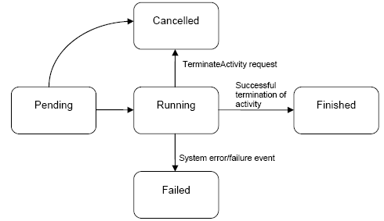
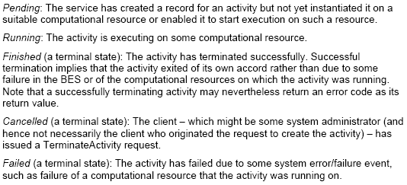
Related Work: OGSA-BES – State Model
Source: OGSA-BES, V 1.0, GFD 108
Basic State Model

Slide 11
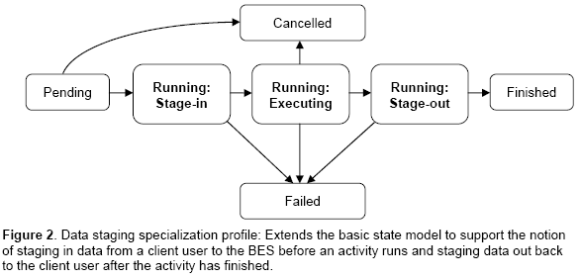
Related Work: OGSA-BES – State Model
Source: OGSA-BES, V 1.0, GFD 108
Data-Staging Specialization Profile (one example)
Same as HPC-File Staging Profile except „Cancelled “ is called „Terminated“

Slide 12
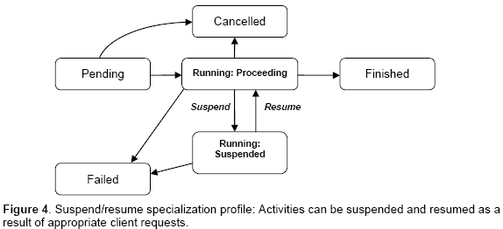
Related Work: OGSA-BES – State Model
Source: OGSA-BES, V 1.0, GFD 108
Suspend / Resume Specialization Example

Slide 13
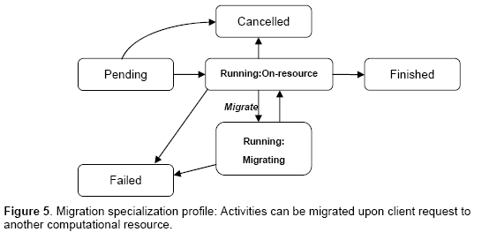
Related Work: OGSA-BES – State Model
Source: OGSA-BES, V 1.0, GFD 108
Migration Specialization Example

Slide 14
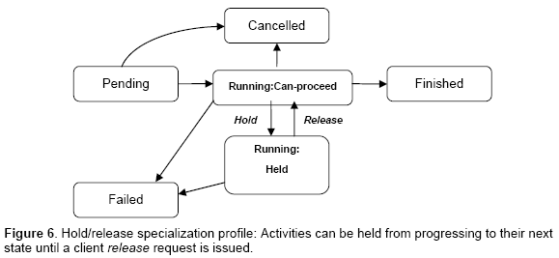
Related Work: OGSA-BES – State Model
Source: OGSA-BES, V 1.0, GFD 108
Hold / Release Specialization Example

Slide 15
Related Work: FSP – State Model

Slide 16
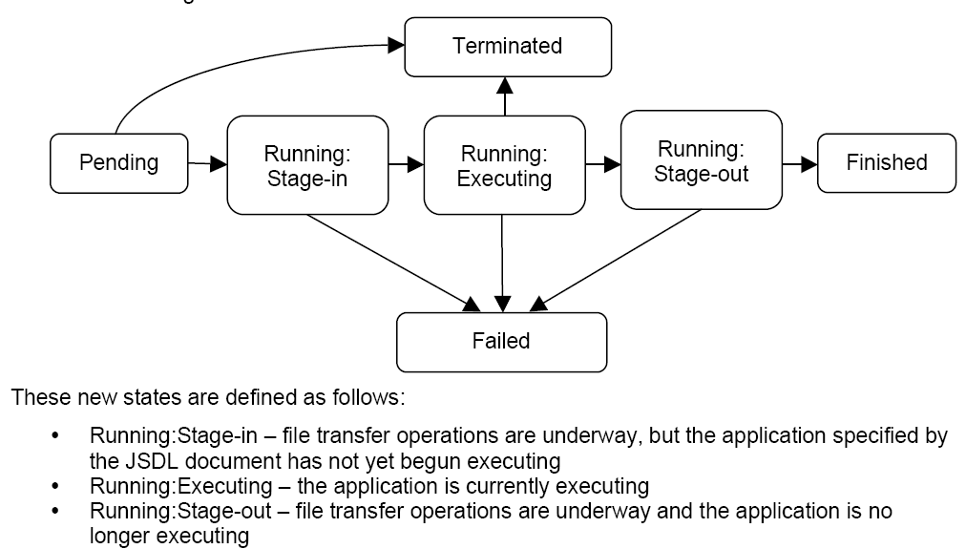
Related Work: FSP – State Model
Source: HPC – File Staging Profile (FSP), V1.0 – GFD135
Same as OGSA-BES except „Terminated“ is called „Cancelled“

Slide 17
Full Copyright Notice
Copyright (C) Open Grid Forum (2009). All Rights Reserved.
This document and translations of it may be copied and furnished to others, and derivative works that comment on or otherwise explain it or assist in its implementation may be prepared, copied, published and distributed, in whole or in part, without restriction of any kind, provided that the above copyright notice and this paragraph are included on all such copies and derivative works.
The limited permissions granted above are perpetual and will not be revoked by the OGF or its successors or assignees.
Notes:
OGF Full Copyright Notice if necessary

