Slide 1
OGF
Network Measurement Control WG
Jeff Boote
Internet2
Martin Swany
University of Delaware
Jason Zurawski
Internet2

Slide 2
OGF IPR Policies Apply
“I acknowledge that participation in this meeting is subject to the OGF Intellectual Property Policy.”
Intellectual Property Notices Note Well: All statements related to the activities of the OGF and addressed to the OGF are subject to all provisions of Appendix B of GFD-C.1, which grants to the OGF and its participants certain licenses and rights in such statements. Such statements include verbal statements in OGF meetings, as well as written and electronic communications made at any time or place, which are addressed to:
    the OGF plenary session,
    any OGF working group or portion thereof,
    the OGF Board of Directors, the GFSG, or any member thereof on behalf of the OGF,
    the ADCOM, or any member thereof on behalf of the ADCOM,
    any OGF mailing list, including any group list, or any other list functioning under OGF auspices,
    the OGF Editor or the document authoring and review process
Statements made outside of a OGF meeting, mailing list or other function, that are clearly not intended to be input to an OGF activity, group or function, are not subject to these provisions.
Excerpt from Appendix B of GFD-C.1: ”Where the OGF knows of rights, or claimed rights, the OGF secretariat shall attempt to obtain from the claimant of such rights, a written assurance that upon approval by the GFSG of the relevant OGF document(s), any party will be able to obtain the right to implement, use and distribute the technology or works when implementing, using or distributing technology based upon the specific specification(s) under openly specified, reasonable, non-discriminatory terms. The working group or research group proposing the use of the technology with respect to which the proprietary rights are claimed may assist the OGF secretariat in this effort. The results of this procedure shall not affect advancement of document, except that the GFSG may defer approval where a delay may facilitate the obtaining of such assurances. The results will, however, be recorded by the OGF Secretariat, and made available. The GFSG may also direct that a summary of the results be included in any GFD published containing the specification.”
OGF Intellectual Property Policies are adapted from the IETF Intellectual Property Policies that support the Internet Standards Process.
Notes:
IPR Notices Note Well for OGF meetings

Slide 3
Agenda
Agenda Bash
Charter Discussion
Work Items
perfSONAR Overview

Slide 4
Working Group Summary
Generation and exchange of network measurements is critical for all networked environments, and in particular advanced environments like the Grid. The schemata for network metrics that have been defined in the OGF’s Network Measurement Working Group (NM-WG) have spawned a vibrant community among R&E network operators who have been developing and deploying an infrastructure called perfSONAR. The perfSONAR effort began in September 2004 in a series of meetings in and around GGF-12 in Brussels, Belgium. The perfSONAR consortium has begun to produce a series of protocol documents describing the messaging functionality in that system and the NMC group will house the formalization of those standards within the OGF.

Slide 5
Purpose and Scope
The purpose of the Network Measurement and Control Working Group is to standardize the XML-based protocols that are currently in use in the perfSONAR project to control network measurement infrastructure and to share the results of the measurements and metrics that are generated. These protocols are already in widespread use and are described across a number of documents with various degrees of formality.
The scope of the Network Measurement and Control Working Group is to define base protocols and extension frameworks for those protocols, as well as to define extensions that are already in common use.

Slide 6
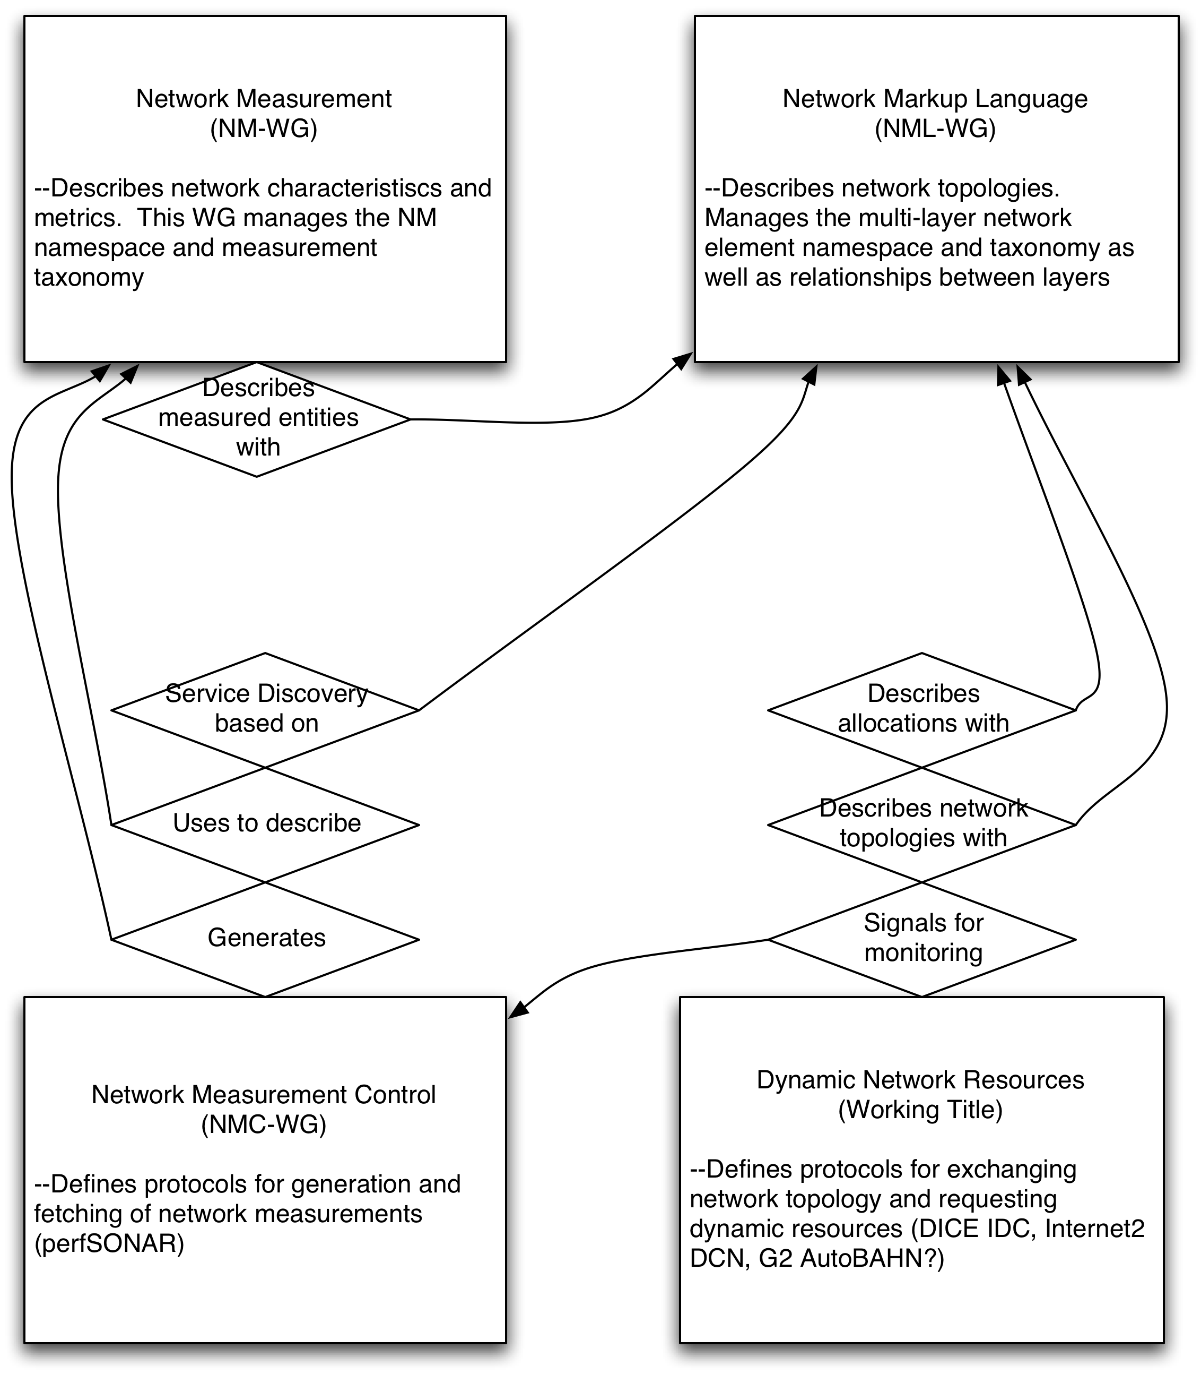
Relationships with other WGs
Network Services
Interface

Slide 7
Deliverables and Milestones
D1. Base perfSONAR Protocol. This document describes the basic message formats and exchange models. This document also describes the extension mechanism and simple extensions that are common to all perfSONAR services as well as the “result codes” and their extension mechanism. This document will also discuss the AA framework and describe more complicated message patterns and the extension points to allow definition of new ones.

Slide 8
Deliverables and Milestones
D2. Measurement Archive Protocol. This document describes the extension and application of the base protocol to support communication with a Measurement Archive (MA). The particular message types that MAs support are defined here.

Slide 9
Deliverables and Milestones
D3. Information Service Protocol. This document describes the extension and application of the base protocol to support communication with an Information Service. The particular message types that ISs support are defined here.

Slide 10
Deliverables and Milestones
D4. Measurement Point Protocol. This document describes the extension and application of the base protocol to support communication with a Measurement Point (MP). The particular message types that MPs support are defined here.

Slide 11
Deliverables and Milestones
D5. Transformation Service Protocol. This document describes the specific messages and interactions required to provide a generic transformation service. The concept is to allow a mechanism for data transformation using a pipeline of web services.
  No progress yet

Slide 12
perfSONAR Overview
Raison d'être and Definition
Architecture
Development groups and deployments

Slide 13
Introduction & Overview
Most organizations perform monitoring and diagnostics of their own network
Networking is increasingly a cross-domain effort
Monitoring and diagnostics must also become a cross-domain effort
Notes:
Standard introduction to pS. Lots of these slides are duplicates. Emphasize that this is a monitoring solution for the masses – relies on cooperation to work effectively.

Slide 14
What is perfSONAR
A collaboration
  Production network operators focused on designing and building tools that they will deploy and use on their networks to provide monitoring and diagnostic capabilities to themselves and their user communities.
An architecture & a set of protocols
  Web Services Architecture
  Protocols based on the Open Grid Forum Network Measurement Working Group Schemata
Several interoperable software implementations
  Java, Perl, Python…
A Deployed Measurement infrastructure
Notes:
perfSONAR is the sum of all parts. Make sure to note that even though it is a distributed development effort between the different parties involved (sometimes with different goals) the core is still the protocol and the end deployments.

Slide 15
perfSONAR Architecture
Interoperable network measurement middleware (SOA):
  Modular
  Web services-based
  Decentralized
  Locally controlled
Integrates:
  Network measurement tools and archives
  Data manipulation
  Information Services
    Discovery
    Topology
    Authentication and authorization
Based on:
  Open Grid Forum Network Measurement Working Group schema
  Currently attempting to formalize specification of perfSONAR protocols in a new OGF WG (NMC)
Notes:
Architecture goes on for 3 slides (including this). Standard cartoons describe the pieces will follow.

Slide 16
perfSONAR Architecture
Data Services
Analysis/Visualization
Infrastructure
Measurement
Points
User GUIs
Auth(n/z)‏
Services
Measurement
Archives
Web Pages
Information Services
Transformations
NOC Alarms
Service Lookup
Topology
Service Configuration
Notes:
Transformations still do not exist.
GUIs are an active area of development
Auth is only supported in perfSONAR-MDM currently (planned for 2009 in perfSONAR-PS based on DICE recommendations)
Information Services is an area of active change.

Slide 17
Decouple 3 phases of a Measurement Infrastructure
Notes:
APIs are being updated in perfSONAR-PS to encourage new development of GUIs

Slide 18
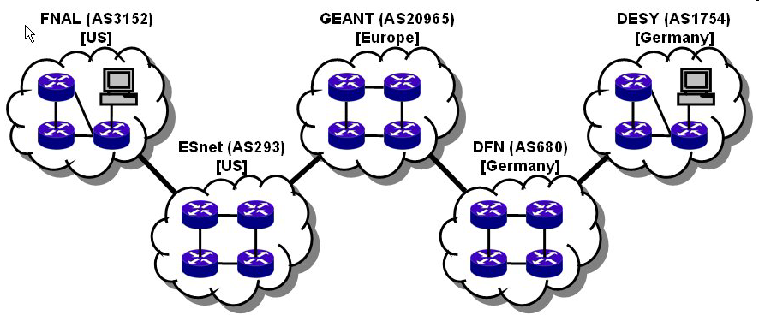

perfSONAR works E2E when All Networks Participate
Many collaborations are inherently multi-domain, so for an end-to-end monitoring tool to work everyone must participate in the monitoring infrastructure
user
performance GUI
measurement archive
measurement archive
Analysis tool
measurement archive
measurement archive
m1
m1
m4
m1
m4
m4
measurement archive
m3
m3
m3
GEANT (AS20965)
[Europe]
m1
m4
DESY (AS1754)
[Germany]
FNAL (AS3152)
[US]
m1
m4
m3
ESnet (AS293)
[US]
DFN (AS680)
[Germany]
m3
Notes:
Cooperation is key to the success of perfSONAR-PS. End-to-end problem debugging cannot work without it.

Slide 19
perfSONAR Development Partners
perfSONAR-MDM
  Originally funded through Geant2 (and eventually Geant3) Project
  Java Platform
perfSONAR-PS
  Joint effort between US Higher Education partners and National Laboratories
  Perl Platform
Notes:
Need to introduce the two sets of folks involved.

Slide 20
perfSONAR Collaboraters
GRNET
HEAnet
Internet2
ISTF
POZNAN
UNINETT
University of Delaware
Indiana University
Renater
RedIRIS
RNP
SLAC
SWITCH
SURFnet
ARNES
BELNET
CARNET
CESNET
CYNET
DANTE
DFN
ESnet
FCCN
FERMI
GARR
GEANT
Georgia Institute of Technology
Notes:
Shoutouts – maybe we missed some, so apologize in advance.

Slide 21
Development Status
perfSONAR-MDM
  Current Release: v3.1 (Jan 2009)
  http://wiki.perfsonar.net/jra1-wiki/index.php/PerfSONAR_v3.1
  Services:
    RRD Measurement Archive
    SQL Measurement Archive
    SSH Telnet Measurement Point
    Lookup Service
    Authentication Service
    BWCTL Measurement Point
    Command Line Measurement Point
Notes:
MDM Status. This is to the best of my knowledge.

Slide 22
Development Status
perfSONAR-PS
  Scheduled Release (v3.1) for Late March
  http://www.internet2.edu/performance/pS-PS/
  Services & Tools
    SNMP Measurement Archive
    Status Measurement Archive
    PingER Measurement Archive/Measurement Point
    perfSONAR-BUOY Measurement Archive
    Global & Local Lookup Service
    Topology Service
    perfSONAR GUIs
Notes:
PS status – we have two upcoming releases work mentioning (tools + performance node)

Slide 23
Development Status
Performance Node
  Live CD (v2.1) to be released Early April
  http://www.internet2.edu/performance/node/index.html
  Services & Tools
    perfSONAR-PS Tools
    OWAMP
    BWCTL
    NDT
    NPAD
    Reverse Traceroute Server
Notes:
Performance node status.

Slide 24
Deployment Status
Backbone Networks
  APAN
    SNMP
    perfSONAR-BUOY (Trial)
  ESnet
    SNMP
    PingER
    Planed BWCTL/OWAMP data through perfSONAR-BUOY
  Geant
    Components from perfSONAR-MDM v3.1
  Internet2
    SNMP
    perfSONAR-BUOY
  RNP
    Command Line Measurement Points
Notes:
Tried to represent these as close as possible. Geant is a mystery so I aimed high. APAN may be touchy (can list both as trial maybe).

Slide 25
Deployment Status
(National) Regional Networks
  MAX
  MCNC
  SOX
  TransPac2
(National) Regional Networks (Trials)
  CENIC
  GPN
  JGN2
  LONI
  MERIT
  NOX
  NYSERNET
  PIONIER
  SWITCH
  TWAREN
  UEN
Notes:
Regional (mostly US, some International). (May be more running old versions of software that don’t interact with the gLS…)

Slide 26
Deployment Status
User Communities
  LHC (Tier1 Sites)
    perfSONAR-MDM v3.0/3.1
    Support provided by Dante
  USATLAS (Tier2/Tier3 Sites in the United States)
    Performance Node: Live CD deployments (currently v2.0)
    Support provided by perfSONAR-PS developers and user community
  USCMS (Tier2/Tier3 Sites in the United States)
    Evaluating Performance Node
  GLIF
    Trial of perfSONAR tools to monitor circuits
Notes:
List these as ‘special’ cases since they span backbones and regionals. Don’t go into detail who is on each community.

