Slide 1


OGF 25 2-6 March 2009 Catania, Italy NSI-WG Chain vs. Tree model
Radek Krzywania radek.krzywania@man.poznan.pl

Slide 2
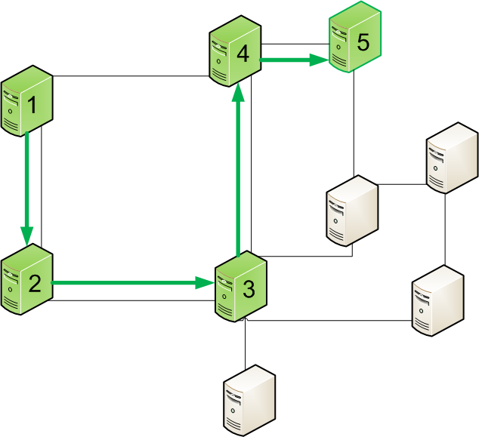
Chain model
Chain model assumes that nodes/domains are allowed to communicate only one-by-one, passing message from one to another

Slide 3
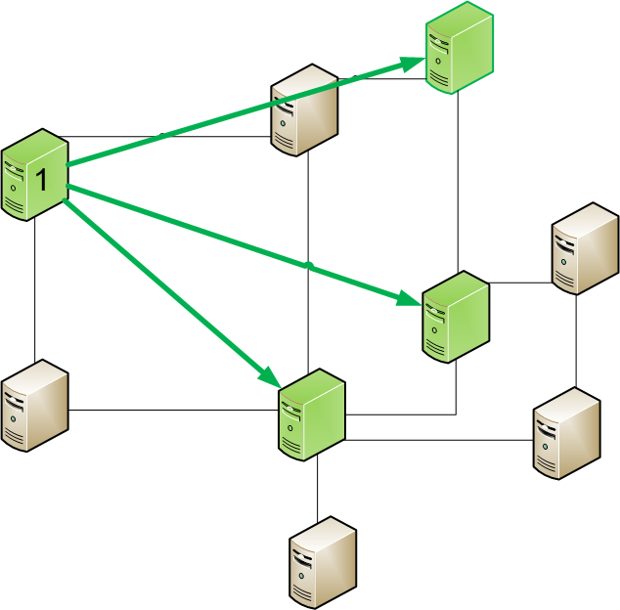
Tree model
Tree communication model does not introduce „reachability” limitations, thus any node/domain can contact directly any other (despite if they are adjacent), also in simultaneous way

Slide 4
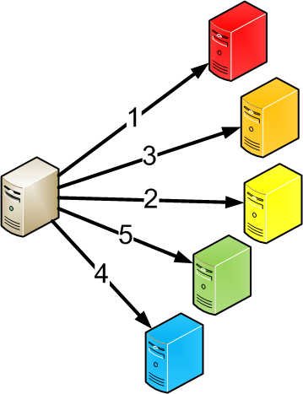

Comparison – nodes order
Chain
Tree
Visited nodes has exactly defined order
There is no predefined order of reaching nodes

Slide 5
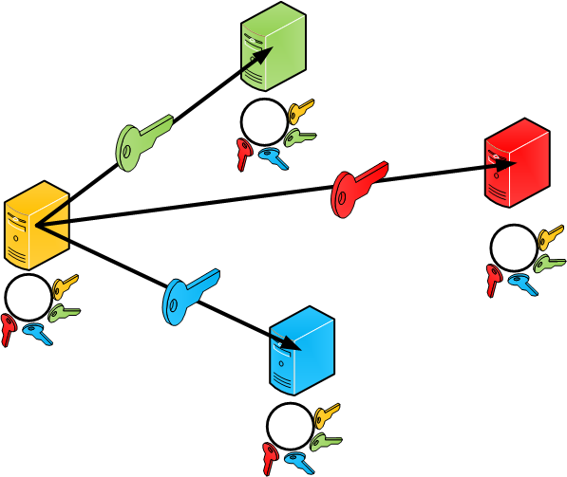
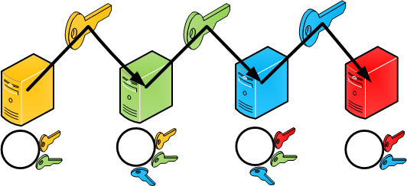
Comparison – AAI
Chain
Tree
AAI consideration may base on neighbor trusts
AAI infrastructure needs to allow any-to-any communication

Slide 6
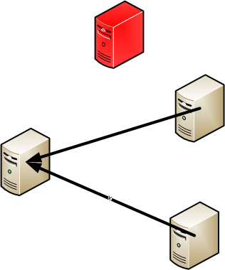

Comparison – failure
Chain
Tree
Less flexibility in case of failure (chain break needed if intermediate node is down)
Flexibility in case of failure (can simply avoid not responding node)

Slide 7
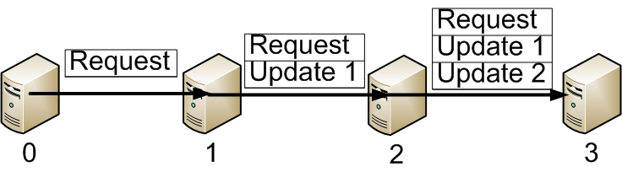
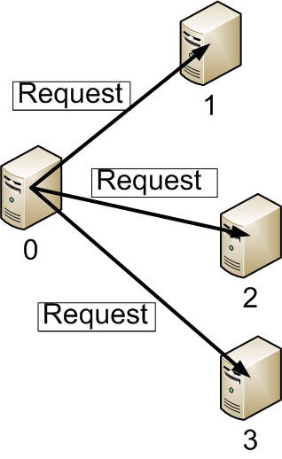
Comparison – request update
Chain
Tree
Next nodes along path may have access to previous nodes information (as request may be updated by them)
Nodes receives only request message; all information exchange between nodes needs to go through central point (request sender) or be independent messaging process between adjacent nodes

Slide 8
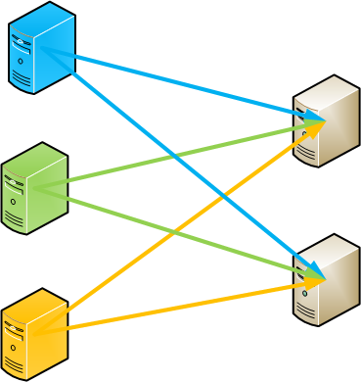
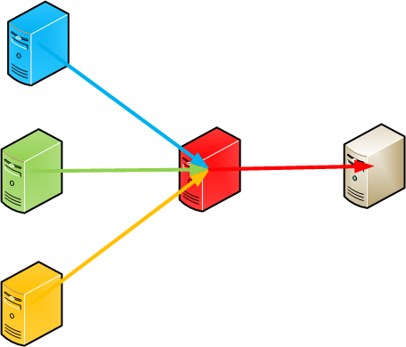
Comparison – flooding and loops
Chain
Tree
Ordered messaging process allows to control messages loops and flooding
Flooding possible in one-to-many communication

Slide 9
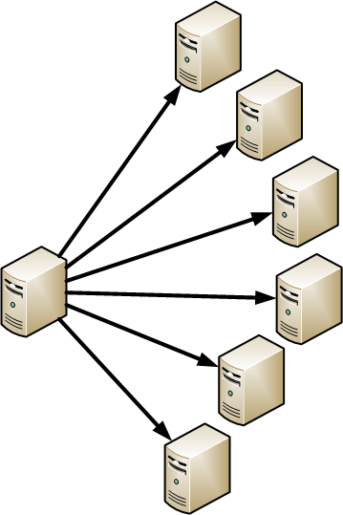

Comparison – Delivery time
Chain
Tree
Message delivery depends on number of hops between nodes
Immediate message delivery independent from nodes distance (hops) – at least theoretically

Slide 10
Coexistence of methods
The coexistence of chain and tree communication model is supposed to be possible in some scenarios, however a detailed investigation is needed.
E.g. the chain and tree enabled nodes/domains should be grouped, otherwise tree enabled node may try to reach chain enabled nodes skipping the chain.

Slide 11
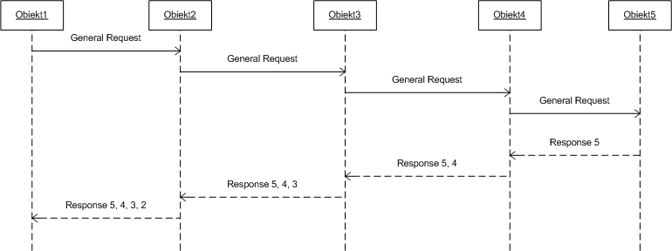
Examples of messages processing Chain Model
Simple reservation request, where each object is expected to provide some resources

Slide 12
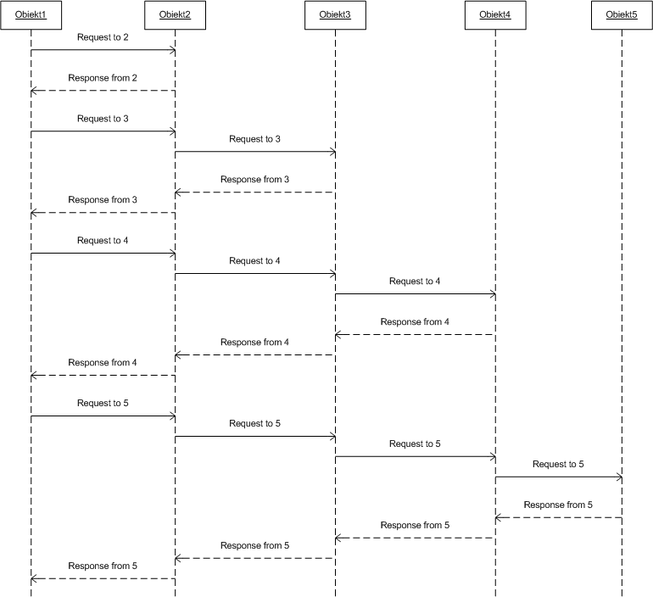
Examples of messages processing Chain Model
Simple reservation request, where each object is expected to provide some resources
Objects are expected to respond one by one to the Object1 before sending request to next object
Messages forwarding mechanism

Slide 13
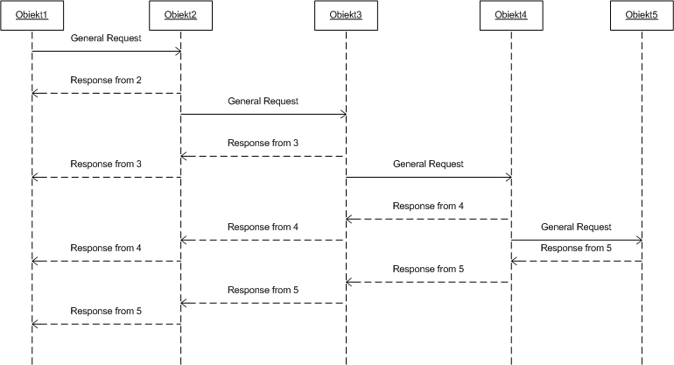
Examples of messages processing Chain Model
Reservation request, which is forwarded through all objects, but responses are send individually to the Object1

Slide 14
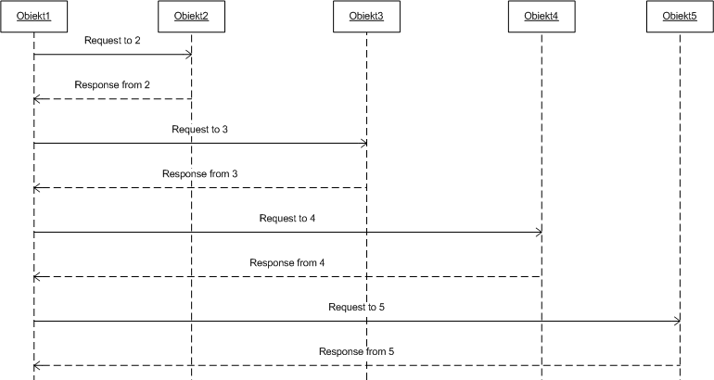
Examples of messages processing Tree Model
Request is sent to all objects (possibly at the same time) and each objects responds individually to the Object1. The order of responses is unpredictable.

Slide 15
Chain and tree model in NSI WG
Both models can be used to achieve NSI goals, only the messaging process is different
NSI should not choose only one of the method, but should be opened to both (at the same time probably)
Messaging should not concern the real objectives of NSI, as this is mostly implementation issue, not architecture

Slide 16
Thank you
Q&A, Discussions

