Slide 1

NMC-WG Session 1
June 22nd 2010, OGF 29
Martin Swany – University of Delaware
Jason Zurawski – Internet2

Slide 2

OGF IPR
“I acknowledge that participation in this meeting is subject to the OGF Intellectual Property Policy.”
Intellectual Property Notices Note Well: All statements related to the activities of the OGF and addressed to the OGF are subject to all provisions of Appendix B of GFD-C.1, which grants to the OGF and its participants certain licenses and rights in such statements. Such statements include verbal statements in OGF meetings, as well as written and electronic communications made at any time or place, which are addressed to:
    the OGF plenary session,
    any OGF working group or portion thereof,
    the OGF Board of Directors, the GFSG, or any member thereof on behalf of the OGF,
    the ADCOM, or any member thereof on behalf of the ADCOM,
    any OGF mailing list, including any group list, or any other list functioning under OGF auspices,
    the OGF Editor or the document authoring and review process
Statements made outside of a OGF meeting, mailing list or other function, that are clearly not intended to be input to an OGF activity, group or function, are not subject to these provisions.
Excerpt from Appendix B of GFD-C.1: ”Where the OGF knows of rights, or claimed rights, the OGF secretariat shall attempt to obtain from the claimant of such rights, a written assurance that upon approval by the GFSG of the relevant OGF document(s), any party will be able to obtain the right to implement, use and distribute the technology or works when implementing, using or distributing technology based upon the specific specification(s) under openly specified, reasonable, non-discriminatory terms. The working group or research group proposing the use of the technology with respect to which the proprietary rights are claimed may assist the OGF secretariat in this effort. The results of this procedure shall not affect advancement of document, except that the GFSG may defer approval where a delay may facilitate the obtaining of such assurances. The results will, however, be recorded by the OGF Secretariat, and made available. The GFSG may also direct that a summary of the results be included in any GFD published containing the specification.”
OGF Intellectual Property Policies are adapted from the IETF Intellectual Property Policies that support the Internet Standards Process.
2 – 11/08/26, © 2010 Internet2

Slide 3
Overview
OGF-NMC relationship to perfSONAR
perfSONAR Overview
  Motivation
  What is perfSONAR
  Who is involved
  Who is adopting
NMC working status
<number> – 11/08/26, © 2010 Internet2

Slide 4
NMC Charter
Charter Focus/Purpose and Scope:
The purpose of the Network Measurement and Control Working Group is to standardize the XML-based protocols that are currently in use in the perfSONAR project to control network measurement infrastructure and to share the results of the measurements and metrics that are generated. These protocols are already in widespread use and are described across a number of documents with various degrees of formality.
The scope of the Network Measurement and Control Working Group is to define base protocols and extension frameworks for those protocols, as well as to define extensions that are already in common use.
<number> – 11/08/26, © 2010 Internet2

Slide 5
perfSONAR Overview
Desirable design features for any network monitoring solution
  Component Based
    Functionality should be split into logical units
    Each function (e.g. visualization) should function through well defined communication with other components (e.g. data storage)
  Modular
    Monolithic designs rarely work
    Components allow choice of how to operate a customized end solution.
  Accessible
    Well defined interfaces (e.g. APIs)
Initial design should facilitate future expansion
Communication between the components should be open, and well documented
<number> – 11/08/26, © 2010 Internet2

Slide 6
perfSONAR Overview
<number> – 11/08/26, © 2010 Internet2

Slide 7
perfSONAR Overview
Most organizations perform monitoring and diagnostics of their own network
  SNMP Monitoring via common tools (e.g. MRTG, Cacti)
  Enterprise monitoring (e.g. Nagios)
Networking is increasingly a cross-domain effort
  International collaborations in many spaces (e.g. science, the arts and humanities) are common
  Interest in development and use of R&E networks at an all time high
Monitoring and diagnostics must also become a cross-domain effort
<number> – 11/08/26, © 2010 Internet2

Slide 8
perfSONAR Overview
A collaboration
  Production network operators focused on designing and building tools that they will deploy and use on their networks to provide monitoring and diagnostic capabilities to themselves and their user communities.
An architecture & set of communication protocols
  Web Services (WS) Architecture
  Protocols established in the Open Grid Forum
    Network Measurement Working Group (NM-WG)
    Network Measurement Control Working Group (NMC-WG)
Several interoperable software implementations
  perfSONAR-MDM
  perfSONAR-PS
A Deployed Measurement infrastructure
<number> – 11/08/26, © 2010 Internet2

Slide 9
perfSONAR Inception
perfSONAR originated from discussions between Internet2’s End-to-End Performance Initiative (E2Epi), and the Géant2 project in September 2004.
Members of the OGF’s (then GGF) NM-WG provided guidance on the encoding of network measurement data.
Additional network partners, including ESnet and RNP provided development resources as well as served as early adopters.
The first release of perfSONAR branded software was available in July 2006.
All perfSONAR branded is open source
All products looking to be labeled as perfSONAR compliant must establish protocol compliance based on the public standards of the OGF
<number> – 11/08/26, © 2010 Internet2

Slide 10
perfSONAR Architecture Overview
Interoperable network measurement middleware designed as a Service Oriented Architecture (SOA):
  Each component is modular
  All are Web Services (WS) based
  The global perfSONAR framework as well as individual deployments are decentralized
  All perfSONAR tools are Locally controlled
perfSONAR Integrates:
  Network measurement tools and archives (e.g. stored measurement results)
  Data manipulation
  Information Services
    Discovery
    Topology
  Authentication and authorization
<number> – 11/08/26, © 2010 Internet2

Slide 11
perfSONAR Architecture Overview
The key concept of perfSONAR is that each entity performs a service
  Each service provides a limited set of services, e.g. collecting measurements between arbitrary points or managing the registration and location of distributed services
  The service is a self contained entity and provides functionality on its own as well as when deployed with the remainder of the framework
Services interact through protocol exchanges
  Standardized message formats
  Standardized exchange patterns
A collection of perfSONAR services within a domain is a deployment
  Deploying perfSONAR can be done À la carte, or through a complete solution
Services federate with each other, locally and globally
  Services are designed to automatically discover the presence of other perfSONAR components
  Clients are designed with this distributed paradigm in mind
<number> – 11/08/26, © 2010 Internet2

Slide 12
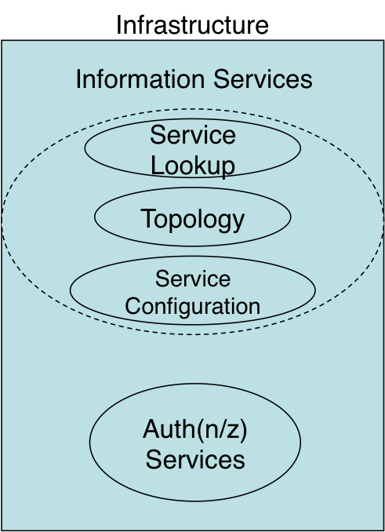
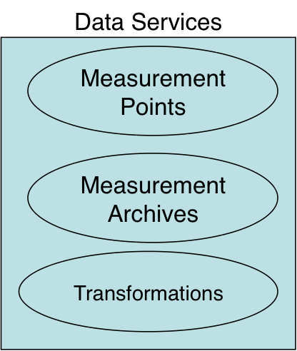
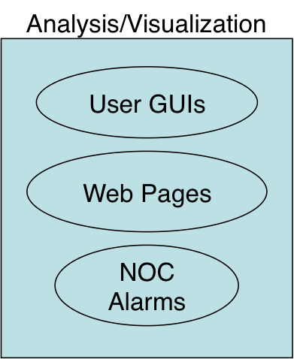
perfSONAR Architecture Overview
<number> – 11/08/26, © 2010 Internet2

Slide 13
perfSONAR Architecture Overview
A perfSONAR deployment can be any combination of services
  An instance of the Lookup Service is required to share information
  Any combination of data services and analysis and visualization tools is possible
perfSONAR services automatically federate globally
  The Lookup Service communicates with a confederated group of directory services (e.g. the Global Lookup Service)
  Global discovery is possible through APIs
perfSONAR is most effective when all paths are monitored
  Debugging network performance must be done end-to-end
  Lack of information for specific domains can delay or hinder the debug process
<number> – 11/08/26, © 2010 Internet2

Slide 14
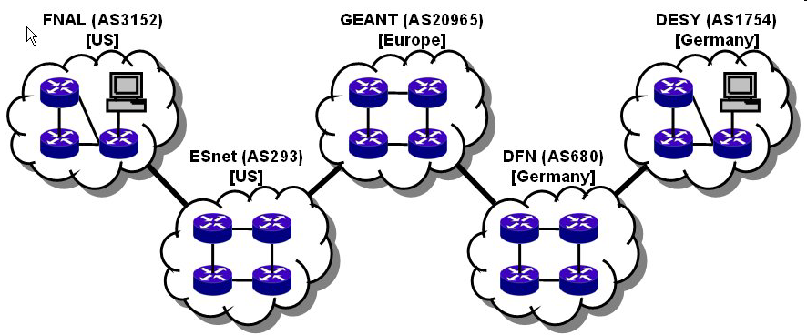

Many collaborations are inherently multi-domain, so for an end-to-end monitoring tool to work everyone must participate in the monitoring infrastructure
user
performance GUI
measurement archive
measurement archive
Analysis tool
measurement archive
measurement archive
m1
m1
m4
m1
m4
m4
measurement archive
m3
m3
m3
GEANT (AS20965)
[Europe]
m1
m4
DESY (AS1754)
[Germany]
FNAL (AS3152)
[US]
m1
m4
m3
ESnet (AS293)
[US]
DFN (AS680)
[Germany]
m3
<number> – 11/08/26, © 2010 Internet2

Slide 15
Who is perfSONAR?
The perfSONAR Consortium is a joint collaboration between
  ESnet
  Géant
  Internet2
  Rede Nacional de Ensino e Pesquisa (RNP)
Decisions regarding protocol development, software branding, and interoperability are handled at this organization level
There are two independent efforts to develop software that is compatible with perfSONAR
  perfSONAR-MDM
  perfSONAR-PS
Each project works on an individual development roadmap and works with the consortium to further protocol development and insure compatibility
<number> – 11/08/26, © 2010 Internet2

Slide 16
Who is perfSONAR-MDM?
perfSONAR-MDM is made up of participants in the Géant project:
  Arnes
  Belnet
  Carnet
  Cesnet
  CYNet
  DANTE
  DFN
  FCCN
  GRNet
  GARR
  ISTF
  PSNC
  Nordunet (Uninett)
  Renater
  RedIRIS
  Surfnet
  SWITCH
perfSONAR-MDM is written in Java primarily and was designed to serve as the monitoring solution for the Large Hadron Collider (LHC) project.
perfSONAR-MDM is available as Debian or RPM packages.
<number> – 11/08/26, © 2010 Internet2

Slide 17
Who is perfSONAR-PS?
perfSONAR-PS is comprised of several members:
  ESnet
  Fermilab
  Georgia Tech
  Indiana University
  Internet2
  SLAC
  The University of Delaware
perfSONAR-PS products are written in the perl programming language and are available for installation via source or RPM packages
perfSONAR-PS is also a major component of the Internet2 pS Performance Toolkit – A bootable Linux CD containing measurement tools.
<number> – 11/08/26, © 2010 Internet2

Slide 18
perfSONAR Adoption
perfSONAR is gaining traction as an interoperable and extensible monitoring solution
Adoption has progressed in the following areas:
  R&E networks including backbone, regional, and exchange points
  Universities on an international basis
  Federal labs and agencies in the United States (e.g. JET nets)
  Scientific Virtual Organizations, notably the LHC project
Recent interest has also accrued from:
  International R&E network partners and exchange points
  Commercial Providers in the United States
  Hardware manufactures
<number> – 11/08/26, © 2010 Internet2

Slide 19
perfSONAR Adoption
Networks
  US National R&E Networks
    ESnet, Internet2, NLR, NOAA
  International R&E Networks/Exchange Points
    APAN NOC, CSTNET, GEANT (and NREN Partners), Gloriad, JGN2, JPNet, KRNET, MANLAN, Starlight, TransPac2, RNP
  US Regional R&E Networks
    CENIC, CIC OmniPoP, Florida LambdaRail, Front Range GigaPoP, GPN, Indiana GigaPoP, LEARN, LONI, MAX, MCNC, Merit, MOREnet, Northern Lights GigaPoP, NOX, NYSERNet, OARnet, Pacific Northwest GigaPoP, SoX, UEN
US Based Federal Labs/Facilities
  ANL, BNL, DOE Headquarters, FNAL, LBNL, LLNL, MIT Lab for Nuclear Science, National Library of Medicine, NCAR, NCSA, NERSC, PNNL, PPPL, PSC, SLAC
<number> – 11/08/26, © 2010 Internet2

Slide 20
perfSONAR Adoption
International Sites
  North America
    Simon Frazier University (Canada), University of Western Ontario (London, Ontario, Canada), Camosun College (Canada)
  South America
    MonIPE - RNP (Rio de Janeiro, Brazil), Universidade Federal De Santa Catarina (Brazil), SPRACE (Brazil), UERJ (Brazil), Innova-Red (Buenos Aires, Argentina), UFSC (Florianopolis, Brazil), REUNA (Santiago, Chile), PUCP (Lima, Peru), MRREE (Lima, Peru), RAGIE2 (Universidad Mariano Galvez – Guatemala), UDESC (Brazil), UNIFACS (Salvador, Bahia, Brazil)
  Europe/Middle East
    Universitat Politecnica de Catalunya (Barcelona Spain), GEANT Affiliated NRENs (Europe), Northwestern (Doha, Qatar), Georgetown University (Doha, Qatar)
  Africa
    African Network Information Center, KRNET, UbuntuNet
  Asia/Oceana
    Chinese University of Hong Kong, Chonnam National University (South Korea), KISTI (Korea), Teritary Education Commission (Wellington, NZ), IHEP (China), Advanced Network Lab. at JNU (South Korea), Monash University (Melbourne, Australia), USTC ATLAS Tier-3 in Hefei (AnHui Province, China), NCHC (Taiwan), NICT (Japan), Thaisarn Nectec (Bangkok, Thailand)
<number> – 11/08/26, © 2010 Internet2

Slide 21
perfSONAR Adoption
Universities
Boise State University
Boston University *
California Institute of Technology **
The College of William and Mary
Colorado School of Mines
Colorado State University
Florida Atlantic University
George Mason University
Georgia Tech University
Georgetown University
Hat Creek Radio Observatory
Harvard University *
Hope College
Indiana University *
Indiana Purdue University *
Iowa State University
Johns Hopkins University
Leeward Community College
Louisianna State University
Massachusetts Institute of Technology (MIT) **
Merced County Office of Education
Michigan State University *
Middle Tennessee State University
North Dakota State University
Northwestern University
Oregon State University
Penn State University
Portland Community College
Purdue University **
Scripps College
Southern Methodist University *
Syracuse University
Texas A&M University
Tufts *
Universities
University of California Irvine *
University of California Los Angles
University of California San Diego **
University of California Santa Barbara *
University of California Santa Cruz *
University of Chicago *
University of Connecticut
University of Delaware
University of Florida **
University of Hawaii
University of Houston
University of Illionios *
University of Maryland
University of Michigan *
University of Minnesota
University of Nebraska **
University of Northern Iowa
University of Oklahoma *
University of Oregon
University of Pennsylvania
University of South Dakota
University of South Florida
University of Texas *
University of Utah
University of Washington *
University of Wisconsin * **
Vanderbilt University **
Washington University in St. Louis
Wayne State University
* USATLAS
** USCMS
<number> – 11/08/26, © 2010 Internet2

Slide 22
perfSONAR Adoption
Commercial Networks/Organizations
  AboveNet, BCNet, BBN, Cobham, EagleNet, KDL Inc., Northrop Gruman, Ocala Electric Company, Philadelphia Orchestra, Steelville Telephone Exchange, Viawest, Verizon
Virtual Organizations
  GENI, LIGO, LSST, MeasurementLab, REDDnet, USATLAS, USCMS
Live pS Status:
  Services: http://www.perfsonar.net/activeServices
  Locations: http://www.perfsonar.net/activeServices/IS
<number> – 11/08/26, © 2010 Internet2

Slide 23
Workgroup Status
Holding regular calls
Making progress on the base document (new version will be posted to gridforge today)
Having discussions on problems related to specifying the work done by organizations such as perfsonar:
  Effective split of the work between documents
    Base doc should only have pS messages in it
    Profile document discussing how to use pS messages in HTTP/SOAP context should come out concurrently
  Result Codes
Would like more people willing to author and edit documents
Next session will be a “working” session. Please stay, and expect to get work assignments.
<number> – 11/08/26, © 2010 Internet2

Slide 24
NMC-WG Session 1
June 22nd 2010, OGF 29
Martin Swany – University of Delaware
Jason Zurawski – Internet2
For more information, visit https://forge.gridforum.org/projects/nmc-wg
<number> – 11/08/26, © 2010 Internet2

