Slide 1





Status Reviews and Plans
Production Grid Infrastructure (PGI) - WG
Morris Riedel et al.
Juelich Supercomputing Centre
PGI Co-Chair

Slide 2
OGF IPR Policies Apply
“I acknowledge that participation in this meeting is subject to the OGF Intellectual Property Policy.”
Intellectual Property Notices Note Well: All statements related to the activities of the OGF and addressed to the OGF are subject to all provisions of Appendix B of GFD-C.1, which grants to the OGF and its participants certain licenses and rights in such statements. Such statements include verbal statements in OGF meetings, as well as written and electronic communications made at any time or place, which are addressed to:
    the OGF plenary session,
    any OGF working group or portion thereof,
    the OGF Board of Directors, the GFSG, or any member thereof on behalf of the OGF,
    the ADCOM, or any member thereof on behalf of the ADCOM,
    any OGF mailing list, including any group list, or any other list functioning under OGF auspices,
    the OGF Editor or the document authoring and review process
Statements made outside of a OGF meeting, mailing list or other function, that are clearly not intended to be input to an OGF activity, group or function, are not subject to these provisions.
Excerpt from Appendix B of GFD-C.1: ”Where the OGF knows of rights, or claimed rights, the OGF secretariat shall attempt to obtain from the claimant of such rights, a written assurance that upon approval by the GFSG of the relevant OGF document(s), any party will be able to obtain the right to implement, use and distribute the technology or works when implementing, using or distributing technology based upon the specific specification(s) under openly specified, reasonable, non-discriminatory terms. The working group or research group proposing the use of the technology with respect to which the proprietary rights are claimed may assist the OGF secretariat in this effort. The results of this procedure shall not affect advancement of document, except that the GFSG may defer approval where a delay may facilitate the obtaining of such assurances. The results will, however, be recorded by the OGF Secretariat, and made available. The GFSG may also direct that a summary of the results be included in any GFD published containing the specification.”
OGF Intellectual Property Policies are adapted from the IETF Intellectual Property Policies that support the Internet Standards Process.
Notes:
IPR Notices Note Well for OGF meetings

Slide 3
Outline

Slide 4

Outline
PGI Status Checks
  Documents, RedMine, Plans, etc.
Activities around Execution Interfaces
  EMI-ES, BES Profiles, towards BES2.0
Activities around GLUE2 and profiles
  GLUE2 XML rendering, security profiles
AOB
  GIN Session,…

Slide 5
PGI Status Checks

Slide 6

Done: Existing Documents
[GFD180] OGF-Production Grid Infrastructure: Use Case Collection, Version 1.0
  http://www.ogf.org/documents/GFD.180.pdf
[GFD181] OGF-Production Grid Infrastructure: Glossary of Acronyms and Terms, Version 1.0
  http://www.ogf.org/documents/GFD.181.pdf

Slide 7
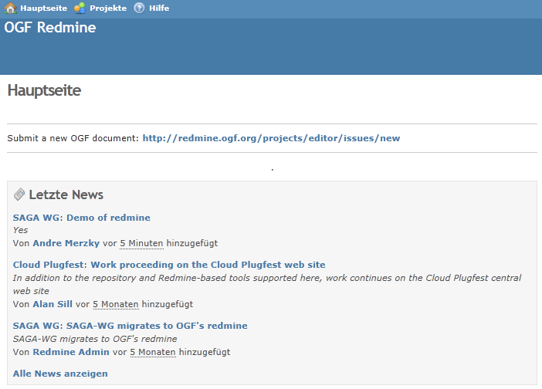
RedMine Transfer
OGF moved
away from GridForge
  RedMine is new
  http://redmine.ogf.org
  Initial material transferred
  Derived Task Activities:
  Identify material that can be removed
  Transfer rest of ‘approved’ material
  Update plans and charter documents

Slide 8
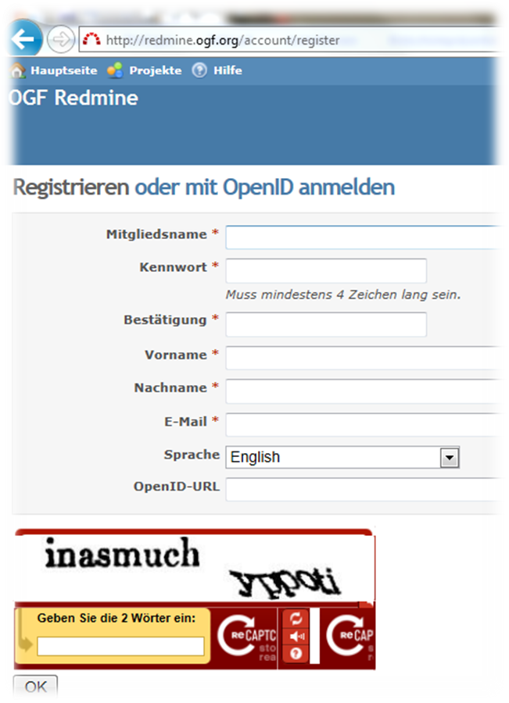
Register: PGI Members!

Slide 9

Plans: Experiences in Standards
Continue to bring experiences into OGF
  ‘Major mission of PGI’ → lessons learned!
  Document/share know-how from infrastructures
Contribute to new emerging specifications
  BES2.0 et al. & profiles
  Consistent information with GLUE2 et al.
  Attribute-based security XACML&SAML et al.
  Identity delegation gets uptake → new group!

Slide 10
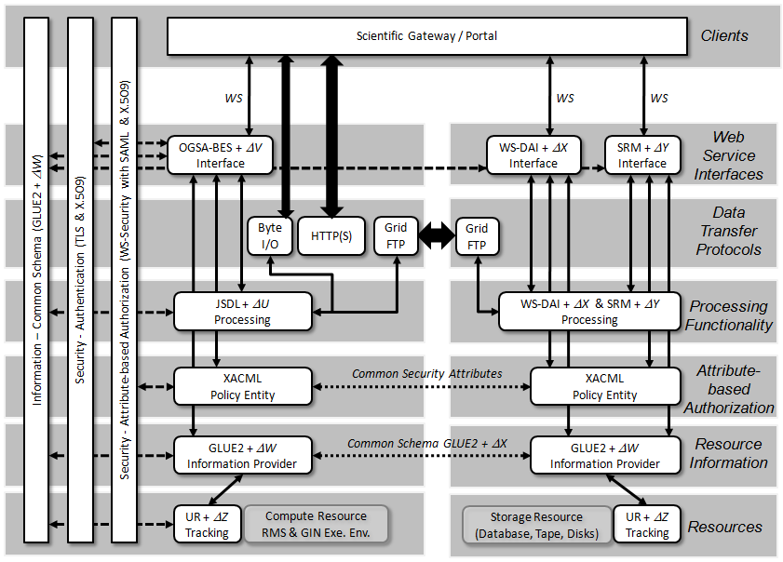
Plans: PGI Reference Model

Slide 11
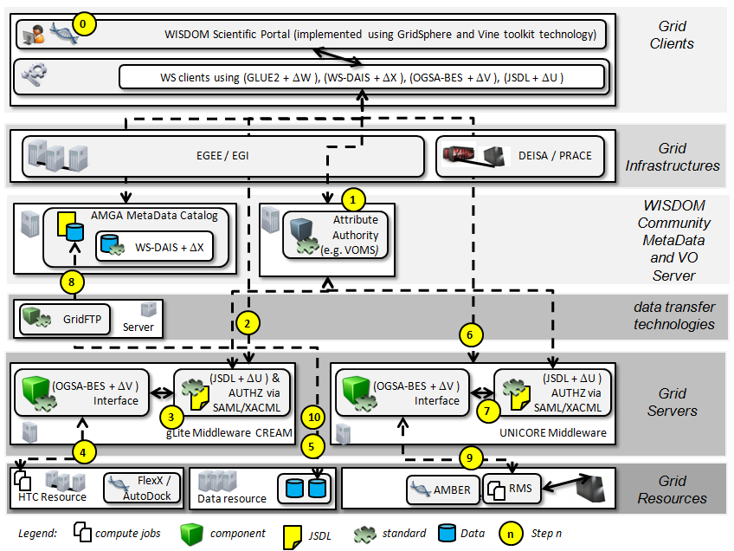
Application Driver: bio-informatics

Slide 12
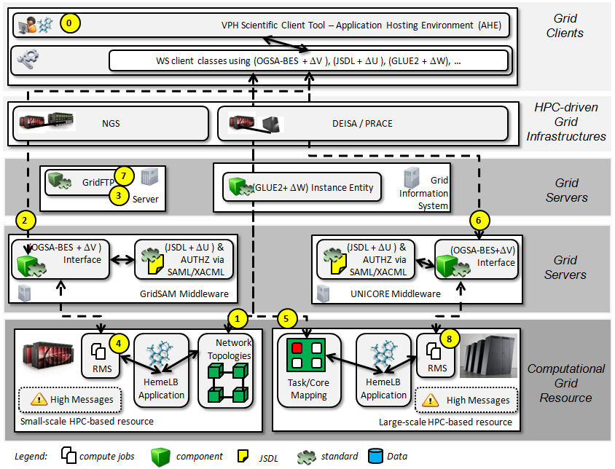
Application Driver: e-Health

Slide 13
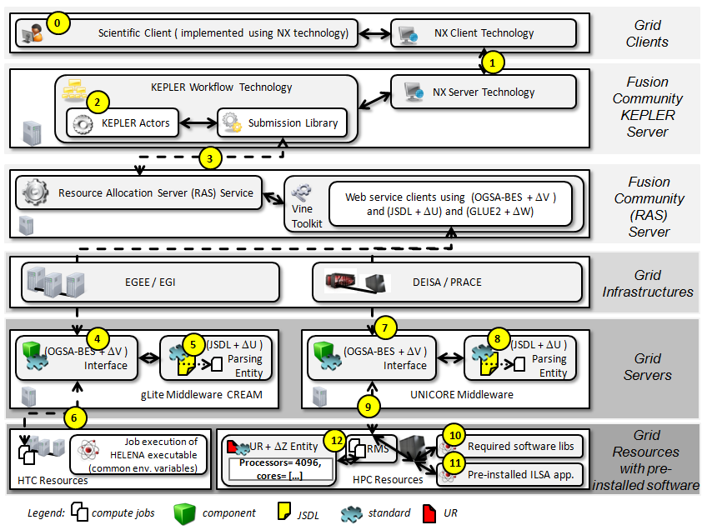
Application Driver: Fusion

Slide 14
Activities Execution Interfaces

Slide 15
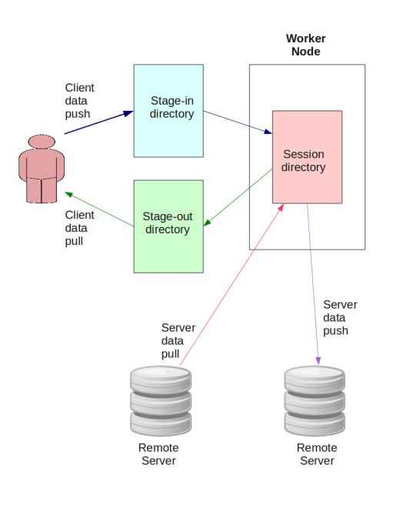
Several PGI Material Available
Concepts derived from applications
  Improving HPC, e-Science
  applications, data staging, etc.
EMI-ES information document
  Implements many those concepts
  https://forge.ogf.org/sf/go/doc16442?nav=1
BES, UR takes PGI work in account…
  New Two Profiles standardizing the concepts
  E.g. access to working directory, etc.

Slide 16
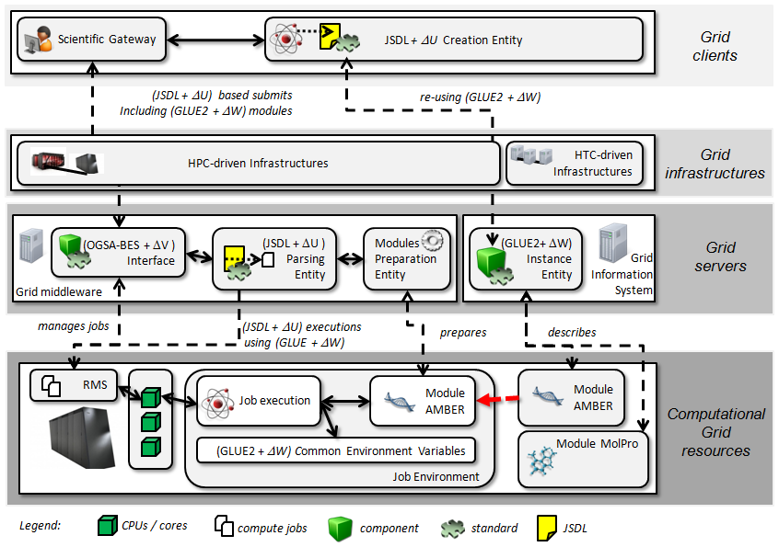
Concept: Application Support

Slide 17
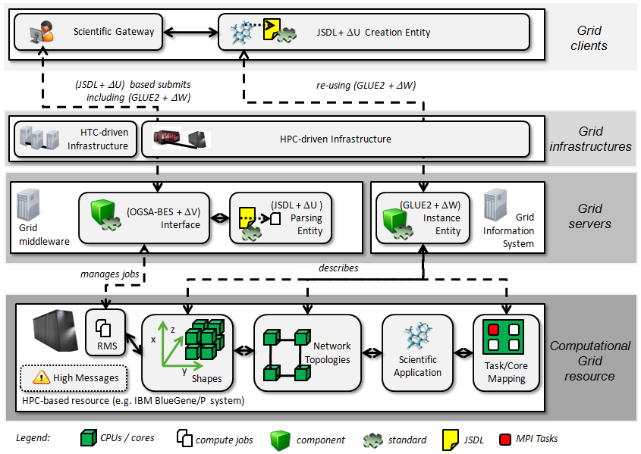
Concept: HPC Extensions

Slide 18
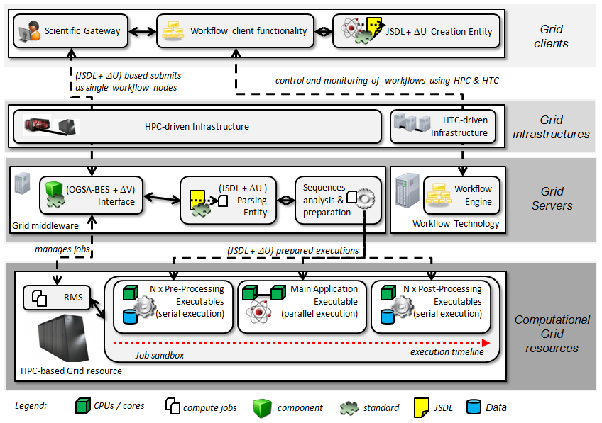
Concept: Sequence Support

Slide 19
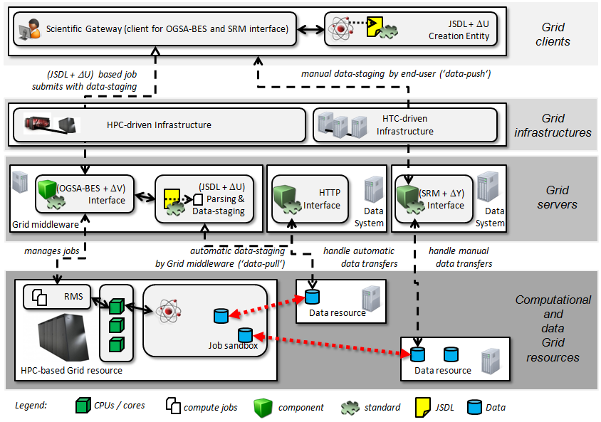
Concept: Directory Access

Slide 20
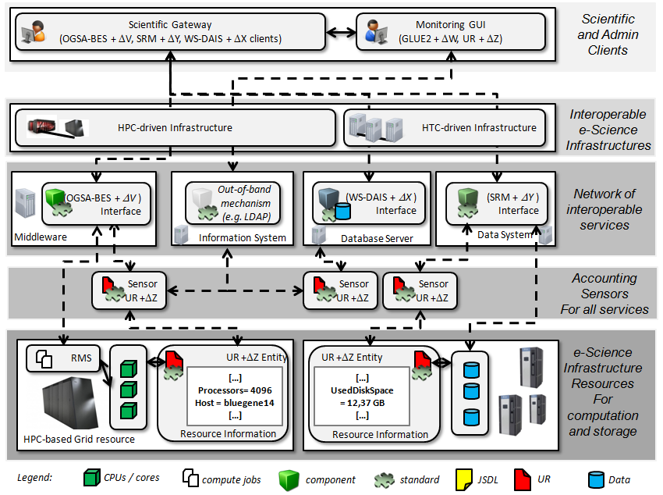
Concept: Improve Records

Slide 21
Activities GLUE2 and Profiles

Slide 22
The GLUE2 Case…
Strong adoption (in EU, also US…)
PGI builds on GLUE2
XML rendering not available
  But it seems progress is made?!
  Hiarchical vs. flat rendering settled…
PGI members could thus do:
  Contribute to GLUE2 experience document
  Work on security profiles while waiting

Slide 23
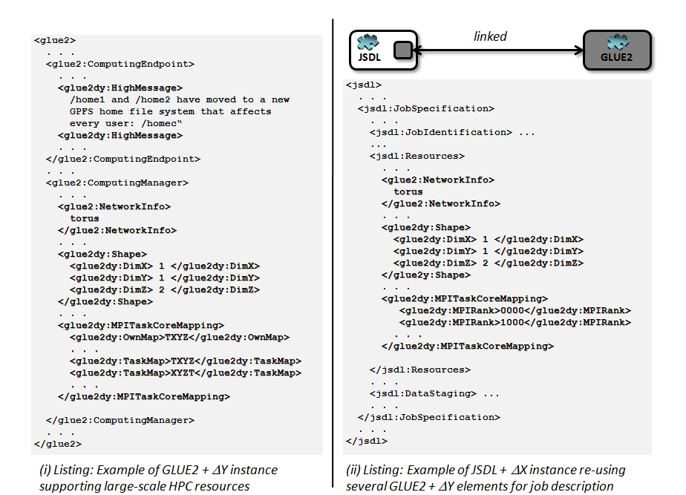
PGI builds on or extends GLUE2

Slide 24


GLUE2 XML Rendering Re-use
<glue2>
. . .
<glue2:ComputingEndpoint>
. . .
</glue2:ComputingEndpoint>
<glue2:ComputingManager>
. . .
</glue2:ComputingManager>
// relevant material available in the JSDL / GLUE2 document – just transfer elements here
<glue2:ComputingService.Name>
<glue2:ComputingEndpoint.Name>
<glue2:ComputingShare.Name>
<glue2:ExecutionEnvironment.OSFamily>
<glue2:ExecutionEnvironment.OSName>
<glue2:ExecutionEnvironment.OSVersion>
</glue2>
JSDL
linked
GLUE2
<jsdl>
. . .
<jsdl:JobSpecification>
<jsdl:Resources>
. . .
// relevant material available in the JSDL / GLUE2 document – just transfer elements here
<jsdl:HostName>
. . .
<jsdl:OperatingSystemName>
...
<jsdl:OperatingSystemVersion>
</jsdl:Resources>
</jsdl:JobSpecification>
. . .
</jsdl>
XML Rendering Issue

Slide 25
Security Profiles
PGI brings back lessons learned from:
  Information → GLUE2 and re-use of it
  Execution → Towards BES2.0
  Security → Use of SAML and XACML
Several PGI members use SAML&XACML
  EMI has XACML & SAML profiles as input
  UoVirginia uses SAML in GENESIS
  SAML and federated identity wave…

Slide 26
EMI Inputs: Security Profiles
Security in EMI drives many activities
  Identity delegation, attribute-based authZ
Common SAML Attribute Profile
  Implemented in EMI
  https://twiki.cern.ch/twiki/bin/view/EMI/EmiJra1T4SAML
Common XACML AuthZ Profile
  Implemented in EMI, generally, CEs, etc.
  https://twiki.cern.ch/twiki/bin/view/EMI/EmiJra1T4XACML

Slide 27
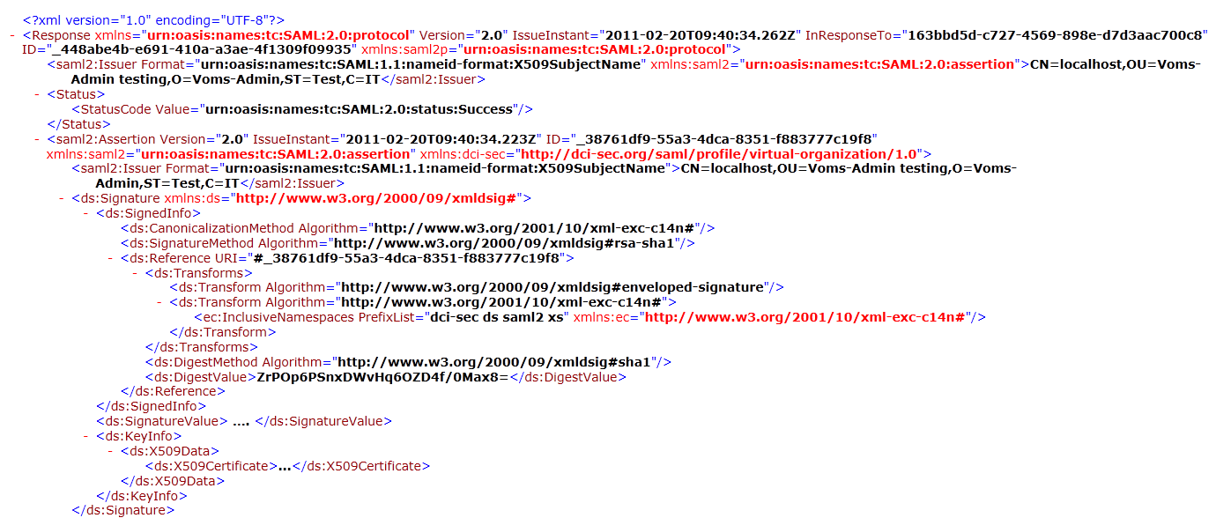
EMI Inputs: SAML Example (1)

Slide 28
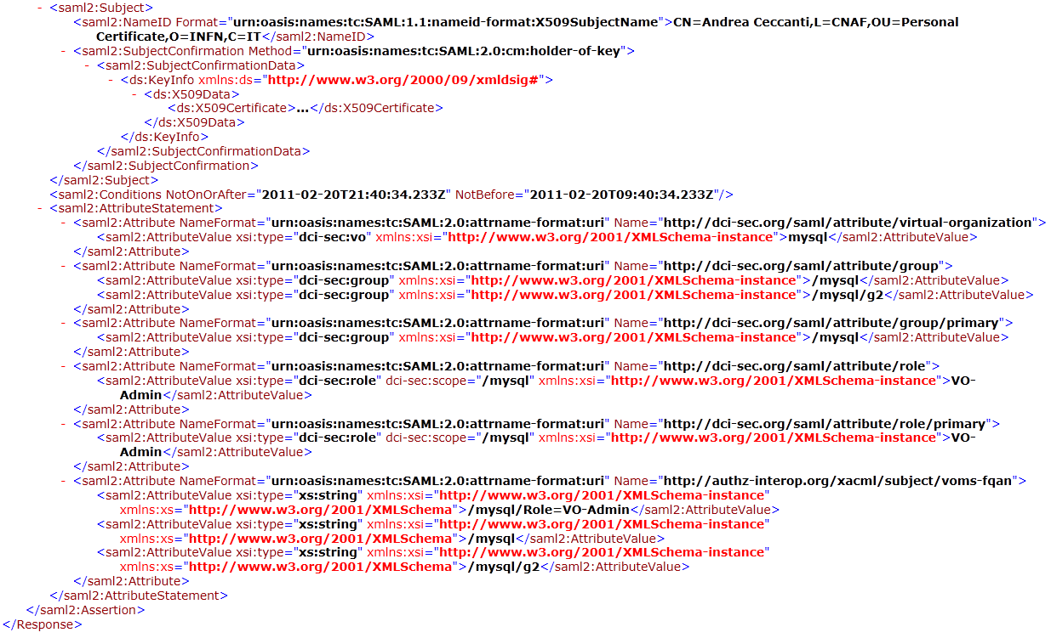
EMI Inputs: SAML Example (2)

Slide 29
AOB

Slide 30



GIN Session Hint
PGI is a spin-off group from GIN
  PGI experience is often
  derived from GIN
Session here at OGF36
  Wednesday, 8:30, Room Columbian
  S.Crouch, G. Andronico: Interoperability demos
  JSDL Parameter Sweep use in e-Science
  (Sonja Holl, bio-informatics work-flows)
  Supercomputing demonstrations

Slide 31
AOB: Notes
GLUE2 specification issues
  Will be discussed in GLUE2 OGF36 sessions
EGI GLUE2 Aspects…
  LDAP?
SAGA & RNS and the PGI Ref Model
  TBD

Slide 32
Full Copyright Notice
Copyright © Open Grid Forum (2007). All Rights Reserved.
This document and translations of it may be copied and furnished to others, and derivative works that comment on or otherwise explain it or assist in its implementation may be prepared, copied, published and distributed, in whole or in part, without restriction of any kind, provided that the above copyright notice and this paragraph are included on all such copies and derivative works.
The limited permissions granted above are perpetual and will not be revoked by the OGF or its successors or assignees.
Notes:
OGF Full Copyright Notice if necessary

