Slide 1













GIN Update Session
Grid Interoperation Now (GIN) - CG
Morris Riedel, Juelich Supercomputing Centre, GIN Co-Chair
Steve Crouch, University of Southampton, GIN Co-Chair

Slide 2
OGF IPR Policies Apply
“I acknowledge that participation in this meeting is subject to the OGF Intellectual Property Policy.”
Intellectual Property Notices Note Well: All statements related to the activities of the OGF and addressed to the OGF are subject to all provisions of Appendix B of GFD-C.1, which grants to the OGF and its participants certain licenses and rights in such statements. Such statements include verbal statements in OGF meetings, as well as written and electronic communications made at any time or place, which are addressed to:
    the OGF plenary session,
    any OGF working group or portion thereof,
    the OGF Board of Directors, the GFSG, or any member thereof on behalf of the OGF,
    the ADCOM, or any member thereof on behalf of the ADCOM,
    any OGF mailing list, including any group list, or any other list functioning under OGF auspices,
    the OGF Editor or the document authoring and review process
Statements made outside of a OGF meeting, mailing list or other function, that are clearly not intended to be input to an OGF activity, group or function, are not subject to these provisions.
Excerpt from Appendix B of GFD-C.1: ”Where the OGF knows of rights, or claimed rights, the OGF secretariat shall attempt to obtain from the claimant of such rights, a written assurance that upon approval by the GFSG of the relevant OGF document(s), any party will be able to obtain the right to implement, use and distribute the technology or works when implementing, using or distributing technology based upon the specific specification(s) under openly specified, reasonable, non-discriminatory terms. The working group or research group proposing the use of the technology with respect to which the proprietary rights are claimed may assist the OGF secretariat in this effort. The results of this procedure shall not affect advancement of document, except that the GFSG may defer approval where a delay may facilitate the obtaining of such assurances. The results will, however, be recorded by the OGF Secretariat, and made available. The GFSG may also direct that a summary of the results be included in any GFD published containing the specification.”
OGF Intellectual Property Policies are adapted from the IETF Intellectual Property Policies that support the Internet Standards Process.
Notes:
IPR Notices Note Well for OGF meetings

Slide 3
Outline

Slide 4

Outline
GIN Status Checks
  GIN & e-Science, RedMine, News, etc.
Experiences from e-Science Production
  JSDL parameter sweeps (S.Memon/S.Holl)
Interoperability Demonstrations
  BES interoperability: IGE, EMI, FutureGrid (S. Crouch)
Science Gateways Interoperability Update
  CHAIN interoperability work (G. Andronico/R. Barbera)
Preparations for SC12
AOB

Slide 5
GIN Status Checks

Slide 6
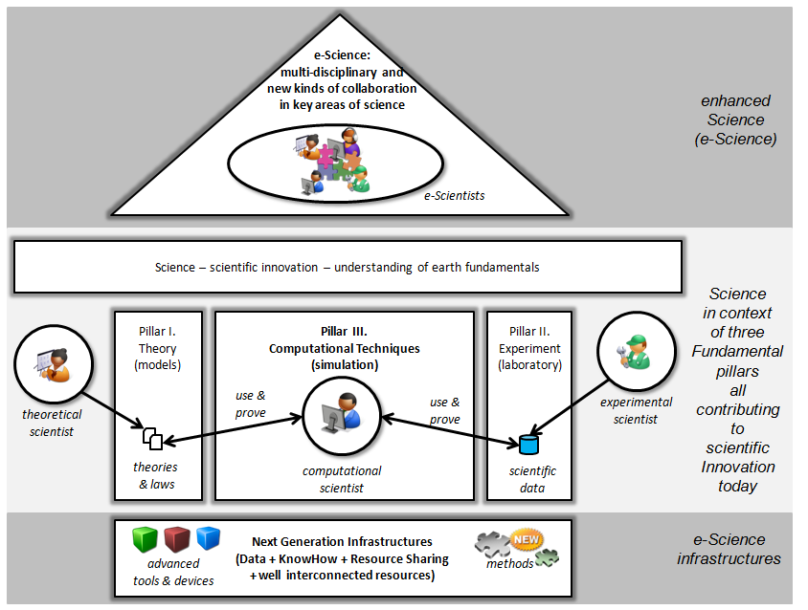



GIN - Scientific Applications!

Slide 7
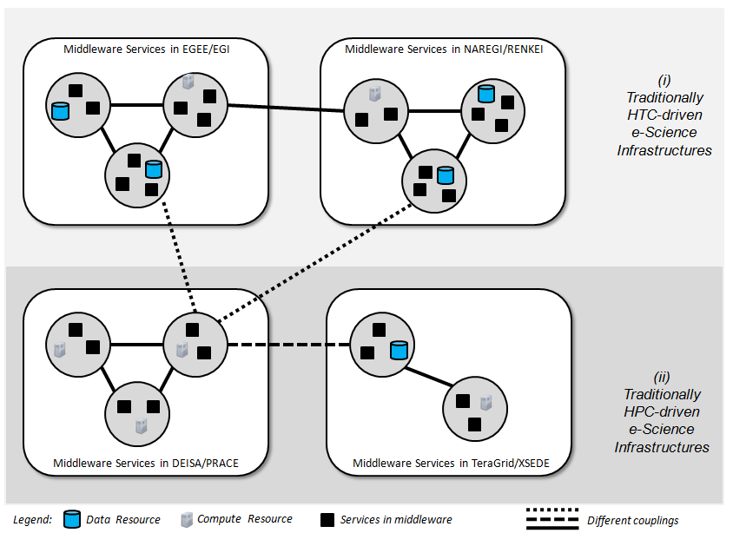
GIN Challenges

Slide 8
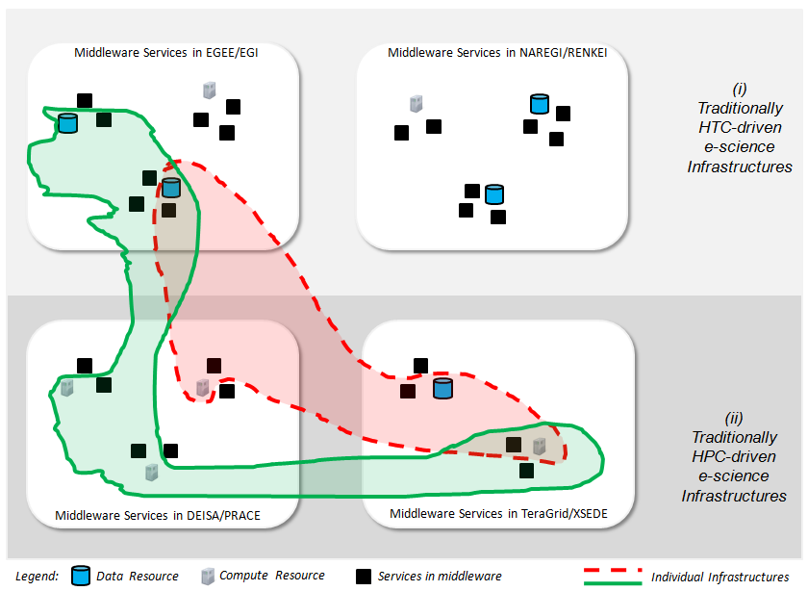
GIN Vision

Slide 9
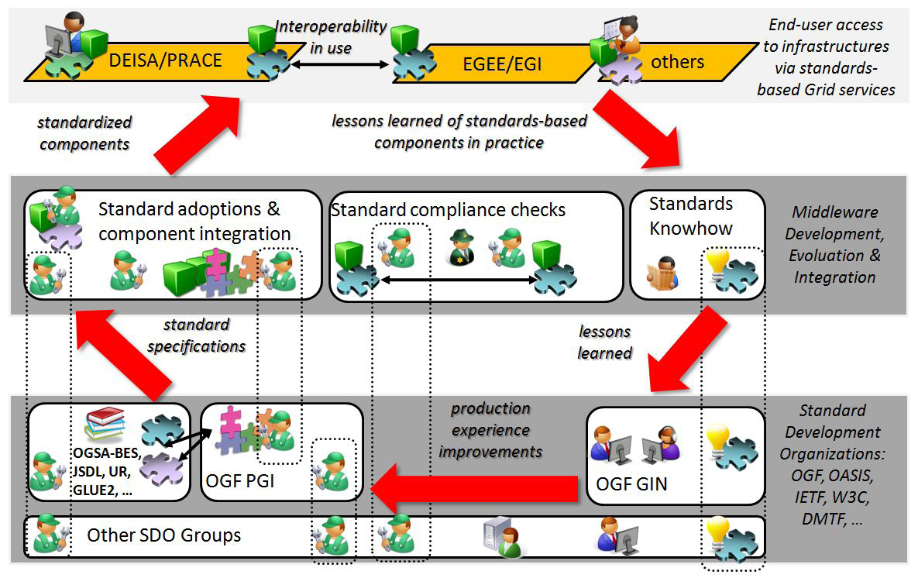
GIN 101: Standards Feedback

Slide 10
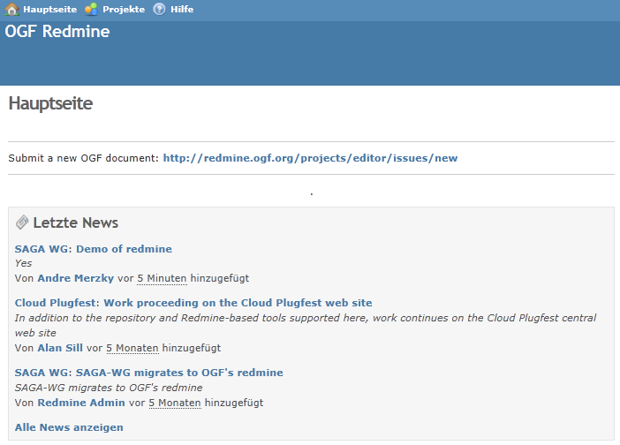
RedMine Transfer
OGF moved
away from GridForge
  RedMine is new
  http://redmine.ogf.org
  Initial page exists
Derived Task Activities:
  Identify material that can be removed (wiki!)
  Transfer rest of ‘approved’ material
  Update plans and charter documents

Slide 11
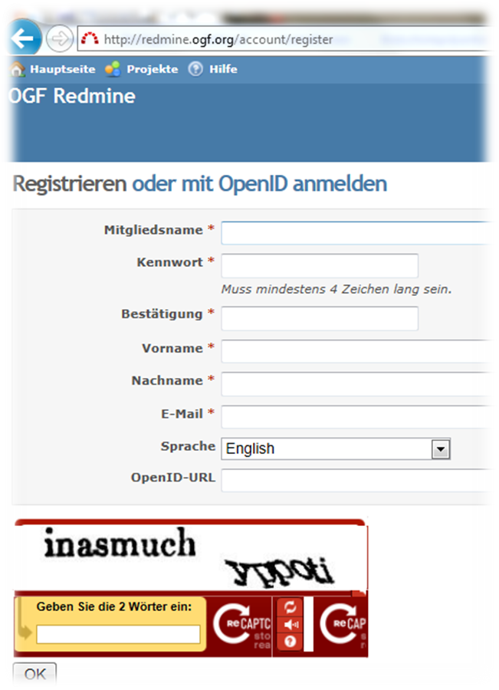
Register: GIN Members!

Slide 12


Update: XSEDE&PRACE Call
‘PRACE and XSEDE call for Expressions of Interest for Joint Access by International Teams’
Several proposals have been submitted: Also from GIN community members
Interoperation between XSEDE & PRACE used by applications/tools in practice
Reference:
  http://www.prace-ri.eu/PRACE-XSEDE-EoI?lang=en

Slide 13

Update: XSEDE&PRACE Call

Slide 14

Update: Townhall OGF36
Feedback: ‘OGF needs to communicate better the added-value for OGF&standards for science and infrastructure providers’
GIN needs to work with others in OGF urgently on this feedback
  Many aspects known - but not written down
  Suggestion: Special GIN track in next OGFs
  E.g. ‘Added-value of Interoperability’

Slide 15
Speakers

Slide 16

Session Talks & Speakers
Experiences from e-Science Production
  JSDL parameter sweeps (S.Memon/S.Holl)
Interoperability Demonstrations
  BES/JSDL interoperability: IGE & EMI (S. Crouch)
Science Gateways Interoperability Update
  CHAIN interoperability work
  (M. Riedel on behalf of G. Andronico/R. Barbera)

Slide 17
Supercomputing 2012 Demos

Slide 18


Continue GIN Tradition…
Supercomputing 2012 Conference
Participation?
  M. Riedel (JSC booth), OTHERS?
Demo Plans?
  Fusion science with Kepler/BES (Riedel)
  IGE/EMI BES interoperability (Crouch)

Slide 19
AOB

Slide 20
AOB: Notes
File-Staging in computational science
  Extending existing demos
Parameter sweep interop demo
  Genesis and UNICORE?
  Sonja and Taverna workflow
  UVA: users use parameter sweeps
  DORII – parameter sweep reference

Slide 21
Full Copyright Notice
Copyright © Open Grid Forum (2012). All Rights Reserved.
This document and translations of it may be copied and furnished to others, and derivative works that comment on or otherwise explain it or assist in its implementation may be prepared, copied, published and distributed, in whole or in part, without restriction of any kind, provided that the above copyright notice and this paragraph are included on all such copies and derivative works.
The limited permissions granted above are perpetual and will not be revoked by the OGF or its successors or assignees.
Notes:
OGF Full Copyright Notice if necessary

