Slide 1
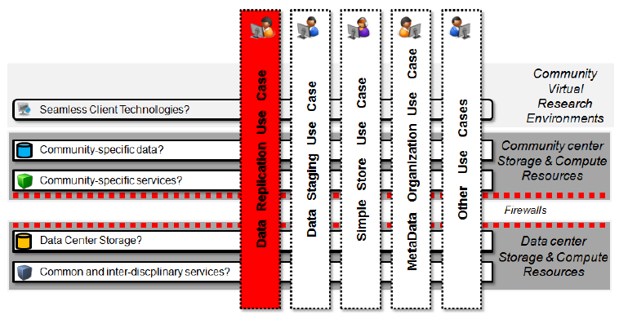
‘Big Data’ in GLUE2
Thoughts using GLUE2 in Data-Driven Infrastructures
Morris Riedel et al.
Juelich Supercomputing Centre
EUDAT Scientific Community Coordinator
OGF37, Charlottesville, 12th March 2013

Slide 2
Outline

Slide 3

Outline
EUDAT 101
Thoughts about using GLUE2

Slide 4
EUDAT 101

Slide 5

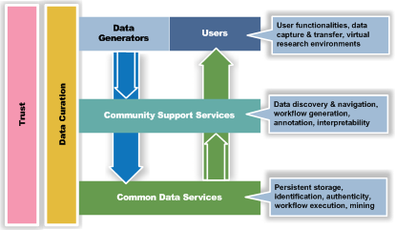
European Collaborative Data Infrastructure
European Commision Project
Start: 10/2011, Duration: 3 years
Funds: 16,3 M€ (9,3M€ EC)
Create a long-term oriented collaborative federated data infrastructure for science
Simple, secure, and registered policy-based storage of data
Enable data access for geographically-dispersed teams
Support multi-disciplinary service re-use for science

Slide 6

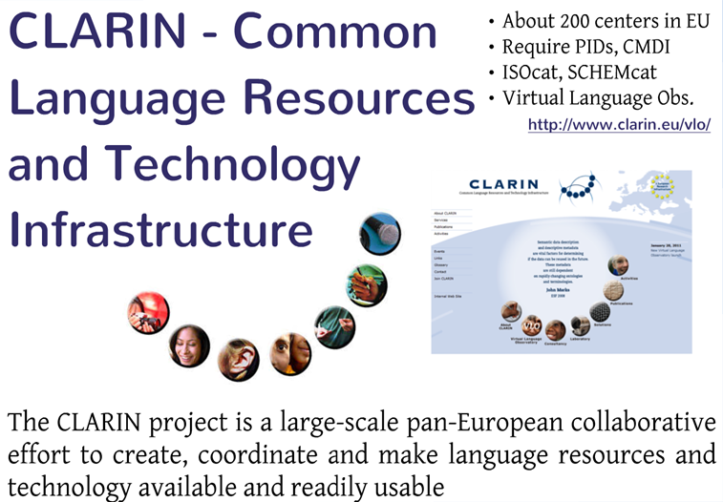
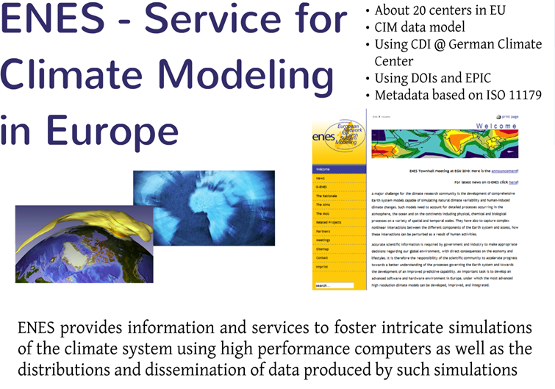
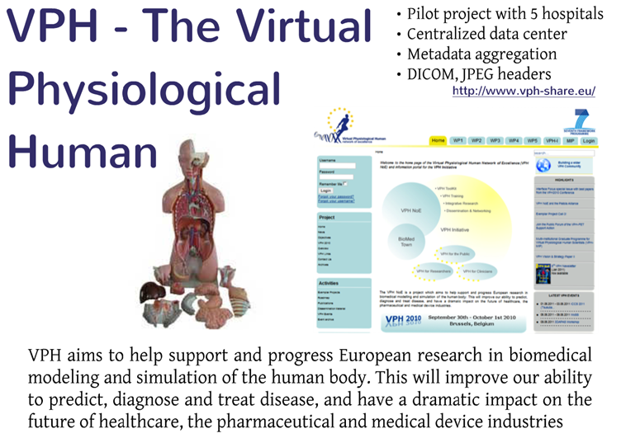

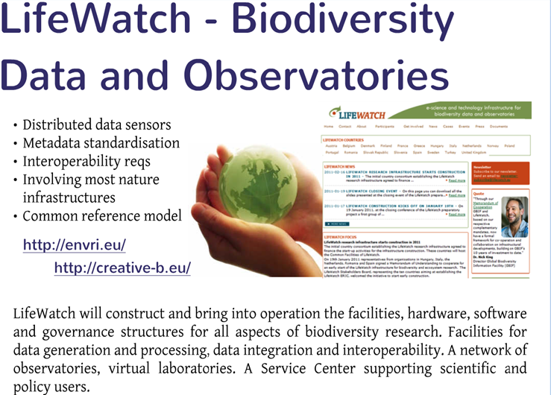




Selected Scientific Communities

Slide 7
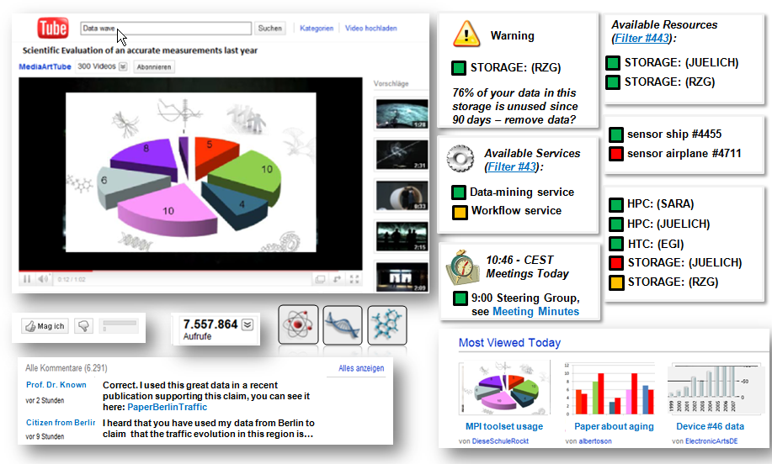
Motivational ‘ScienceTube’ Vision
Riedel and Wittenburg et al., ‘A data infrastructure reference model with applications: towards realization of a ScienceTube vision with a data replication service’, Journal of Internet Services & Applications, Vol. 4, Issue 1, 2013

Slide 8
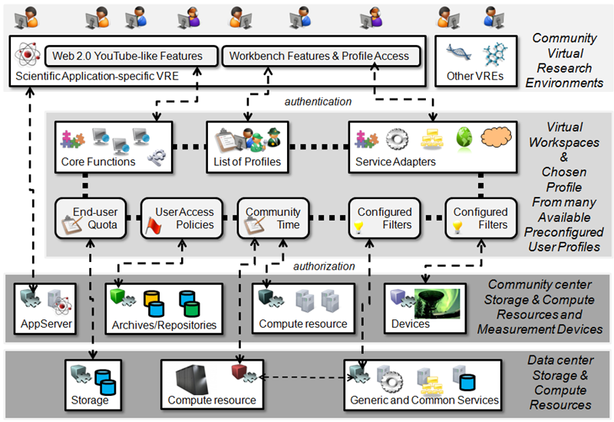
Reference Model Core Building Blocks
Riedel and Wittenburg et al., ‘A data infrastructure reference model with applications: towards realization of a ScienceTube vision with a data replication service’, Journal of Internet Services & Applications, Vol. 4, Issue 1, 2013

Slide 9
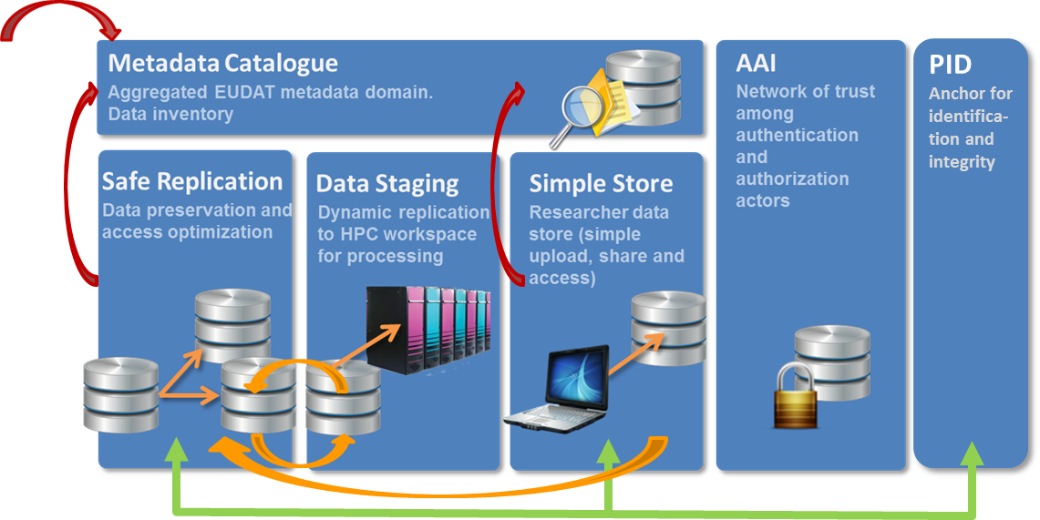
Initial Set of EUDAT Service Types

Slide 10
Thoughts about using GLUE2

Slide 11
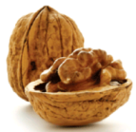

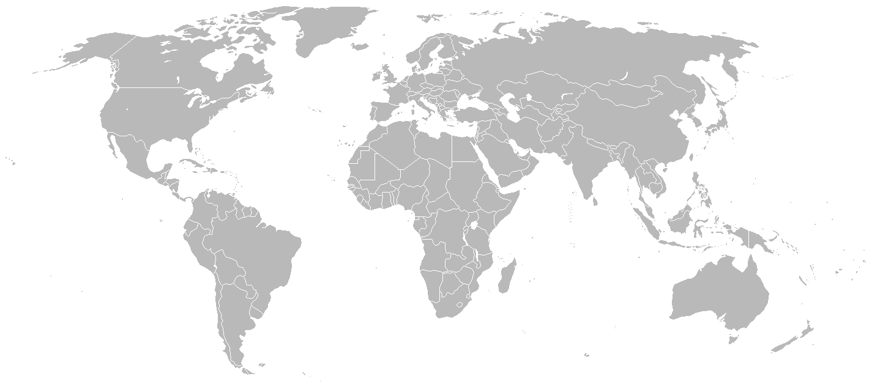


GLUE2 to describe EUDAT services?
Enhancing GLUE2 entities:
Location of services Data Policies
Guaranteees for data
Validity of data
Information Service
Different Service Instances

Slide 12
Need for new GLUE2 Entities/Attributes?
Compute and Storage Services are good to be used already
Several more data-driven services might be good to add
Commonly shared data and community-specific services (e.g. CLARIN/WebLicht)
Data Replication Service
[Note it is not about metadata of scientific data, but about the services itself]
E.g. guarantees: data is preserved for 50 years guaranteed by Max Planck Society
E.g. policy: data is automatically replicated to JSC, EPCC, and SARA
E.g. storage space: XYZ PB community storage space available
E.g. location and access: URI of service, security levels required (e.g. read-only)?
E.g. Ingested scientific data automatically receives Persistent Identifier type ‘handle’
E.g. Hints on tertiary storage impacts on restoring (many small files can take ages)
Similar attributes/entities for other services alongside existing computing
Metadata Service, Data-Staging Service, Simple Store Services,
Persistent Identifier Services
[Different? AAI Services maybe in the future]

Slide 13
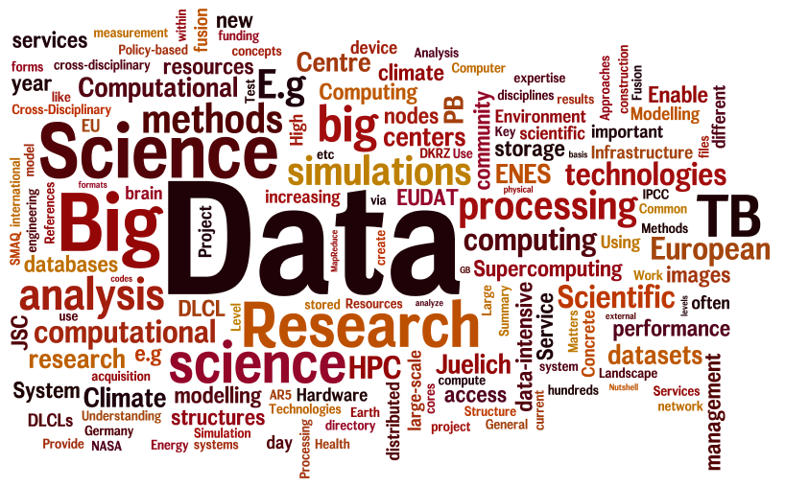
Thanks

