Slide 1
Application Contents Service (ACS)
- An introduction -
ACS-WG
acs-wg@ggf.org
August 2005

Slide 2

What is ACS?
Application Contents Service:
  Application Contents Repository Interface (ARI),
  Application Contents Archive Format (AAF)
    to be created or exchanged between Application Contents Services.
submit job
EPR
Job
Job
Manager
Business Activity
Manager
ACS
EPR
CRUD
EPR
create
job
AA Document
Get Content
Deployment
Service
EPR
Job
EPR
ACS scope
target
resources
Grid System
out of scope

Slide 3
AA and job
Archive contents can be reused for repetitive jobs execution or separate jobs running simultaneously.
Job A
EPR
refers
job status
execution log etc ...
AA
refers
Job B
application
contents
EPR

Slide 4
ACS as an OGSA service
ACS
Application
Archive
Application Repository
Candidate Set Generator (Work -Resource mapping)
Provisioning
Deployment
Configuration
Information Services
Execution Planning Services
Reservation
Service
Container
Persistent State Handle Service
Job Manager
Accounting Services

Slide 5
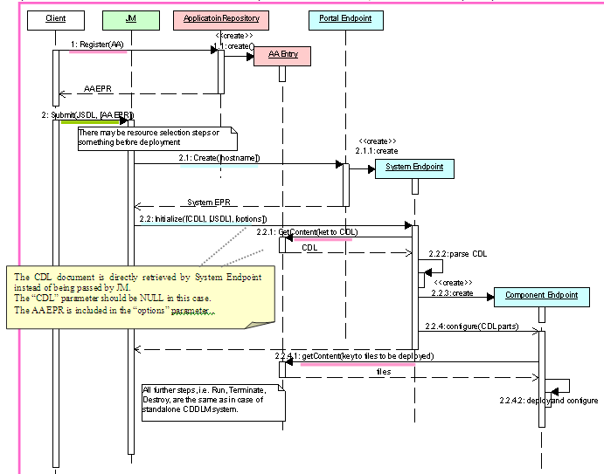
CDDLM Interactions
Need updated Version

Slide 6
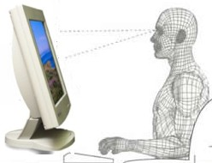

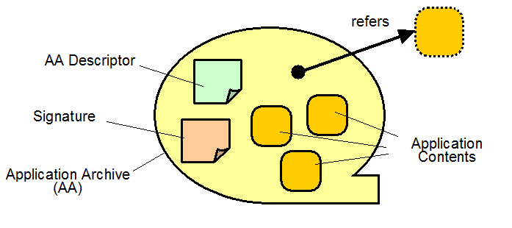



Example workflow
1. Develop application
and Store in repository
Federated PKI enabled
Secure Repository
ARI
2. Update application, make final build.
3. Search/Lookup instance and submit task.
AAF
ACS
EPR
4. Retrieve (recursively) all components not local which are needed, comparing, checking, security, etc
Entry Point
Distributes to nodes
ESM, JSDL, CDDLM, GRAM
Grid nodes
Grid Container

Slide 7
IUDD – What it is…
IBM, InstallShield (Macrovision), Zero G, and Novell collaborated on a set of specifications to
  “define the schema of an XML document describing the characteristics of an installable unit (IU) of software that are relevant for its deployment, configuration and maintenance. ”
  Published by W3C on July 15, 2004
    http://www.w3.org/Submission/2004/04/
    Made available to Industry under RF terms
  Publication coincident with announcements calling for formation of a standards workgroup to formalize an Industry standard for IUDD Schema.
OASIS Solution Deployment Descriptor (SDD) TC began June 2005 to create specifications:
  Installable Unit Deployment Descriptor (IUDD)
  Installable Unit Package Format (IUPF)

Slide 8
Solution Installation – Profile and Status
OASIS Solution Deployment Descriptor (SDD) TC began June 2005
Published by W3C on July 15, 2004
  http://www.w3.org/Submission/2004/04/
  Announcement: http://xml.coverpages.org/ni2004-07-19-a.html
  Made available to Industry under RF terms
Authored by IBM, Novell, and Macrovision (InstallShield, and Zero G.)
Comprising the following specifications:
  Installable Unit Deployment Descriptor (IUDD)
  Installable Unit Package Format (IUPF)

