Slide 1
A System for Monitoring and Management of Computational Grids
Warren Smith
Computer Sciences Corporation
NASA Ames Research Center

Slide 2
Motivation
Computational grids:
  Many different types of resources
  Services deployed on those resources
  Applications executed by users
There will be failures
  Failures need to be observed
  Observation of failures need to be communicated
A grid must be managed
  Failure management
  General administration

Slide 3
Approach
Develop a general framework for observation and control
  Observe and control a variety of resources and services
  Operate in a distributed environment
  Secure
  Scalable
Use this framework to monitor and manage grids
  Observe computer systems, storage systems, networks
  Observe job submission, information, file transfer services
  Start, stop, and configure services
  Notify administrators of problems
Help develop and be compatible with standards
  Global Grid Forum

Slide 4
Why not use an existing system?
Commercial systems
  Many fully-featured tools available
  Cost that could be too high for smaller partners
  Incompatibility between different tools
  Incompatible with grid security and authentication mechanisms
Open source systems
  Not as many features
  Incompatible with each other
  Not compatible with grid security mechanisms
Either
  Want a testbed for standardization

Slide 5
High-Level Architecture
Directory Service
Advertise
Advertise
Search
Observer
Events
Manager
Commands
Actor

Slide 6
Monitoring and Managing a Cluster
Management Host
Receive observations
Decide if any actions need to be taken
Ask for actions
Log any problems
Cluster Manager
Directory Service
Host 1
Host N
Host Observer
Host Actor
Host Actor
Host Observer
CPU load
Disk space
Memory use
Kill process
Clean temp disk
Kill process
Clean temp disk
CPU load
Disk space
Memory use

Slide 7
Observer
Observer
Service Hosting Environment
Event Producer
Sensor
Sensor Manager
Sensor
Sensor
Sensor
  Performs a measurement and reports results
Sensor manager
  Manages sensors, subscriptions, and queries
Event Producer
  Subscribe
  Query
  Available events
  Event schemas
Service Hosting Environment
Key
Low-level
Higher-level
User-written

Slide 8
Actor
Actor
Service Hosting Environment
Actor
Actuator
Actuator Manager
Actuator
Actuator
Actuator
  Performs an action
Actuator Manager
  Handles requests for actions by calling actuators
Actor
  Request action (RPC)
  Available actions
  Action schemas
Service Hosting Environment
Key
Low-level
Higher-level
User-written

Slide 9
Manager
Manager
Event Consumer Client
Manager
Event Consumer Client
Management Logic
Expert System
Actor Client
Actor Client
Management Rules
Two external interface components
  Event Consumer Client
  Actor Client
2 approaches to higher-level components
  User writes management logic
  User writes management rules and uses an expert system
Key
Low-level
Higher-level
User-written

Slide 10
Directory Service
Information about observers and actors
  Contact location and protocol
  Available events and actions
  Who has access
Dictionary
  Event and action schemas
Future: Information about event consumers
  Archives
  Channels
Experimental component

Slide 11
Security
GSI security
Encrypted communication
  SSL/TLS
Authentication
  X.509 certificates
  Proxy certificates
Authorization
  Per-observer and per-actor
  Pluggable user-defined authorization module
    Module for X.509 subject-based access control lists available
  Future: per-sensor and per-actuator

Slide 12
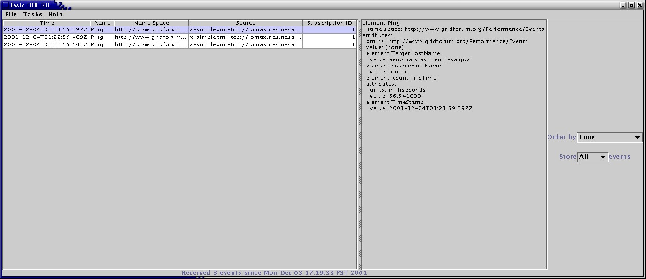
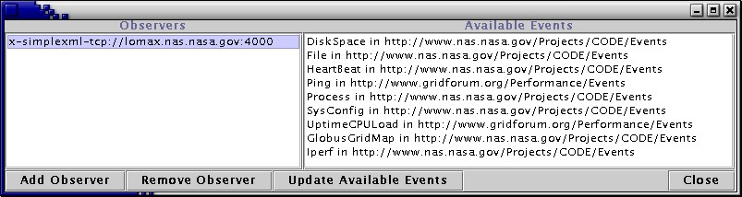
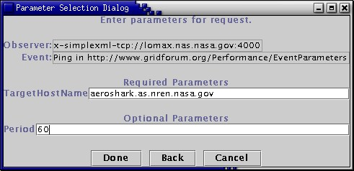
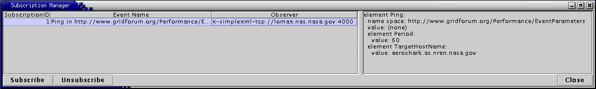
Basic GUI

Slide 13
Monitoring and Managing a Cluster
Management Host
Cluster Manager
Receive observations
Decide if any actions need to be taken
Ask for actions
Log any problems
Management Logic
Event Consumer Client
Director Client
Directory Service
Host 1
Host N
Host Observer
Host Actor
Service Hosting Environment
Service Hosting Environment
Event Producer
Actor
Sensor Manager
Sensor Manager
CPU Load Sensor
Disk Space Sensor
Memory Sensor
Kill Process Actuator
File Deletion Actuator

Slide 14
Implementation
Communicates using TCP, UDP, or SSL
XML encoding of messages
C++ version
  pthreads
  Xerces XML parser
  Globus I/O for authenticated and secure communication
  Currently runs under IRIX, Solaris, Linux
  CLIPS expert system
Java version
  Xerces XML parser
  Globus Java CoG for authenticated and secure communication
  JDK 1.3.x or 1.4.x

Slide 15
Grid Management System
Things to observe:
  Resource status and usage
    Computer systems and networks
  Grid services
    GRAM, MDS
    Includes processes, log files, and test queries
Things to control:
  Add/remove user mappings in grid-mapfiles
  Starting and stopping MDS servers
  Add/remove/update CA certificates
Provide a nice GUI to do all this

Slide 16
Grid Management System
Directory Service
Advertise existence
Find managers and archive
MDS Management Agent
Management GUI
Events describing current state
Action requests
GRAM Management Agent
Query for events that describe problems
Subscribe
Events with problems
Event Archive
Experimental Component

Slide 17
Management Agent
Management agents:
  Perform observations
  Perform actions
  Manage local problems
    Not doing any management right now
Handle local problems locally
Management Agent
Manager
Local management
Local and remote observations
Observer
Actor
Local actions

Slide 18
GRAM Management Agent
Observes:
  Network latency between GRAM hosts: ping
  Available network bandwidth between hosts: IPerf
  CPU load: Unix uptime, PBS qstat, LSF bjobs
  Available memory: vmstat?
  Available disk space: df
  The Globus GRAM service: Log files
Performs actions:
  Modify Globus grid-mapfile
  Start/stop IPerf server
  Send email
In the future will manage local problems
  Receive local observations
  Perform local actions when necessary

Slide 19
MDS Management Agent
Observes:
  Network connectivity between GIS hosts: ping
  CPU load: uptime
  Available memory: vmstat?
  Available disk space: df
  The status of the LDAP server
    The LDAP server process: ps
    If LDAP queries are successful: ldap_search()
Performs actions:
  Start and stop LDAP server
  Send email
In the future will manage local problems

Slide 20
Event Archive
Allows events to be archived and searched
An XML database
  Currently Xindice
  Compatible with our XML-based events
Queried using the Xpath language
Use for all events, just errors, …
Experimental component

Slide 21
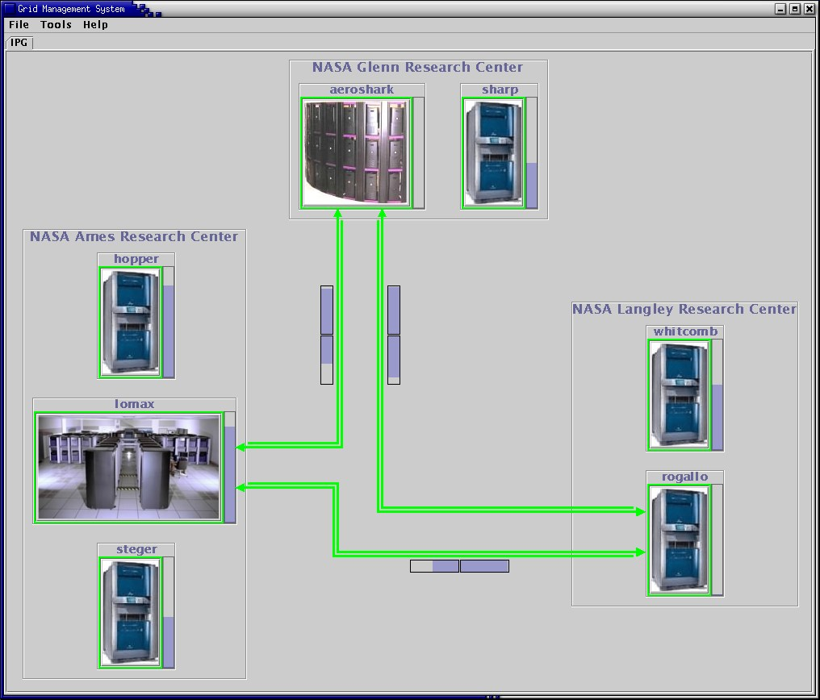
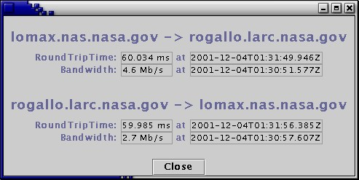
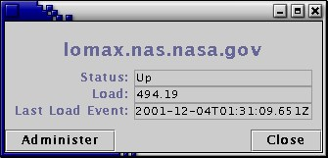
Grid Management GUI

Slide 22
Grid Management GUI
Similar to many you’ve seen before
Java program
Load on systems
  System up or down
Latency and bandwidth of network
  Network up or down
XML configuration file defines GUI
  Which systems to monitor
  Which sensors to use on each system
  Where to place information on the screen
More detailed information available as dialogs

Slide 23
Standardization
Performance Working Group of the Grid Forum
  Architecture
  Event representations
  Directory service schema
  Producer-consumer communication protocols
Grid Monitoring Architecture Working Group
DAMED Working Group
Grid Event Service Working Group?
  BOF at next GGF, hopefully

Slide 24
Status and Future Work
Current Status:
  Worldwide noncommercial release expected Real Soon Now
  Release quality
    CODE framework used day-to-day in the IPG
  Preliminary grid management system
Our future plans include:
  Define and be compatible with Grid Forum standards
  Use in the IPG (Need a web interface)
  Develop more sensors and actuators
  Sensors and actuators as programs as well as classes
  More sophisticated event service
    event routing network, more subscription models and options
  OGSI as hosting environment
  Work with IPG (and other) administrators to improve the grid management system
  A public release! Open source!

