Slide 1
A Unified Relational Approach to Grid Information Services
(GWD-GIS-012-1 (Informational))
Peter A. Dinda, Northwestern
Beth Plale, Georgia Tech
http://www.cs.nwu.edu/~pdinda/relational-gis

Slide 2
Related Work
Steve Fisher, RAL
  Relational model for Grid Performance Working group
  Interesting thoughts on how to provide distributed relational model
Jennifer Schopf, “The Dictionary Project”

Slide 3
Claim
Applications need common compositional queries over information of varying dynamicity
Approach
Build down from an RDBMS world-view
Relational = relational data model and queries
Unified = tables and streams
Research Questions
How “far down” must we go?
What extensions are needed?
1
2
3

Slide 4
Outline
Needs of Grid applications
Why RDBMS?
Our approach (and research)
  Existence proofs
Call for participation

Slide 5
Needs of Grid Applications
Compositional queries
  Application-specific information aggregration
Support for information of varying dynamicity
  Varying update rates and freshness requirements
  Seamless inclusion of streaming data
A common data model and query language
  Powerful, high level, declarative, easy-to-optimize

Slide 6
Some Examples
Adaptive data parallel SOR
Workflow
Dv scientific visualization
Distributed laboratories
    dQUOB
RPS prediction system and Remos
    RPSDB
Grid schedulers
    GridSearcher

Slide 7

Adaptive
Data Parallel SOR
?
?
?
?
Startup: “Find 4 hosts which all have the same architecture and have a combined memory of 0.5 to 1 GB”
Compositional Query Over Static Information
Adaptation: “Tell me about instances in which the predicted load on any one of those 4 hosts exceeds the average of their predicted loads by 50%”
Compositional Query Over Dynamic Information

Slide 8
Our Approach
Compositional queries as SQL queries
Extensible type hierarchy
Extensible schemas and indices
Time-bounded non-deterministic queries
Data streams as relations
High update rates and freshness
Friendly interfaces for non-experts
Decentralized administration and data
Prototype Systems: RPSDB, dQUOB

Slide 9
Supporting Compositional Queries
Set operations -> Relational Algebra -> RDBMS
Relational data model
  Tables with relationships
  Indices separately created and managed
    Can change to meet changing query demands
ANSI SQL
  Powerful, flexible, complete query language
  Declarative nature (what, not how) enables optimization
  Decouples app from specific RDBMS implementations
Relational database manager
  ACID (Atomicity, Consistency, Isolation, Durability)

Slide 10
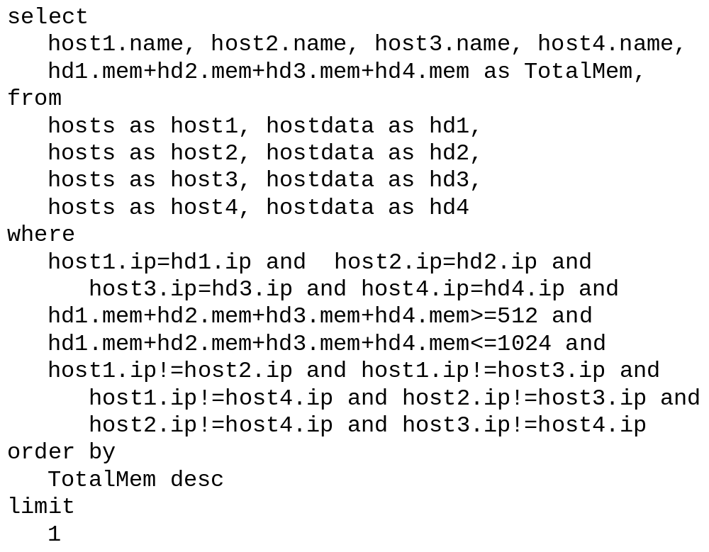
Query Example (RPSDB)

Slide 11
Extensible Type Hierarchy
Type identifiers
Single inheritence tree
Is-a relationships
Type conversion requirement
Set of base types that can be extended
Single manager
Subtypes added by consensus

Slide 12
Extensible Type Hierarchy (RPSDB)
unique
benchmark
networknode
datasource
module
networklink
endpoint
moduleexec
networkpath
host
switch
switchport
linksource
linkbenchmark
flowsource
nodesource
hostbenchmark
pathbenchmark
switchbenchmark
hostspecificbenchmark
switchpecificbenchmark

Slide 13
Schemas and Indices
Schemas encode types into tables and establish relationships between the tables
Indices determine which relationships are fast with respect to queries

Slide 14
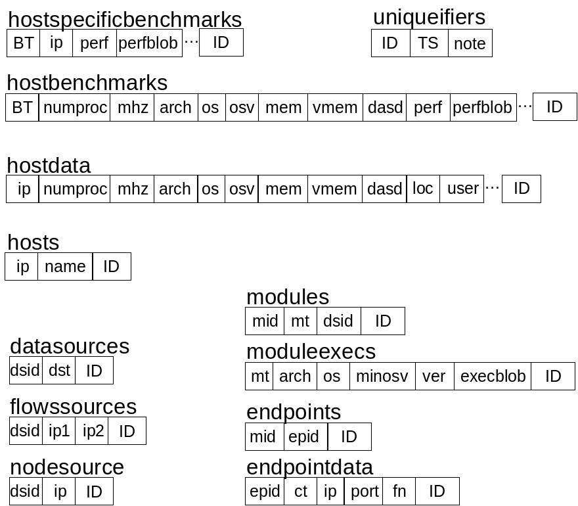
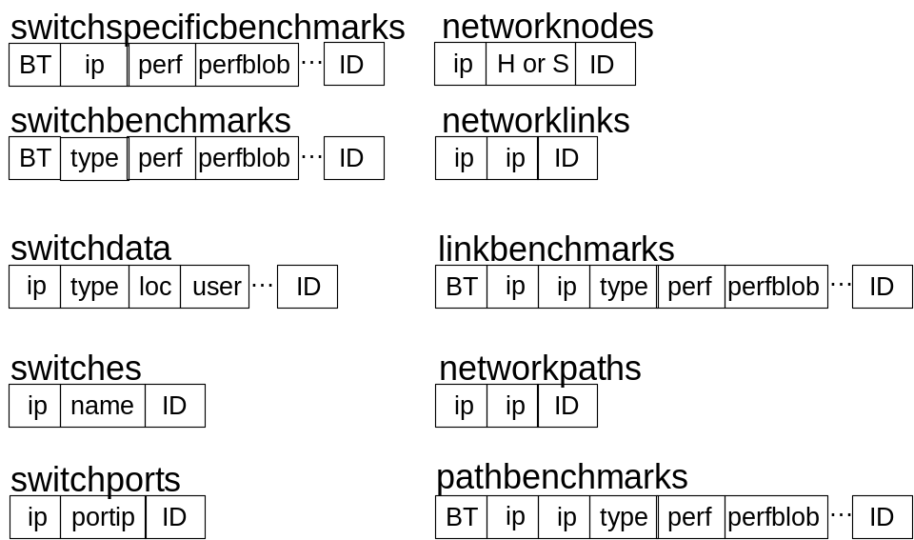
Schema (RPSDB)

Slide 15
Non-deterministic Time-bounded Queries
Queries can be incredibly expensive
  N-way joins
Typically don’t need “all the answers”
  Example: “Find 4 hosts which all have the same architecture and have a combined memory of 0.5 to 1 GB”
  Only one such group is needed
Typically have time and resource constraints
Run until the deadline, returning a
non-deterministic subset of the full query results

Slide 16
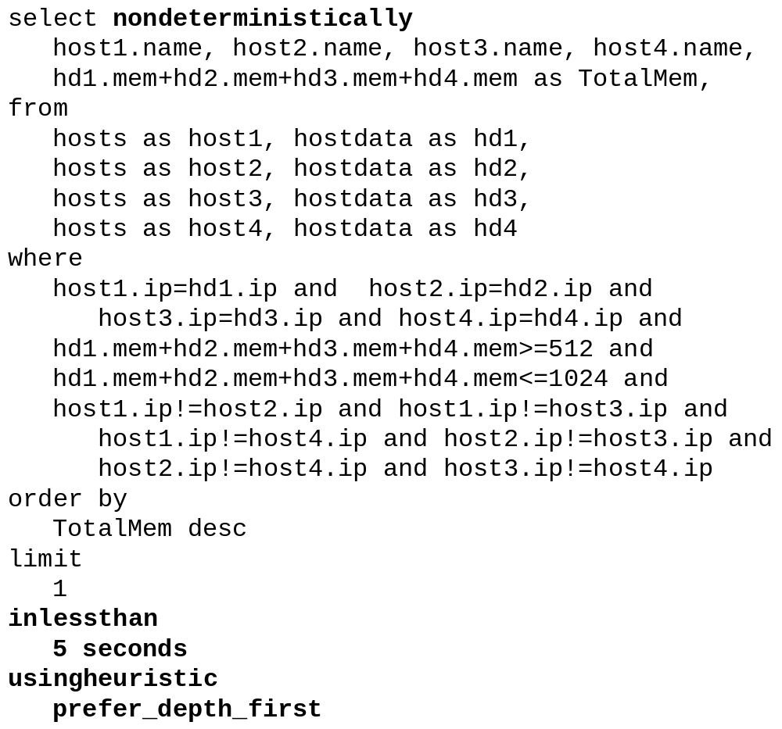
Example

Slide 17
Data Stream Support and Unification
Extend SQL query model to streams
Add dynamic types to hierarchy
  RPS measurements and predictions, etc.
Leverage dQUOB technology
  Data stream is a set of relational tables
  SQL-like queries on data stream
  Stream optimizations enabled by relational model

Slide 18
dQUOB Quoblet
bounding
box extraction
units
conversion
violation
notification
user-
defined
action
user-
defined
action
user-
defined
action
SQL
query
MPEG
compression
C1
C2
C3
C4
D D D D D D A T A D D D D D D D D D D D S T R E A M D D D D D
Notes:
Quoblet consists of one or more rules: Rule is a query and action. Action is executed when query evaluates to true for event set received.
Key to pipe is not so much computation strung together as it is refined views on data.
A query is capable of creating a new event type that can then serve as input to subsequent queries.

Slide 19
Fast Updates and Freshness
Dynamic objects will become the majority
Update rate and freshness constraints
Remote filtering and triggers
Push updates to GIS and to consumers
dQUOB-like technology
RDBMS systems support frequent updates

Slide 20
Distributed Operation
Centralized model
  One administrative domain, fine-grain access control, centralized database
Decentralized model
  Multiple administrative domains, distributed database
Centralization seems to be a real disadvantage for RDBMS Can it be overcome? Should it be overcome?
Is distributed operation really necessary?

Slide 21
Performance Evaluation
Scalability of relational approach compared to the hierarchical approach
Effectiveness of nondeterminism
Achievable update rates and freshness
Value of ACID properties

Slide 22
Tensions to explore
RDBMS versus distributed data and decentralized administration and multiple security domains
RDBMS versus expensive queries
Expressibility versus usability (SQL)

Slide 23
Interaction with other GIS and Grid Performance Systems
App
App
App
Relational GIS
Prediction
Monitors
Non-relational GIS
Alternatives: MDS Index Nodes, …

Slide 24
Claim
Applications need common compositional queries over information of varying dynamicity
Approach
Build down from an RDBMS world-view
Relational = relational data model and queries
Unified = tables and streams
Research Questions
How “far down” must we go?
What extensions are needed?
1
2
3

Slide 25
Come Join Us
Peter A. Dinda, Northwestern, pdinda@cs.nwu.edu
Beth Plale, Georgia Tech, beth@cc.gatech.edu
Relational Task Group, http://www.cs.nwu.edu/~pdinda/relational-gis

Slide 26
Proposed Areas/Papers
AREAS RIPE FOR PARTICIPATION!
Use cases
    Expand on the examples in our paper
Type hierarchy and set of base types
    Useful independent of data model
The vision paper (Plale)
Schema design / critique
Reference implementations
Interaction with Steve Fisher’s work

Slide 27
Implementation of Non-deterministic, Time-bounded Queries
Current research
Leverage work by Olken and Tan, et al
Query-rewriting approach
Hopefully RDBMS-independent

Slide 28
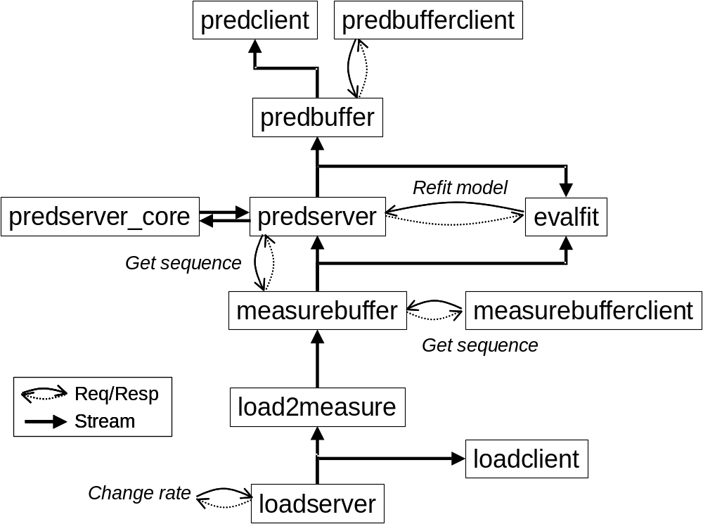
Resource
Prediction
System
Software Configuration Management: “For each of those hosts, find an RPS prediction stream corresponding to a measurement stream from a load sensor on the host”
Compositional Query Over Semistatic Information
Performance Monitoring Streams: “Tell me about instances in which the predicted load on any one of those 4 hosts exceeds the average of their predicted loads by 50%”
Compositional Query Over Dynamic Streams

Slide 29
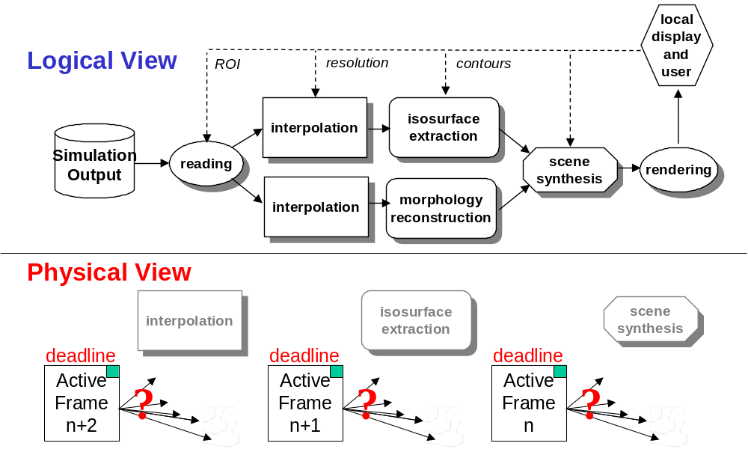
Dv
(and traditional workflow)
Startup: “Find a pool of five hosts each of which have at least a GB of memory for interpolation, a second pool of five different hosts with at least 1 GFLOP/s performance for isosurface extraction, and a third pool of five different hosts with special scene synthesis hardware, where the inter-pool bandwidth is at least 10 MB/s.”
Compositional Query Over Static Information
Adaptation: “What is the host within the isosurface extraction pool which is expected to have the minimum load over the next 10 seconds?” Compositional Query Over Dynamic Streams

Slide 30
Dv as a
Query
“Show me the results of rendering the scene synthesized by combining the results of isosurface extraction and morphology reconstruction over regularly grided data resulting from interpolation of this region of the simulation database”
Compositional Query Describing An Application
No Specific Query Plan is Implied

Slide 31
Grid Schedulers
Similar needs, more flexibility
But these abstractions are important
  GridSearcher [Schopf]
    Compositional Queries over MDS

Slide 32
Our Approach
Compositional queries as SQL queries
Type hierarchy
Schema and indices (including example)
Time-bounded non-deterministic queries
Data stream support with dQUOB
Fast updates and streaming
Tensions and questions
Prototype Systems: RPSDB, dQUOB

