Slide 1
Alternative Governance Models for PKI
GGF8 BOF
June 26/03

Slide 2
Agenda
Overview and proposed scope (5min)
Governance Models (25 min)
QIK as a possible mechanism (15 min)
Discussion of proposed charter and milestones.(30 min)

Slide 3
BOF Goals
Agree on RG Charter
Identify parties interested in working within a RG
Identity overlap/interest with other groups
Identity preliminary work items
  Rough out schedule

Slide 4
Overview
X.509 does not dictate a particular governance model
The conventional governance model of CP/CPS is best suited to the TTP business model
There is room for a variety of governance models to address different business models
The requirements of the GRID community may best be served by a different governance model

Slide 5
Definitions
PKI governance model
  Identifies the types of participants in a PKI and the relationships between them
• PKI governance instruments
  Contractual and supporting documents that define the warranties offered by, and the obligations imposed on, the participants in the PKI
  Mechanisms for maintaining the trustworthiness of statements made by authorities
  Gentlemen’s agreements
Notes:
Governance model: A representation of the entities and the mechanisms for maintaining the trustworthiness of statements made by authorities

Slide 6
Objectives of Governance models
To achieve a proper understanding and equitable allocation of risk among the actors
Make the risks commensurate with the benefits for all participants
  Expose risk
  Apportion liability
  Identify obligations

Slide 7
Trust/Expectations
To trust someone is to have a reasonable belief that they will behave as expected.
Issuer
Notification of revocation
Conduct quality processes
Notification of issuance
Notification of revocation
Publish the certificate and CRLs
Query for revocation
Rely within limits
Protect private key
Use appropriately
Trust this is from me
Subscriber
Relying
Party
Use within limits
Notification of revocation

Slide 8
Governance Models Taxonomy
Governance models can be characterized by
  The nature of the information shared
  On which party the risk assessment burden falls
Trusted Third Party
‘Equivalent Safeguards’
‘Equivalent Conditions’

Slide 9
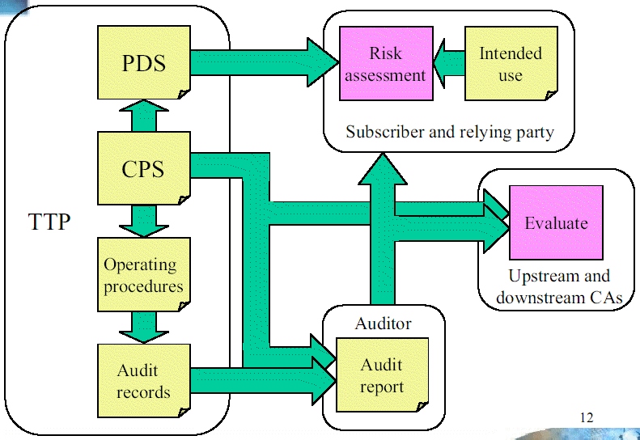
Trusted Third Party
CA describes practices in CPS
Subscriber & Relying party perform risk assessment to determine if practices are suitable for purposes
Auditor’s report provides independent assessment of TTP’s adherence to published practices

Slide 10
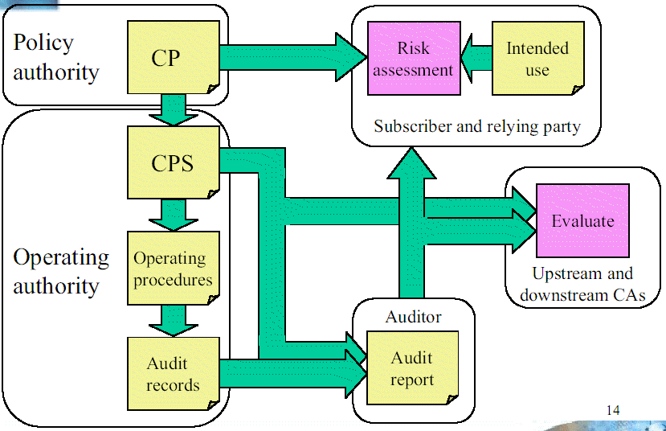
Equivalent Safeguards
CP lists statement of requirements for PKI safeguards
CA describes its practices in CPS
Subscriber & Relying party perform risk assessment to determine if practices are suitable for purposes
Auditors report details CA adherence to published practices (at a very high level)

Slide 11
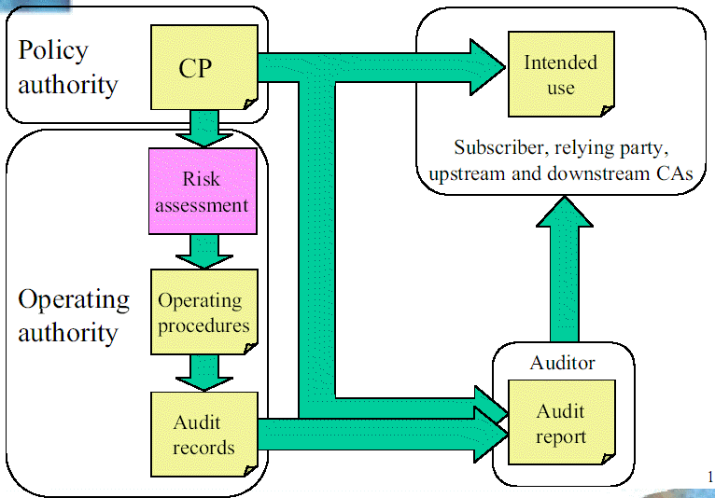
Equivalent Conditions
CP lists conditions for certificates
  Approved uses
  Obligations
  Warranties
CPS (if it exists) is internal document
Risk assessment performed by Operating authority
Auditors report offers opinion wrt suitability of practices to intended use

Slide 12
Comparison
Model | CP | CPS
TTP | NA | CA practices Limited liability Public
Equivalent Safeguards | CA practice requirements | CA practices Limited liability Public
Equivalent Conditions | Approved uses Commitments Obligations | Private

Slide 13
Policy Authority
Issuer
Policy
Authority
Issuer
Policy
Authority
Subscriber
Relying
Party
Subscriber
Relying
Party
Issuer
Subscriber
Relying
Party
Policy
Authority

Slide 14
Applications
Application
Details
Certificate
Policy
(generic)
Policy
Authority
Relying
Party
Y/N
Application
Details
Certificate
Policy
(app)
Policy
Authority
Relying
Party
Y/N

Slide 15
Possible mechanism - QIK
Qualified Installation of Keys
Key-owners publish their public verification key – appended with appropriate uses & associated commitments and obligations in a QIK statement
Relying parties parse QIK statement to determine if contained public key should be ‘trusted’
If ‘yes’, key is ‘installed’, ‘qualified’ by appropriate conditions (e.g. uses and restrictions)

Slide 16
QIK statement
A binding between a public key and the terms and conditions of its use, as specified by the key owner or issuer.
Keys can be discovered based on these terms & conditions
Keys characterized by
  The Commitments the key-owner/issuer makes with respect to their use
  The Obligations attendant on those entities that use the key

Slide 17
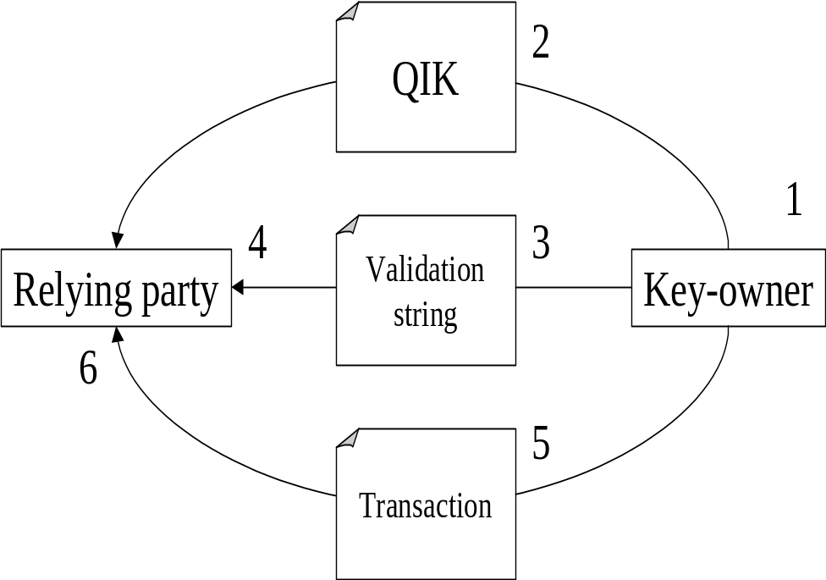
Basic model
The owner of a digital-signature key-pair creates a QIK instance, containing the public verification key and the conditions of use for that key.
It publishes the QIK instance, either on the Web or by some other means, e.g. in WSDL or UDDI.
It creates a validation string by digesting the QIK instance and makes the digest available by an authentic channel,
The relying party retrieves and validates the QIK instance, using the digest, confirms the suitability of its conditions of use to the intended application and, if these checks pass, installs the key.
The key owner sends signed transactions to the relying party
The relying party validates the transactions using the key from the QIK instance

Slide 18
Variations
 | Key Owner | Relying Party
Bilateral trust | Subscriber | End-entity
Root import | CA | End-entity
Cross-cert | CA | CA

Slide 19
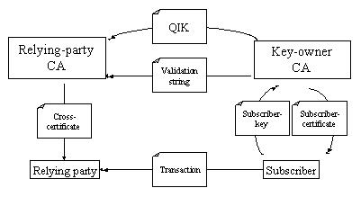
Cross-certification

Slide 20
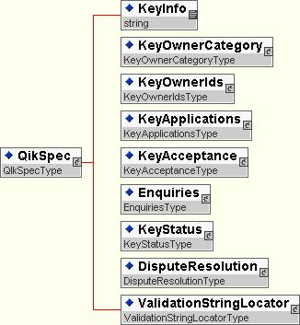
Top-level Schema

Slide 21
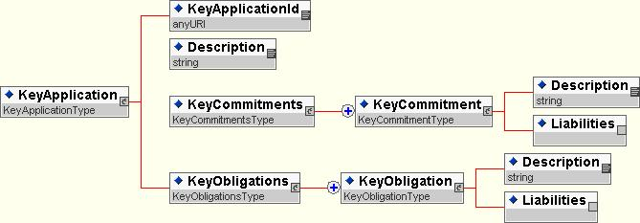
Key Application Schema
A key is listed along with the applications for which its use are appropriate
Each KeyApplication has associated Commitments and Obligations

Slide 22
Charter
Purpose
The Alternative Governance Model Research Group will explore the potential for a simpler, less-expensive, semi-automated alternative to the CP/CPS model for PKI policy governance. It is hoped that such an alternative will simplify and enable the establishment of trust between Grid participants, both end-entities and Certificate Authorities.
Output
The output of this research group will be an informational or community practices GGF document and suggestions for future development work in GGF working groups.

Slide 23
Summary
The requirements of the GRID community may best be served by a PKI governance model different than the conventional
Work warrants the creation of a Research (Working?) Group to explore the pros/cons of different models and relevance to Grid scenarios

