Slide 1

AugerAccess
Use Case for controlling the Pierre Auger Observatory remotely
Michael Sutter
H.-J. Mathes, V. Hartmann, R. Stotzka and T. Jejkal
Institute for Data Processing and Electronics
Forschungszentrum Karlsruhe

Slide 2

OGF IPR Policies Apply
“I acknowledge that participation in this meeting is subject to the OGF Intellectual Property Policy.”
Intellectual Property Notices Note Well: All statements related to the activities of the OGF and addressed to the OGF are subject to all provisions of Appendix B of GFD-C.1, which grants to the OGF and its participants certain licenses and rights in such statements. Such statements include verbal statements in OGF meetings, as well as written and electronic communications made at any time or place, which are addressed to:
    the OGF plenary session,
    any OGF working group or portion thereof,
    the OGF Board of Directors, the GFSG, or any member thereof on behalf of the OGF,
    the ADCOM, or any member thereof on behalf of the ADCOM,
    any OGF mailing list, including any group list, or any other list functioning under OGF auspices,
    the OGF Editor or the document authoring and review process
Statements made outside of a OGF meeting, mailing list or other function, that are clearly not intended to be input to an OGF activity, group or function, are not subject to these provisions.
Excerpt from Appendix B of GFD-C.1: ”Where the OGF knows of rights, or claimed rights, the OGF secretariat shall attempt to obtain from the claimant of such rights, a written assurance that upon approval by the GFSG of the relevant OGF document(s), any party will be able to obtain the right to implement, use and distribute the technology or works when implementing, using or distributing technology based upon the specific specification(s) under openly specified, reasonable, non-discriminatory terms. The working group or research group proposing the use of the technology with respect to which the proprietary rights are claimed may assist the OGF secretariat in this effort. The results of this procedure shall not affect advancement of document, except that the GFSG may defer approval where a delay may facilitate the obtaining of such assurances. The results will, however, be recorded by the OGF Secretariat, and made available. The GFSG may also direct that a summary of the results be included in any GFD published containing the specification.”
OGF Intellectual Property Policies are adapted from the IETF Intellectual Property Policies that support the Internet Standards Process.
Notes:
IPR Notices Note Well for OGF meetings

Slide 3

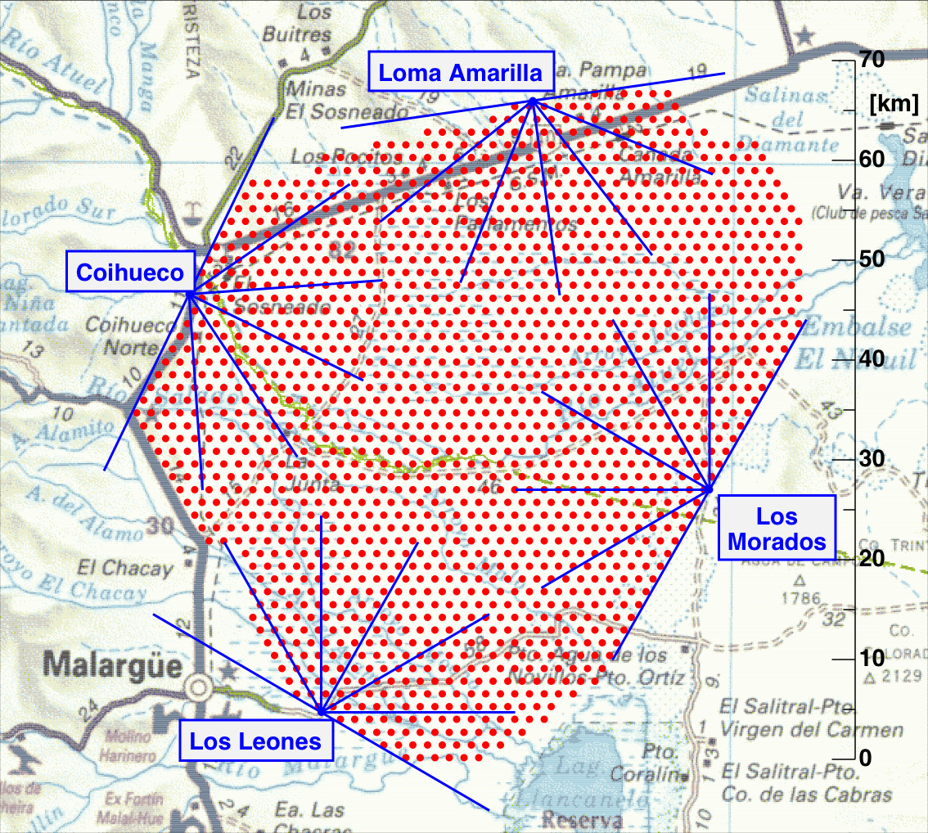
Auger Observatory
Study of ultra-high energy cosmic rays
  Energies up to 10²⁰ eV
  Rare events (one particle per km² and century)
Hybrid measurement
  Surface detector (SD)
    1600 Water-Cherenkov-Tanks
  Fluorescence detector (FD)
    24 telescopes in 4 buildings
About 3000 km² detector area

Slide 4
Summary - AugerAccess
Extension of Pierre Auger Observatory
EU project in the Sixth Framework Program
Improve access to observatory in Argentina
  Replication of 7 Tbytes of measured data per year
  Additional much larger monitoring data
  Upgrade of the communication link
Improve management via remote connection
  Controllable world wide
  Software for remote control and remote monitoring
    Authentication and authorization
    Secure communication

Slide 5
Customers
Remote scientist to assist local collaborator
Remote scientist to control and monitor the systems in the observatory without local collaborators
Special:
  Access from international to private networks
  Access to data acquisition and slow control system

Slide 6
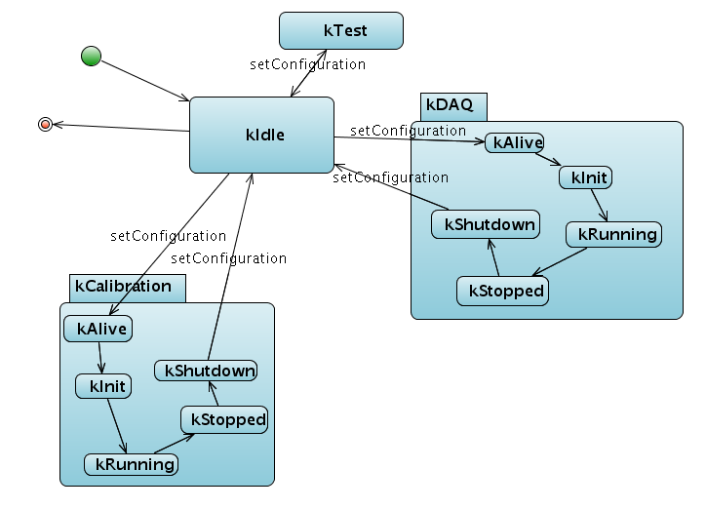
Scenarios
Primary scenario:
Init + test
  Create log file
  Switch on and check availability
Configure
  Calibrate telescopes
  Register dead pixels in log file
Init data acquisition software
Measurement and monitoring
  Check weather conditions
  Check variance
  Check number of events – lightning?
Shutdown
  Calibrate telescopes

Slide 7
Scenarios II
Secondary scenario – adding/removing
telescopes
Stop data acquisition software in according telescope building
Add or remove telescope(s)
Start data acquisition software with new configuration
  System already in data acquisition mode – simply start it
Monitor the run

Slide 8
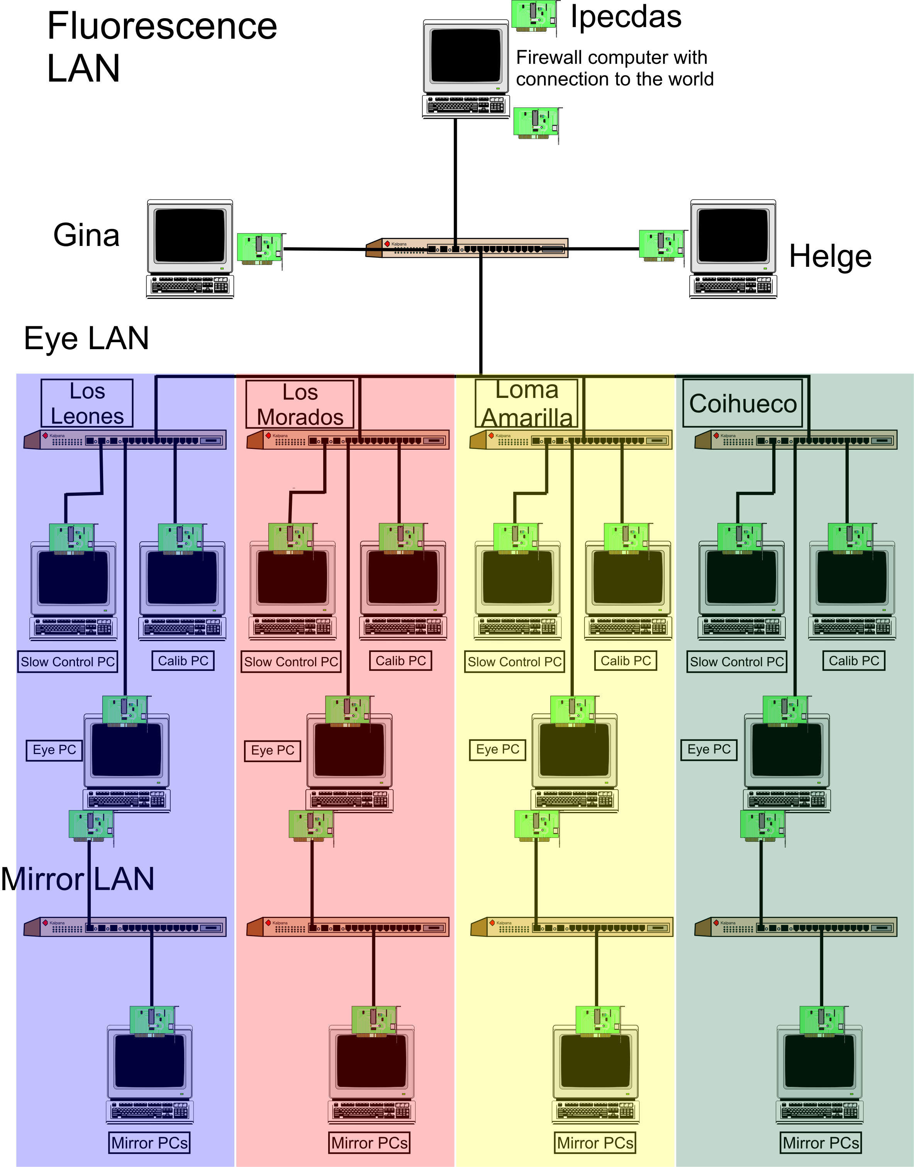
Involved resources
Internet/RETINA network
Central campus
Radio link
4 buildings
Pbus protocol for communication with the hardware
6 computers each

Slide 9
Functional Requirements
Access from world wide to private networks via a dedicated server
Access from central campus to telescope buildings
Not only remote control – remote data acquisition is needed
  Storage of measured data on Grid infrastructure
  Analysis of the measured data on the Grid
  Near real time properties

Slide 10
Non-Functional Requirements
Authorization and authentication
Secure communication
Different security levels for different groups
  Software update of the system (highest)
  Control and monitor the system (high)
  Reading measured data (low)
All real time properties are handled by the Front-End-Crates

Slide 11
Related work
Setup of an virtual testbed of the hardware infrastructure of the Auger Observatory
Development of remote control software
  GT 4 Grid security for authentication and authorization from world wide
  Axis 2 services for communication inside the Auger Observatory

Slide 12
Comparison
Situation now
  SSH access with tunnels
  X11 forwarding of GUI in central campus
  Controllable only local
Situation in future
  Grid security for authentication, authorization and communication
  Services for controlling
  Controllable world wide

Slide 13
Situation analysis
Special for Auger use case
  Remote data acquisition – not only remote control
  Dynamic adding/removing of components
  Access from world wide to private networks
  Different security levels for different user groups
    Remote software update
H. Gemmeke, “The Auger Fluorescence Detector electronics”, ICRC 2001 (http://www.auger.org/technical_info/pdfs/icrc2001/papers/ici6189_p.pdf).
H,-J. Mathes, S., A. Kopmann and O. Martineau, “The DAQ system for the Fluorescence Detectors of the Pierre Auger Observatory”, Chep 2004 (http://indico.cern.ch/contributionDisplay.py?contribId=119&sessionId=3&confId=0)

Slide 14
Full Copyright Notice
Copyright (C) Open Grid Forum (applicable years). All Rights Reserved.
This document and translations of it may be copied and furnished to others, and derivative works that comment on or otherwise explain it or assist in its implementation may be prepared, copied, published and distributed, in whole or in part, without restriction of any kind, provided that the above copyright notice and this paragraph are included on all such copies and derivative works.
The limited permissions granted above are perpetual and will not be revoked by the OGF or its successors or assignees.
Notes:
OGF Full Copyright Notice if necessary

