Slide 1
Application Contents Service (ACS)
- An introduction -
ACS-WG
acs-wg@ggf.org
February 14, 2006

Slide 2
What is ACS?
Specification for the ACS repository.
  ACS: Application Contents Service
Application Contents Repository Interface (ARI)
  WSRF interface for ACS repository to create, retrieve, update and delete archives in the repository
Application Contents Archive Format (AAF)
  Information schema for repository operations for contents in an archive. Information for lifecycle operations is presented in contents in a archive.
Application
Archive
Deployment, data staging, workflow, etc.
Subscribe
requests
Notify
response
contents
Application
Producer
Application
Repository
Application
Consumer

Slide 3
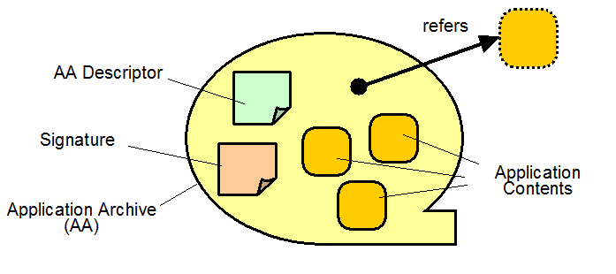
What is in an ACS Archive?
Any files for a unit of task in grid systems
  Each is called as an Application Contents.
  Application Contents are opaque object to the ACS.
AA Descriptor (AAD)
  AAF defines an XML Schema
  Universal access method to the contents by consumers
  References to the external storage are pending for future extension.
Possible ACS 2.0 extension

Slide 4
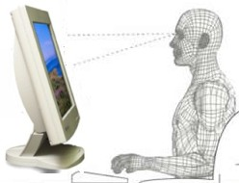


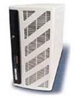
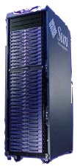
Example workflow
1. Develop application
and Store in repository
Federated PKI enabled
Secure Repository
ARI
2. Update application, make final build.
3. Search/Lookup instance and submit task.
AAF
ACS
EPR
4. Retrieve (recursively) all components not local which are needed, comparing, checking, security, etc
Entry Point
Distributes to nodes
EMS, JSDL, CDDLM, GRAM
The Grid
Grid nodes

Slide 5

How can ACS be utilized?
For Business Activity Managers,
  Create an Archive for later use in job submission.
  Submit new jobs just referring to the archive for:
    Multiple job instances with arbitrary parameters
    If the access constraint permits, the third party may use it.
Business Activity
Manager
submit job
Job
Info.
EPR
Job
Manager
CRUD
ACS
AA Document
Get Content
EPR
create
job
Business Activity
Manager
EPR
Deployment
Service
EPR
Job
EPR
ACS scope
target
resources
Grid System
out of scope

Slide 6
AA and job
  Archives can be reused
    for repetitive jobs execution or
    for separate jobs running simultaneously
Job A
EPR
refers
job status
execution log etc ...
AA
refers
Job B
application
contents
EPR

Slide 7
More advanced usage
Consumers
ACS
Once archives in the ACS repository created,
  They can be easily managed and moved around.
  One can submit new jobs referring the archive.
Producer
Job
Replicator
ACS
Job
ACS
Job

Slide 8
ACS as an OGSA service
ACS
Application
Archive
Application Repository
Candidate Set Generator (Work -Resource mapping)
Provisioning
Deployment
Configuration
Information Services
Execution Planning Services
Reservation
Service
Container
Persistent State Handle Service
Job Manager
Accounting Services

Slide 9
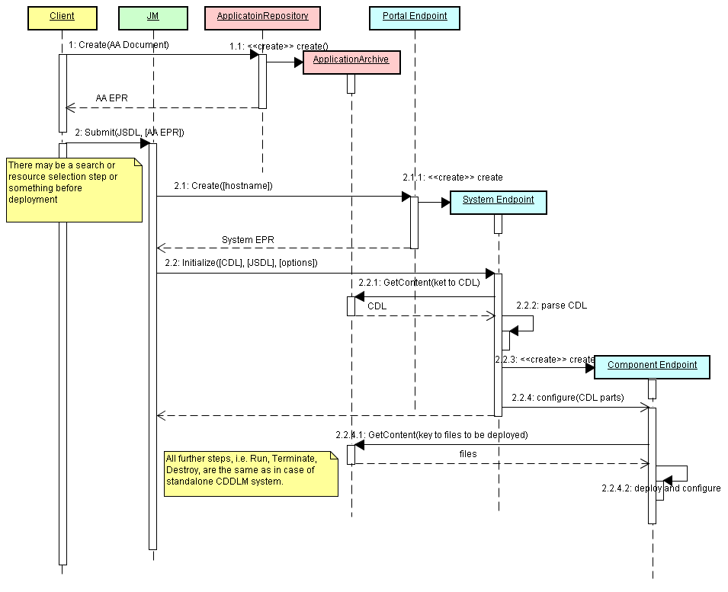
CDDLM Interactions

Slide 10
OASIS SDD TC – What it is...
OASIS SDD TC
  A Technical committee under OASIS
  SDD stands for Solution Deployment Descriptor
  Began June 2005 to create specifications
  Chartered [1] as:
    “defining a standardized way to express software installation characteristics required for lifecycle management in a multi-platform environment” on its charter.
    [1] http://www.oasis-open.org/committees/tc_home.php?wg_abbrev=sdd
  The SDD TC chair is also a co-chair of the ACS-WG.
  Referencing IUDD and IUPF specifications shown below:
    IBM, InstallShield*, Zero G*, and Novell collaborated on a set of specifications:
      Installable Unit Deployment Descriptor (IUDD)
      Installable Unit Package Format (IUPF)
    They are submitted as W3C member submission in June, 2004
    In order to
      “define the schema of an XML document describing the characteristics of an installable unit (IU) of software that are relevant for its deployment, configuration and maintenance. ”
* Macrovision has acquired InstallShield in July 2004
* Macrovision has acquired ZeroG in June 2005

Slide 11
Baseline comparison of SDD and ACS
 | SDD | ACS
Purpose | To define a standard archive format for multiple applications to be installed on the multiple platform.
Descriptor | An XML document to describe its contents. (IUDD in SI, Archive Descriptor in ACS)
Target platform | A set of Heterogeneous and multiple platform.
Scope | Grid application/system is among the scope Defines information for software lifecycle operations for files in a solution package. | Grid application/system is the scope Defines information for repository operations for contents in an archive. Information for lifecycle operations are presented in contents, for example, CDL, etc.
Emphasis | Package format and IUDD format | Application Archive Format and Application Repository Interface
Contents in an archive | Any combination of applications that needs to be installed. | A set of applications that works together to fulfill the job submitted to the grid system.
Structure | Hierarchically layered installable units | Flat files and logical description of those relationships.

Slide 12
Purpose of SDD and ACS
OASIS SDD TC ^{*1}
  Defining a standardized way to express software installation characteristics required for lifecycle management in a multi-platform environment
GGF ACS WG*²
  To ease the submission and the following management of the application related files, which are needed to deploy and execute an unit of a task processed in grid systems.
*1 http://www.oasis-open.org/committees/tc_home.php?wg_abbrev=sdd
*2 https://forge.gridforum.org/projects/acs-wg

