Slide 1
SIP for Grid networks
  Franco Callegati, Aldo Campi, Walter Cerroni
  DEIS – University of Bologna
  (fcallegati,acampi,wcerroni)@deis.unibo.it

Slide 2
Introducing SIP (1/2)
Session Initiation Protocol
IETF standard application layer protocol
  Independent of the transport layer
  Transaction-oriented
    Request–response
    Dialog → independent transactions
  Re-use syntax of HTTP 1.1 (Text-based)
Based on domains
Application-layer call signaling
  Set-up, modification, termination, Negotiation, Re-negotiation during session
  User location → personal mobility
  Security (AAA)
  etc…

Slide 3
Introducing SIP (2/2)
SIP has been developed purely as a mechanism to establish sessions
  it does not know about the details of a session
  it just initiates, terminates and modifies sessions.
SIP does not provide services.
SIP provides primitives that can be used to implement different services.
  Example: locate a user and deliver an opaque object to his current location
SIP characteristics
  Large scales
  Mobility
  Many extensions for supplementary services
  Applicable to different architectures and deployment scenarios.
    Centralized, P2P,hybrid

Slide 4
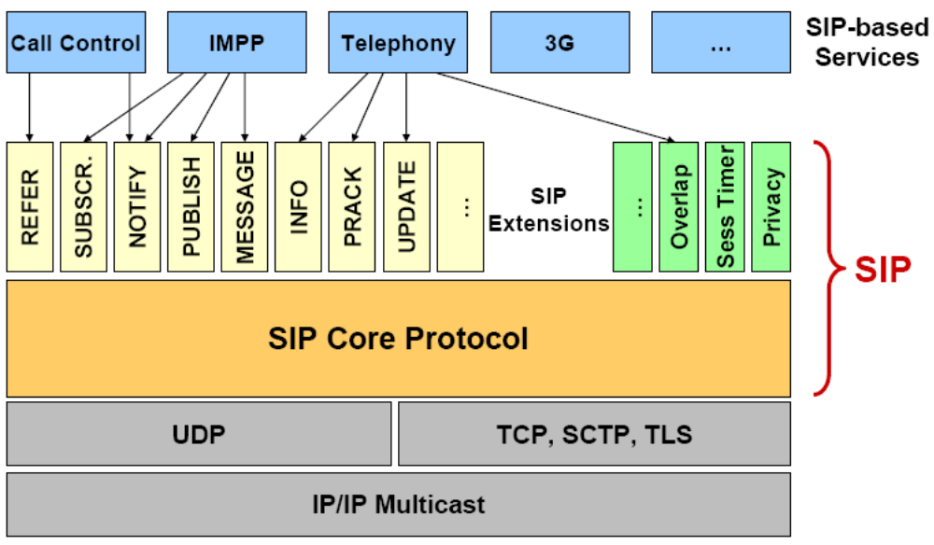
SIP Service Creation Model

Slide 5
RFCs related to SIP (1/2)
Base spec RFCs related to SIP (1)
  RFC 3261: SIP: Session Initiation Protocol
  RFC 3263: Locating SIP Servers
  RFC 3264: An Offer/Answer Model with SDP
Extended Features
  RFC 2976: The SIP INFO Method
  RFC 3262: Reliability of Provisional Responses in SIP
  RFC 3265: SIP-specific Event Notification
  RFC 3311: SIP UPDATE Method
  RFC 3312, RFC 4032: Integration of Resource Management and SIP
  RFC 3326: Reason Header
  RFC 3327: Registering Non-Adjacent Contacts
  RFC 3428: Instant Messaging
  RFC 3487: Requirements for Resource Priority
  RFC 3515: SIP REFER Method
  RFC 3581: Symmetric Message Routing
  RFC 3680: SIP event package for registrations
  RFC 3725: Third-party Call Control (3PCC)
  RFC 3840, 3841: Callee capabilities and caller preferences
  RFC 3842: Message waiting indication / message summary
  RFC 3857, 3958: Watcher Information event package + XML format
  RFC 3891: Replaces: header
  RFC 3892: Referred-By: header
  RFC 3903: Event state publication (SIP PUBLISH method)
  RFC 3911: Join: header
  RFC 4028: Session timers
  RFC 4168: SCTP as transport protocol

Slide 6
RFCs related to SIP (2/2)
Security
  RFC 3323: A Privacy Mechanism for SIP
  RFC 3325: Private Extension for Asserted Identity in Trusted Networks
  RFC 3329: Security-Mechanism Agreement for SIP
  RFC 3603: Proxy-to-Proxy Extensions
  RFC 3702: AAA requirements for SIP
  RFC 3853: S/MIME AES
  RFC 3893: Authenticated Identity Body
Others
  RFC 3665, 3666: SIP Call Flows
  RFC 3361: DHCP Option for SIP Servers
  RFC 3608: Service Route Discovery
  RFC 3398, 3578: ISUP and SIP Mapping
  RFC 3420: Internet Media Type message/sipfrag
  RFC 3427: SIP Change Process
  RFC 3455: Header Extensions for 3GPP
  RFC 3485, 3486: SIP header compression
  RFC 3764, 3824: Using ENUM with SIP
  RFC 3959: Early Session disposition type (early-session, session)
  RFC 3960: Early Media and Ringing Tone Generation
  RFC 3968, 3969: IANA SIP header field and URI registry
  RFC 3976: SIP – IN Interworking
  RFC 4117: 3rd party call control invocation of transcoding services
  RFC 4123: SIP – H.323 Interworking requirements
  Related: RTP, SDP, Security basics, 3GPP requirements and extensions

Slide 7
Why SIP and Grid?
IETF standard application layer protocol
  SIP has proved its capacity to provide services to a large variety of users
  Easy and flexible
SIP is the main protocol of IMS
  IMS can take advantage of Grid
  Grid is a service of IMS
SIP is used to established sessions
  Bring session parameters
  Put sessions state into the network for “Application aware networking”
SIP has a large variety of mechanism to manage sessions (extensions)
  Get all the features of SIP network
  Is easy to extend for non native operations

Slide 8
Role of SIP into Grid networks
SIP is used to establish sessions described by other application protocols
SIP can be the driver to deliver messages to Grid middleware, Users, Resources
  Grid protocols
    Users (JSDL)
    Resources (~WSRF)
Grid features
  Resource discovery
  Reservation
Session oriented Grid service platform to negotiate and manage the Grid session
  Submit job description
  Acknowledge resources availability
  Open/close and modify connections

Slide 9
Architectures and Procedures
Architectures
  Overlay
    SIP-Grid in some nodes of the networks
  Integrated into network
    SIP-Grid coupled to the networks equipments
Procedure
  Grid users and Grid resources act as SIP users
    One phase :
      Resource discovery and reservation
    Two phase
      Resource discovery
      Reservation
SIP for Anycast

Slide 10
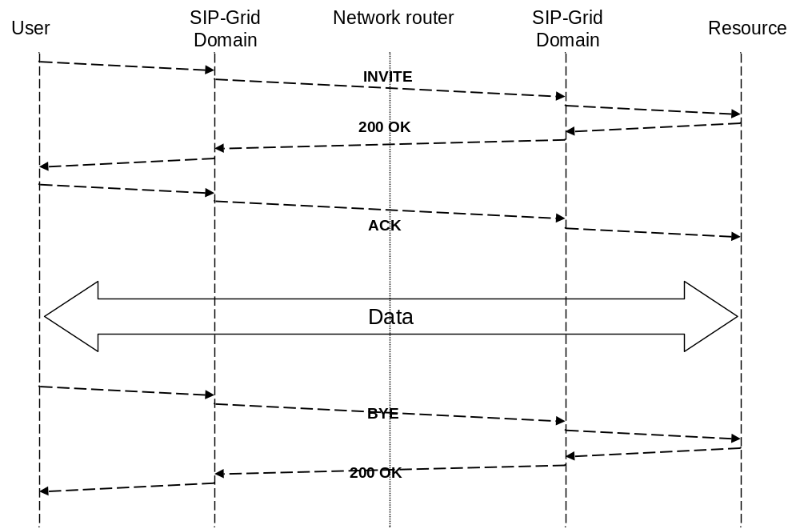
Reservation

Slide 11
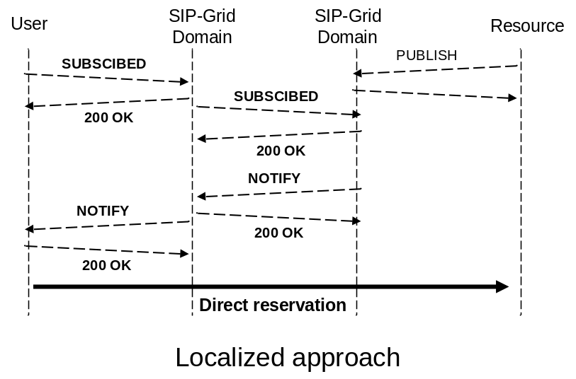
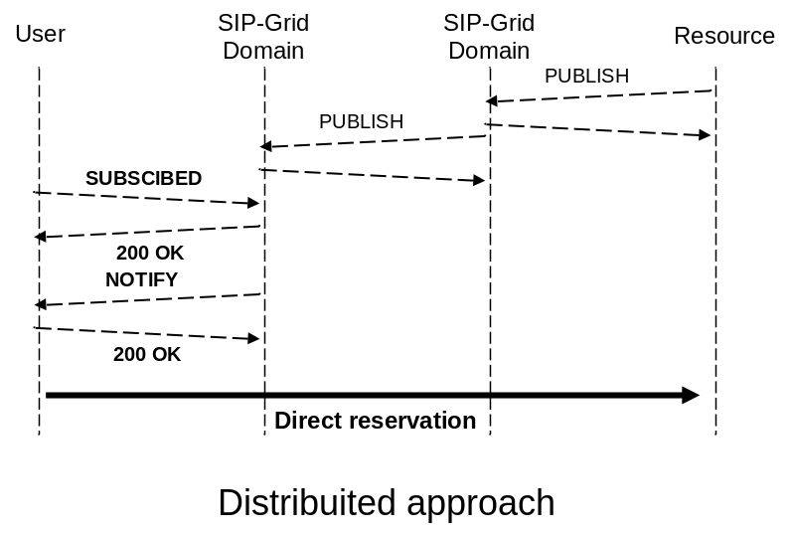
Resource discovery
Messages
  Availability -> PUBLISH
  Query -> SUBSCRIBE
  Notification -> NOTIFY
Localized approach
  Resource availability into the domain
  Low network overhead
Distribuited approach
  Domains send resource availability* to the others domains
  Higth network overhead
Balance between Localized and Distribuited approach

Slide 12
Application oriented networking (1/2)
The problem: Application oriented networking
  Communication between applications is a logical entity that does not necessarily match with the transport facilities because communication in the network is based on “connections”
    The transport network establish connections but does not know the applications requirements for communication
    The applications do not see the network connections
The solution
  Introduce into the network the ability to identify the application logical communications called “sessions”
    SIP support sessions set up, management and tear down
    SIP brings the session concept into the network (Dialog identifier)
The player: SIP-Grid Middleware
  Store application parameters (Dialog SIP) to indicate sessions
    Esch session is inside a dialog
  At each session negotiation (with SIP) Middleware effects network decision.
    Effect to routing decision, QoS, reservation etc…

Slide 13
Application oriented networking (2/2)
The objective
  De-couple the problems of managing application sessions and network connections
    One session many connections
    One connection many sessions
The network provides the communication services required by the sessions
  Same path for sessions inside the same dialog
  QoS for application (all the session inside a dialog)
  Reservation is not for a stream but is for application
By introducing the session layer, the Network has the capability to understand the application instances expressed by means of session attributes
Network services (bandwitdh, QoS, etc…) are oriented to the application requirements and not simply to the connections attributes
App
Connection(s)
App
Dialog(s)
Session(s)
Connection(s)

Slide 14
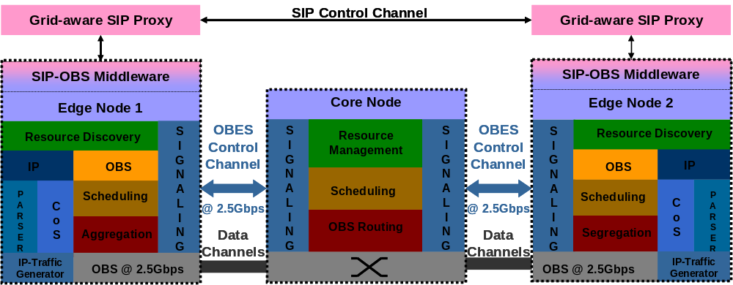
What we have done
Deveplop SIP-Grid proxy and SIP-GRID Client in a Overlay architecture
  Resource discovery
  Reservation
OBS testbed as a transport network
In collaboration with University of Essex, Prof. Dimitra Simeonidou, Reza Nejabati, Georgios Zervas

Slide 15
Conclusion : advantages of using SIP
Sip is a valid candidate to provide the communication needs for feature Grid networking.
SIP is used to carry Grid protocols
  Use extensions of SIP
  Statelfull or stateless
  IETF standard
  Born for large user and mobility
  Resource discovery and Reservation
  Many architectures
Redy for IMS
  IMS can use Grid
  Grid is a service of IMS
Because SIP is a session protocol
  Put the concept of session into the network
  Advantage manage

Slide 16
Thanks

