Slide 1



edutain@grid
Network and Runtime
Monitoring in the edutain@grid SOA
Alexander Ploß, Münster University

Slide 2
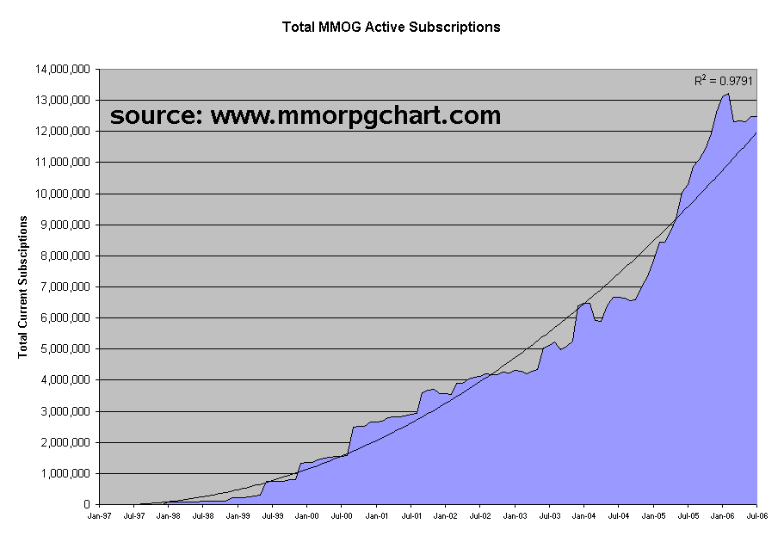
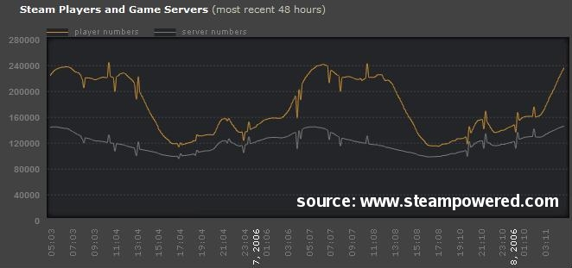
Grid for Games: Motivation
Massive growth of Online Gaming:
  Requires enormous resources
  Demand changes dynamically
Computational Grid for games:
  Provide dynamic server resources on-demand
  Scale games to be massively multiplayer

Slide 3
Project Overview
Online games share technical characteristics (real-time, interactive) with other application classes:
  E-Learning/virtual classrooms
  Training applications
  Interactive simulations
Real-Time Online Interactive Applications (ROIA)
EU IST project edutain@grid* (2006-2009): develop a comprehensive Grid architecture for all ROIA
  Share resources between different application classes
  Transfer technologies among interactive systems
  Research business models covering the complete value chain
7 european partners from industry and academia
www.edutaingrid.eu
Notes:
Todays online computer games …
This group of application classes forms the field of interest of the e@g

Slide 4
Remainder of the talk
Description of ROIA
Overview of the edutain@grid system
Details on runtime monitoring
Impact of network characteristics
Possible use of schemas

Slide 5
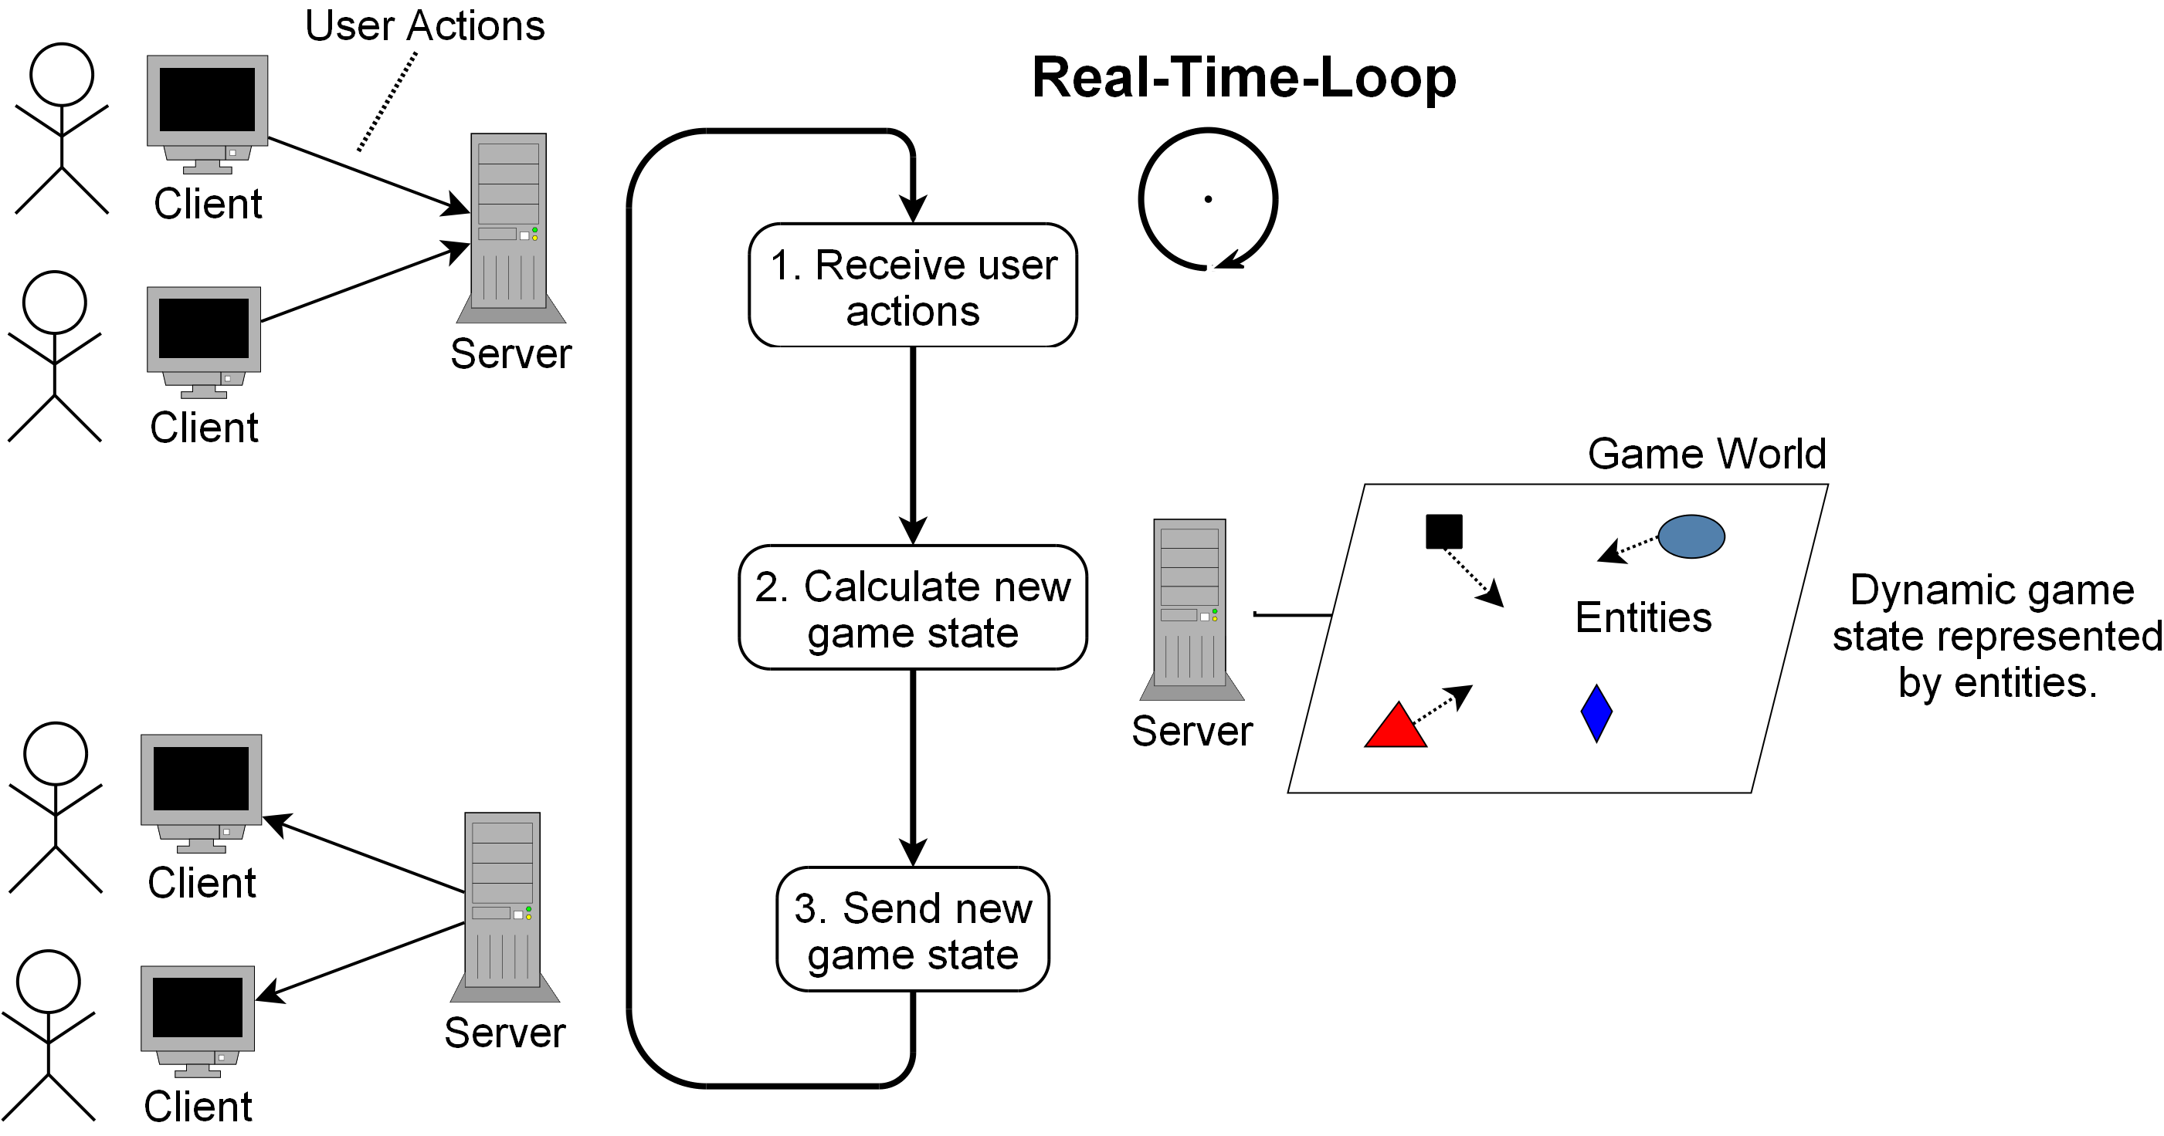
Real-Time Online Interactive Applications
Update of the application state with a high frequency
  Receive and process user actions
  Transfer parts of the application state to the clients
Notes:
User connect through clients
State computation is handled by server components
Client send user actions, and receives result through state updates
T_resp is reasonably influenced by communication latencies

Slide 6
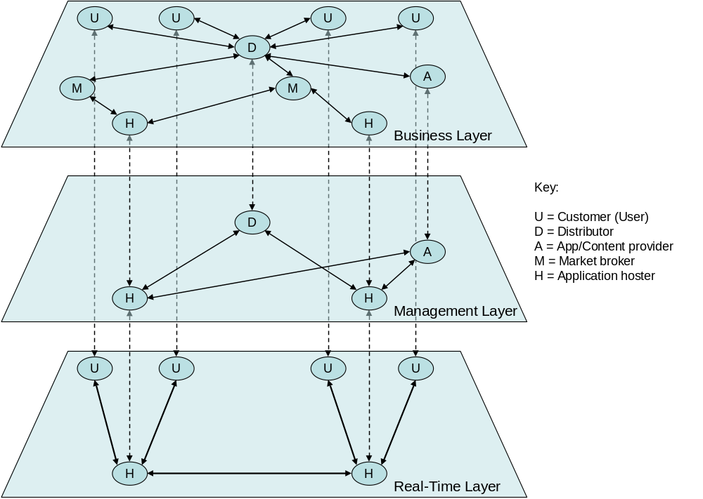
System Layer Overview
Notes:
Identified 3 layers, bottom: RT , ontop: Business between: management → orchestrate, run and coordinate application instances with 1) information from RT to 2) fulfil negotiations from business layers
In the following: focus on connection between RT and management

Slide 7
System Layer
RT-Layer:
  Actual execution of ROIA on resources assigned to them by the Management Layer
Management Layer
  Grid-style resource management methodologies used to map user requirements in terms of SLAs negotiated in the Business Layer to available resources
Business Layer
  Business interactions between different actors (users, distributors, hosters)

Slide 8
System Layer
details following
Notes:
Identified 3 layers, bottom: RT , ontop: Business between: management → orchestrate, run and coordinate application instances with 1) information from RT to 2) fulfil negotiations from business layers
In the following: focus on connection between RT and management

Slide 9
Runtime Monitoring
ROIA Client
ROIA Client
RTF (CCP Module)
RTF (CCP Module)
Real-Time Communication over ROIA Links
ROIA
Management
ROIA Process
report monitoring resources
ROIA Process
CCP Module
Monitoring/Controlling Module
Monitoring/Controlling Module
CCP Module
Grid Site
runtime library reports monitoring resources to management component
Local Java Interface between RT-Layer and Management Layer

Slide 10
Monitoring Profiles
RTFRealTimeApplication
  CPU load, real-time loop saturation
RTFSystem
  Information about uptime or connected processes
RTFNetwork
  Information regarding network characteristics
MonitoringPassThrough
  Generic profile to report arbitrary <key, value> data
Profiles are realized as Plain Java objects
Management component polls resources for information

Slide 11
Reported Network Characteristics
Bandwidth utilization between distinct processes
  hostToHostPath.bandwidth.utilized
  Mainly used for review of SLAs
  Management reacts, when utilization exceeds a certain threshold
Delay (RTT) from one process to another
  hostToHostPath.delay.roundTrip
  Great impact on responsiveness of a running ROIA
  RTT sufficient, flow of information always in both directions
  Measured through protocol typical test packets
    Reflects application level stack layer character of the RTF Library

Slide 12
Possible use for schemas
Provide integrated Monitoring service
Combine data from inside the system with global network characteristics gathered by external tools
Provide additional network characteristics to management component, so more reasonable decisions could be made
Use
Monitoring Module
NetworkMeasurementService
Provide Data

Slide 13
Summary
edutain@grid provides a novel high-level grid infrastructure for Real-Time Online Interactive Applications
edutain@grid includes a sophisticated middleware (RTF) for easy development of distributed ROIAs
Applications developed with the eduatin@grid can be controlled and monitored through dedicated service oriented management hosts
www.edutaingrid.eu
Thank you!

