Slide 1
Updates of APGridPMA
CAOPS, OGF28
15 March, 2010
Eric Yen
APGridPMA

Slide 2
Members (15 + 2)
15 Accredited CAs
  AIST (JP)
  APAC (AU)
  ASGC (TW)
  CNIC (CN)
  IGCA (IN)
  IHEP (CN)
  KEK (JP)
  KISTI (KR)
  NAREGI (JP)
  NCHC (TW)
  NECTEC (TH)
  NGO/Netrust (SG)
  PRAGMA-UCSD (US)
  HKU (HK)
  SDG (CN)
Planning
  Mongolia (under accreditation)
  ThaiGrid (TH)
Coverage by RAs
  Philippine, Vietnam, Malaysia, Indonesia, New Zealand and Pakistan & Sri Lanka (soon)
CA: 9 Countries
RA: + 7 Countries
New: +1 Country

Slide 3
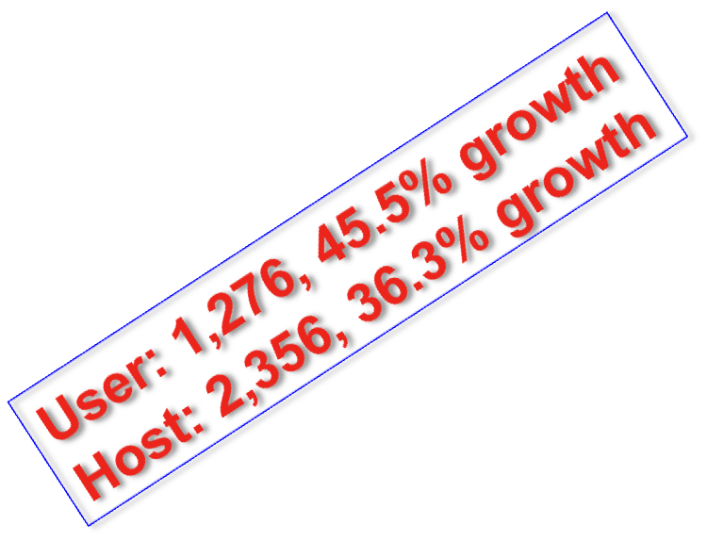
Up-to-date certificate statistics
CA Name | Valid user cert | Valid host cert | Revoked cert
AIST GRID CA | 21 | 361 | 2255
APAC Grid CA | 196 | 299 | 977
ASGC CA | 522 | 836 | 631
KEK | 83 | 219 | 1121
CNIC Grid CA | 0 | 2 | 0
SDG CA | 37 | 20 | 30
HKU Grid CA | 5 | 1 | 4
IGCA | 77 | 31 | 19
KISTI Grid CA | 40 | 147 | 68
NAREGI CA | 93 | 287 | 2519
NCHC Grid CA | 38 | 15 | 2
NECTEC GOC CA | 54 | 18 | 0
NGO-Netrust CA | 13 | 26 | 2
IHEP | 85 | 92 | 234
PRAGMA-UCSD CA | 12 | 2 | 11
Updated at : 14, January 2010
Notes:
No IHEP and PRAGMA data in statistics of Oct.’09

Slide 4

Up-to-date certificate statistics
CA Name | Valid user cert | Valid host cert | Revoked cert
AIST GRID CA | 22 | 345 | 2241
APAC Grid CA | 196 | 299 | 977
ASGC CA | 264 | 338 | 703
KEK | 83 | 219 | 1121
CNIC Grid CA | 0 | 2 | 0
SDG CA | 37 | 20 | 30
HKU Grid CA | 3 | 1 | 4
IGCA | 68 | 29 | 11
KISTI Grid CA | 40 | 147 | 68
NAREGI CA | 64 | 259 | 2519
NCHC Grid CA | 35 | 26 | 2
NECTEC GOC CA | 52 | 18 | 0
NGO-Netrust CA | 13 | 26 | 2
Updated : October 15, 2009

Slide 5
APGridPMA F2F meeting on 8 Mar.’10
Attendance
  11 CA presented in person, 2 representatives joined remotely, and 2 absences
New CA Accreditation: Mongolia – new phase CP/CPS review is still undergoing.
Resume Routine Self-Auditing:
  Each CA should present self-auditing report once every two years.
  APAC, NECTEC, and CNIC, SDG reported this time
  Current audit template should be followed but the procedure has to be clearly defined before next F2F meeting
  AIST, IGCA, ASGCCA, NCHC will report in next meeting.

Slide 6
APGridPMA F2F meeting on 8 Mar.’10 (II)
IGTF Policy Document Discussion
  Private Key Protection Policy and Robot Certificate are endorsed.
Action Items
  Updates of CA Contact
  Status matrix of Accreditation and Operation Status will be drafted by Eric for comment.
Next F2F Meeting
  APGridPMA spring F2F meeting will be joint with ISGC.
  IGTF All Hands Meeting is also welcomed to be held at ISGC2011.
  KEK and ARCS are two candidates for the F2F meeting in 2nd half of 2010 and 2011. They will explore possible dates later.

