Slide 1
APME GGF-10 Area Meeting
Applications, Programming Models and Environments
Area Co-Directors
  Satoshi Matsuoka
  Tokyo Institute of Technology, matsu@is.titech.ac.jp
  Craig Lee
  The Aerospace Corporation, lee@aero.org

Slide 2
Agenda
Area Overview
Group Reports
Group Metrics and Report Cards
APME and GGF-wide Issues
Area Roadmap

Slide 3
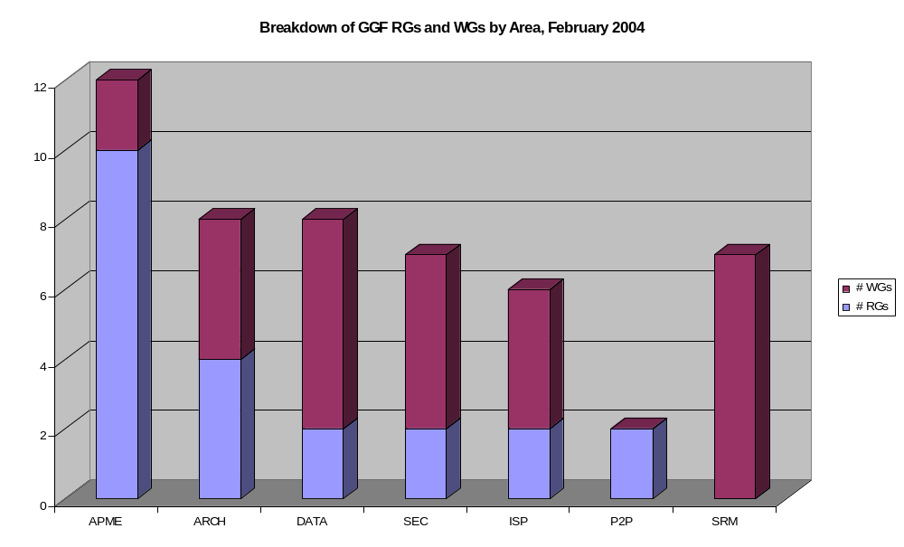
Breakdown of GGF RGs and WGs by Area
(from February, probably needs updating already)

Slide 4
APME Activities at GGF-10
  Preservation Environments RG (new)
  Production Grid Management RG
  User Program Development Tools RG
  Astronomy Applications RG (new)
RGs and WGs meeting at GGF-10
  GridRPC WG
  GridCPR WG (2x)
  Apps and Testbed RG
  Life Sciences Grid RG
BoFs
  Humanities, Arts & Social Science RG
  Grid and Social Issue RG
  Simple API for Grid Applications WG
Workshops
  Workflow in Grid Systems, GCE
  Grid Services for Particle and Nuclear Physics Applications, PNPA
  Case Studies on Grid Applications, Apps, UPDT, GUS, PGM
Groups sponsoring workshops but not meeting separately
  GUS, GCE, PNPA
Groups not meeting or running a workshop at GGF-10
  ACE

Slide 5
Group Reports

Slide 6
Production Grid Management - RG
Officers:
  Co-chair: Judith Utley, NASA Ames Research Center
  Secretary: Laura McGinnis, Pittsburgh Supercomputing Center
Goals
  Foster the development of Persistent and Production Grids by
    Providing a forum for sharing and discussing production grid issues
      Discussion Sessions and Workshops
    Producing documents as needed for sharing information
Significant Accomplishments at GGF-10
  One session, 28 participants from 24 organization
  Re-evaluation of Group Direction and Goals
    Established two internal groups
      Program Group for Workshops and GGF session discussions
      Survey Group for a FAQ Resource
    Both with action items due prior to GGF-11
Plans
  Organize Focused Discussion Sessions and Workshops
  Produce Production/Persistent Grid FAQ Resource
Concerns/Issues
  Focusing on pertinent topics to meet member needs
  Members with time to contribute; need spread the work around

Slide 7
Applications & Testbeds RG
Officers:
  Tom Hinke, NASA Ames Research Center
  Thilo Kielmann, Vrije Universiteit, Amsterdam
  Ed Seidel, Louisiana State University
Goals
Significant Accomplishments at GGF-10
  Good water-cooler exchange at APPS meeting (31 in attendance)
  Discussed new charter and received feedback
  Workshop on Saturday with 12 papers selected from 17 submissions
  Shantenu Jha has agreed to be the new secretary for APPS
Plans
  co-sponsored workshop at GGF-11 with Semantic Grid group
Concerns/Issues
  Getting a new charter approved
  Getting Simon Cox approved as an additional co-chair.

Slide 8
PNPA-RG
Officers: Ian Bird – CERN, Ruth Pordes – FNAL, Doug Olson – LBNL
Goals (of the RG)
  To bring the requirements of the HENP community to the GGF in order to explain and inform the wider grid community of the specific needs and issues of HENP
  To ensure participation of the HENP community in grid standardization efforts, particularly in those areas and services essential to the successful use of grids in HENP.
  To provide early feedback to GGF technical working groups on the success or failure of various grid software components as used in high performance production activities by HENP experiments.
Significant Accomplishments at GGF-10
  Workshop (tomorrow!)
    Look for commonalities with other apps groups (Astro, Biology);
    Focus on data management issues
Plans
  Finalise first requirements document – draft available and will be discussed tomorrow
Concerns/Issues

Slide 9
Grid Checkpoint Recovery (GridCPR-WG)
Officers: Co-Chairs
Derek Simmel, Pittsburgh Supercomputing Center dsimmel@psc.edu
Thilo Kielmann, Vrije Universität, kielmann@cs.vu.nl
Goals
  Develop Specifications for a GridCPR API and associated Services
Significant Accomplishments at GGF-10
  2 consecutive working group sessions were held, Thursday 4-5:30pm, 6-7:30pm
  17 participants in 1st session, 13 in 2nd session, (11 in both sessions)
  one called in from U.S. and participated via speakerphone
  3 short presentations introducing additional GridCPR use cases
  Reviewed and revised both GWD-I documents (GridCPR Use Cases, Architecture) in detail, itemized notes and action items for authors to complete final drafts
Plans
  Finalize Use Cases GWD-I document and submit to GGF Editor
  Finalize GridCPR Architecture GWD-I document and submit to GGF Editor
  Generate initial draft of GridCPR API Specification document
Concerns/Issues
  Have invited members to nominate/volunteer to serve as Co-Chair
  (Thilo needs to reduce his administrative commitment to the group)
  Sonst ist Alles in Ordnung.

Slide 10
UPDT
(User Program Development Tools for the Grid)
Officers: Robert T Hood (CSC-NASA), Susanne Balle (HP)
Goals
  Review Last UPDT meeting
  Discuss progress on informational document detailing results from user survey
  Discuss initial results of "known problems" survey and finalized questions for new survey
  Discuss potential workshop at GGF-12
Significant Accomplishments at GGF-10
  1 session, 41 attendees
  Agreed to submit User Survey report
  Discussed initial results of "known problems" survey and finalized questions for new survey
  Discussed potential workshop at GGF-12
Plans
  Distribute "known problems" final survey
  Update and submit User Survey Report as a GGF Informal document
Concerns/Issues
  None

Slide 11
GridRPC
Officers:
  Craig Lee, Aerospace Corp.
  Hidemoto Nakada, AIST
  Keith Seymour, UTK
Goals
  A GridRPC Model and API for End-User Applications
  A GridRPC Model and API for Middleware Developers
Significant Accomplishments at GGF-10
  Presentation and agreement on re-charter for Middleware document
    Scope, schedule
  Presentation of data handles approach
    Laurent Philippe, GRAAL Project
Plans for next GGF
  First official meeting of re-chartered WG
  Final agreement on argument data structure, “grpc_arg” data type, and all associated issues, e.g., lifetime, creation, destruction, copy.
  Short list of persistent data and workflow mechanisms
  Short list of introspection capabilities
Concerns/Issues
  More implementation experience always better
  Yoshio Tanaka, AIST
  Frédéric Desprez, ENS/Lyon

Slide 12
Simple API for Grid Applications (SAGA) WG
Officers: Co-Chairs
Keith Jackson (LBNL), Tom Goodale (LSU), Stephen Pickles (Manchester)
Goals
  Specify Simple API for Grid Applications, multiple languages, recommendations track
Significant Accomplishments at GGF-10
  2nd Charter Discussion BoF
  62 attendees, many willing to do work – clearly critical mass
  name changed – formerly GAPI
  Scope refined
    Simple APIs (80-20) for (1) job management (2) data transfer
    plus informational document – areas ready for Simple APIs
Plans
  start work
    face-to-face co-located with EU GridStart meeting is possible before GGF 11
Concerns/Issues
  WG or RG?
    overwhelming (61-1) preference for WG
  Still not ratified

Slide 13
End of Group Reports

Slide 14
Group Metrics and Report Cards
How to Measure/Monitor Group Progress?
Rough metrics for group progress developed late 2003:
  Date most-recent document submitted
    If nothing submitted, when was first document due?
  Last update to milestones?
  Last Website or GridForge update?
  Working within Scope of Approved Charter?
  Non-GGF meetings/telecons since 01 July 2003?
    Meeting Participation (number distinct people including chairs)
    Minutes Posted
  Number of emails since 01 July 2003?
  Implementations in progress?
Monitor externally visible activity between GGFs
  Not just at the meetings – back channel communication doesn’t count
Number of distinct active participants between GGFs
  Critical Mass

Slide 15
Group States and Transitions (Draft)
Start
Good
Standing
Completed
Dormant
Probation
Terminated
No visible progress for good reasons
No visible progress for no good reasons
Initiated by Group Officers w/ GFSG concurrence
Initiated by GFSG

Slide 16
APME and GGF-wide Issues
More strict WG governance
Relaxed RG governance
Individuals can chair at most one group
Separate Applications Area?
Testbeds?
Area-wide mailing list?
Periodic Area Group Chairs Telecon? Monthly?
Design Teams?

Slide 17
Area Roadmap
Where are we going as an area?
What are the technical goals?
What are the strategic goals?
  What will we have in hand in one year?
  What will be possible in three years, five years?
What are the steps and dependencies for achieving those goals?
APME Gap Analysis
  What should APME be doing that we’re not?
  Relevant docs:
    Data Area Gap Analysis
    www.grid2002.org/ukescience/gapresources/GapAnalysis30June03.pdf
Roadmap Document Specifics
  Structure, content, schedule, authors???

