Slide 1
Information Modeling in OGSA
Ellen Stokes
stokese@us.ibm.com

Slide 2
OGSA Info Model
Capabilities and Requirements
have same language (name-value
pairs) with ability to express range
values for easy mapping and selection
Managed
Info Instances
Advertised
Capabilities
Activity’s
Requirements
algorithms
simple mapping
and selection
Instances info, e.g. CIM, GLUE
Granular
Expresses managed
information in the environment
Abstracted and generated
from managed information
via algorithms
Simple, meaningful & user
friendly
Expresses the capabilities
of an entity, e.g. container
Simple, meaningful & user
friendly
Expresses an activity’s needs

Slide 3
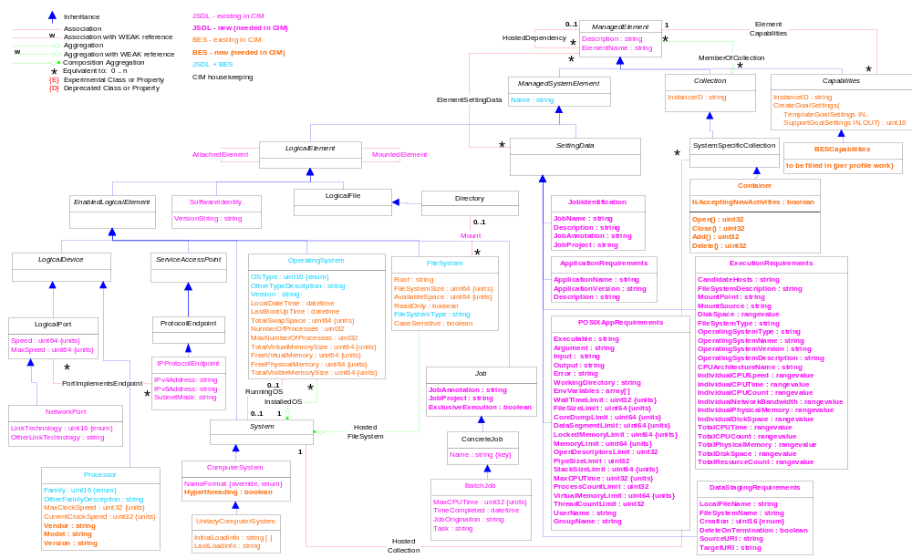
JSDL + BES
Note: Simplified flattened
version consists of class
names that are not in black
(the leaf nodes)
CONCRETE
CIM STUFF
BES
JSDL

Slide 4
Current Spreadsheet
Maps JDSL to CIM
  Simple mapping; identifies what exists in CIM that can be used and what is missing
  Ignores flattening
  Ignores separation of instance data, capabilities, and requirements (per proposed position paper)

Slide 5
Next Steps
Write short position paper to describes the capabilities, requirements, and instance information architecture/framework we’re pursuing
Spreadsheet (for JSDL and BES mapping to CIM)
  Separate out the notion of CIM managed information from capabilities and requirements
  Modify / fill out the columns to reflect that separation of managed information, capabilities, and requirements
Fill out the BESCapabilities class
  Use BES profile work as input
From the model diagram and spreadsheets
  Generate simple abstracted set of name-value pairs as initial strawman to express capabilities and requirements
  Then work on the complete language for expressing the capabilities and requirements
Write specification describing the capabilities and requirements model and its relationship to instance information (implementation)
NOTE: Doing the above essentially validates the position paper that there is the notion of (a) requirements with a simple mapping to capabilities and (b) instance information can be surfaced via reasonable algorithms can generate capabilities.

