Slide 1
The Healthgrids
Ignacio Blanquer
Universidad Politécnica de Valencia
Spain
EGEE Project, Medical Applications

Slide 2
Contents
Introduction and Objectives.
Specific Considerations of Healthgrids.
  Requirements.
  Current Technologies.
  Lacks and Needs.
Conclusions.

Slide 3
Introduction and Objectives
Discuss the Main Requirements in Healthgrids and Current Technologies.
Describe the Needs and Lacks of Grid Technologies in Health Applications.
Discuss the Future Trends.
Invite for Cooperation and Collaboration.

Slide 4

Terms and Concepts: eHealth
eHealth Deals with Using Information and Communication Technologies to Develop an Intelligent Environment that
  Enables Ubiquitous Management of Citizens’ Health Status,
  Assists Health Professionals in Coping with some Major Challenges,
  or Integrates the Advances in Health Knowledge into Clinical Practice.
Health Term is Considered in a Broad Sense.
Notes:
When talking about health in this presentation, we refer to Health in a broad sense, covering from biomolecular engineering to epidemiology.
But Health GRID applications are born from Health Information and Communication Technologies Applications, typically known as eHealth. The EC precisely considers eHealth as the use of ICT to provide several benefits in healthcare delivery, such as the ubiquitous management of citizens’ health status, more focused on data storage and access, the assistance to Health professionals in doing better diagnosis and selecting better therapies, or to foster the take-up of latest advances in health knowledge into Clinical Practice.

Slide 5
Terms and Concepts: Healthgrid
Health Grids are Grid Services or Middleware Components that Deal with the Specific Problems that Medical Data Processing Involve.
Resources in Health Grids are Databases, Computing Power, Medical Expertise and Even Medical Devices.
Health Grids Aim at Assisting Epidemiology and Individualised Healthcare:
  Integrating Large Databases and Extracting Knowledge.
  Execute Complex Simulations on Biomedical Models.
  Process Large Genomic Databases.
  Securely Exchange Medical Data and Share Applications for its Processing.

Slide 6
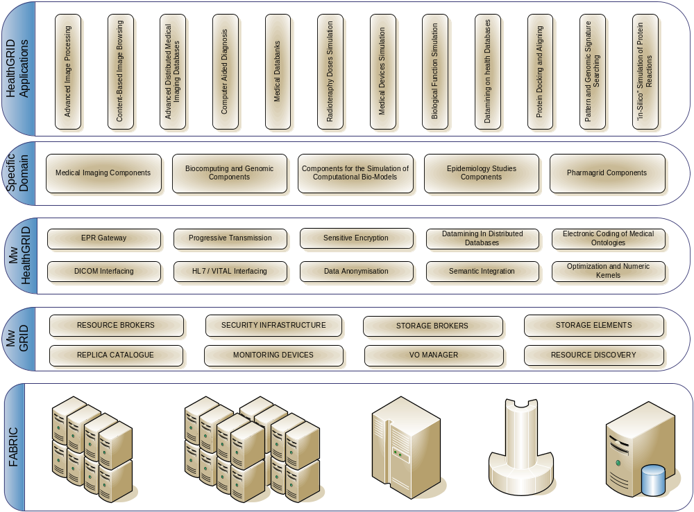
Healthgrid
HealthGrids Imply New Requirements.
Components Should Be Developed at Different Levels
  Grid Infrastructure.
  HealthGrid Middleware.
  High-level Components.

Slide 7

Specific Considerations of Healthgrids
Security and Privacy.
Access to Distributed Data.
Heterogeneity of Data.
Ubiquity on the Access.
Computational HealthGrids.

Slide 8

Security and Privacy: Requirements
Medical Data is Extremely Confidential.
  Protected by European (95/46/CE, 97/5/CE, 02/58/EC) and National Regulations (LOPD, LSSICE,…).
  Access Must Ensure that Identity of Patient Cannot be Guessed by Non-Authorised Users.
  Misuse of the Information can Lead to Economic Benefits.
  Privacy Leakage is Irreparable.
Encryption is Required on the Access, Storage and Transmission of Medical Data.
[Pseudo-] Anonymisation is Required in Data Accessible by Virtual Organisations.
Access Control Rights For Critical Data Must Be Performed at File and User Levels.

Slide 9
Security and Privacy: Technologies
Authentication and Authorisation are the Basic Pillars.
Data Encryption
  Standard Pair of Keys Encryption (DSA, RSA, Blowfish).
Data Transmission
  SSL-Based Protocols.
Access Control Rights
  PKI and GSI Could be Sufficient if Data is Encrypted with User Public Keys from Grid Certificates.
  Although Data is Accessible, Information is not.
Privacy Enhancing Technologies (CEN/TC251).
  WS-Privacy, WS-Policy and EPAL (Enterprise Privacy Authorisation Language).
  Tagged Information (HL7, DICOM,…) Could be Easily Anonymised, Plain Text of Diagnosis Could not.

Slide 10
Security and Privacy: Lacks and Needs
Grid Infrastructure
  Automatic Data Storage Encryption and Decryption.
  Fine-Grain Access Control is Required (File-Based and User-Based Access Privileges).
  Auditing Mechanisms are Needed.
Health-Related Layer
  Implementation of Privacy-Enhancing Techniques.
  Pseudo-anonymisation Components.
  Difficulty (Impossibility?) of Total Anonymisation of Many Medical Records (Medical Images, Data from very Rare Diseases).
  Laws Regarding the Processing of Electronic Data, Delegation of Rights and Legal Liability can be Very Restrictive.

Slide 11

Access to Distributed Data: Requirements
Medical Data is Geographically Distributed.
  Many eHealth Applications will Benefit From the Coherent Access to Several Databases.
  Federation of Databases.
  Brokering Storage Resources.
  Compiled Access to Spread Patient Data.
Management of Replicas.
Metadata Cataloguing.
Transparent to the User.

Slide 12
Access to Distributed Data: Technologies
Information Technologies
  OGSA-DAI (Open Grid Services Architecture Data Access and Integration), WSRF or WS.
Projects and Initiatives
  Biomedical Informatics Research Network (BIRN), Medical Data Storage and Processing on the GRID (MEDIGRID).
  Efforts on the Federation of Biomedical Related Databases: EntReZ, SRS.
Trends in Evidenced-based Medicine are Increasing the Integration of Distributed Medical Knowledge.

Slide 13
Access to Distributed Data: Lacks and Needs
Deployment
  DataGrid Infrastructure Must be Deployed Including Hospitals.
Technology
  Trustworthy Federation of Resources.
  Virtualize Queries.
  Support of Different Database Implementations
  Management of Replicas do not Need Read/Write Access but Patient Records Must Be Updatable.
  Intelligent Storage Brokers, Making the Process of Searching more Efficient.
  Unlimited Access to Global Data Without Compromising Privacy.

Slide 14




Heterogeneity of Data: Requirements
Medical Data is Multimedia and Heterogeneous.
  Different Storage Formats.
  Different Modalities and Protocols Difficult Interoperability.
  Standardisation is Compulsory for Global Processes and Knowledge Extraction.
Biomedical Data is Also Heterogeneous
  Compatible Classifications and Definitions are Needed to Make Databases Interoperable.

Slide 15
Heterogeneity of Data: Technologies
Medical Information Exchange Protocols
  General Patient Data: HL7, CEN ENV 12265.
  Vital Signs: ENV13734/5, OpenECG .
  Images: DICOM 3.0.
Normalised Formats are being Defined (SMF,…).
Ontologies
  Medical Ontologies (Unified Medical Language System-UMLS, from the American National Library of Medicine, SNOMED, MEDLINE Citations) do Exist in Medical Practice and Research.
  Genetic and Genomic Ontologies are Being Consolidated.

Slide 16
Heterogeneity of Data: Lacks and Needs
Data Compatibility
  Develop Multiple Components to Homogenise Formats.
  Target Current Information Standards.
  Gateway and Format Coding/Decoding Modules Must Be Implemented on Top of Grid Storage Layers
Semantic Compatibility
  Standard Normalised Formats are Needed.
  Medical Ontologies are Needed In Electronic Format.
  Domain-specific meta-data will Enable Interoperability (Basic for Epidemiology Studies).

Slide 17

Ubiquity on the Access: Requirements
A User Must be Able to Access Grid Data and Services from any Computer:
  Not Requiring a Grid Middleware to be Installed.
  Preserving the Security and Personalised Access.
  Not Requiring Administrative Privileges Neither Complex Installation.
  Configuration Must be Easily Removable.
Requirements on the User Side Must be As Minimum as Possible.
  Maximum Independence of Software and Hardware Platform.
  Requirements Must not Exceed Conventional Resources Available.

Slide 18
Ubiquity on the Access: Technologies / Lacks and Needs
Technologies
  Standard Web-Based Transmission.
  Web-Browser Certificates.
  Proxy Repositories.
    Repositories of Access Credentials (MyProxy).
  Portal-Based Grid Applications
    Genius Portal.
Lacks and Needs
  Improvement in the Relation of Web-Browser Certificates and Grid Certificates.
  Higher-level API for Portal Grid Development.
  More Efficient Management of Input and Output.

Slide 19

Computational HGrids: Requirements
HPC
  Execution of Grand-Challenge Jobs.
  High-Throughput Execution.
Typical Computational Requirements
  Resource Reservation.
  Load Balancing.
  Efficient Scheduling.

Slide 20
Computational HGrids : Technologies / Lacks and Needs
Technologies
  Job-Based Grid Infrastructures.
  Special Needs
    Efficient Parallel Jobs Execution: MPI-G.
    Short Jobs Execution.
    Interactive Jobs.
Lacks and Needs
  More Efficient Resource Brokers.
  Shorter Grid Overhead.

Slide 21

Conclusions
The Needs of HealthGrids are Mainly Focused on the Data Management.
Needs from the Computational Point of View are Very Alike Other Disciplines.
Several Components Should be Developed the Closest to the Basic Grid Middleware (Encryption, RB, SB, PET,…).
Other Higher-Level Components can Constitute a Health-Grid Middleware Layer (Medical Data Format Plug-ins, Health Portals, Medical Ontologies,…).

Slide 22
Conclusions
Upgrade Grid Infrastructures with the Requirements of Healthgrids (Specially Security and Data Storage).
  EGEE is Identifying Requirements and Case Studies and Feeding them into the EGEE Middleware.
Deploy a Health-Grid Infrastructure.
Effective Health-Grid Applications (Efficient and Oriented to a Wide Community of Users) are Needed.

Slide 23
Contact
Ignacio Blanquer
GRyCAP
Universidad Politécnica de Valencia
Camino de Vera s/n
46022 Valencia
E-mail: iblanque@dsic.upv.es
Tel: +34-963877356
web: http://www.grycap.upv.es

